Slide 1

Creating Illustrations & Graphs for Presentations: Generative AI Art Tools
Chong ho Alex Yu
2024.10.31
teaching with AI workshop series
Hawaii Pacific University

Slide 2
What are gen AI art tools?
Generative AI art tools are advanced AI systems designed to create images from text descriptions (prompts). It is partly based on large language models (LLMs) because prompt engineering requires natural language processing.
Customization: Users can often adjust various parameters to fine-tune the output.
Deep Learning Models: These tools use complex neural networks trained on vast datasets of images and text.

Slide 3
What are gen AI art tools?
Some artists accuse that these AI companies ”steal” their work.
Generative AI art tools are not simply collage or copy-paste tools.
Like many other AI models, it is about pattern recognition. These models learn to understand the patterns, styles, and features that make up different types of art and images.
Rather than copying existing images, the AI generates new images pixel by pixel, based on its understanding of the prompt and its learned patterns.

Slide 4
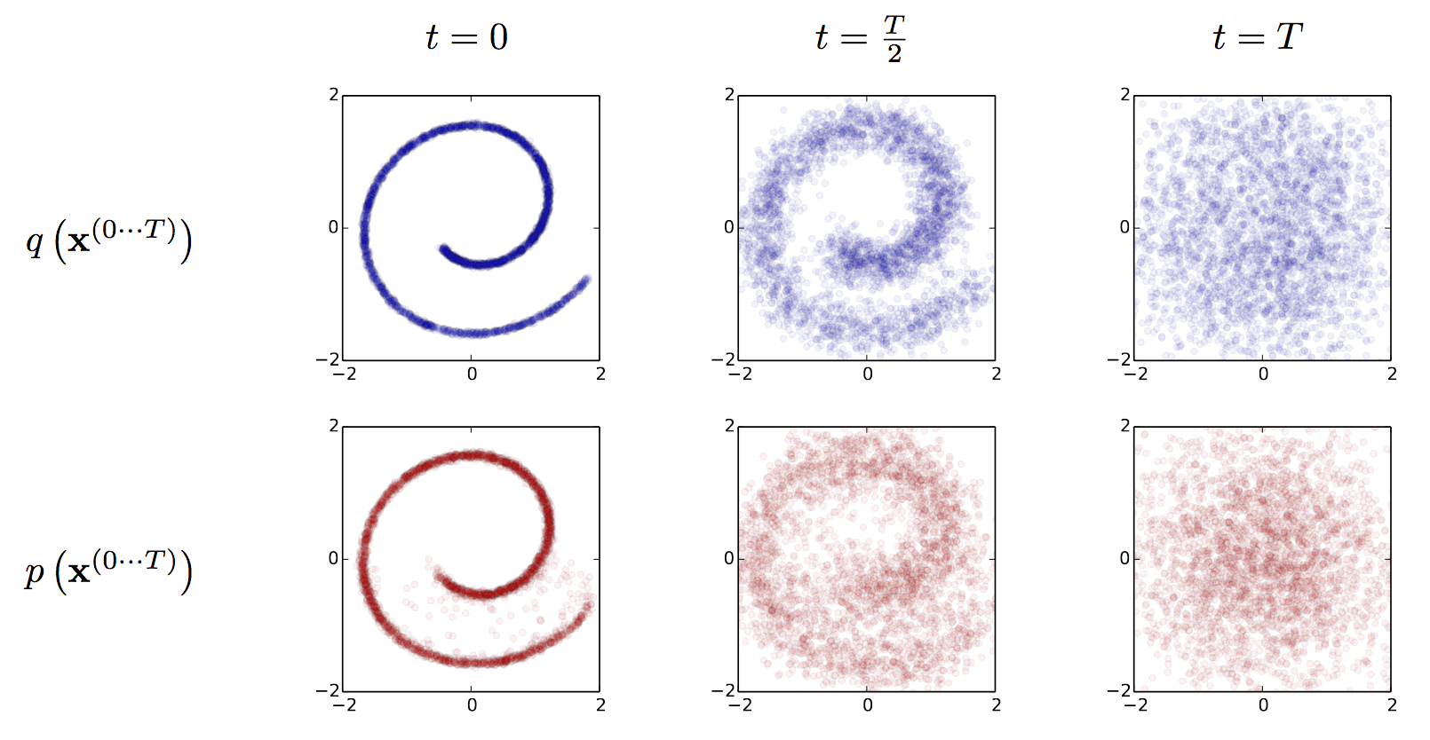
What are gen AI art tools?
Diffusion Process: Many models use a technique called diffusion, where they start with random noise and gradually refine it into a coherent image that matches the prompt.
Source: Jascha Sohl-Dickstein, Eric A. Weiss, Niru Maheswaranathan, Surya Ganguli

Slide 5
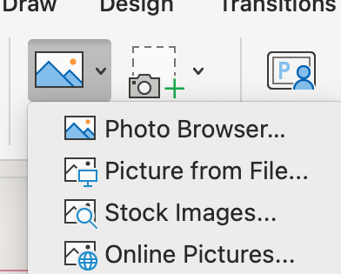
Why do we need gen AI art tooLs?
In the past it is expensive and time-consuming to create graphs for illustration.
Although you can use online pictures, you take the risk of copyright infringement.
The same stock image is used by others. No uniqueness.

Slide 6
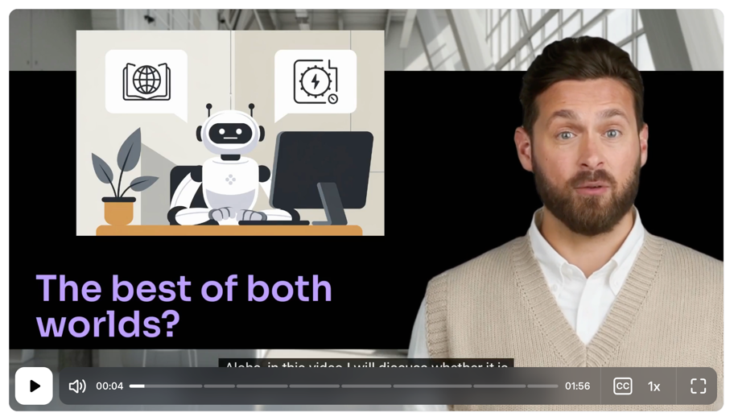
Why do we need gen AI art tools?
I use these tools for both my PowerPoint slides and video lectures.
In gen AI video lectures, I can upload my own media to the video clip, including the images created in gen AI art tools.

Slide 7
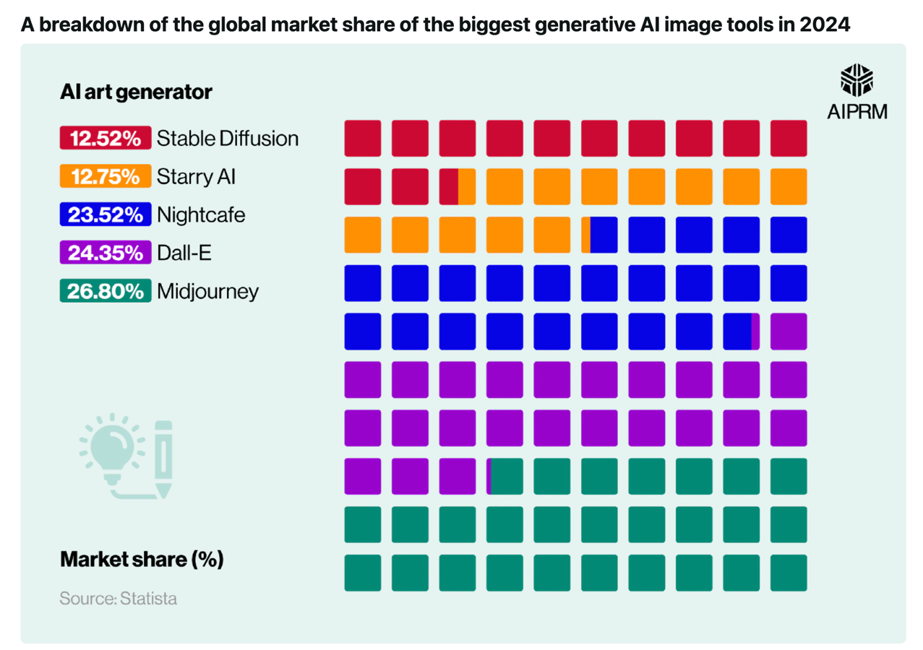
Most popular
By Market Share
Midjourney
DALL.E
NightCafe
Notes:
Source: https://www.aiprm.com/ai-art-statistics/

Slide 8
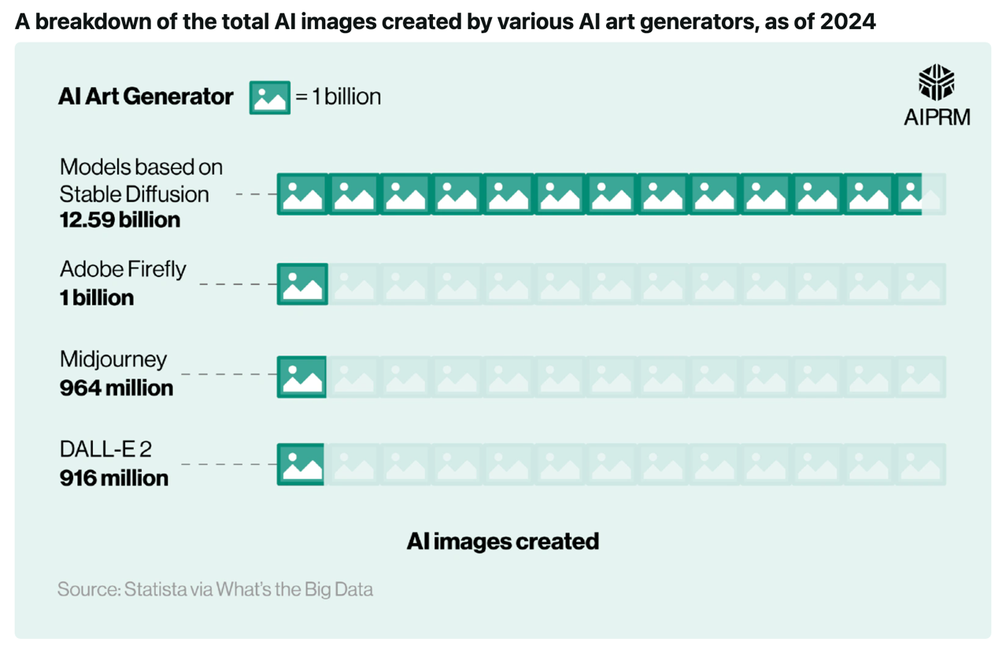
Most popular
By images created
Stable Diffusion
Adobe Firefly
Midjoruney
DALL.E
Source: https://www.aiprm.com/ai-art-statistics/
Notes:
Source: https://www.aiprm.com/ai-art-statistics/

Slide 9
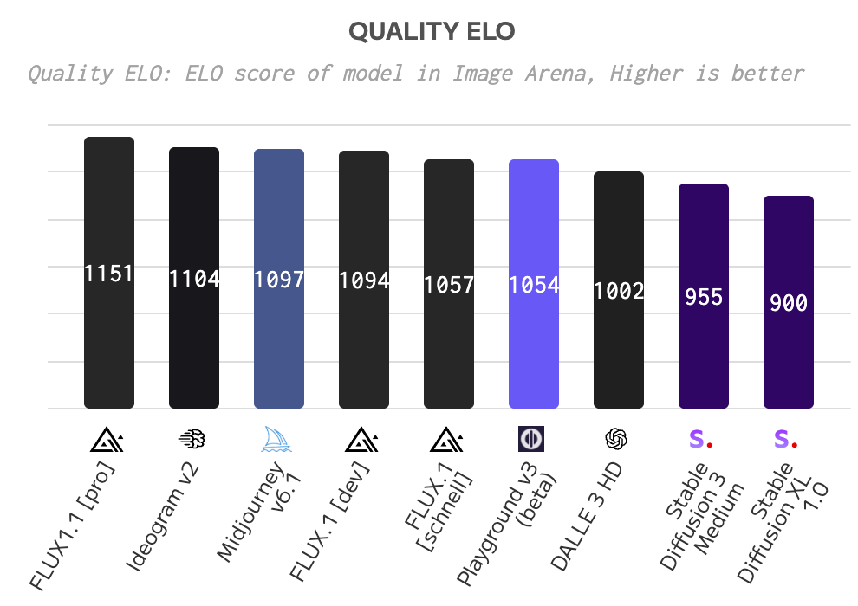
Quality
FLUX 1.1
Ideogram V2
Midjourney V6.1

Slide 10
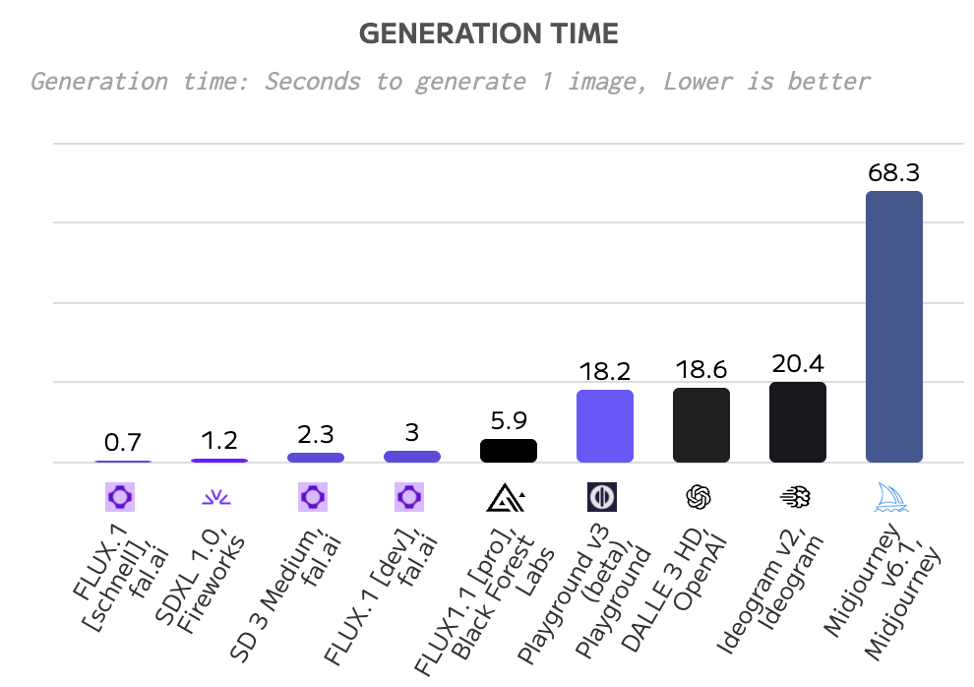
Generation time
FLUX 1.1
Stable Diffusion 1.0
SD 3

Slide 11
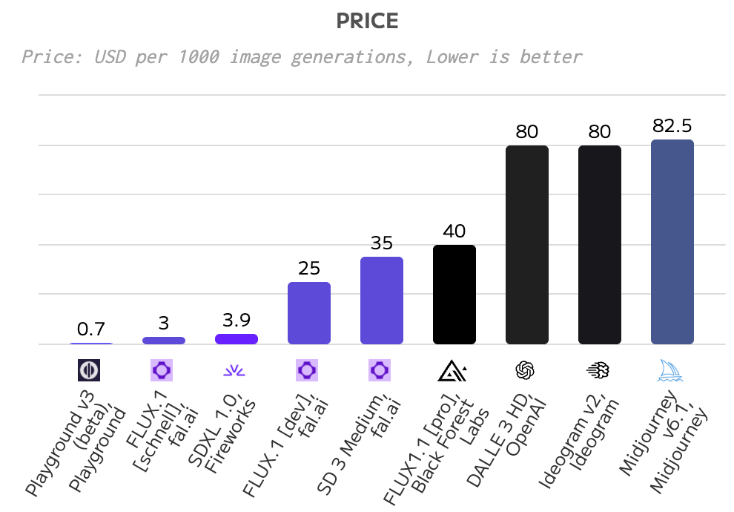
Price-performance
Playground
FLUX 1
Stable Diffusion 1

Slide 12
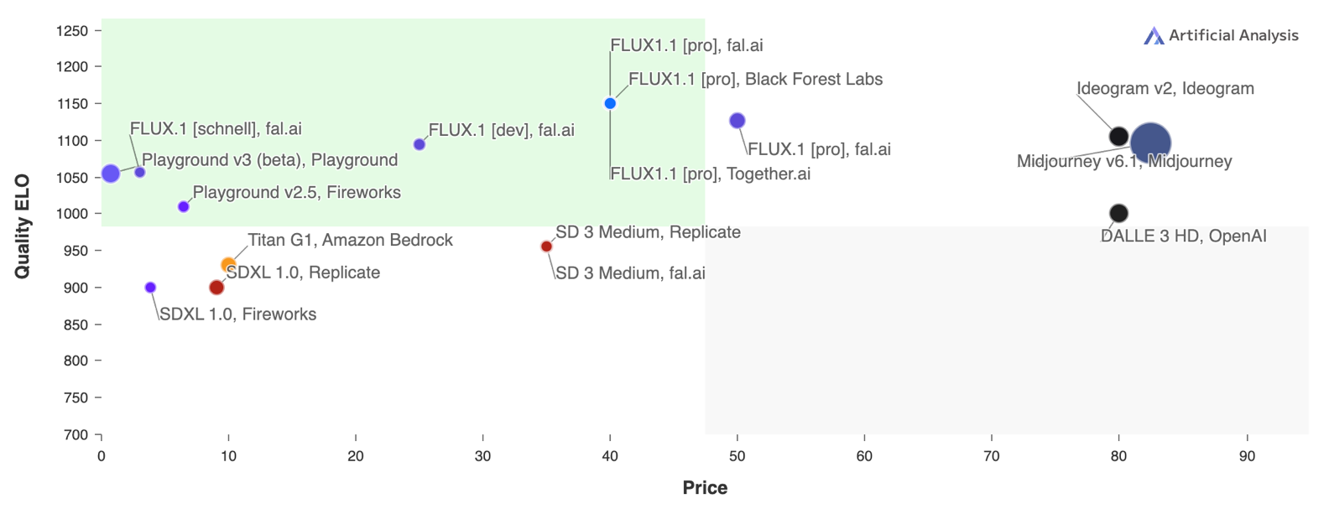
Quality * price

Slide 13
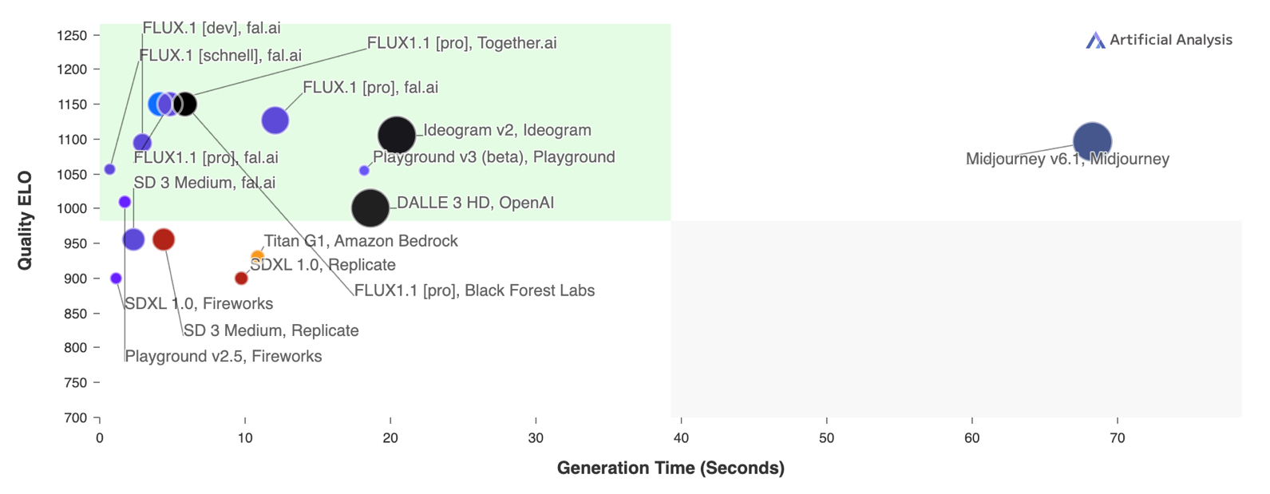
Quality * generation time

Slide 14
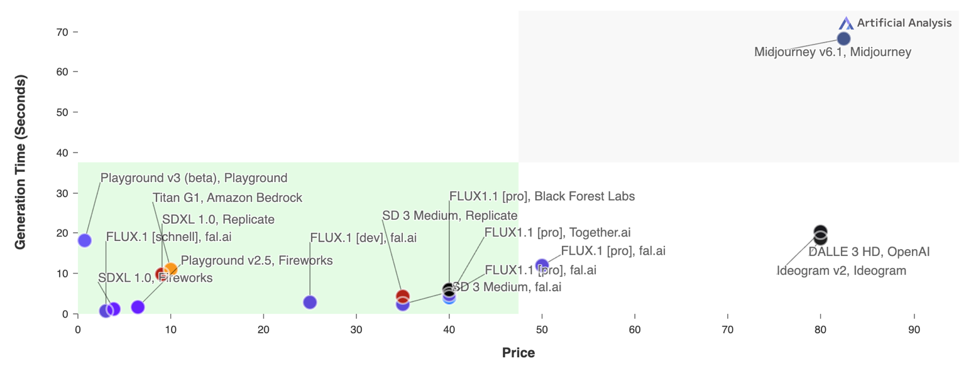
generation time * price

Slide 15
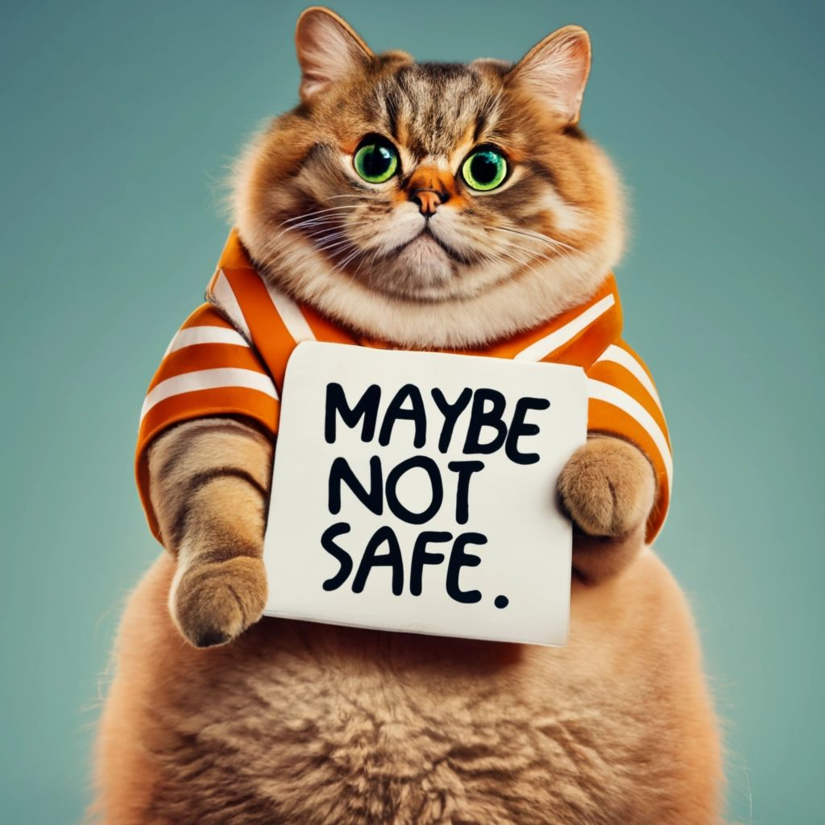
Tensor art
Pros
  Many gen AI art tools prohibits using certain inappropriate words. If you force it, they might cancel your membership.
  Some tools generate it but block the output. For example, Ideogram warns that the image “may not be safe.”
  Tensor Art has no restrictions. If you are a professor of biology or medical science teaching human anatomy, or a professor of psychology teaching human sexuality, you may need certain explicit illustrations.

Slide 16
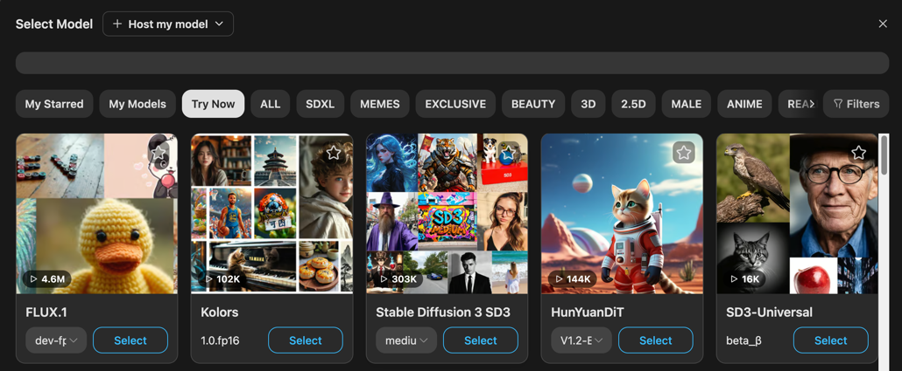
Tensor art: carry many different gen AI art tools
PROS: Includes Flux and Stable Diffusion

Slide 17
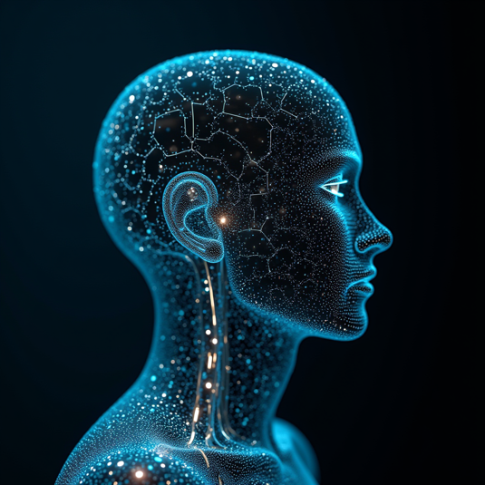
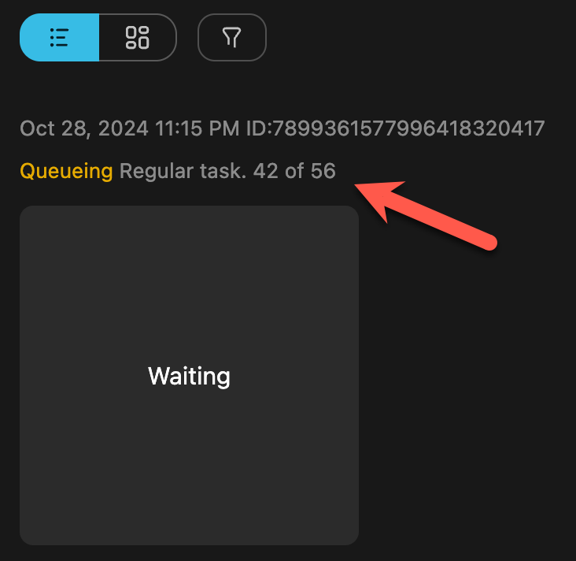
Tensor art: FLUX
Pros: High quality output
Cons: Very popular, a long wait time for the free account

Slide 18
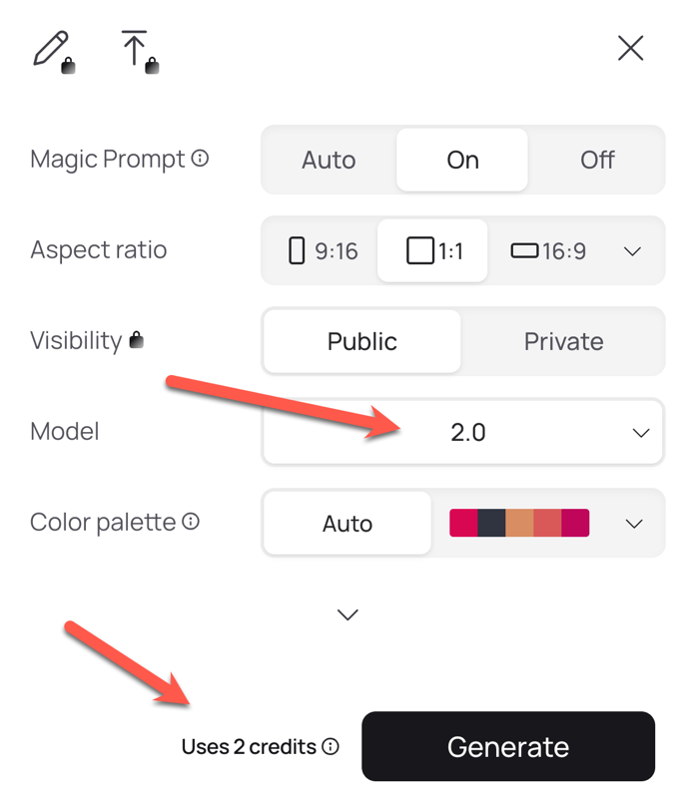
ideogram
Pros
  High quality output
  Better than others in generating the exact words
Cons
  The free account allows 10 credits per day only
  Version 2.0 uses 2 credits per picture.

Slide 19
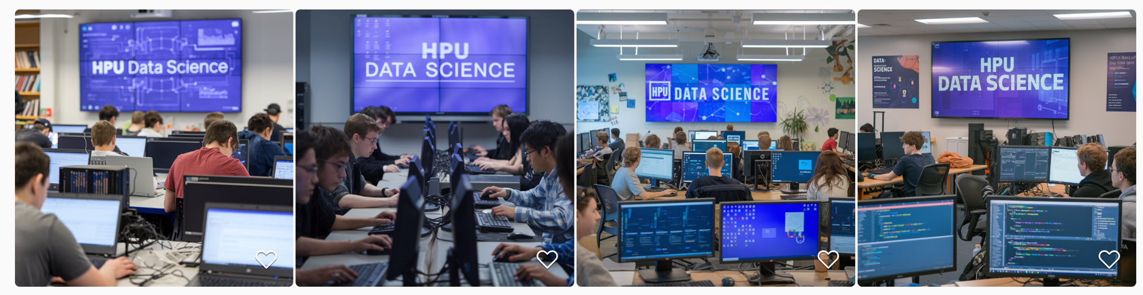
Exact words: Ideogram 2.0
Students are learning data science in a computer lab. A big LCD screen shows these exact words: "HPU Data Science".

Slide 20
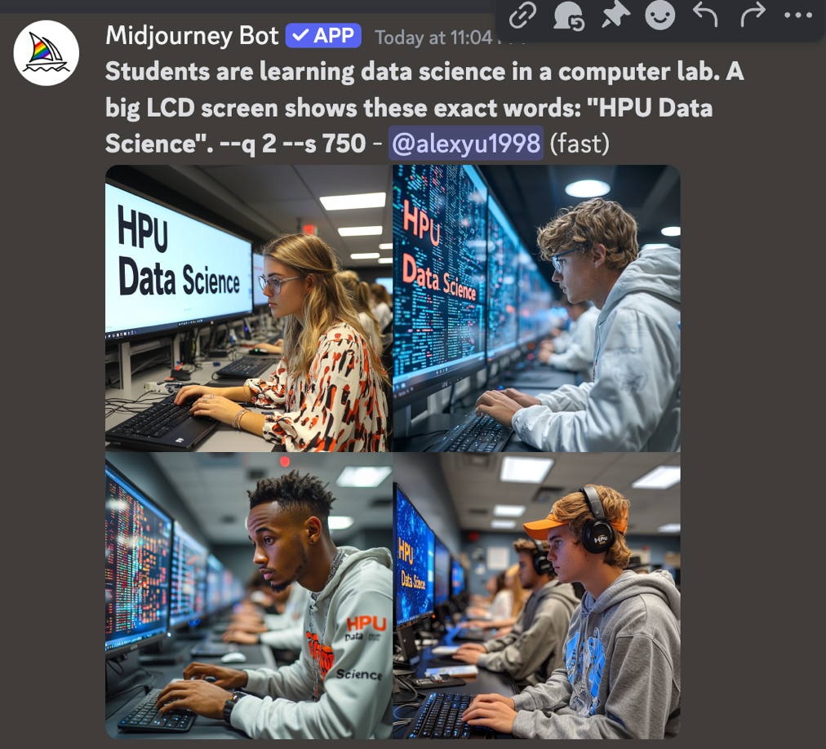
Exact words: midjourney
Students are learning data science in a computer lab. A big LCD screen shows these exact words: "HPU Data Science".
Only two out of four can clearly display the text.

Slide 21
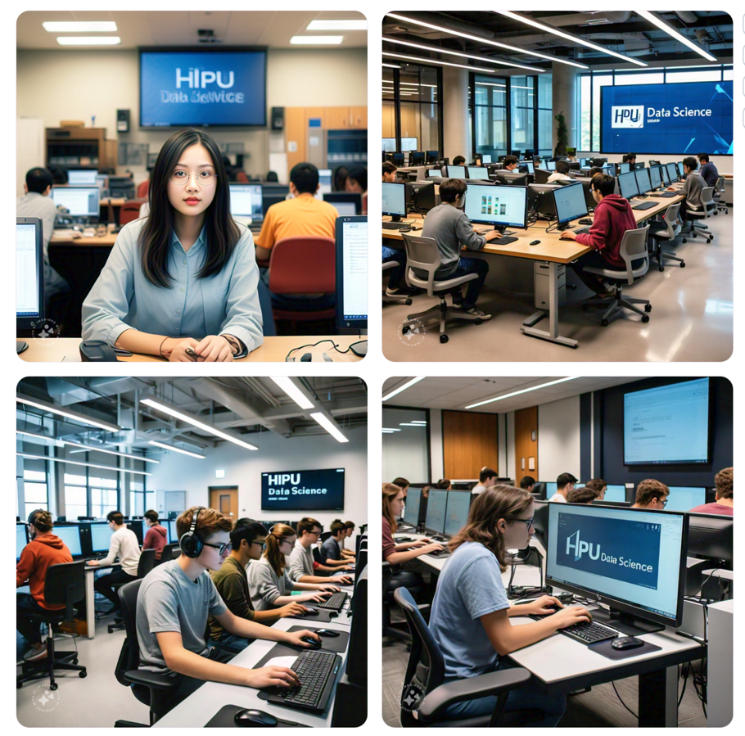
Exact words: Meta AI
Students are learning data science in a computer lab. A big LCD screen shows these exact words: "HPU Data Science".
The letter “H” is distorted

Slide 22
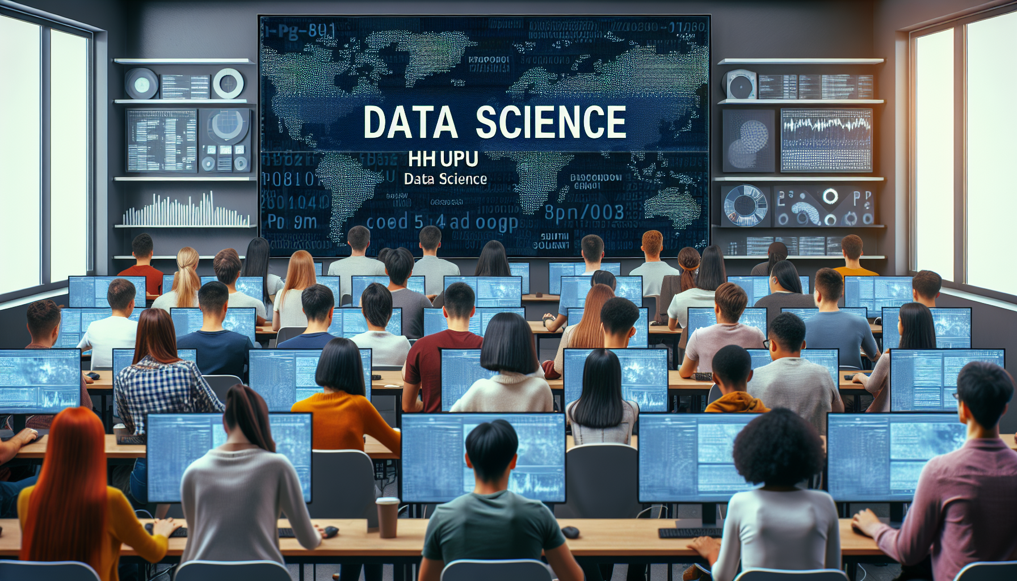
Exact words: DALL.E3
Students are learning data science in a computer lab. A big LCD screen shows these exact words: "HPU Data Science".
HHUPU

Slide 23
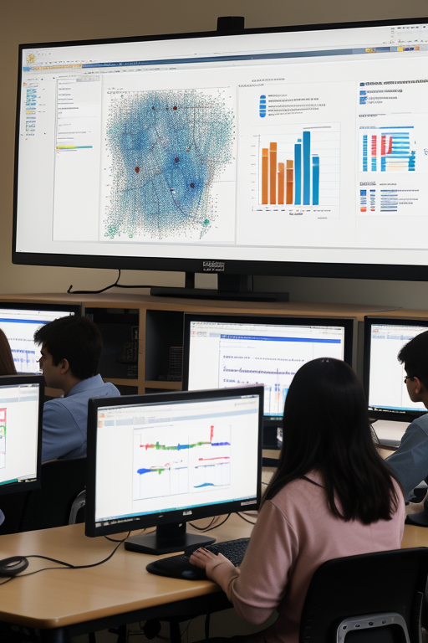
Exact words: Tensor art (Stable Diffusion)
Students are learning data science in a computer lab. A big LCD screen shows these exact words: "HPU Data Science".
Did not show the words at all

Slide 24
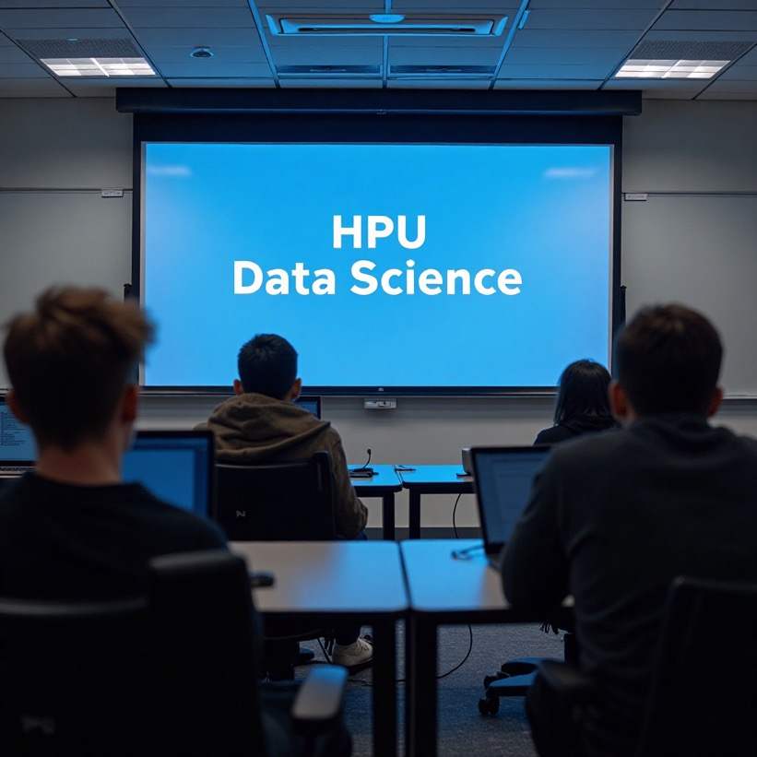
Exact words: Tensor Art (Flux)
Students are learning data science in a computer lab. A big LCD screen shows these exact words: "HPU Data Science".
OK, but flat and boring

Slide 25
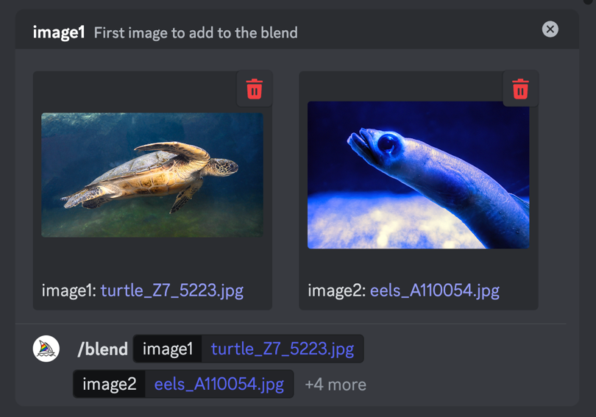
Midjourney
Pros
  High quality
  Many features, such as blending multiple images, alter parts of the image
Cons
  Slow
  Primary command prompt, not much GUI

Slide 26
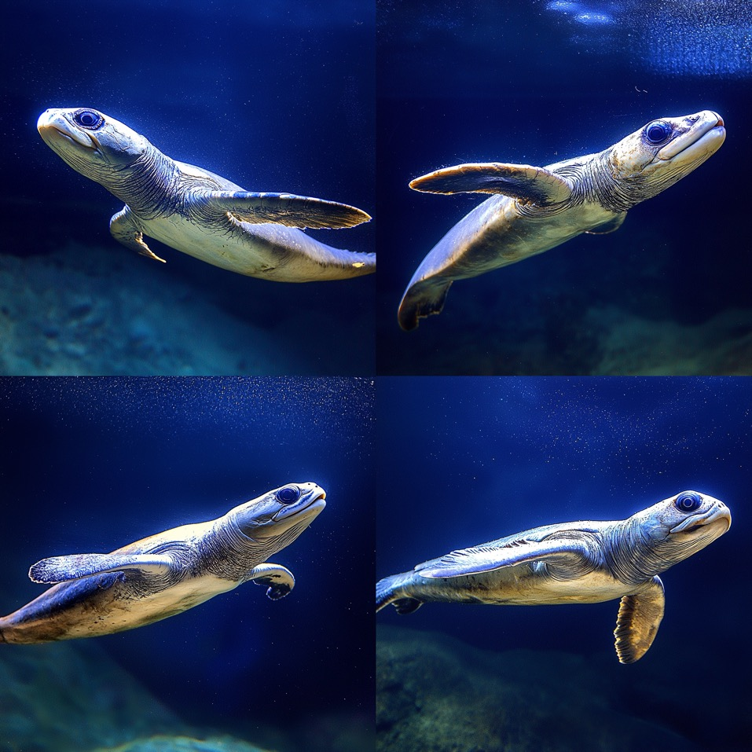
Midjourney
Turtle-eels

Slide 27
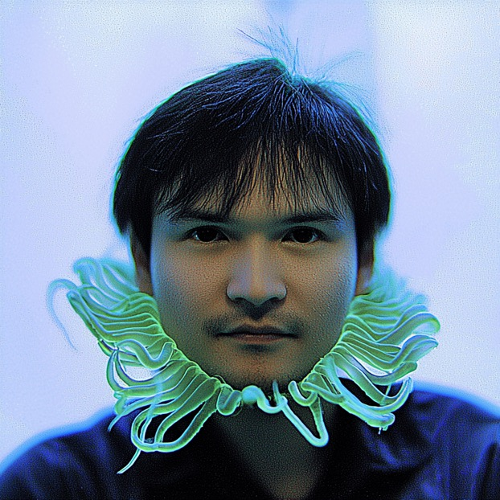
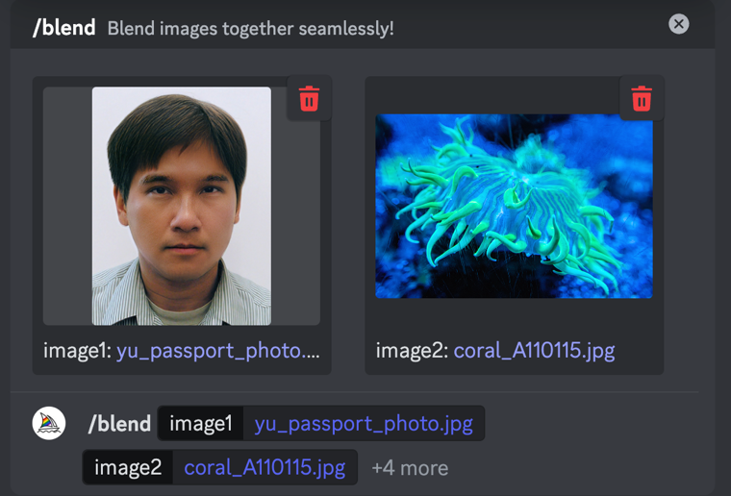
Midjourney
Another blending example: Coral man

Slide 28
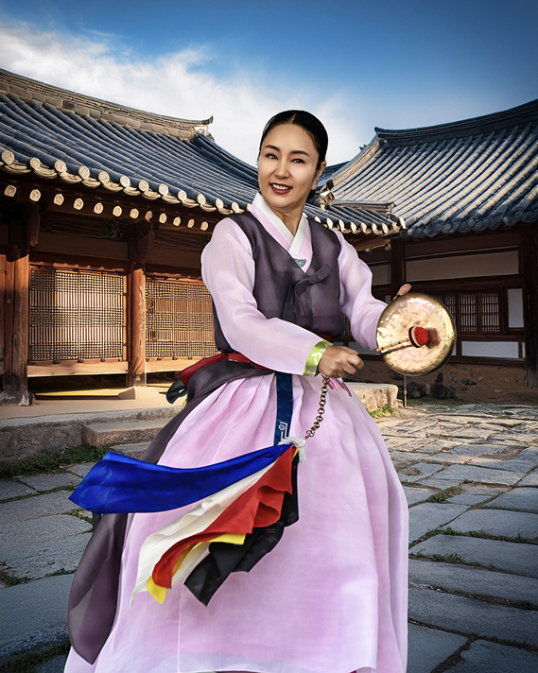
Adobe Firefly
Pros:
  Embedded in Adobe Photoshop, fully integrated
Cons
  No free account, need subscription
  Lower quality comparing with others (The model is a real person whereas the background is generated in Firefly)

Slide 29
Recommendations
Use it! Your PowerPoint presentations and video lectures will be enhanced by customized images that fit into your content.
If you don’t want to pay, open a free account in each of the preceding gen AI art services. If you use up your credit in one service, go to another one.
If you would like to produce all images from a single platform for consistency, subscribe to Ideogram because it is the best for generating exact words.

Slide 30

Recommendations
The tool is not perfect. For example, in this picture the head and the body of the woman are not proportional.
The Internet is flooded with poorly made AI images. It would drive your audience away!
Sometimes it takes several trials and errors to get it right.

Slide 31
Advantages
Cost Efficiency: Generative AI art tools can drastically reduce the cost of creating visual content, as they allow users to produce images or illustrations without hiring professional designers or illustrators. This is especially valuable for people who might have limited budgets for customized art.
Speed: AI can produce illustrations almost instantaneously, which accelerates project timelines. Traditional design work can take days or weeks, especially when involving complex requirements or revisions. AI-generated art is often ready within seconds or minutes, allowing for rapid experimentation and immediate feedback.

Slide 32
Advantages
Accessibility and Consistency: AI makes high-quality visuals more accessible to people without formal design skills, enabling anyone to create polished, professional-looking graphics. This opens up design possibilities for non-designers, making it easier for individuals and organizations to maintain consistent branding and style across multiple projects. In this sense, it is a great equalizer that levels the playing field.
Customization and Creativity: Traditionally, faculty use existing images for presentations. As a result, the images may not exactly fit the content, and it takes the risk of copyright infringement. Generative AI can quickly adapt images to specific needs (changing styles, colors, themes) without requiring full redesigns.

Slide 33
Disadvantages
Job Displacement: As AI tools become more capable, some roles traditionally held by graphic designers, illustrators, and stock photo photographers may decline in demand. Companies that once hired designers for basic illustrations may now rely on AI tools to handle these tasks, potentially leading to reduced job opportunities.
Impact on the Stock Image Industry: The demand for stock images and illustrations could decrease as companies and individuals turn to AI tools to generate unique visuals instead of purchasing stock assets. Companies selling stock images may need to adapt by offering niche, high-quality content or transitioning to offer unique design services to stay competitive.

Slide 34
Disadvantages
Quality and Authenticity Concerns: While AI-generated art can look professional, it may lack the originality, authenticity, and nuanced creativity that human designers bring to custom projects.
Intellectual Property and Ethical Concerns: Generative AI often learns from existing images, raising questions about intellectual property rights, originality, and ethical use. Designers and artists might feel their work is being co-opted or devalued if AI tools generate images based on large datasets that include their original creations without credit or compensation.

Slide 35
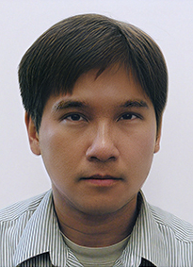
Thank you!
Contact: cayu@hpu.edu

