Slide 1


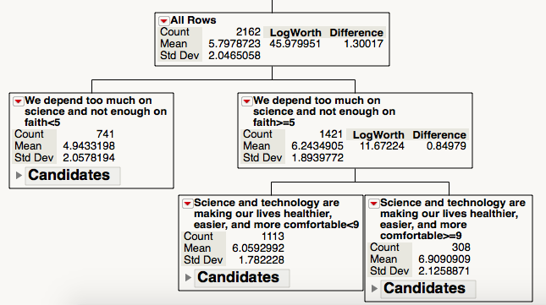
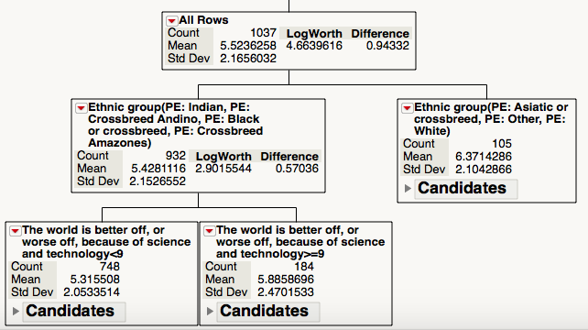
Politics and Attitudes toward Science:
A Big Data Analytic of the Relationship in 15 Countries
Hailey A. Trier, Chong Ho Yu, Ph.D.*
Azusa Pacific University
INTRODUCTION
“Because of science and technology, there will be more opportunities for the next generation”
“We depend too much on science and not enough on faith”
“One of the bad effects of science is that it breaks down people’s ideas of right and wrong”
Demographic variables
Social class
Sex
Age
Highest educational level attained
Ethnic group
Education (country specific)
Recent literature has suggested a link between political self-positioning and attitudes toward science (Dunlap, 2014; Gauchat, 2012; Jelen & Lockett, 2014).
  Gauchat (2012) found that respondents identifying as conservative were significantly more distrustful of science than otherwise politically aligned respondents during a 35-year period
  Dunlap (2014) found that conservatives were significantly more distrustful of impact scientists than of production scientists
  Hamilton (2014) found that New Hampshire respondents’ trust in scientists as a source of information about environmental issues differed significantly by political alliance
This study further investigated the relationship between left/right political alliance and support for science by comparing results for the United States with results for 14 other countries.
Countries
USA
Australia
Germany
Japan
Netherlands
New Zealand
Peru
Philippines
Poland
Romania
South Korea
Spain
Sweden
Taiwan
Zimbabwe
RESULTS
METHODS
Of the 12 dependent variables, the most significant variable for the US was “we depend too much on science and not enough on faith”. For this variable, US respondents who affirmed that we depend too much on science also tended to report a more right-wing political position (Figure 1). Although in the Peru sample, the variable “the world is better off, or worse off, because of science and technology” turned out to be the second most important predictor, this result is not meaningful because the partition tree put observations answering “10” in one group and those answering “1-9” in another group (Figure 2), a highly asymmetrical and impractical grouping.
Data for the US and 14 other countries with left/right political spectrums were extracted from the Wave 6 archival data set (2010-2014) of the World Values Survey. The variable ‘self positioning in political scale’ was the dependent variable, and 6 variables related to attitudes toward science as well as 6 demographic variables were included for preliminary analysis.
Due to the large sample size conventional statistical procedures would not be appropriate. First, when the statistical power is too high, the Type I error rate would be inflated. Second, when there are too many collinear independent variables, the variance explained by conventional modeling would also be inflated.
As a remedy, recursive partition trees and median rendering were created for nation subsets to analyze and visualize relationships between variables. The former is exploratory and non-parametric in nature and thus it is not subject to over-powering and parametric assumptions. The latter aims at pattern recognition and therefore patterns could be identified by recurring trends in a large data set.
Variables related to attitudes toward science
“Science and technology are making our lives healthier, easier, and more comfortable”
“The world is better off, or worse off, because of science and technology”
“It is not important for me to know about science in my daily life”
Figure 1. Partition tree for United States survey data
Figure 2. Partition tree for Peruvian survey data

Slide 2
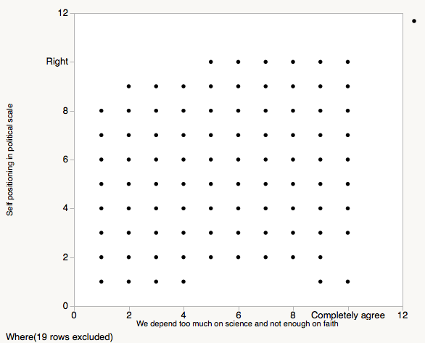
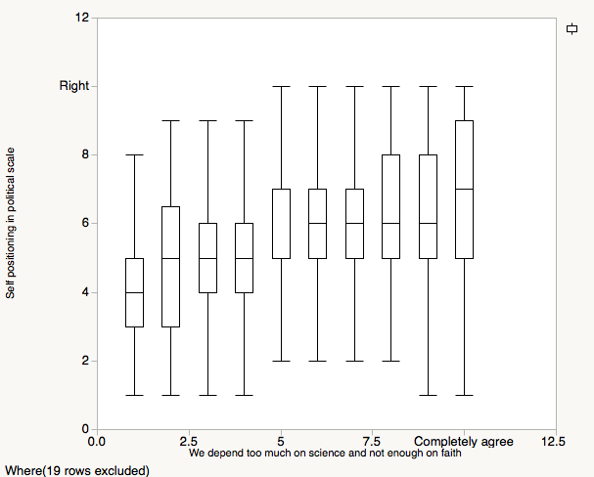
Politics and Attitudes toward Science:
An Analysis of the Relationship in 15 Countries
Hailey A. Trier, Chong Ho Yu, Ph.D.*
Azusa Pacific University
RESULTS CONTINUED
CONCLUSION
Data visualization methods were utilized to examine the relationship between self-reported political orientation and attitude toward science. However, conventional scatterplotting was not helpful because in such a large sample size there were always some participants choosing one of the 10 options from the Likert scale. As a result, the data points were everywhere (Figure 3). Indeed many data points in Figure 3 are on top of each other and it is difficult, if not impossible, to draw any conclusions from the scatterplot. To rectify the situation, median rending was employed. In this approach every point on the x-axis is depicted by a boxplot (five-point summary), which includes the median. While the distribution and the density of the data on each point can be displayed, one can also see the upward trend of the median to conclude that there is a correlation between the two variables (Figure 4).
This analysis supported the findings of previous literature and indicated that the US was the only country in the World Value Survey for which left/right political positioning was significantly affected by respondents’ attitudes toward science. However, this exploratory and correlational study does not imply a causal inference. We cannot assert that people’s attitudes toward science are politically based nor that people’s political orientations are due to their perspectives on science.
One finding of interest hinted at the possibility of the involvement of another factor. Of the 12 variables examined in this study, the only variable related to science that was significant was “we depend too much on science and not enough on faith”. The fact that this was the only significant variable may suggest that religious belief affects Americans’ opinions on science and impacts their political alliance. This conjecture awaits further investigation.
Nonetheless, readers should interpret this result with caution because several major nations are not included in the World Value Survey, such as the United Kingdom, Canada, France, and so on.
REFERENCES
Dunlap, R. E. (2014). Clarifying anti-reflexivity: Conservative opposition to impact science and scientific evidence. Environmental Research Letters, 9(2), n. p. doi: 10.1088/1748-9326/9/2/021001
Gauchat, G. (2012). Politicization of science in the public sphere: A study of public trust in the United States, 1974 to 2010. American Sociological Review, 77(2), 167-187. Doi: 10.1177/0003122412438225
Hamilton, L. C. (2014). Do you trust scientists about the environment? News media sources and politics affect New Hampshire resident views. Carsey Institute Regional Issue Brief, 40, 1-10.
Jelen, T. G., & Lockett, L. A. (2014). Religion, partisanship, and attitudes toward science policy. SAGE Open, Jan-Mar 2014, 1-8. Doi: 10.1177/2158244013518932
Figure 3. Conventional scatterplot showing the relationship between political positioning and “we depend too much on science and not enough on faith” (United States)
Figure 4. Median rendering showing the relationship between political positioning and “we depend too much on science and not enough on faith” (United States)

