Slide 1


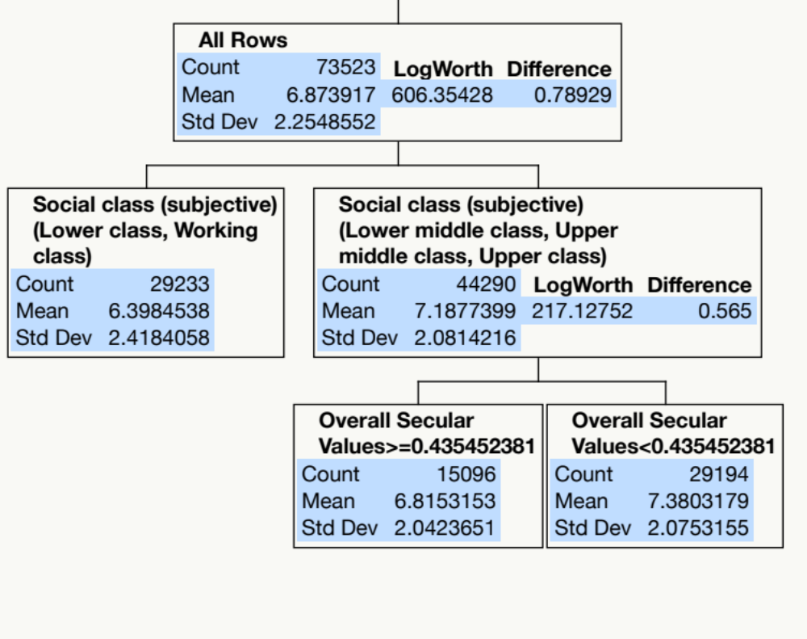
A data mining approach to examine the inter-relationships between subjective wellbeing, secularization and religiosity
Chong Ho Yu, Ph.D., Hailey Trier, & Maryann Slama
Azusa Pacific University
INTRODUCTION
With such a huge sample size any trivial effect would be misidentified as significant by conventional parametric tests. In addition, because there are many independent variables, the validity of regression analysis is threatened by multicollinearity. As a remedy, the recursive partition tree (Breiman, Friedman, Olshen, & Stone, 1984; Speybroeck, 2012; Vanitha & Niraimathi, 2013; Yu, 2010), which is not subject to statistical power and immune to parametric assumptions, was employed to analyze this large data set.
For verification, the bootstrap forest approach was used to examine whether replications by randomly resampling from the data set would yield the same conclusion.
Several scholars have argued that social-economic (objective) wellbeing and secularization are positively correlated (e.g. Paul, 2014; Zuckerman, 2008, 2012, 2014)
These past studies narrowly focused on comparing secular Europe and relatively religious America. To gain a more holistic view on the inter-relationships between secularization, religiosity, and subjective perception of wellbeing, the present study utilized the Wave 6 archival data set (2010-2014) of World Values Survey (WVS), which contains 74,042 observations from 52 countries.
METHODS
RESULTS
Dependent variable
Satisfaction with your life
Independent variables indicating religiosity
Active/Inactive membership of Church or religious organization?
How often do you attend religious services?
How often to you pray?
Are you a religious person?
Do you believe in God?
Do you believe in hell?
What is the meaning of religion? To follow religious norms and ceremonies vs. To do good to other people
What is the meaning of religion? To make sense of life after death vs. To make sense of life in this world
How important is God in your life?
How important is religion?
Confidence in churches
What is your religious denomination?
Independent variables indicating secular values
Overall Secular Values
Secular value: Defiance
Secular value: Disbelief
Secular value: Relativism
Secular value: Skepticism
Demographic variables
Sex
Age
Marital status
Ethnicity
Social class (subjective)
Highest educational level attained
Country-specific education
Active/Inactive membership of political party?
Which party would you vote for if there were a national election tomorrow?
Figure 1 shows the partition tree result using 73,523 observations (519 missing values). Although 17 independent variables were examined by the partition tree algorithm, only two variables were considered important. The best predictor of satisfaction was social class whereas the second best was secular values.
A bootstrap forest was generated in order to verify whether these two variables were the only two that possessed the highest predictive power. In each tree about 70% of the data set was selected for training and the remaining 30% was reversed for validation.
In terms of portion, social class contributes 30.41% while overall secular index contributes 20%. However, the portions of all other variables range from .0023 to .0942 only.
Figure 1. Partition tree for data from 52 countries

Slide 2
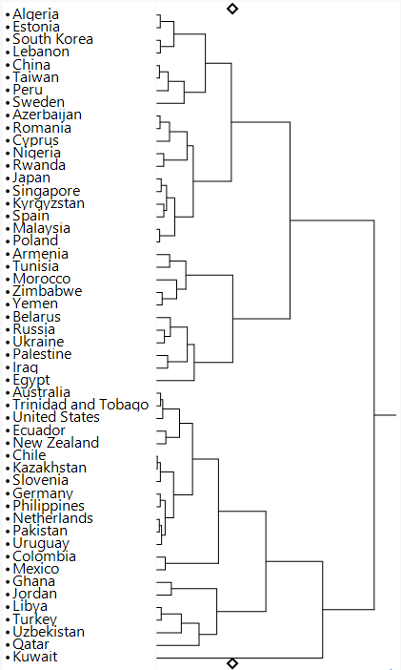
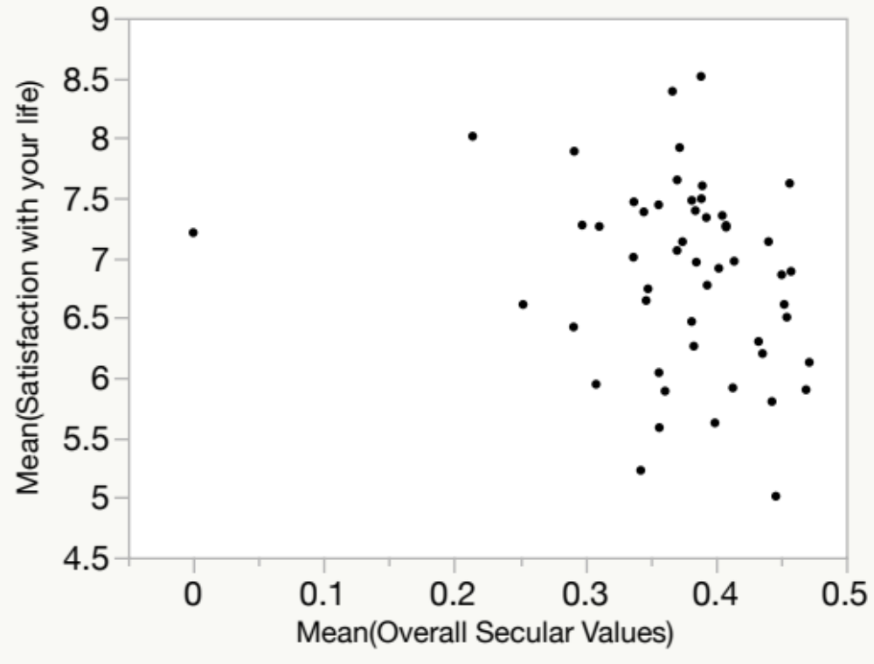
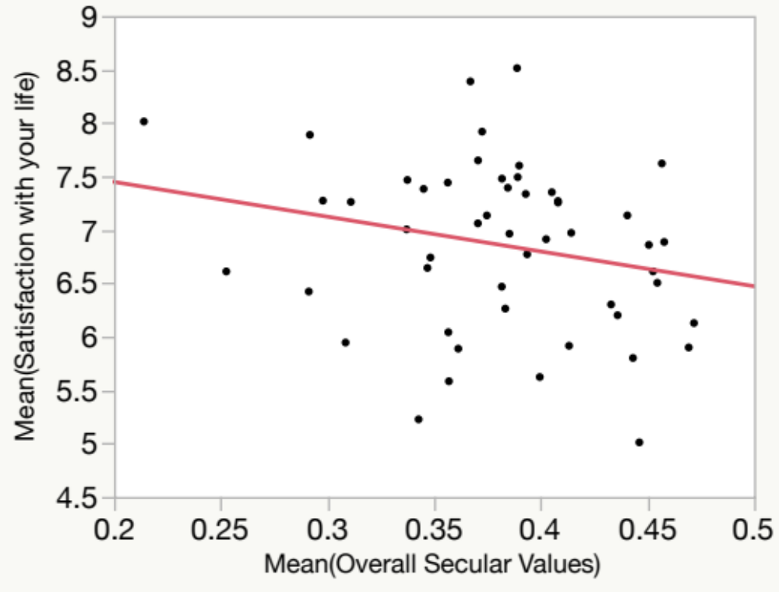
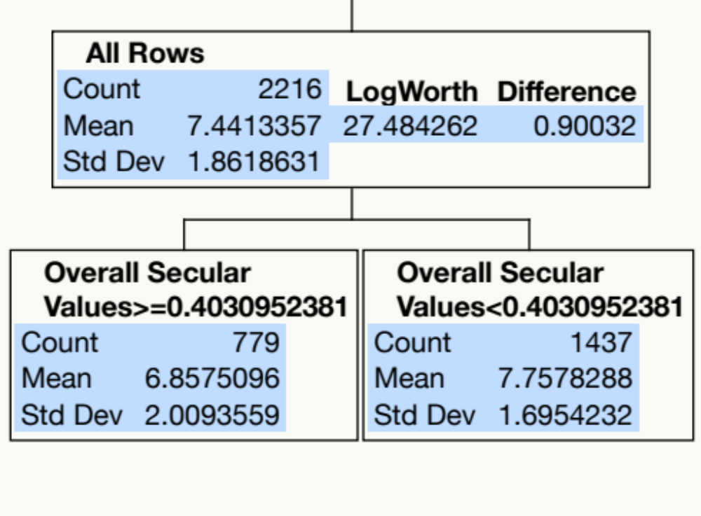
A data mining approach to examine the inter-relationships between subjective wellbeing, secularization and religiosity
Chong Ho Yu, Ph.D., Hailey Trier, & Maryann Slama
Azusa Pacific University
RESULTS CONTINUED
Interestingly, the partition tree result of the US data alone (n=2216, 16 missing values) is similar to that of the whole world data (see Figure 5).
Even though additional variables were used in this analysis, the US sample model was saturated with just one variable: secular values.
Like the overall result with all nations, secular values were also inversely correlated with satisfaction in the US. Specifically, if the secular value score is less than 0.403, then the average satisfaction is 7.758. If the score is equal to or less than 0.403, then the mean of satisfaction is 6.858.
The entire data set was summarized by country (n = 52) for pattern recognition. The scatterplot (see Figure 2) of satisfaction and overall secular values shows that Kuwait is a bivariate outlier. After the outlier was removed regression analysis yielded a significantly negative relationship (b = 1.967, t = -1.65, p = .05)
Figure 2. Scatterplot with outliers included
Figure 3. Scatterplot with outlier (Kuwait) excluded
Paul (2015) put European countries into one cluster due to their commonalities in secularization and objective wellbeing indices. However, when subjective wellbeing (satisfaction) and secularization were used as input for hierarchical clustering, the picture was no longer clear-cut (Figure 4). For example, European nations were scattered all over the dendrogram; the United States, Trinidad/Tobago, and Australia had close proximity; and South Korea, Lebanon, Estonia, and Algeria were grouped together. This implies that secularization and satisfaction could vary from country to country regardless of geographical location, culture, or development status.
Figure 4. Dendrogram showing hierarchical clustering of nations
Figure 5. Partition tree of US data alone

Slide 3
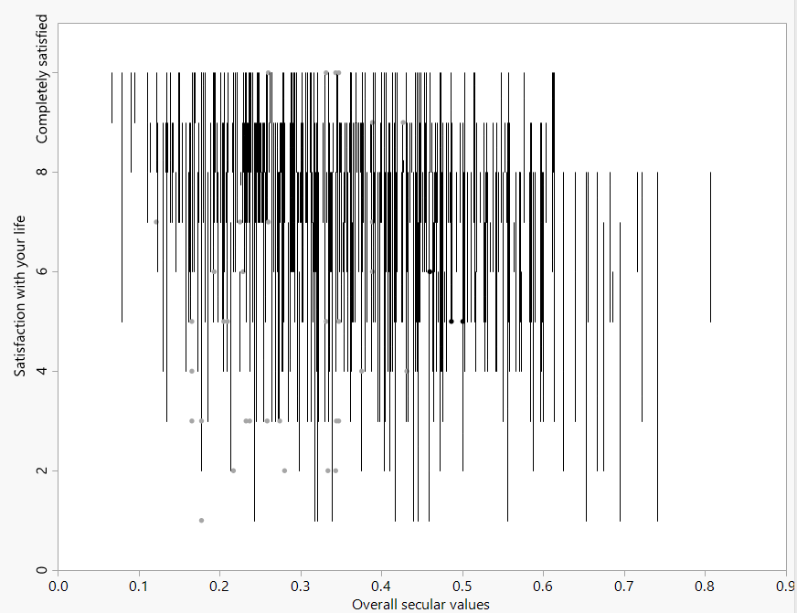
A data mining approach to examine the inter-relationships between subjective wellbeing, secularization and religiosity
Chong Ho Yu, Ph.D., Hailey Trier, & Maryann Slama
Azusa Pacific University
RESULTS CONTINUED
CONCLUSION
Data visualization of this relationship is difficult due to overplotting. To rectify this situation quantile rendering was used (see Figure 6). In this plot, rather than showing 2216 dots as a big cloud, the secular values were partitioned into certain levels and in each level satisfaction was depicted by quantile. As a result, the noisy data were smoothed and the negative slope was implicitly shown by the density of the observations.
Previous studies suggested a positive relationship between secularization and wellbeing, as well as a geographical, cultural, and developmental pattern primarily based on data gathered in Europe and the US. By expanding the scope of analysis to the whole world the current study suggested that the existing view might be over-simplified.
Finally, there are several limitations in this study. Despite its wide geographical coverage, certain important nations are missing from the WVS, such as the United Kingdom, Canada, and France.
Most survey items are standalone observed items instead of composite scores indicating latent constructs. Because the measurement by WVS are standalone observed items, readers should view them as indicators of observed behaviors rather than latent constructs.
REFERENCES
Breiman, L. (2001). Random forests. Machine Learning, 45, 5–32.
Breiman, L. (2004). Consistency for a simple model of random forests (Technical report 670), UC Berkeley. Retrieved from http://www.stat.berkeley.edu/˜breiman
Breiman, L., Friedman, J.H., Olshen, R.A., & Stone, C.J. (1984). Classification and regression trees. Monterey, CA: Wadsworth International Group.
Klimberg, R., & McCullough, B. D. (2013). Fundamentals of predictive analytics with JMP. Cary, NC: SAS Institute.
Koenig, H. G., Meador, K. G., & Parkerson, G. (1997). Religion index for psychiatric research. American Journal of Psychiatry, 154, 885-886.
Paul, G. (2014, July). The health of nations. Skeptic, 19(3), 10-16.
SAS Institute. (2015). JMP 12 [Computer Software]. Cary, NC: Author.
Speybroeck, N. (2012). Classification and regression trees. International Journal of Public Health, 57, 243-246.
World Values Survey Association. (2014). World values survey. Retrieved from http://www.worldvaluessurvey.org/wvs.jsp
Vanitha, A., & Niraimathi, S. (2013). Study on decision tree: Competent data classification. International Journal of Computer Science and Mobile Computing, 2, 365-370.
Zuckerman, P. (2008). Society without God. New York, NY: New York University Press.
Zuckerman, P. (2012). Faith no more: Why people reject religion. New York, NY: Oxford University Press.
Zuckerman, P. (2014). Living the secular life: New answers to old questions. New York, NY: Penguin Press.
Figure 6. Plot showing quantile rendering of data

