Slide 1

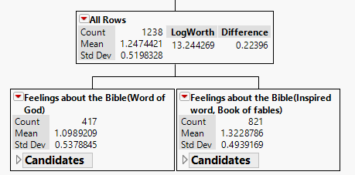
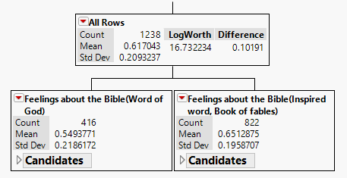
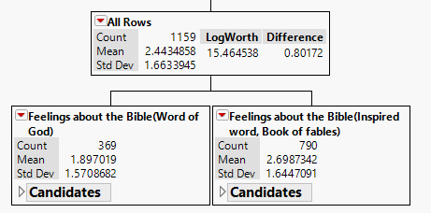
Examining the trilateral relationships between religiosity, attitudes towards science and education attainment
Brown, E., Yu, C.H., Lee, H.S., & Gan, S.
Azusa Pacific University
INTRODUCTION
Hence, in PLS analysis certain nominal variables are converted into numeric. In the conversion process a reference point was chosen for coding. For example, “belief in God” was coded as “1” and all the rest were coded as “0”. It is important to point out that this coding scheme does not imply any value judgment. Since the variable “Christian denomination” had many missing values and it was impossible to choose a reference point for denomination, this variable is excluded from the PLS analysis. Next, another PLS targeted the remaining predictors. The inter-relationships among these variables were examined in the loading plot in order to determine which variable belongs to which principal component. Last, a principal component regression was run to determine whether the reduced set of religious variables could well-predict the criterion
Certain science educators (e.g. Bill Nye) and scientists (e.g. Lawrence Krauss) question whether religious education is at odds with science education on the grounds that religiosity might lead to an anti-science mentality. They argue that the US needs more scientists and engineers in the era of globalization, but religiosity is a stumbling block to science education. On the other hand, Christian scientists (e.g. Hugh Ross) counter-argue that religiosity facilitates science learning because the notion of a designed universe motivates scientific discovery. However, neither camp provides empirical data to substantiate their claims. The authors of this paper do not take a side in this debate. Rather, the research team subscribes to the philosophy of exploratory data analysis and data mining: Let the data speak for themselves.
METHODS
RESULTS
Data source and variables The data for this project were sourced from the National Opinion Researcher Center (NORC) website. Responses to certain survey questions in 2014 relating to education, religiosity, and science were extracted. The outcome variables are overall interest in science, science courses taken, and scientific knowledge. The last one is a composite variable resulting from averaging the scores of the following ten questions:
Overall interest in science The bootstrap forest using “overall interest in science and technology” as the dependent variable shows that the most important predictor of the outcome is “feelings about the Bible” (Figure 1). If the participants perceive the Bible as the Word of God in a literal sense, the mean score of “overall interest in science” is 1.1, which is significantly lower than those who accept the Bible as inspired word or fables (mean = 1.32).
Scientific knowledge In the bootstrap forest using “scientific knowledge” as the outcome measure “feelings about the Bible” stands out to be the most important predictor. The decision tree in Figure 2 indicates that the mean score of “scientific knowledge” of participants that consider the Bible as the Word of God is 0.55, which is 10% lower than their counterparts who view the Bible as fables or inspired word.
Taken science courses For the dependent variable “Taken science courses,” the bootstrap forest shows that “feelings about the Bible” is again, the number one predictor. The decision tree in Figure 3 shows that if the participants believe that the Bible is the Word of God, the expected score of “Taken science courses” is 1.897. If the Bible is taken as fables or inspired word, the expected score is 2.699.
1. The center of earth is very hot
2. All radioactivity is man-made
3. Father gene decides sex of baby
4. Lasers work by focusing sound waves
5. Electrons are smaller than atoms
6. Antibiotics kill viruses as well as bacteria
7. The universe began with a huge explosion
8. The continents have been moving
9. The earth goes around the sun
10. How long the earth goes around the sun
Data Analysis. To rectify shortcomings of large sample size (n=2538), which may lead to excessive statistical power and multi-collinearity, we approached the issue with bootstrap forest analysis. In each bootstrap forest both the criteria of the number of splits and sum of squares (SS) were used to determine which predictor should be retained. Also, in order to comprehend the “big picture” by data reduction, the partial least squares (PLS) approach was employed, as it extract several latent factors and responses from several dependent and independent variables, respectively. In PLS every level of a categorical variable is treated as a factor, resulting in a more complicated model variables.
Figure 1. Decision Tree of Overall Interest in Science and Technology
Figure 2. Decision Tree of Scientific Knowledge.
Figure 3. Decision Tree of Taken science courses

Slide 2
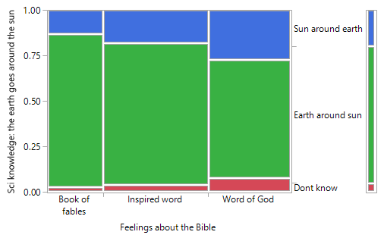
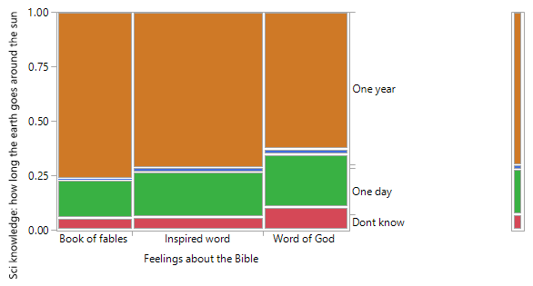
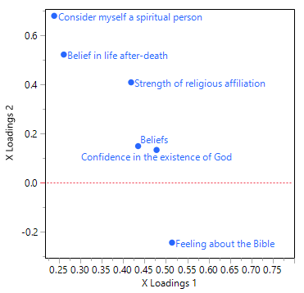
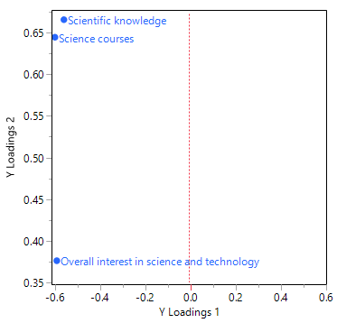
Examining the trilateral relationships between religiosity, attitudes towards science and education attainment
Brown, E., Yu, C.H., Lee, H.S., & Gan, S.
Azusa Pacific University
People who believe the Bible is the Word of God (27.16%) asserted that the sun goes around the earth, compared with those who view Scripture as fables (13%) and inspired word (18.16%). 62.84% of those who perceived the Bible as the Word of God could correctly answer the question, compared with those viewing the Bible as fables (76.5%) and inspired word (71.25%). These two items were singled out for further examination because relative to other scientific questions, they are considered common sense.
DISCUSSION
While, at first glance, religious people tend to be less interested in science and technology, less competent in scientific knowledge, and take fewer science courses, it is premature to conclude that Christianity is an obstacle of science education. The result does not necessarily imply that Christians are unintelligent and Christianity is anti-science . Intriguingly, in the past, many prominent scientists were Christians, such as Isaac Newton, James Maxwell, and Lord Kevin. To these scientists, religiosity was not a hindrance to scientific exploration; rather, they were motivated to reveal the glory of God by showing the order of the universe via science. Torrance (1985) found that Christian theology, such as the belief that the universe is orderly and not random, contributed to the birth and development of modern science. Some scholars conjectured that openness might be a key factor for an explanation to a strong inverse relationship between religiosity and intelligence. Open-minded people tend to enjoy intellectual inquiry rather than conforming to religious dogmas, while religious sectarianism may hinder individuals from learning scientific findings that are not in line with their religious dogmas. However, the previous literature and this present study are largely confined to probing the relationship between religiosity and analytic intelligence based on scientific facts, which discards other possible indicators of intelligence and intellectual disciplines. Further investigation is encouraged to shed light on relationship between Christianity and performance in social science or non-scientific disciplines.
Figure 4. Mosaic Plot of “The earth goes around the sun” and “Feelings about the Bible”
Note. Chi-square X² = 38.66, p < .0001. Fisher’s exact test ( p < .0001)
Figure 5. Mosaic Plot of “How long the earth goes around the sun?” and “Feelings about the Bible”.
Note. Chi-Square X² = 15.33, p = 0.0178. Fisher’s exact test (p = 0.176).
A preliminary partial least squares (PLS) analysis, which takes all three dependent measures into account simultaneously, was employed to identify the most powerful predictors. Table 1. indicates that six variables were retained based on the criterion of VIP > .8. Figure 6 and 7 show the PLS model ran with the six variables that have a high VIP. Apparently, “scientific knowledge” and “taken science courses” go together as a group while “overall interest in science and technology” is a standalone outcome.
CONCLUSION
Table 1. VIP scores of all potential predictors.
To address these findings, a faith-learning integration approach may be applicable. Faith-learning integration is defined as “a scholarly project whose goal is to ascertain and to develop integral relationship which exist between the Christian faith and human knowledge, particularly as expressed in the various academic disciplines” (Hasker 1992, p.235). Its foundation lies in the understanding of all truth to be God’s truth; however there may be various ways of revealing, perceiving, and interpreting this truth (Guy 1980). In the concepts of Christianity, both Scripture and science are viewed as tools that facilitate individuals in studying the natural world, as well as the nature of humanity. More specifically, religion provides understanding about humanity, while science contributes to self-understanding, driven by curiosity. In this case, both religion and science are equally important, as each discipline represents half of a circle. Faith integration completes this circle, which provides a holistic understanding of reality (Kim, 2016).
Variable | VIP
Feeling about the Bible | 1.9181
Consider myself a spiritual person | 1.1706
Confidence in the existence of God | 1.1315
Beliefs | 0.8740
Strength of religious affiliation | 0.8242
Belief in life after-death | 0.8012
Confidence in organized Religion | 0.6833
Consider myself a religious person | 0.6661
Tried to convince others to accept Jesus | 0.6197
Ever had a 'born again' experience | 0.5389
Note. A Variable importance plot (VIP) score is a measure of a variable’s predictive power by taking all dependent and independent variables into account.
Figure 6. Loading plot of independent variables. Shows clustering pattern of dependent variable (Xs)
Figure 7. Loading plot of dependent variables. Shows grouping pattern of independent variables (Ys)
REFERENCES
A new component consisting of “science knowledge” and “taken science courses” was created while five religion-related variables were loaded into another component named “religious component.” A regression analysis indicated that the religious component is a significant predictor of science knowledge and courses with a negative association (b= -0.13, p = .0062). The same inverse relationship is also observed between overall interest in science/technology and religious component (b = -0.10, p = .0002).
Bertsch, S., & Pesta, B. J. (2009). The wonderlic personnel test and elementary cognitive tasks as predictors of religious sectarianism, scriptural acceptance and religious questioning. Intelligence, 37, 231-237.
Guy, J. D. (1980). The search for truth in the task of integration. Journal of Psychology & Theology, 8(1), 27-32.
Hasker, W. (1992). Faith-learning integration: an overview. Christian Scholar's Review, 21, 234-248.
Kanazawa, S. (2010). Why liberals and atheists are more intelligent. Social Psychology Quarterly, 73, 33–57, doi:10.1177/0190272510361602.
Kim, S. C. (2016). Religion and science in dialogue: an Asian Christian view. Zygon, 51(1), 63-70. doi: 10.1111/zygo.12236
Krauss, L. (2013). Teaching Creationism is child abuse. Retrieved from https://www.youtube.com/watch?v=UTedvV6oZjo
Sherkat, D. E. (2011). Religion and scientific literacy in the United States. Social Science Quarterly, 92, 1134-1150.
Torrance, T. (1985). Reality and scientific theology. Edinburgh, UK: Scottish Academic Pres.
Zuckerman, M., Silberman, J., & Hall, J. A. (2013). The relation between intelligence and religiosity a meta-analysis and some proposed explanations. Personality and Social Psychology Review, 17, 325-354.

