Slide 1
Emotive and experiential factors of leaving the Christian faith and the Church
Sarah Ro, Stephanie Chavez, Emily Brown and Chong Ho Yu

Slide 2

Introduction
According to Barnes Group, 50% of young adults, while transiting from high school to college, either cease to attend church or give up their Christian faith.
Statistical figures are incapable of revealing the deeper structure of the phenomenon, especially the emotive and experiential factors.

Slide 3
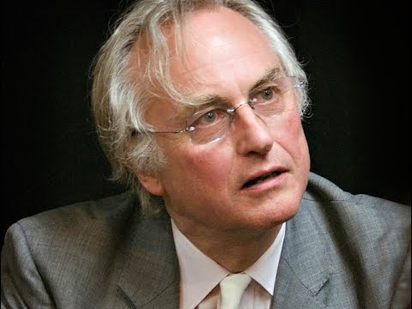
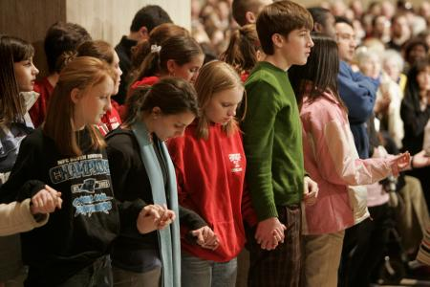
Introduction
Prior studies conducted by the research team found that intellectual challenges by the New Atheist Movement and the postmodern culture are not major concerns by the participants at all.
According to Hope and Packard, the experience of churchgoers in the community is a more determining factor to their continuation of Christian life than theological factors.

Slide 4
Literatures Review
Bielo addresses three factors:
  Emerging evangelical’s dissatisfaction and frustration toward the present state of Christianity in regards to societal issues and spiritual practices within the church, like worship, evangelism, and theology.
  Cultural tension that exists between Gen X and Millennials.
  Generational tension exist as the transition is being made between modern and postmodern.

Slide 5

Literature Review
Waters findings suggest that millennials who are leaving the church do so because of feelings of lack of trust and satisfaction.
  Non-denominational churches seem to offer this sense of trust and relationship for millennial Christians.
  Millennials are looking for conversations and personal experiences to be stressed rather than doctrines.

Slide 6
Literature Review
Hamilton, Martin, and Martin (2011) studied attachment styles within church members and measured their satisfaction levels within the church.
  One’s attachment (secure, preoccupied, dismissing, and fearful) is a determinant of one’s satisfaction of participation within the church.
  Those who were securely attached were significantly more satisfied with their church in comparison to all other attachment styles combined.

Slide 7

Literature Review
“The Dones” = previously active members and faithful leaders who have given up church, but continue to practice faith
Discontent with: imbalanced hierarchy
inauthentic community
stifling of different ideas
Cultivate generous, compassionate, loving community without institution of church
Call to pastors and leaders to reflect and change

Slide 8
Method
In this study 212 responses from adults aged 18-40 were collected.
Qualitative methodologies were employed in an attempt to find out what the disconnect is between their expectations and their actual church experience.
The unstructured textual data are categorized into major themes.
To avoid bias and to improve reliability, a panel was set up to classify the open-ended responses.
Sentiment analysis in text mining is also employed for triangulation.

Slide 9

Open-ended question
If you think there is a disconnect between the teaching of the Bible about what the church ought to be and the actual church that you are experiencing, please describe what the disconnect is and why.

Slide 10
List of Discontent
Concept | Frequency
Bible Misinterpretation | 27
Judgmentalism | 22
Lack of compassion, forgiveness, love | 22
Narrrow mindedness | 16
Flawed System | 14
Uninformed of Current Events | 13
Money | 12
Anti-LGBTQ | 10
Hypocritical | 8
Invalidity of Bible/God | 8
Cherry-picking | 6
Leadership | 6
Self-righteous | 6
Ally with Republicans/Too Conservative | 4
Lack of Unity/Denominations | 4
Social Networking | 4
Gender Roles | 3
Benefits of Faith | 2
Abortion/Birth Control/Contraceptives | 2
Church-picking | 2
Lack of Commitment | 2
Power and control | 2
Science | 1
Fantasy Preaching | 1
Prayer | 1
It is surprising to see that intellectual reasons (e.g. conflict between science and faith, New Atheism) are not on top of the list.
Only one person mentions “science” as a reason for his/her discontent.

Slide 11
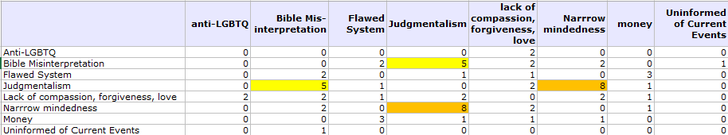
Relationships of concepts
(Co-occurrence)
Participants perceive that people who misinterpret the Bible also are judgmental and narrow-minded.

Slide 12
Misinterpret the Bible
“I think in general many churches are teaching a worldly view in one way or another. Some want us to believe that an all inclusive world is the one Jesus wanted, others want us to feel comfortable being surrounded by figures and statues of false gods. The Bible teaches against these things.”

Slide 13
Judgmental
Many participants expressed their concern that the church is too judgmental. However, only one pointed out a specific example: dress code.
“The church I'm experiencing is very shallow, our pastor turns people away because of their dress code and it makes me angry. The bible says to love everyone, Jesus loved everyone. He hung out with tax collectors and outcasts and he never cared how they were dressed.”

Slide 14
Lack of love and compassion
“the bible said you should give back to otehrs, your neighbors and especially those that are less fortunate but i think a lot oif churches do this for show.”
“In the Bible, Jesus is extremely focused on the poor and treating those as we would like to be treated.”
“The church is all about making money, and it doesn't do much to help the needy in the community. My church has homeless people less than a mile from it, and they never receive help.”

Slide 15
Narrow mindedness
“They are preaching about unconditional love, yet the condemn all sorts of people who don't fit into the christian mold. I personally don't think that fits the description of unconditional love, because clearly there are all sorts of conditions that a person would need to qualify first before Jesus will accept him or her. They don't use love with people they consider "other." They use shame, guilt, and violence in their message (you'll burn in hell) if you don't accept Christ as your savior.”

Slide 16
Text mining
Text mining (TM) is automated computerized method for textual analysis.
It is based on artificial intelligence, natural language processing, and computational linguistics, meaning that the software is aware of the context of the sentences.
  E.g. I book an air ticket <> I read a book
Unlike human coding TM is objective and consistent: regardless of who runs the software, it yields the same result.

Slide 17
Sentiment analysis (SA)
SA is a subset of TM: The software evaluates the emotional tone of the sentence
And then classify the sentence as positive, neutral, or negative
In this analysis we aim to find out the portion of negative expressions among the participants.

Slide 18
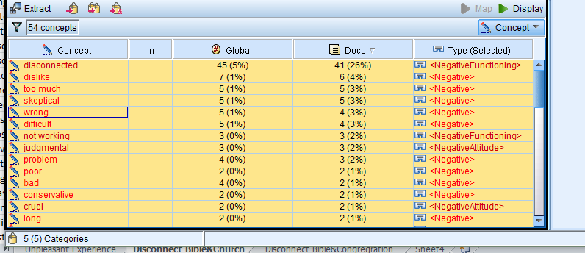
Negative expressions
84.41% expressed negative feelings

Slide 19
Future studies
This is the result of preliminary textual analysis. There are more open-ended responses to be analyzed. For example,
  If you have given up the Christian faith, please give a brief explanation of your choice.
  How would you describe the relationship with your church members?
  If you have any unpleasant experience in the church, please describe the details:
More will be coming. Stay tuned

