Slide 1
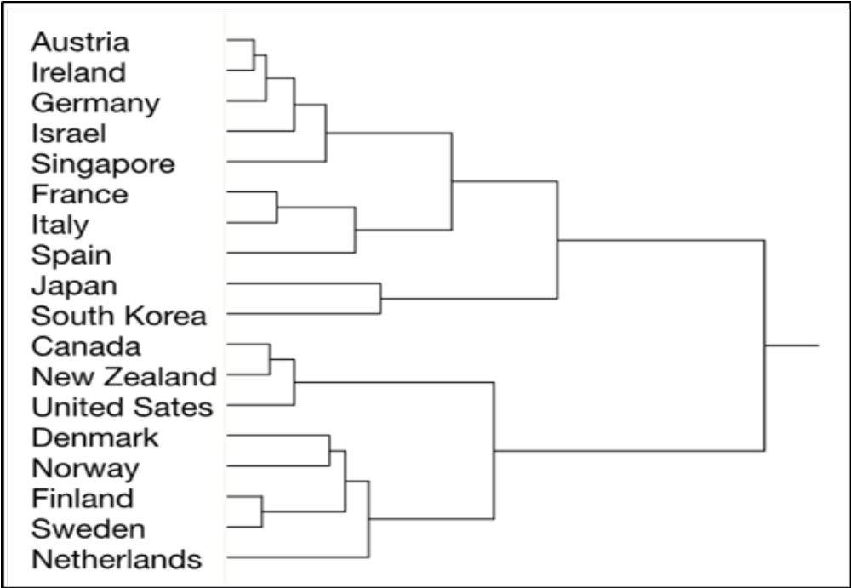
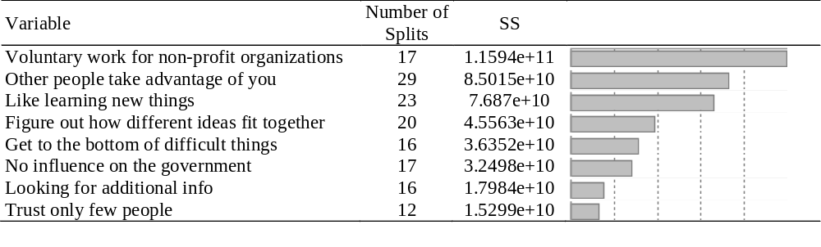
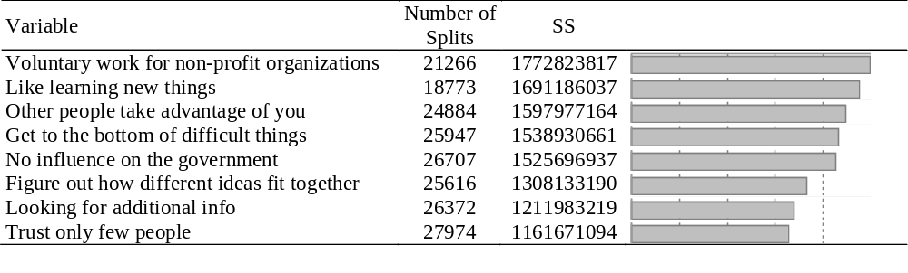
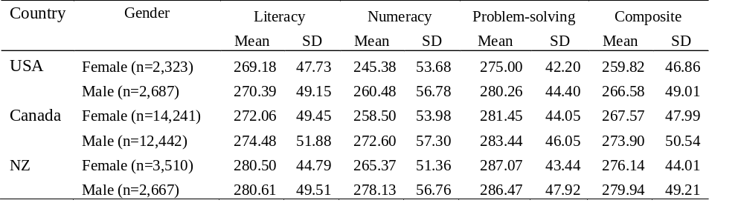
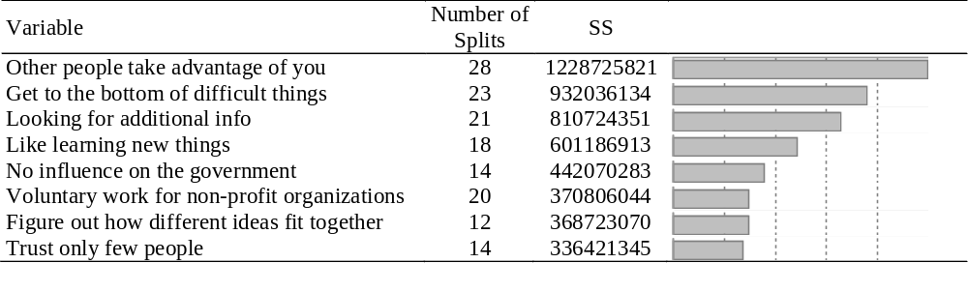
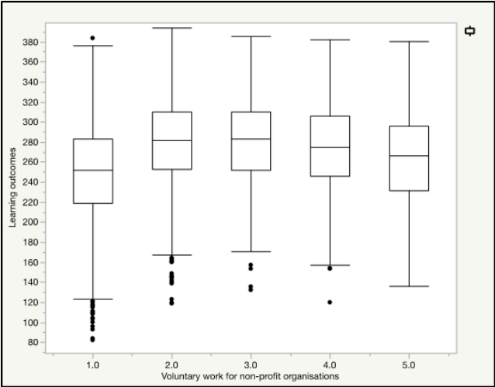
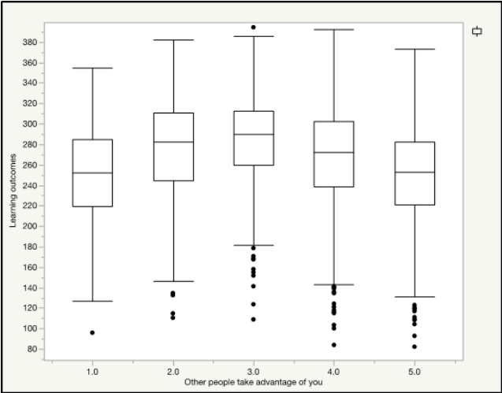
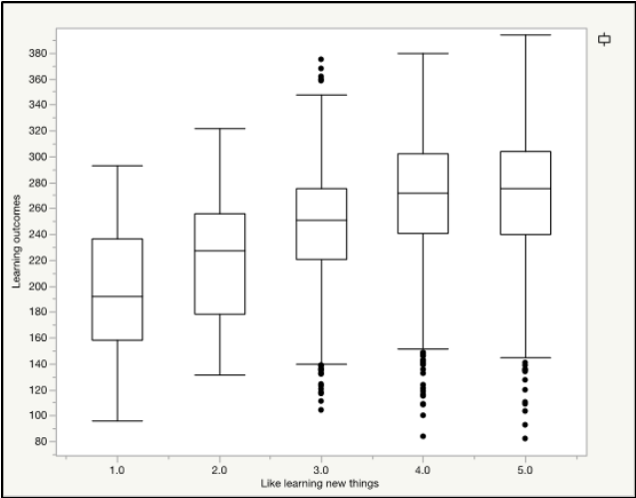
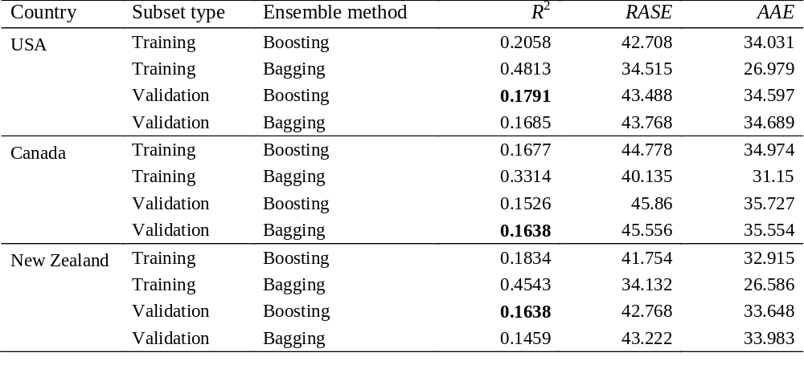
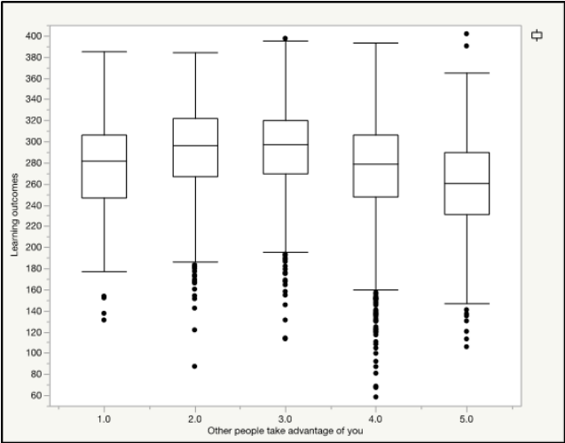
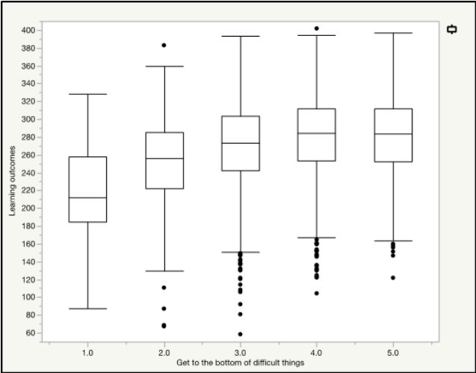
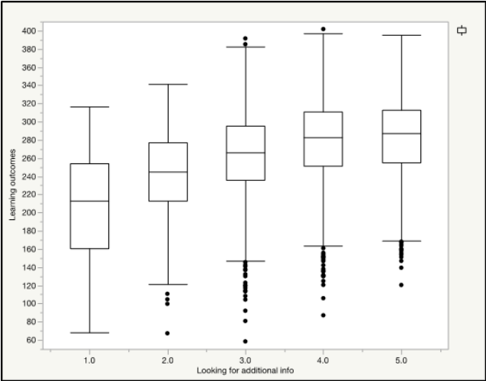
A cross-cultural comparison of adult skills: The ensemble approach
Emily Brown, Hyun Seo Lee, Siyan Gan, Chong Ho Yu
Azusa Pacific University
Abstract
Method
Results
Conclusion
Programme for the International Assessment of Adult Competencies (PIAAC) indicated that US adults are far behind their international peers in literacy, numeracy, and technology-based problem solving. This study utilized data mining to explore the possible association between PIAAC scores and several constructs. Since the US, Canada, and New Zealand were considered as culturally similar nations, patterns between PIAAC scores and selected constructs were analyzed by a variety of big data analytical methods, including cluster analysis, bootstrap forest, boosted tree, and data visualization. Given that PIAAC used multiple computerized adaptive testing, the consequential plausible values were randomly selected when the ensemble approach was used. Additionally, model comparison was utilized to decide between bagging and boosting in order to select the optimal model for each sample. In these three samples, cultural engagement, readiness to learn, and social trust, respectively emerged as strong predictors on learning outcomes assessed by PIAAC.
The top three predictors within the USA sample were cultural engagement (voluntary work for non-profit organizations), social trust (other people take advantage of you), and readiness to learn (like learning new things).
Implications for methodology Large-scale assessments are challenging to researchers because conventional statistical procedures are inappropriate to big data. One obvious shortcoming is that with a huge sample size the statistical power of a parametric test would approach nearly 100 percent, leading even trivial effects to be misidentified as significant. Big data analytics remediates the problem of hypothesis testing by utilizing both model building and data visualization. Like classical procedures, there are pros and cons in different data mining techniques. It is the conviction of the authors that method choice and model goodness should be assessed on a case-by-case basis. We ran both bagging and boosting, and then choose the best result according to the criteria of model comparison
Implications for education The PIAAC data indicated three constructs to be strong predictors of test performances in the samples from the US, Canada, and New Zealand: cultural engagement, readiness to learn, and social trust.
1. Motivation and readiness to learn: as predicted, one’s intrinsic motivation for learning correlated with learning outcomes. One’s personal positive expectation and experiences of learning , willingness to seek additional resources to purposely comprehend the subject are forces to direct individual to learn more and better.
2. Cultural engagement: one plausible explanation for its non-linear pattern with learning outcome, is that without volunteering in the community, one has fewer opportunities to widen the horizon, resulting in a limited learning experience. Yet, spending too much time in volunteering services could also disrupt one’s regular learning schedule.
3. Social trust: its non-linear relationship with learning outcome suggests some useful insight: If one accepts every piece of information given by others without a doubt, this individual is likely to be misinformed or obtain false knowledge. On the contrary, having too many doubts will also result in isolation of knowledge. Thus, having the ability to trust and learn, but also be skeptical at times is more likely to create better learning outcomes.
4. Political efficacy. On the other hand, the construct of political efficacy did not arise as a crucial predictor of learning outcomes. This may be due to wide variations in the political efficacy dimension across countries
The result of PIAAC is valuable information for education leaders because it offers global trends as well as national ability. With this information, we hope to contribute to making of educated and supported decisions concerning adult education in the US.
Table 3. The final boosted tree model for the USA sample.
Figure 1. Dendrogram of 18 countries by readiness to learn, cultural engagement, political efficacy, and social trust.
In the Canadian sample, the top three predictors of learning outcomes were the same as those found in the US, except that in Canada “like learning new things” ranked the second strongest factor while in the US it ranked the third.
Introduction
USA, Canada, and New Zealand To address this concern of cultural incompatibility, we utilized variables that reflect cultural norms in the PIAAC data set to run hierarchical cluster analysis. The objective of cluster analyses is to find out which countries are similar to the US in terms of shared patterns of learning behaviors, attitudes toward social trust, cultural engagement and political efficacy. As shown in Table 1, USA has the lower scores in all three categories compared to Canada and New Zealand.
Table 4. The final bootstrap forest model for the Canadian sample..
In a world of increasingly global competition, many nations devote tremendous effort in order to improve the education and skill level of their citizens. However, Programme for the International Assessment of Adult Competencies (PIAAC) conducted by Organization for Economic and Cooperation and Development (OECD) reported that adults in U.S display poor performances on most of the test areas when compared to other countries.
Round 1 PIAAC data were collected from 24 countries during 2011-12. In 2003, Round 1 report was released, showing that young Americans aged 16 to 24 were at the bottom in numeracy and problem-solving in technology-rich environments, whereas in literacy they ranked 17th. When all age groups were put together, the US ranked 16th in literacy, 21st in numeracy, and 14th in problem-solving (OECD, 2013c).
In addition to test items about literacy, numeracy, and problem-solving in technology-rich environments, PIAAC also includes many survey items that are believed to be related to those learning outcomes. This study focused on four factors that were believed to impact learning outcomes.
1. Motivation and readiness to learn: Learning is an active process of knowledge construction that requires perception, thinking, problem solving, memory, and behavior on the part of the learner.
2. Cultural engagement: In PIAAC, the concept of cultural engagement is gaged by volunteering in the community, an activities for building ongoing relationships for the benefit of both the individual and the community.
3. Social Trust: Benevolence (i.e. caring for one’s well being) and competence (i.e. one’s expertise) are components of social trust that determine learning outcomes. Thus, learning becomes a two-way process in which one party is required to be vulnerable, and the other to be genuine in teaching, caring and also qualified enough to provide.
4. Political efficacy: An individual’s sense of belief in one’s willingness and ability to influence on governmental authorities and general political processes has been linked to the educational level.
Note. The number of splits in classifiers of bagging is much higher than that of boosting because bagging creates different models in parallel while boosting is an adaptive method.
Table 1. Descriptive statistics of test scores of the USA, Canada, and New Zealand.
Unlike their American and Canadian peers, social trust was the most important predictor of learning outcomes while readiness to learn are less important in the New Zealand sample.
Table 5. The final bootstrap forest model for the New Zealand sample..
For each of these three countries, variables related to readiness to learn, cultural engagement, political efficacy, and social trust were input into bagging and boosting as predictors of composite learning outcomes, respectively. The bagging and boosting results were evaluated by model comparison criteria and the best one was retained. Therefore, all comparisons were based on the validation results only. Using the criteria of R-square, RASE, and AAE, the boosted tree models were adopted for the US and the New Zealand samples whereas the bagging model was considered the best for the Canadian sample.
In all three countries, the relationship between readiness to learn and learning outcomes were positive and linear. However, non-linear patterns were detected when social trust and cultural engagement regressed against learning outcomes.
Table 2. Model comparison.
Selected References
Figure 2. Plots of learning outcomes and top three predictors in the USA sample.
Cerasoli, C. P., Nicklin, J. M., & Ford, M. T. (2014). Intrinsic motivation and extrinsic incentives jointly predict performance: A 40-year meta-analysis. Psychological Bulletin, 140, 980-1008.
Gedvilienė, G., Staniulevičienė, D., & Gridel, C. (2013). Strengthening social cohesion: Adult learning through the practice of volunteering. Social Education, 1, 86-97.
Organization for Economic Co-operation and Development [OECD]. (2013a). Technical report of the survey of adult skills (PIAAC). Retrieved from https://www.oecd.org/skills/piaac/_Technical%20Report_17OCT13.pdf
Organization for Economic Co-operation and Development [OECD]. (2013b). The survey of adult skills: Reader’ s companion. OECD Publishing. Retrieved from: http://dx.doi.org/10.1787/9789264204027-en
Wang, G. W., Zhang, C. X., & Guo, G. (2015). Investigating the effect of randomly selected feature subsets on bagging and boosting. Communications in Statistics—Simulation and Computation, 44, 636–646.
Wilson, J. (2000). Volunteering. Annual Review of Sociology, 26, 215-240. DOI: 10.1146/annurev.soc.26.1.215
Yamazaki, Y. (2005). Learning styles and typologies of cultural differences: A theoretical and empirical comparison. International Journal of Intercultural Relations, 29, 521-548.
Yu, C. H. (2014). Dancing with the data: The art and science of data visualization. Saarbrucken, Germany: LAP.
Figure 3. Plots of learning outcomes and top three predictors in the New Zealand sample.

