Slide 1



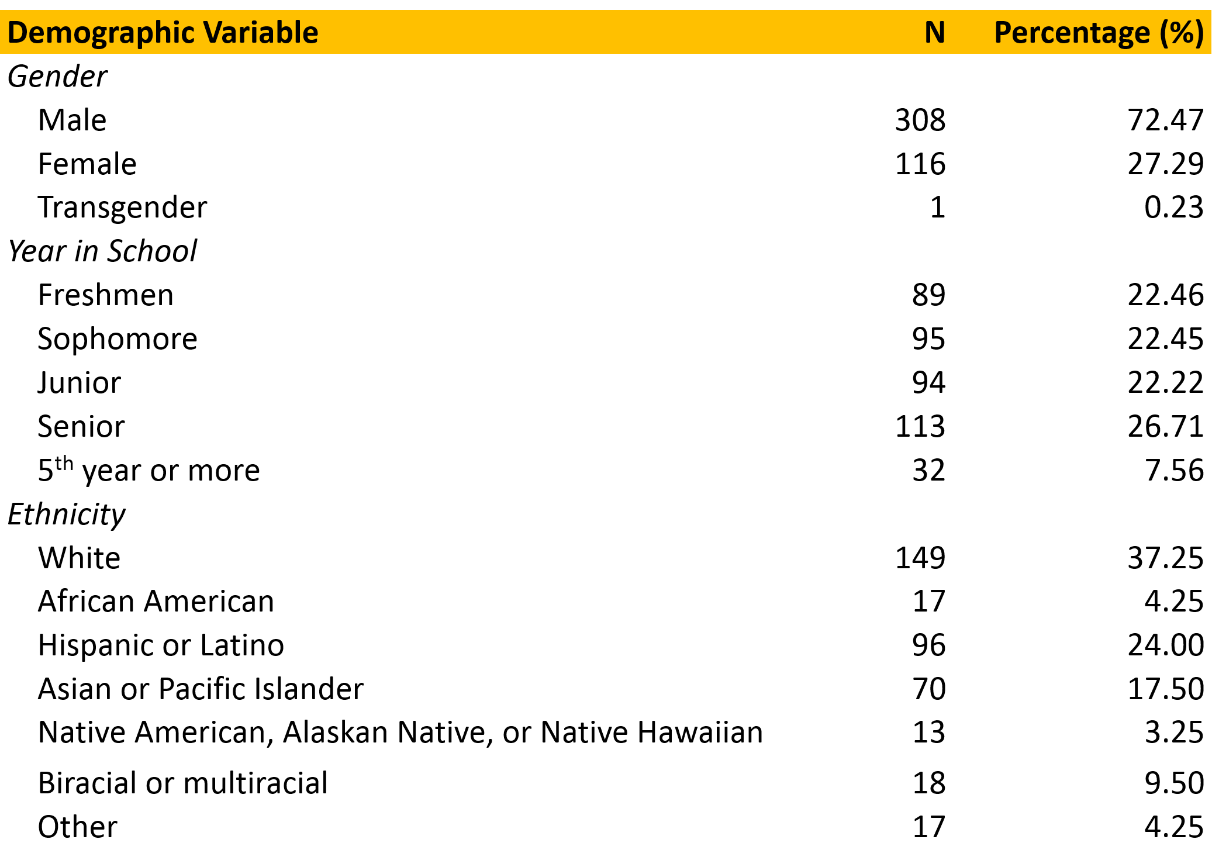
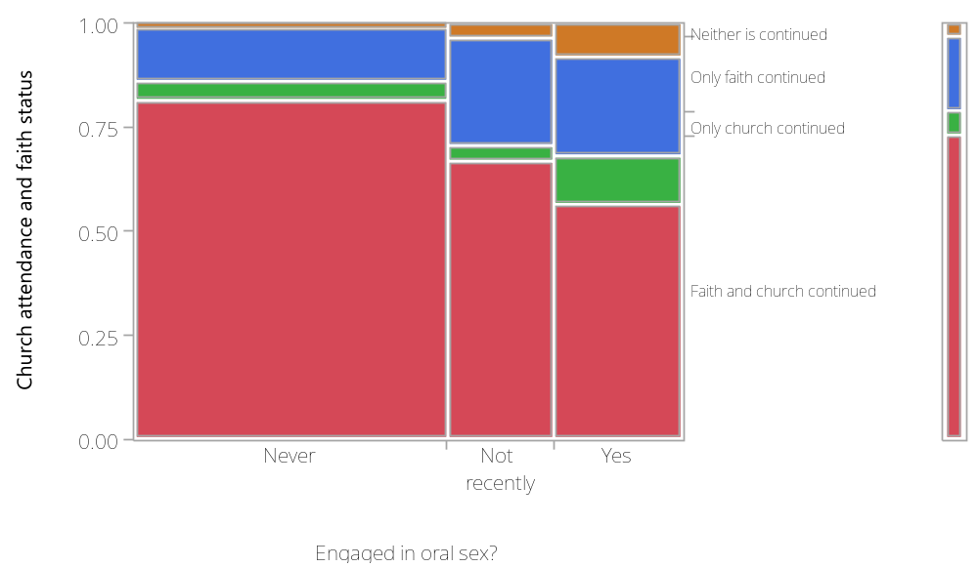
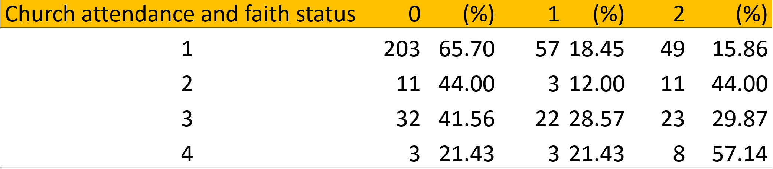
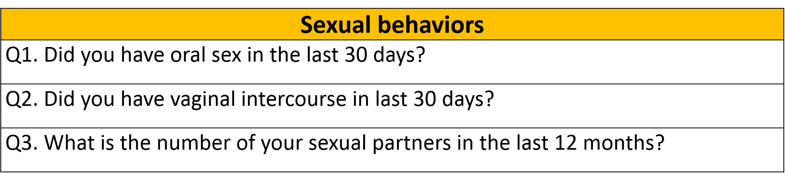
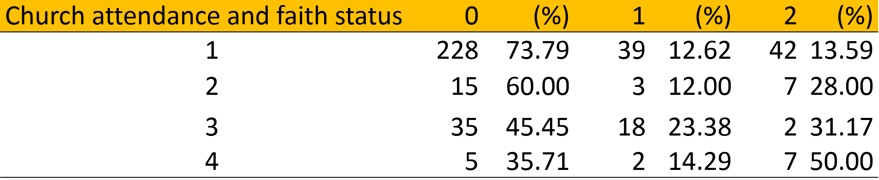
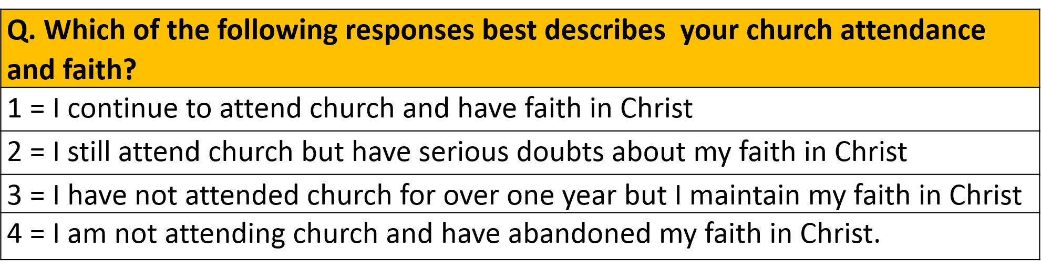
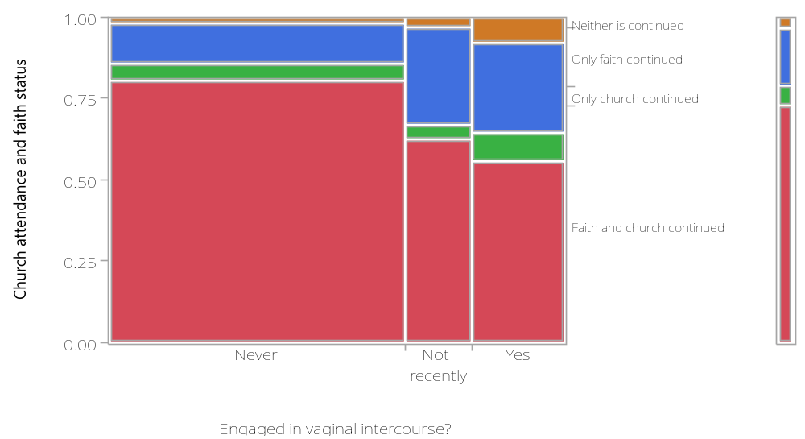
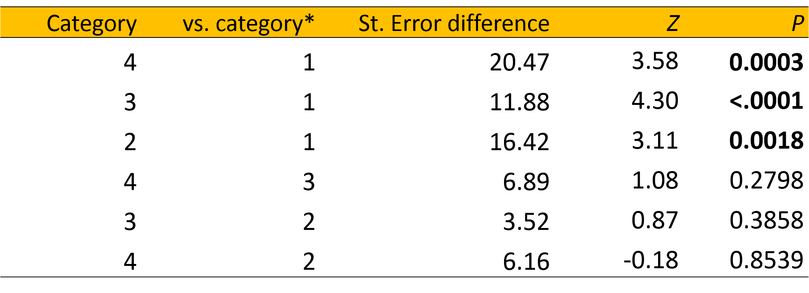
Are religious faith and church attendance protective factors against casual sex?
Chong Ho Yu and Hyun Seo Lee
Azusa Pacific University
Introduction
Discussion
The current bio-psychosocial view of human sexuality encourages openness, diversity, and freedom in sexual philosophies and activities. Also, a culture of “hook up” (i.e. to sexual encounters with strangers or brief acquaintances without expectation of a continued relationship) is prevalent across high schools and colleges in the U.S. However, it is also evident that adolescents and young adults are more likely to engage in risky sexual behaviors (e.g. sex at early age, multiple sexual partners, etc.), which increase one’s risk of contracting sexually transmitted infections and unintended pregnancies. Conventional Christian approaches have posed monogamous and abstinence-only perspectives and programs. However, such views have been considered as ineffective, restrictive, and outdated. This leads many in the public to no longer regard Christianity as a moral compass of modern days. On the other hand, a nexus of previous studies have reported a possible prophylactic effect of religiosity to risky sexual behaviors. Here, the main objective was to examine whether one’s religiosity can be a protective factor against risky sexual behaviors among college students.
.
Table 1. Demographic
Contrary to the popular belief, the result showed a significant association between Christian faith and casual sex: college students who reported high religiosity are less likely to engage in sexual activities and to have multiple sexual partners. This suggests that Christian faith and church attendance taken together may act as a protective factor against casual sex and furthermore, negative consequences of risky sexual behaviors.
Nevertheless, the numbers alone do not purport to explain the underlying mechanism. Protestant schools, strict regulation on students’ sexual activities through policies may seem functional and practical at the superficial level. However, stories may unfold in a different way under the surface. Restriction without thorough explanation or appropriate education may not only hinder students from obtaining an accurate understanding of sexuality and sexual activities, but also may evoke rebellious attitudes and behaviors. Moreover, such risky sexual activities are more likely to occur secretly and unreported.
On the other hand, it seems far-fetched to give colleges students overindulgence to freely engage in casual and/or unsafe sex. These days, secular psychologists promote “comprehensive sex education.” which attempts to offer appropriate and accurate information on a large spectrum of topics related to sexuality. Christians communities and faith based institutions should also introduce “comprehensive Christian approach to sexuality” to debunk the myth that sexual activity is lustful, sinful and shameful.
Table 2. shows the number of students engaging in oral sex partitioned by church attendance and faith status. Students who reported “Continued church and faith” were less likely to have oral sex (203, 65.70%) than others
Table 3 displays the number of students engaging in vaginal sex partitioned by church attendance and faith status. Students who reported “Continued church and faith” were less likely to have vaginal sex (228, 73.79%) than others.
Table 4 is the Wilcoxon test analysis on responses to the question “what is the number of sexual partners in last 12 months?” The overall result was significant (p < .0001) and the non-parametric multiple comparison indicated that students who continued to attend church and have faith in Christ had a significantly lower number of sexual partners than all three other groups.
Note. The average age of this sample was 20 , SD =1.87. Range was 18 – 33.
Figure 1. Mosaic table for church attendance/faith status and oral sex
Methods
Table 2. Crosstab table of church attendance/faith status and oral sex
Data Source Survey data regarding Christian beliefs/practices and sexual behaviors were collected from pool of religious and non-religious students in a Southwestern Christian university. The sample size was 426, and 12 married students and one outlier that has 40 sexual partners were excluded from the original sample size.
Note. Fisher’s Exact Test ( p < .0001)
0 = No, have never done this sexual activity; 1 = No, have done this sexual activity in the past but not in the last 30 days; 2 = Yes
Dependent Variable
Table 3. Crosstab table of church attendance/faith status and vaginal sex
Adamczyk, A. (2012). Investigating the role of religion‐supported secular programs for explaining initiation into first sex. Journal for the Scientific Study of Religion, 51(2), 324-342.
Ahrold, T. K., Farmer, M., Trapnell, P. D., & Meston, C. M. (2011). The relationship among sexual attitudes, sexual fantasy, and religiosity. Archives of sexual behavior, 40, 619-630.
Balswick, J., & Balswick, J. O. (2013). Authentic human sexuality: An integrated Christian approach. Downers Grove, IL: InterVarsity Press.
Bering, J. (2012). Why is the penis shaped like that?: And other reflections on being human. New York, NY: Farrar, Straus and Giroux.
Burdette, A. M., Ellison, C. G., Hill, T. D., & Glenn, N. D. (2009). “Hooking up” at college: Does religion make a difference?. Journal for the Scientific Study of Religion, 48, 535-551.
Coakley, S. (2013). God, sexuality, and the self. Cambridge, UK: Cambridge University Press.
Freitas, D. (2013). The end of sex: How hookup culture is leaving a generation unhappy, sexually unfulfilled, and confused about intimacy. Philadelphia, PA: Basic Books.
Hock, R. (2011). Human Sexuality (3rd ed). Boston, MA: Pearson.
Ray, D. (2012). Sex and God: How religion distorts sexuality. Bonner Springs, KS: IPC Press.
Reeves, R. (2011). Spirituality according to Paul: Imitating the Apostle of Christ. Downers Grove, IL: IVP Academic.
Ryan, C., & Jetha, C. (2012) Sex at Dawn: How we mate, why we stray, and what it means for modern relationships. New York, NY: Harper Perennial.
Simons, L. G., Burt, C. H., & Peterson, F. R. (2009). The effect of religion on risky sexual behavior among college students. Deviant Behavior, 30, 467-485.
Zuckerman, P. (2011). Faith no more: Why people reject religion. New York, NY: Oxford University Press.
Independent Variable
Figure 2. Mosaic table for church attendance/faith status and virginal sex
Note. Fisher’s Exact Test ( p < .0001)
Table 4. Non-parametric comparisons by Wilcoxon method
Data Analysis. Fisher’s exact tests were utilized to analyze the relationship between categorical dependent and independent variables. In the question the measurement scale was continuous (i.e. the number of sexual partners), the non-parametric Wilcoxon test was used to examine how Christian belief and practice influences the number of sexual partners.

