Slide 1


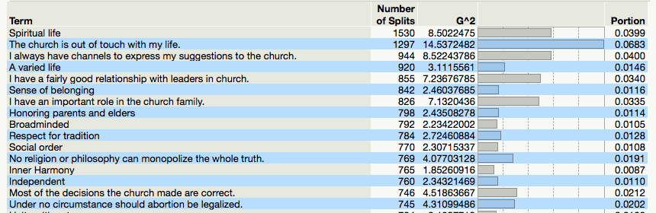
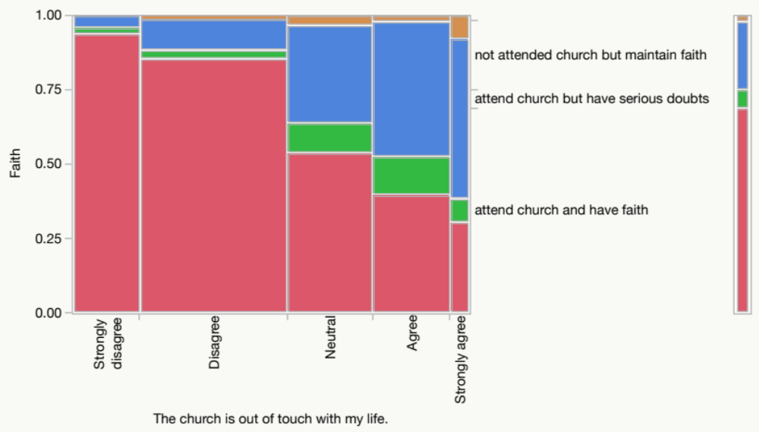
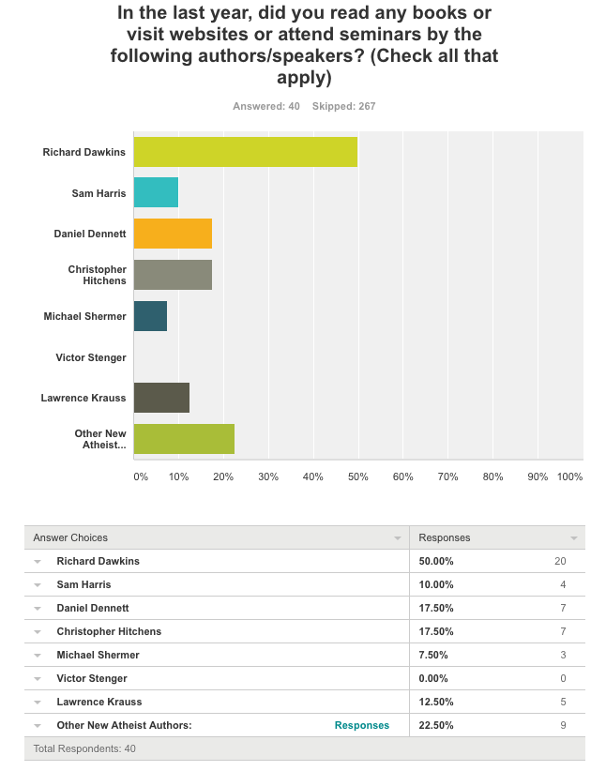
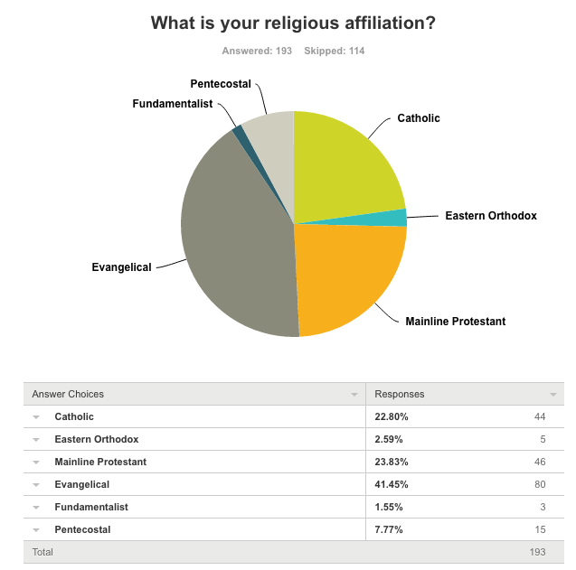
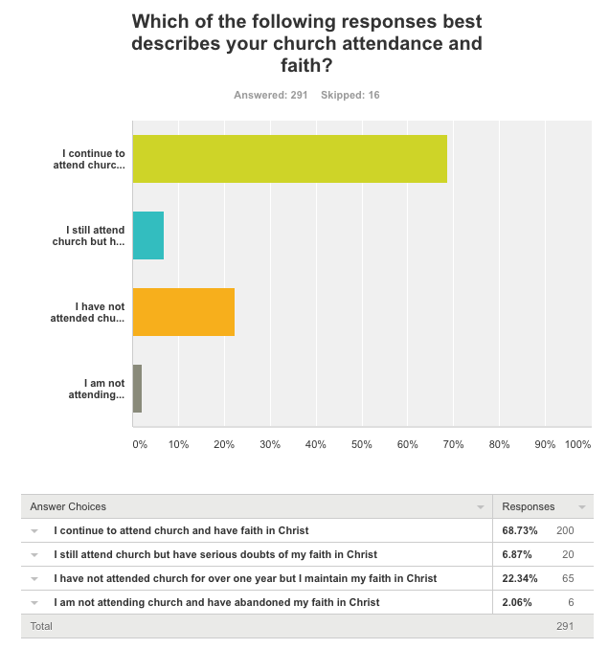
Why do college students give up Christianity? A mixed-method approach
Chong Ho Yu, Harry Hui*, Matthew Kriege, Karine Setyan, & Nathan Mather
Azusa Pacific University and University of Hong Kong*
Objective
Random forest
Open-ended survey responses
Quotations from Focus Group
With decreased attendance in churches and further lack of engagement in Christianity, this study, through a mixed-method approach, explored evidence that suggested reasons for disengagement and deconversion from Christianity among college age (early adults) students.
Deconversion: Give up the Christian faith.
Disengagement: No longer attend religious activities on a regular basis.
Random forest indicates that the most important factors contributing to strong faith, deconversion, or disengagement are both internal and external.
Internal: personality disposition and value system, such as view of spiritual life, respect for tradition, inner harmony.
External: Church experience, such as agreement on “the church is out of touch with my life.”
“Although I have not completely given up my Christian faith, I have a negative perspective of God and do not believe that he is wholly good. I do not wish to be a part of a religion that is supportive of the injustice and brutality of humankind.”
“I feel that attending APU has made me not like the Christian community. I think that this school is filled with self-righteous trust fund babies. This makes them close minded and not open to other walks of life . . . . I'm not bitter :)”
“I took psychedelic mushrooms and, in the expanded state of consciousness, realized that just because I believed something didn't make it true, that my beliefs were only taught (without evidence) at a young and impressionable age at which I also believed in the monster in the closet and Santa Claus. I was in a state of consciousness that did not cling to ideas or identify with them. With that, I wouldn't say I gave up my faith so much as realized that I was blindly following something and was making myself emotionally unwilling to consider alternative views.”
“I personally knows people who broke off from church because of its radical position towards homosexuals.”
“I have very conservative Christian rearing. Christianity shoved down my throat. It crippled belief of Christianity.”
“I stopped going to church. I have divorced parents. The only reason I believed was because of parents. But when individualized, I left the church although I am still spiritual.”
“My pastor is never directly saying what he really thinks, he is very traditional. I thinks life evolves constantly. Everyone can marry whom they want. Divorce is all over the place among Christians. Who is to say what is sacred. Fix your own self before fixing others!”
“Gay marriage is a big problem in my church. It makes people break relationships both with God and each other. Pastors are against people constantly trying to use Scripture to show it is not biblical, which makes my friends cold hearted to church because of this opposition.”
“A lot of people using the bible for what they probably shouldn’t, they hold fast to things that they have been raised with .”
“We are being taught the biblical genesis, but also we shouldn’t break relationships over this. You don’t have to force that on other people be open to other ways that are also very biblical. “
“In America we believe in religious freedom. Politically the church is called to be different than other place, however, now church focuses on everything and picking wrong battles. Church would have been more affective by loving than protesting or shooting and being mean to them. Church would be more effective to be loving and caring. Changing churches’ approach would make a change, they should get a relationship with people first then try to change them. “
Literature review
With the awareness of a plethora of factors affecting the deconversion and disengagement of college students. In our analysis we looked for the most significant factors affecting the deconversion of the individual as well as the potential to change the factors leading to deconversion and disengagement. Various results largely came from parental influence (Vaidyanathan, 2011), a long reliance on parents and guardians into adulthood (Hoge, Johnson, & Luidens, 1993), and experiential trauma. Other associations had been made using personality assessments conducive to religion. Cultural and political influences were also found to have a significant effect. (Hood, Hill, & Spilka, 2009) According to these studies, there is no single factor that contributes to deconversion or disengagement but a multitude of reasons. Some significant factors are poor religious experience within the church and contrary viewpoints such as creationism. There is also a trend with current college generations becoming more secular but although they are no longer religiously affiliated many still retain their spirituality. The recognition of differences between spirituality and religiosity is important and deconversion may have other implications other than just the loss of one’s faith but may play an important part in deciding one’s religious affiliation later in life.
For example, those who strongly agree that “the church is out of touch with my life” tend to have serious doubts of faith. Those who strongly disagree tend to maintain the faith.
New Atheism
Demographics
Religion
Methods
A survey was used to collect responses from 307 college students regarding their positions on religious faith. A random forest, which is a resampling method, was utilized to identify the most crucial psychological and cultural factors contributing to disengagement and deconversion. Unlike regression analysis, the random forest approach is capable of handling numerous collinear predictors without overfitting. At the same time, open-ended responses in the survey were analyzed and focus groups were facilitated in order to understand reasons for unchurching among young early adults.
Hoge, D. R., Johnson, B., & Luidens, D. A. (1993). Determinants of church involvement of young adults who grew up in Presbyterian churches. Journal for the Scientific Study of Religion.
Hood, R.W., Hill, P.C., Spilka, B., (2009). The psychology of religion: an empirical approach (4th ed.). New York, NY: Guilford Press.
Vaidyanathan, B. (2011). Religious resources or differential returns? Early religious socialization and declining attendance in emerging adulthood. Journal for the Scientific Study of Religion, 50, 366-387.

