Slide 1
Model comparison and model merging: Which is better?
Chong Ho Yu (cyu@apu.edu) and Lydia Gaid
Presented at South California AI and Data Science Conference, Los Angeles, LA
October 26, 2019

Slide 2
Ensemble methods
Unlike traditional statistic procedures which ate “one-shot,” data science methods create multiple models by resampling from the same data set e.g. random forest (bagging), gradient boosted tree (boosting)…etc.
At the end an ensemble model for each method is obtained.
When the best from each is put together, we have the ensemble of ensemble.
We can pick the best (the winner takes all) or merge the results (everyone has a voice).

Slide 3
Comparing bagging and boosting
 | Bagging | Boosting
Sequent | Two-step | Sequential
Partitioning data into subsets | Random | Give misclassified cases a heavier weight
Sampling method | Random sampling with replacement | Systematic sampling
Relations between models | Parallel ensemble: Each model is independent | Previous models inform subsequent models
Goal to achieve | Minimize variance | Minimize bias, improve predictive power
Method to combine models | Weighted average or majority vote | Majority vote
Requirement of computing resources | Highly computing intensive | Less computing intensive

Slide 4
Ensemble of ensemble
There are different ways for Ensemble to merge results:
  Average: As the name implies, average the prediction estimates from all models.
  Maximum: Pick the highest estimates of all models.
  Voting: Return the proportion of the models that determine the outcome (e.g. how often the predictor is selected)

Slide 5
Data source for illustration
2015 Program for International Student Assessment (PISA)
By Organization for Economic and Cooperation Development
Subject matters: Reading, math, and science
Sample: 15-year old students from 80 countries/regions. Each country has at least 5,000 students.
Questions: What factors can predict math performance? 500+ potential factors

Slide 6
Implementation
Software:
  JMP PRO
  SAS Enterprise Guide
  SAS Enterprise Miner

Slide 7
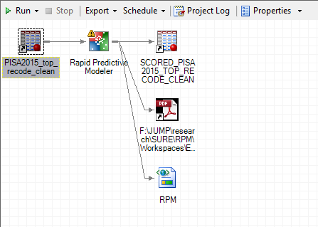
SAS Enterprise Guide: Rapid Predictive Modeling
RPM is fully automatic. The procedures are chosen by the program, not the analyst.

Slide 8
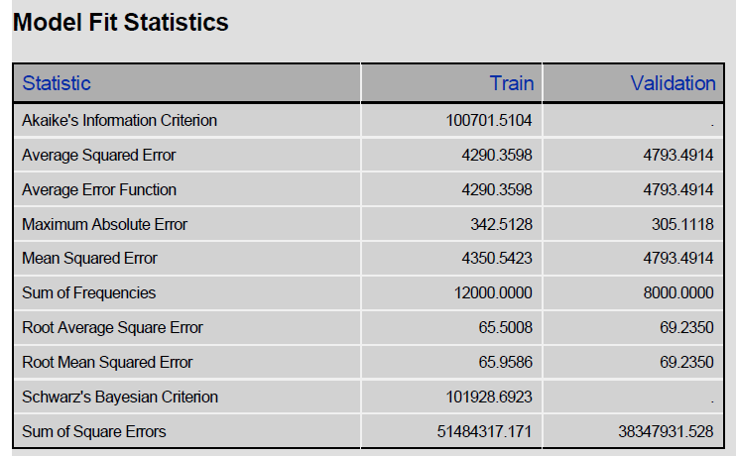
SAS Enterprise Guide:
Rapid Predictive Modeling
SAS EG output multiple fit statistics
Notes:
https://towardsdatascience.com/how-to-select-the-right-evaluation-metric-for-machine-learning-models-part-1-regrression-metrics-3606e25beae0

Slide 9
Fitness indicators
Error = noise variance
The mean square error (MSE): the sum of squared errors (SSE) divided by the degrees of freedom for error (DFE)
DFE is the number of cases - the number of weights in the model. This yields an unbiased estimate of the noise.
Berry, J. (2016). Mean squared error vs average squared error. SAS Data Mining and Machine Learning.

Slide 10
Fitness indicators
MSE is not useful for neural networks and decision trees because they don’t have unbiased estimator.
Usually DFE is negative in neural networks. Approximations for the effective degrees of freedom are often resource-intensive.
Solution: Use average squared error (ASE), which is to divide the SSE by the number of N instead of DFE.
Berry, J. (2016). Mean squared error vs average squared error. SAS Data Mining and Machine Learning.

Slide 11
Fitness indicators
The RMSE is the square root of MSE.
The absolute fit between the model and the data, or between the observed data points and the model’s predicted values.
The standard deviation of the unexplained variance
Lower is better.

Slide 12
Fitness indicators
Akaike's information criterion (AIC) and Bayesian Information Criterion (BIC) are relative fitness indices, not absolute.
Must be done with model comparison
In alignment with Ockham’s razor: Given all things being equal, the simplest model tends to be the best one.
Increasing the number of free parameters to be estimated improves the model fitness, however, the model might be unnecessarily complex.
To reach a balance between fitness and parsimony, AIC and BIC not only rewards goodness of fit, but also includes a penalty.

Slide 13
Fitness indicators
BIC is similar to AIC, but its penalty is heavier than that of AIC.
Some authors believe that AIC is superior to BIC
AIC is based on the principle of information gain.
The Bayesian approach requires a prior input but usually it is debatable.
AIC is asymptotically optimal in model selection in terms of the least squared mean error, but BIC is not (Burnham & Anderson, 2004; Yang, 2005).

Slide 14
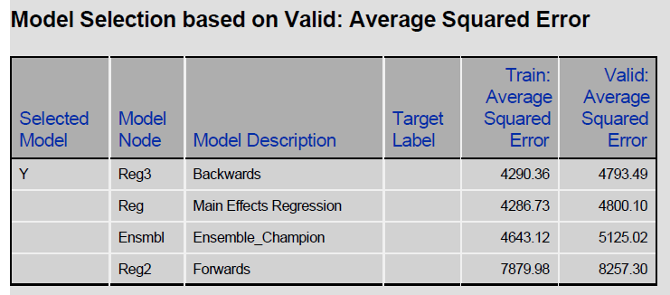
SAS Enterprise Guide: Rapid Predictive Modeling
SAS EG made the decision to select Average squared error

Slide 15
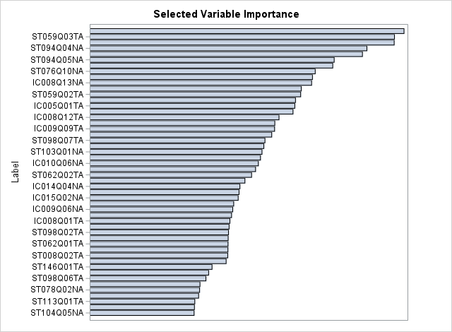
SAS Enterprise Guide: Rapid Predictive Modeling

Slide 16
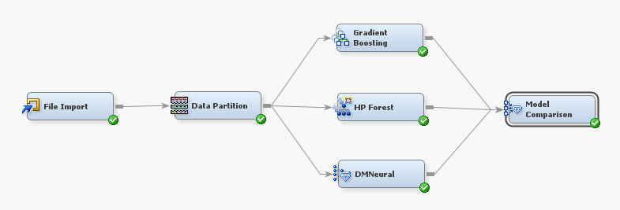
SAS Enterprise Miner
Flow chart of procedures
In SAS EM the analyst can choose particular procedures.

Slide 17
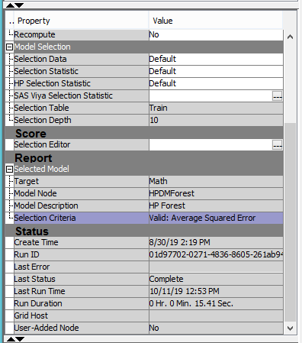
SAS Enterprise Miner
By default SAS EM chose “Average squared error” as the criterion for model comparison.

Slide 18
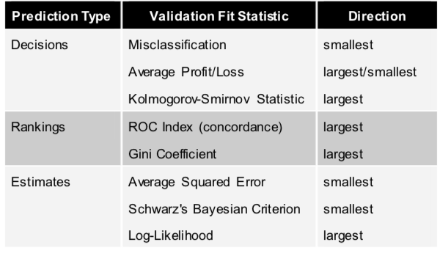
SAS recommendation

Slide 19
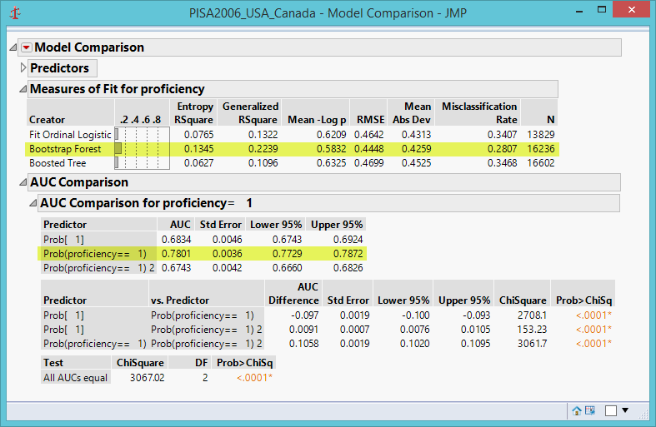
JMP: Model comparison
Like SAS Enterprise Guide and Miner, JMP provides many fitness indices.
You can choose the criterion and then pick the best model.

Slide 20
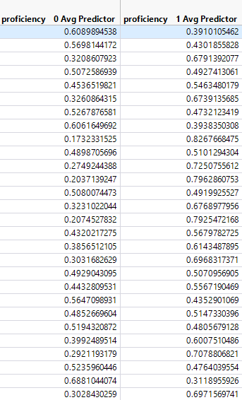
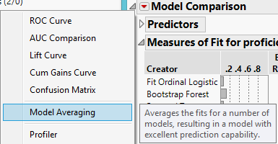
JMP: Model averaging
You can also do model averaging

Slide 21
Model comparison and model averaging
There is no single best.
But if model averaging is used, then input from weaker models might affect the quality of the final model.
And it is more computing-intensive.
Picking the best is easier and cleaner.

Slide 22
How to pick the best?
If predictive accuracy is the ultimate concern and the target variable is categorical, the misclassification rate or ROC curve should be used.
If the target variable is interval, the average squared error should be used. This is the default in SAS.
If you don’t like absolute fitness criterion and want to avoid complexity, then relative criterion such as AIC and BIC should be used.
Between AIC and BIC, AIC is better.

Slide 23
Pros and cons of software implementation
SAS Enterprise Guide will make all the decisions for you. Use it if you have a pressing deadline.
SAS Enterprise Miner let you make decisions and it has high performance (HP) and data mining (DM) procedures.
JMP Pro also let you make decisions. It has fewer DM options but has a nicer interface.

Slide 24



PISA result: Hong Kong
Term | Number of Splits | SS | Portion
DURECEC: Duration in early childhood education and care | 28 | 613279.625 | 0.8353
PA029Q01NA: How many hours per week did your child attend a <pre-primary education arrangement> at the age of three years? | 25 | 72528.4495 | 0.0988
PA027Q01NA: At what ages did your child attend a pre-primary education arrangement prior to grade 1? | 22 | 48423.9351 | 0.0660

Slide 25
PISA: Japan
Term | Number of Splits | SS | Portion
IC011Q08TA: Frequency of use at school: Doing homework on a school computer. | 50 | 457635.7 | 0.5602
IC011Q09TA: Frequency of use at school: Using school computers for group work and communication with other students. | 3 | 312989.988 | 0.3832
IC011Q04TA: Frequency of use at school: Download\upload\browse schools web (e.g. <intranet>). | 47 | 30075.1038 | 0.0368
IC011Q05TA: Frequency of use at school: Posting my work on the schools website. | 50 | 16174.5408 | 0.0198

Slide 26
PISA: Singapore
Term | Number of Splits | SS | Portion
ST059Q03TA: Number of class periods required per week in science | 7 | 16843748.4 | 0.2946
ST013Q01TA: How many books are there in your home? | 3 | 7076026.02 | 0.1238
ST064Q01NA: I can choose the school science course(s) I study. | 3 | 6372589.13 | 0.1115
ST121Q01NA: Motivation: Gives up easily when confronted with a problem and is often not prepared | 3 | 5634120.15 | 0.0986
IC008Q12TA: Use digital devices outside school for uploading your own created contents for sharing | 3 | 4031342.53 | 0.0705

Slide 27
PISA: Netherlands
Term | Number of Splits |  | SS | Portion
IC010Q04TA: Frequency of use outside of school: Using email for communication with teacher\submit of homework or other schoolwork | 20 | 2126243.9 |  | 0.5644
IC010Q12NA: Frequency of use outside of school: Downloading science learning apps on a mobile device. | 7 | 967202.536 |  | 0.2568
IC003Q01TA: How old were you when you first used a computer? | 12 | 560273.987 |  | 0.1487
IC010Q03TA: Frequency of use outside of school: Using email for communication with other students about schoolwork. | 20 | 72339.4588 |  | 0.0192
REPEAT: Grade Repetition | 1 | 41030.7346 |  | 0.0109

Slide 28
PISA: Swiss
Term | Number of Splits | SS | Portion
IC010Q12NA: Frequency of use outside of school: Downloading science learning apps on a mobile device. | 5 | 1099821 | 0.2768
IC011Q06TA: Frequency of use at school: Playing simulations at school. | 43 | 932805.131 | 0.2348
DURECEC: : Duration in early childhood education and care | 50 | 624127.764 | 0.1571
IC011Q08TA: Frequency of use at school: Doing homework on a school computer. | 40 | 610619.915 | 0.1537
IC011Q05TA: Frequency of use at school: Posting my work on the schools website. | 3 | 393114.004 | 0.0989
IC010Q04TA: Frequency of use outside of school: Using email for communication with teacher\submit of homework or other schoolwork | 3 | 287251.341 | 0.0723

Slide 29
PISA: USA
Term | Number of Splits | SS | Portion
ST013Q01TA: How many books are there in your home? | 8 | 14729503.3 | 0.2853
REPEAT: : Grade Repetition | 10 | 9837783.37 | 0.1905
ST121Q01NA: Motivation: Gives up easily when confronted with a problem and is often not prepared | 6 | 6209281.09 | 0.1203
ST076Q10NA: Before going to school did you: Work for pay | 4 | 4579845.12 | 0.0887
SCIEEFF: Science self-efficacy (WLE) | 4 | 3121990.26 | 0.0605

