Slide 1



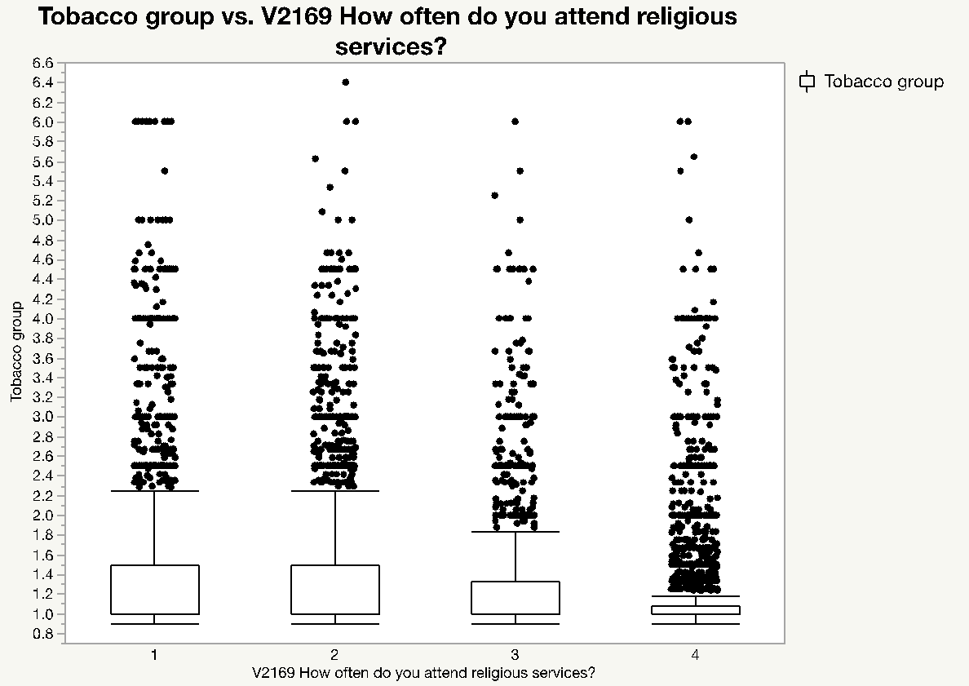
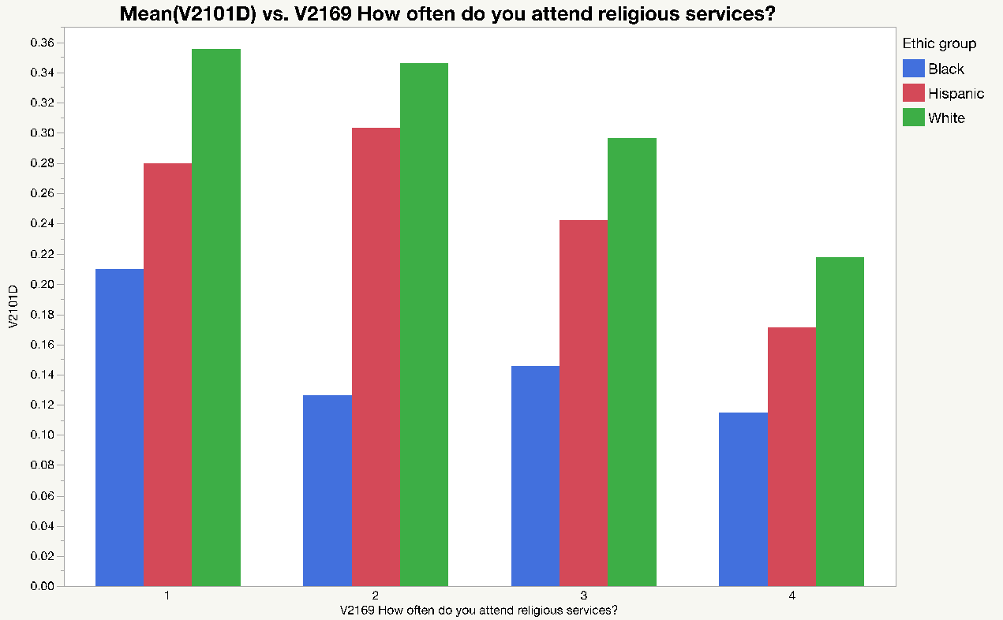
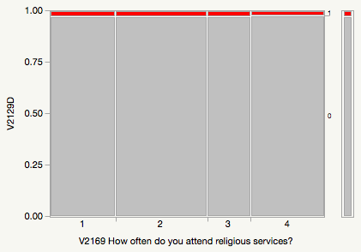
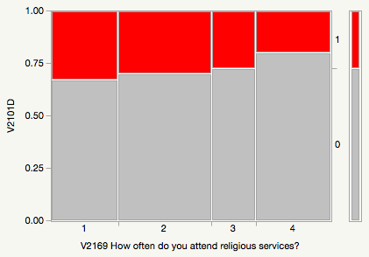
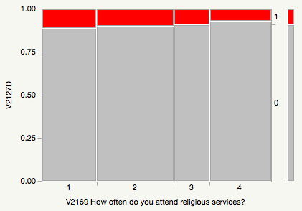
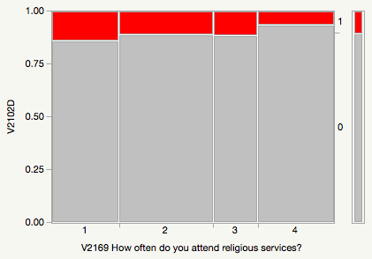
RE-EXAMINE HOW RELIGIOUS ACTIVITIES AND PERCEIVED IMPORTANCE OF RELIGION INFLUENCE SUBSTANCE USE AMONG GRADE-12 STUDENTS
Chong Ho Yu, Nicole Reyes, Claudia Valenzuela, Jolia Awadallah, & Valeria Flores
Azusa Pacific University
Introduction
Substance abuse among youths has been a chronic social problem in America for many decades. According to the National Institute on Drug Abuse, by the time high school students become seniors, about 70 percent of them have tried alcohol, half of them take an illegal drug, 40 percent have tried smoking, and more than 20 percent use a prescription drug for recreational purposes. In addition, opioid is lubricous business. Recently Federal prosecutors charged 60 physicians and pharmacists across five states with illegally giving opioid prescriptions.
Prior research indicates that religious faith is a protective factor against substance use, but most of these studies were conducted with small samples and a narrow focus (only one or two particular substances), and therefore their generalizability is questionable.
The research question of this project is: What is the relationship between religious faith, as measured by attendance of religious services and perceived importance of religion, and various substance abuses?
The portion is represented by the colored rectangle. A clear pattern: More religious activities, less tobacco use (bigger ”0” rectangle; gray & smaller “1” rectangle; red). We focused on the questions that asked if in lifetime have consumed substance. And, if in the last 30 days has the substance been consumed.
Figure 1. Box plots
There are multiple measures of the same behavior (e.g. tobacco) and these Likert-scaled measures are combined into a composite score. Clear data patterns emerge when data are reduced to a binary scale (Y/N).
Figure 5. Coplot by ethnic group
This relationship is not consistent across different ethnic groups. For whites it is a linear relationship (the probability of tobacco use goes down as religious activities increase). For Hispanics it is an inverted U-shaped relationship. For blacks it is a wave-shaped relationship.
Methods
Data Source
Monitoring the Future: A Continuing Study of American Youth (12th-Grade Survey), 2017.
Compiled by Institute for Social Research, Survey Research Center.
N = 9,000+, sample sizes vary from question to question.
Figure 4. Amphetamines on your own--that is without the doctor telling you during the last 30 days?
Discussion
Figure 4 shows that there is no short-term effect (30 days), but in the life-time religious activities have impact on drug use (Figure 5).
Religious faith, in terms of attendance of religious service and perceived importance of religion, has a protective effect against some substance abuse, but not all.
Some data show no short-term protective effect, but there is a long term effect.
The data showing no effect do not imply that religion is not a protective factor. It is inconclusive due to insufficient data.
There is no gender effect but the protective effects are not consistent across different ethnic groups.
Dependent Variable
Usage of tobacco, alcohol, marijuana, hallucinogens, cocaine, amphetamines, sedatives, tranquilizers, heroin, inhalants, and steroids.
The original measure is a Likert-scale; however, the details make it hard to see the data pattern.
As a remedy the data of the DV are reduced to a dichotomous scale (ever used = 1, never used = 0).
Figure 2. Have you ever smoked cigarettes?
Independent Variable
1: How often do you attend religious services? 1="Never" 2="Rarely" 3="Once or twice a month" 4="About once a week or more”
2: How important is religion in your life? 1="Not important" 2="A little important" 3="Pretty important" 4="Very important”
Limitations
The variable used in this study are attendance of religious services and perceived importance of religion, but ICPSR didn’t specify what religion. Further, there is no question about participants’ religion.
Data Analysis. Chi-square test is subject to sample size. As a remedy data visualization is used.
Mosaic plot
Conditional plot (Coplot)
Figure 5. Amphetamines on your own--that is, without a doctor telling you to take them in your lifetime?
Figure 3. How frequently have you smoked cigarettes during the past 30 days?

