Slide 1
Improving science and math education: Lessons from Asia
Chong Ho Yu (2019, October)
Plenary Lecture at International Conference on Social Science & Humanities,
Prague, Czech Republic

Slide 2
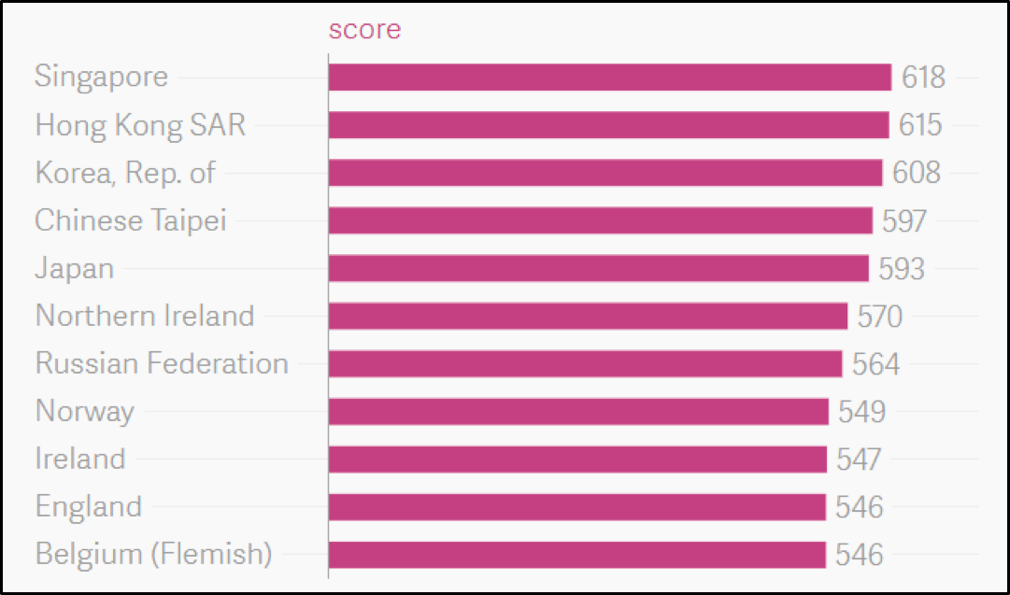
Top Performers of Grade 4 Math in 2015 TIMSS
Notes:
(TIMSS stands for Trends in International Mathematics and Science Study)

Slide 3
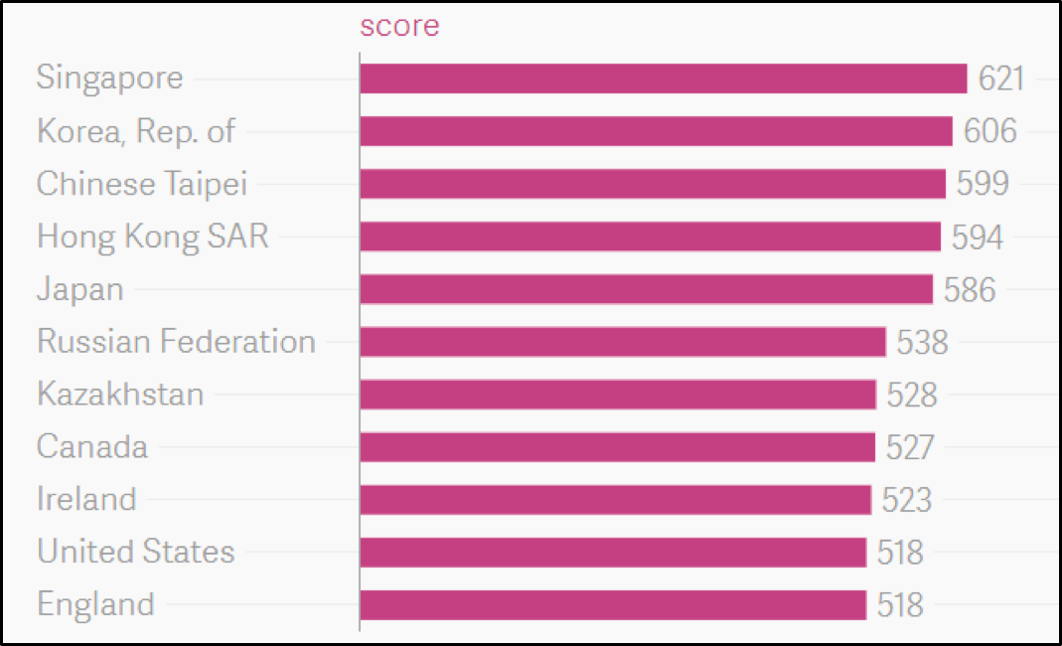
Top Performers of Grade 8 Math in 2015 TIMSS
Notes:
(TIMSS stands for Trends in International Mathematics and Science Study)

Slide 4
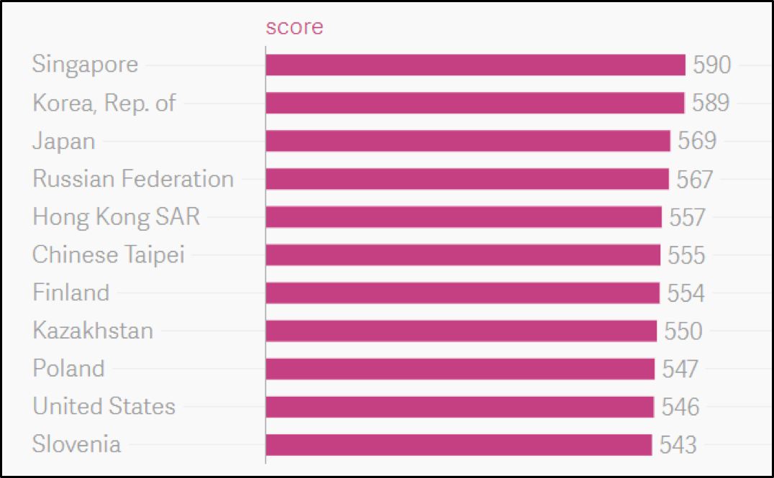
Top Performers of Grade 4 Sci in 2015 TIMSS
Notes:
(TIMSS stands for Trends in International Mathematics and Science Study)

Slide 5
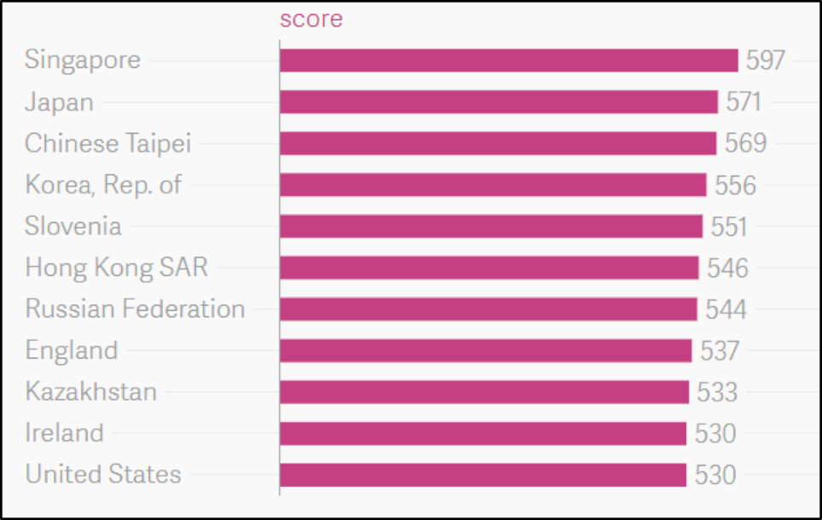
Top Performers of Grade 8 Sci in 2015 TIMSS

Slide 6
Counter-argument
Bracey (2009): ‘‘Using test scores to compare education systems is a mistake…using average scores to compare countries is a worse mistake’’ (p. 450).
Salzman and Lowell (2008) argued that average test scores are mostly irrelevant as a measure of economic potential. Rather, high-performing students are more crucial for producing leading-edge technology.
Notes:
Emphasize “Average Test Scores” vs high performance

Slide 7
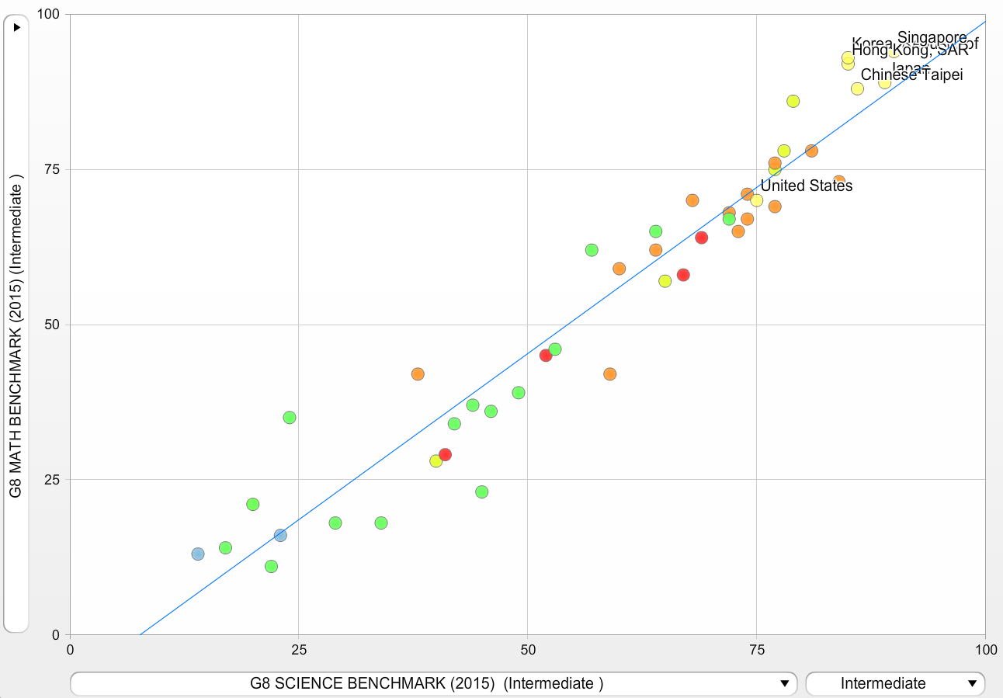
TIMSS 2015: Science and Math Benchmark
If we skip the average and look at better students, we can see a wide performance gap between US and East Asia among intermediate performers.

Slide 8
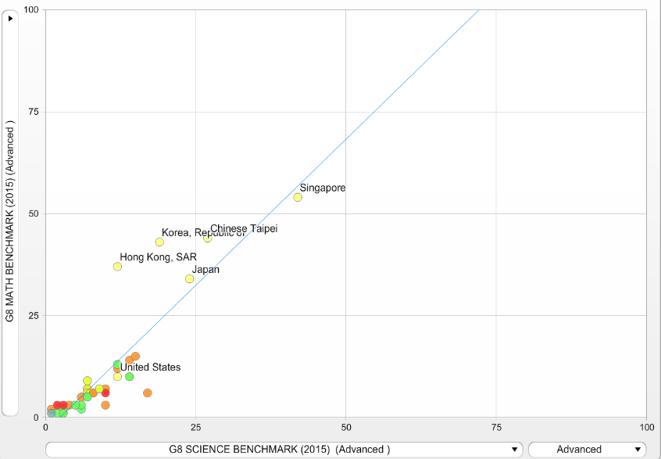
TIMSS 2015: Science and Math Benchmark
If we look at the best, we can see an even wider performance gap between US and East Asia among intermediate performers.

Slide 9
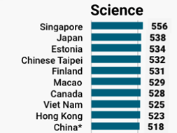
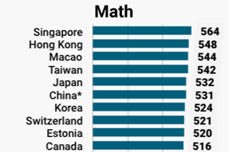
US Performance in PISA
The US performance ranking is low in many PISA tests. In
2015 the U.S. ranked 38th out of 71 countries in math and 24th in science.
The top performers of
PISA are Asian countries and regions (see figure above)
Notes:
The Programme for International Student Assessment (PISA) is a triennial international survey which aims to evaluate education systems worldwide by testing the skills and knowledge of 15-year-old students.
These are two graphs ranking based on math and science profiency and skils, as you can see that the US is on this graph of top performance due to ranking

Slide 10
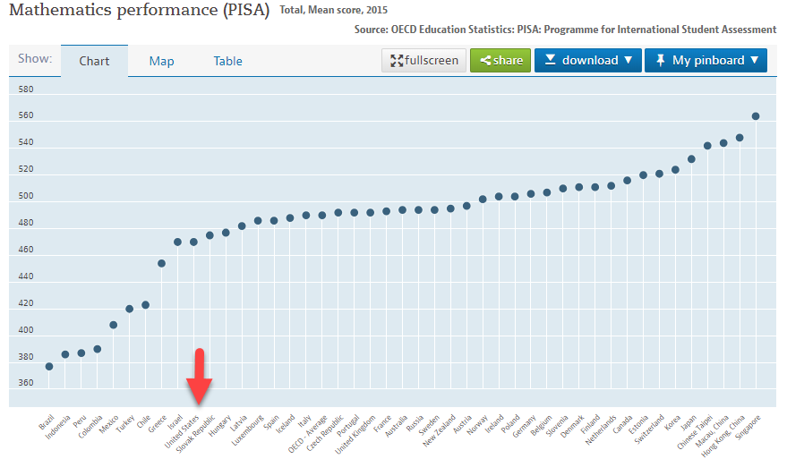
https://data.oecd.org/pisa/mathematics-performance-pisa.htm#indicator-chart

Slide 11
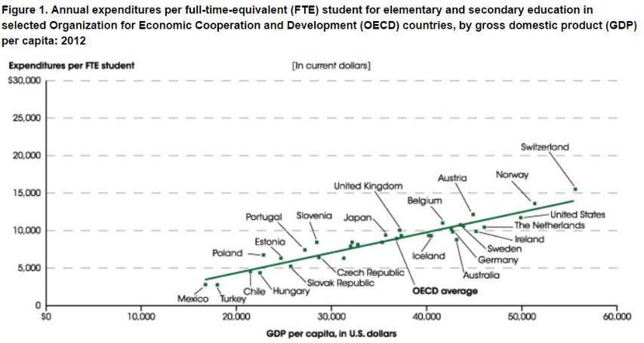
Spending in Education

Slide 12
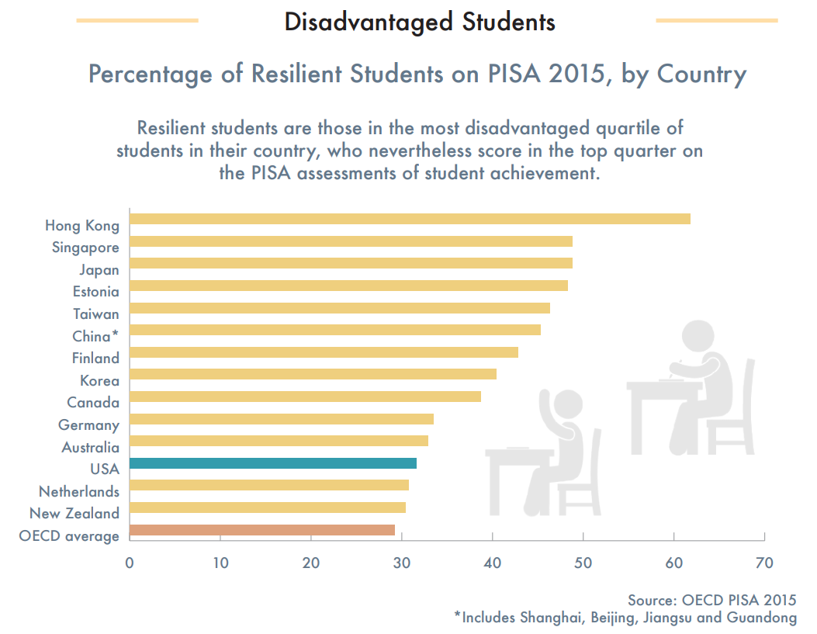

Slide 13
2015 PISA Results based on Random PVs
 | Math PV |  | Science PV |  | Self-efficacy |  | Self-belief |  | Ambition
Country/Region | Mean | SD | Mean | SD | Mean | SD | Mean | SD | Mean | SD
China | 541.74 | 100.84 | 528.34 | 98.56 | 0.06 | 1.17 | 0.19 | 0.87 | 2.98 | 0.73
Hong Kong | 550.55 | 88.48 | 525.60 | 79.58 | -0.07 | 1.22 | 0.21 | 0.95 | 2.80 | 0.80
Japan | 533.30 | 88.18 | 539.03 | 93.28 | -0.46 | 1.22 | -0.51 | 1.02 | 2.64 | 0.82
Macau | 543.98 | 79.03 | 528.59 | 81.84 | -0.03 | 1.12 | -0.50 | 0.81 | 2.63 | 0.81
S Korea | 523.91 | 99.97 | 514.75 | 95.00 | -0.02 | 1.23 | 0.34 | 0.98 | 2.84 | 0.75
Singapore | 557.08 | 95.75 | 545.95 | 104.60 | 0.07 | 1.14 | 0.42 | 0.94 | 3.00 | 0.79
Taiwan | 539.20 | 103.79 | 530.85 | 99.85 | 0.19 | 1.19 | -0.01 | 0.89 | 2.92 | 0.76
USA | 474.35 | 87.92 | 502.60 | 98.04 | 0.29 | 1.29 | 0.65 | 0.95 | 3.25 | 0.72
Notes:
plausible values the measurement used here
US scored pretty low in their math and science compared to the international countries however the US made up for by ranking high in self-efficacy, self-belief, and ambition

Slide 14
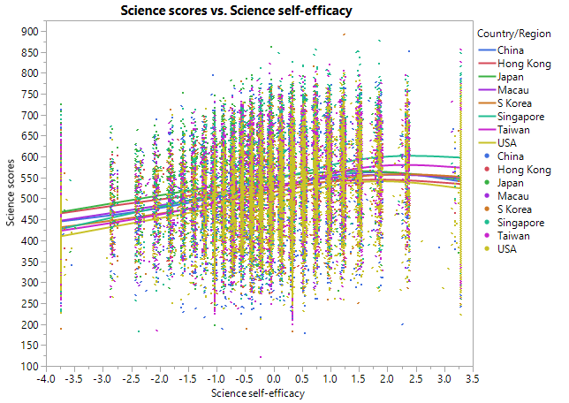
Too much self-efficacy can hurt performance
Bandura: “If people experience only easy successes they come to expect quick results and are easily discouraged by setbacks and failures. Resilient self-efficacy requires experience in overcoming obstacles through persevere effort. Resilience is also built by learning how to manage failure so that it is informative rather than demoralizing”

Slide 15
PIAAC
Evaluate adults: Aged 16-25
Three categories and 5 levels:
  Numeracy
  Technological proficiency
  Literacy
Thirty-six million American adults have low skills.
2016 PIAAC data indicated that American adults are far behind their international peers. In all three test categories US ranks among the bottom in numeracy and technological proficiency
Notes:
Program for international Assessment of Adult Competencies- test given to evaluate adults
OECD: organization for economic cooperation Development

Slide 16
PIAAC
•Numeracy:
–8% US adults achieve at Level 4/5,
–OECD average: 13%
–Japan and Finland: 19%
–A third of adults in the U.S. scored below Level 2
•Problem solving in technology
–About one-third (31%) of US adults score at least at Level 2
–OECD average: 34%
Notes:
The growth of these countries such as Korea, Taiwan, Singapore, and Hong Kong were around two percent higher annually than was predicted based against evidence on if they had only average test scores. Countries on the lower end of the achievement distribution like South Africa, Argentina, the Philippines, and Peru showed that their poor growth was almost 2 percent less per year than would be predicted if their overall scores would have been closer to the world average.
PISA and PIAC are organized by OECD

Slide 17


US Performance in PIAAC
Many older Americans successfully reached Level 2 and 3 in problem-solving skill level, placing the US as the second to the highest performer for this skill.
Yet, the problem-solving skill of young Americans was among the bottom
Younger Singaporeans (aged 16-24)
outperformed the older generation (aged 55-64) in literacy, but the trend is opposite in the US.
In the US, the younger generation fell behind, meaning that older Americans had better literacy skill than young adults.
Notes:
Find picture

Slide 18
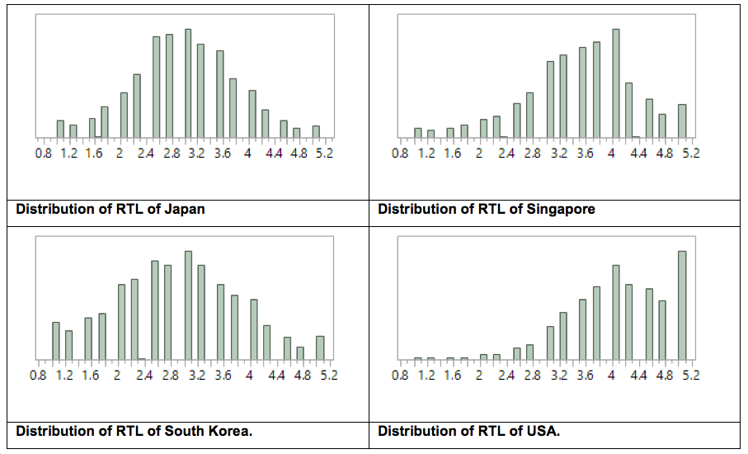
PIAAC Survey: Ready to Learn scores

Slide 19
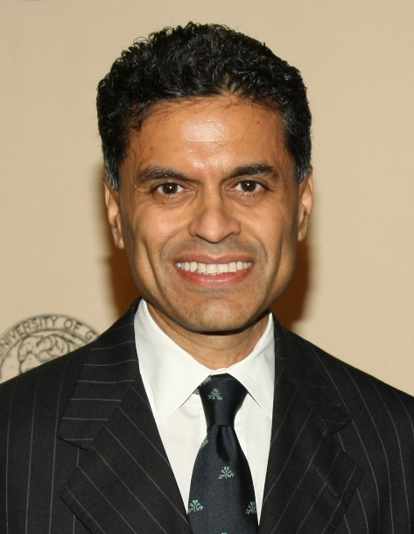
PIAAC
CNN Commentator Zakaria responded to PIAAC:
–develop skills and knowledge at young ages
–peak in proficiency at 30 decline afterwards.
If people start out with poor foundation, those disadvantages will persist throughout their lives.

Slide 20


Counter-argument: USSR is gone!
Ravitch said, “The Soviet Union launched its Sputnik satellite in 1957. We did not respond by raising our test scores on international assessments… something is wrong with those international assessments, if our allegedly terrible public schools continue to produce the greatest workers, thinkers, leaders, and innovators that created the greatest economy in the world. The Soviet Union is gone, but we are still here!”

Slide 21
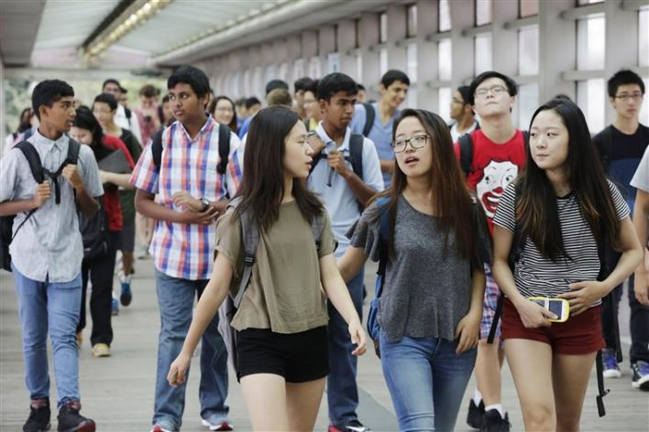
Foreign-originated talents in US
Asians accounted for 73 percent of students at Stuyvesant, 64 percent at Bronx Science and 61 percent at Brooklyn Tech, which are top high schools at New York.

Slide 22
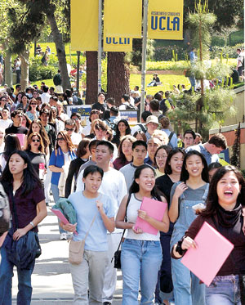
Foreign-originated talents in US
2017 data
 | Asian freshmen
UC Berkeley | 43%
UCLA | 40%
UC San Diego | 44%
UC Irvine | 46%

Slide 23
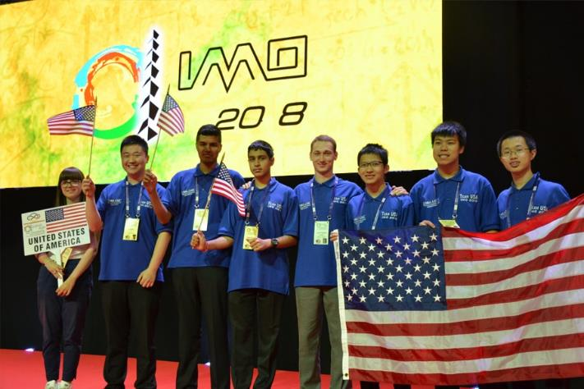
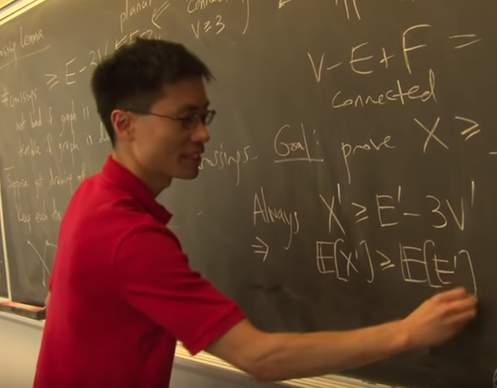
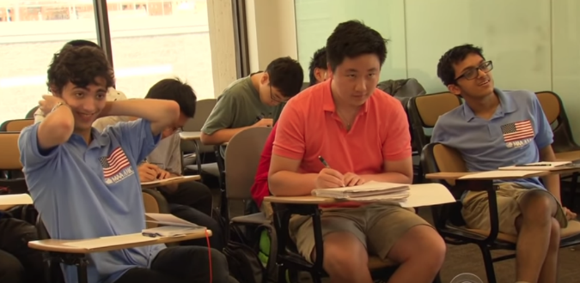
U.S. Team won in International Mathematical Olympiad

Slide 24
2011 Foreign Student Enrollment in US Grad School
Field | Percent of International Students | # of Full-time International Graduate Students | # of Full-time U.S. Graduate Students
Electrical Engineering | 71.4 | 21,933 | 8,802
Computer Science | 64.5 | 19,605 | 10,802
Industrial Engineering | 60.6 | 4,998 | 3,253
Economics | 55.3 | 7,823 | 6,335
Materials Engineering | 53.8 | 3,163 | 2,714
Chemical Engineering | 52.8 | 4,036 | 3,603
Mechanical Engineering | 50.7 | 8,150 | 7,934
Mathematics & Statistics | 45.6 | 8,354 | 9,949
Civil Engineering | 45.6 | 6,554 | 7,809
Physics | 43.6 | 5,844 | 7,569
Other Engineering | 42.3 | 7,682 | 10,499
Chemistry | 40.2 | 8,200 | 12,203

Slide 25

Many scientists and engineers in the US are foreign-born

Slide 26
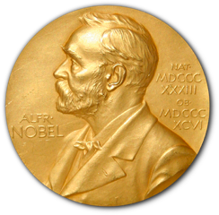
Nobel Prize Winners
Between 1950 and 2005, 27 of the 87 American Nobel Prize winners were born outside the US (Vilcek & Cronstein, 2006).
Counting from 1990, about half of the US Nobel laureates in the scientific and technical disciplines were foreign-born.

Slide 27
Let’s Dive in with the Solutions!

Slide 28

If the UK Can, Why Can’t We?
In England, UK schools invite teachers from Shanghai , adopting their teaching methods. Chinese textbooks were translated to English textbooks.
We should invite foreign teachers to teach in U.S. high schools and grade schools.
We should send our own teachers overseas to receive training in education.

Slide 29

Learn from the Best: Singapore
Periodic revisions of math/science curriculum to ensure focused learning along with a relevant economy (nationally & internationally)
Emphasis on teachers' key role: Teachers in Singapore are entitled 100 hours of funded training and core-upgrading courses each year
Notes:
Education in Singapore is always evolving: policy influenced by research evidence.
Singapore view their people as a resource--they invest in their education and prepare their students for future demands.
Teachers take courses to be up to date with their curriculum
Usage of IT tools for teaching and learning are encouraged to keep up with the latest trends and development.

Slide 30
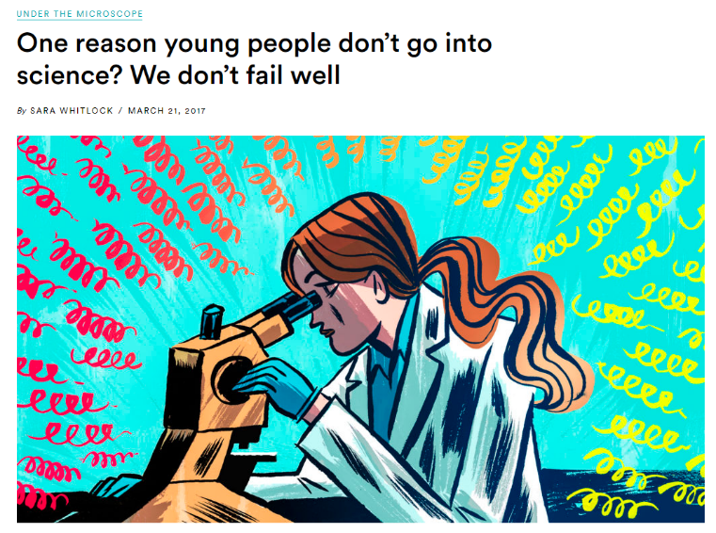
Productive failure
“Learning resilience is fundamental to a successful career as a scientist.”
Our system does not train young people how to fail “well.”

Slide 31
Productive failure
Hong Kong educators has been systematically exposing students to manageable challenge and raising their self-awareness of misconception.
The instructor asks the learners to solve an ill-defined problem with ill-structured or missing information while withholding guideline and feedback.
The instructor sets them up to “fail.”

Slide 32
Summary and Conclusion
Multiple reliable and valid assessments show that the US is behind in math and science education. Top performers of international assessments are Asians.
Many scientist, engineers, and programmers in the US are foreign-born or foreign-originated.
England had started learning from Shanghai.
We can learn from Asia, too e.g.
                Stay current (Singapore)
          Emphasize teacher quality (Singapore)
          Productive failure (Hong Kong)

