Slide 1

Are Christians anti-science?
2017 Southern California Christians in Science Day Conference
An investigation of the relationship between attitudes towards Scripture and science
Chong Ho Yu, Ph.D., D. Phil.; William Whitney, Ph.D.; Emily Brown; Siyan Gan; Hyun Seo Lee

Slide 2
Introduction
Bill Nye and Lawrence Krauss question whether religious education is at odds with science education.
Religiosity might lead to an anti-science mentality.
They argued that the US needs more scientists and engineers, but religiosity is a stumbling block to science education.
This study evaluates this relationship based on archival data from the National Opinion Research Center (NORC).

Slide 3
Methods

Slide 4
Data source and variables
2014 National Opinion Research Center (NORC).
Outcome variables:
  Overall interest in science, science courses taken, and scientific knowledge.
  The last one is a composite variable resulting from averaging the scores of the following ten questions:
  1. The center of earth is very hot
  2. All radioactivity is man-made
  3. Father gene decides sex of baby
  4. Lasers work by focusing sound waves
  5. Electrons are smaller than atoms
  6. Antibiotics kill viruses as well as bacteria
  7. The universe began with a huge explosion
  8. The continents have been moving
  9. The earth goes around the sun
  10. How long does it take the earth to go around the sun?
  11-12 Probability questions

Slide 5
Data Analysis
The bootstrap forest analysis
  Conventional stat procedures are not suitable for this large sample (n=2538); might inflate Type I error,
  The result from one single analysis may be overfitted.
  Repeat the decision tree analysis by resampling and then find the best predictors by “vote counting”.
Partial least squares (PLS)
  To extract several latent factors and responses from several dependent and independent variables

Slide 6
Data Analysis
Another PLS targeted the remaining predictors.
  The inter-relationships among these variables were examined in the loading plot in order to determine which variable belongs to which principal component.
A principal component regression
  Determine whether the reduced set of religious variables could well-predict the criterion.

Slide 7
Results

Slide 8
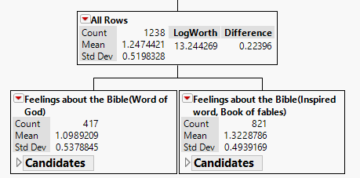
Overall interest in science
The bootstrap forest shows that the most important predictor is “feelings about the Bible”.
Bible as the Word of God in a literal sense (mean = 1.1)
Bible as inspired word or fables (mean = 1.32)

Slide 9
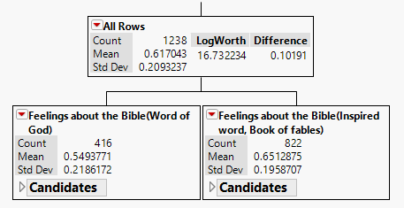
Scientific knowledge
The bootstrap forest shows that “feelings about the Bible” stands out as the most important predictor.
Bible as the Word of God (mean = 0.55)
10% lower than those who view the Bible as fables or inspired word (mean = 0.65)

Slide 10
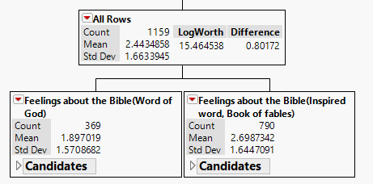
Taken science courses
The bootstrap forest shows that “feelings about the Bible” is again, the number one predictor.
Bible is the Word of God (mean = 1.897)
Fables or inspired word (mean = 2.699)

Slide 11
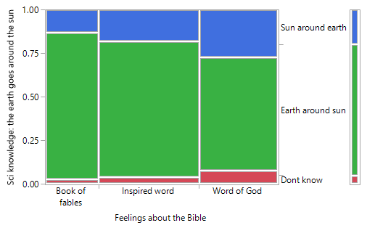
Mosaic Plots
A large percentage of participants who believe the Bible is the Word of God in a literal sense also believes that the sun goes around the earth.

Slide 12
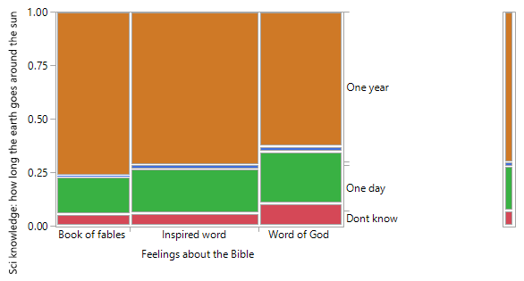
Mosaic Plots
People who believe that the Bible as the Word of God in a literal sense is LESS likely to answer the question “How long does it take for the earth to go around the sun” correctly (1 year).

Slide 13
Partial Least Squares
Takes into account all three dependent measures simultaneously to identifies the most powerful predictors
The PLS model ran with the six variables that have a high Very Important Predictor (VIP) score.
Variable | VIP
Feeling about the Bible | 1.9181
Consider myself a spiritual person | 1.1706
Confidence in the existence of God | 1.1315
Beliefs | 0.8740
Strength of religious affiliation | 0.8242
Belief in life after-death | 0.8012
Confidence in organized Religion | 0.6833
Consider myself a religious person | 0.6661
Tried to convince others to accept Jesus | 0.6197
Ever had a 'born again' experience | 0.5389

Slide 14
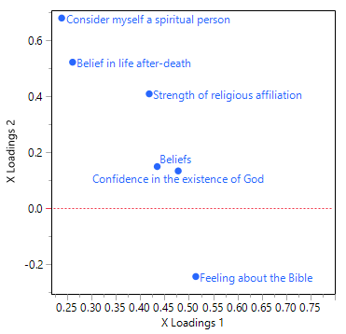
Partial Least Squares
Loading plot of independent variables.
Shows clustering pattern of dependent variable (Xs)
Feeling about the Bible stands out.

Slide 15
Regression Analysis
Showed that the religious component is a significant predictor of science knowledge and courses
  Negative association (b= -0.13, p = .0062)
The same inverse relationship between overall interest in science/technology and religious component
  (b = -0.10, p = .0002).

Slide 16
Discussion

Slide 17
Literal Interpretations of Scripture
Participants who viewed the Bible as the Word of God in a literal sense:
  Earned lower test scores in objective science tests
  Less interested in taking science courses than those who did not hold this view.
Reflects the relationship between more literal interpretations of Scripture and one’s level of interest science, rather than a conflict between Christianity and science

Slide 18

Christians must develop positive ways to engage science and promote working within scientific fields of inquiry
Those who read Scripture more literally show the least amount of interest in science
There is still less interest in science among those who hold a non-literal approach to Scripture compared to those who do not believe in
the inspiration of Scripture at
all.

Slide 19

Further steps
Faith-learning integration should be the area of focus in Christian universities and churches
Stress the contributions of Christians to science
Provide Christians more nuanced explanations on how one might read and understand Scripture

Slide 20
Contact info
Emily Brown: erbrown13@apu.edu
Hyun Seo Lee: hyunseolee12@apu.edu
Siyan Gan: siyan.gan@pepperdine.edu
Chong Ho Yu: cyu@apu.edu
William Whitney: wwhitney@apu.edu

