Slide 1
An analysis of the relationship between Christian faith and mental wellbeing utilizing item response theory
Chong Ho Yu

Slide 2

Problem
More and more American university students suffer from mental distress or disorder.
The current study aimed to verify these previous findings with a novel contribution, namely, the use of item response theory

Slide 3

Lit review
Center for Collegiate Mental Health (CCMH) indicates that distress levels for depression, generalized anxiety, and social anxiety have been increasing since 2012.
In 2018 73% of participants (n=264,681) had depression scores above the cutoff, compared with 70% in 2010 (n=87,884).

Slide 4
Lit review
The National Survey on Drug Use and Health (NSDUH; n=611,880) indicates that from 2005 to 2017, rates of major depressive episode substantively increased (from 8.7% to 13.2%) among adolescents aged 12 to 17.
Among young adults aged 18 to 25, severe psychological distress and suicide-related outcomes, such as suicidal ideation, plans, attempts, and deaths, also increased by 71% between 2008 and 2017.

Slide 5
Lit review
Entwistle, Eck, and White (2019) found that the top five mental issues reported by college students are anxiety, stress, interpersonal concerns, family relationships, and depression.
15 to 43% of participants had prior therapeutic experience, 10-11% are currently on medications, and 33% have used the Counseling Center previously.
7-10% of counseling sessions involved crisis situations, and student hospitalizations substantively increased.

Slide 6
The relationship between religion and mental health
 | Agnostic | Atheist | Buddhist | Catholic | Christian | Hindu | Jewish | Muslim | No preference | Self-identified
Depression | 80% | 79% | 78% | 68% | 70% | 78% | 64% | 78% | 76% | 78%
Generalized anxiety | 78% | 75% | 74% | 69% | 69% | 72% | 69% | 72% | 74% | 76%
Social anxiety | 68% | 68% | 61% | 53% | 54% | 57% | 49% | 55% | 61% | 61%
Academic anxiety | 73% | 72% | 71% | 63% | 65% | 71% | 56% | 77% | 70% | 70%
Family stress | 66% | 65% | 68% | 49% | 56% | 52% | 47% | 65% | 64% | 70%
Thought of ending life | 46% | 47% | 45% | 31% | 33% | 38% | 28% | 36% | 41% | 45%
Suicide attempt | 12% | 12% | 16% | 6% | 8% | 8% | 6% | 8% | 11% | 16%

Slide 7
Data source
A survey administered by the health center in a Christian university in the American Southwest.
496 undergraduate students participated in the survey.
315 are females (72.4%), 119 are males (27.35%), and 1 is transgender (0.002%).
The mean age of the sample is 20.23, and the standard deviation is 2.25.

Slide 8
Independent variable: Faith status
I continue to attend church and have faith in Christ
I have not attended church for over one year but I maintain my faith in Christ
I still attend church but have serious doubts of my faith in Christ
I am not attending church and have abandoned my faith in Christ.

Slide 9
Dependent variable: Mental wellbeing
This variable is the IRT’s severity score derived from 45 questions in a standard survey administered by a university health center (see the list below). Three items were removed later due to psychometric issues e.g.
Ever-Felt things were hopeless
Ever-Felt overwhelmed by all you had to do
Ever-Felt exhausted (not from physical activity)
Ever-Felt very lonely
Ever-Felt very sad

Slide 10
Data analysis
The measures of mental health are reduced by item response theory instead of factor analysis, which is tied to the paradigm of classical test theory.
in a traditional composite score all items are treated equally, but some mental issues are significantly more severe than others. For example, no doubt suicide ideation and attempts are worse than loneliness and sadness. In other words, even if two persons have the same composite scores, their mental health conditions could be vastly different.
IRT estimates the person attribute and the item attribute simultaneously

Slide 11
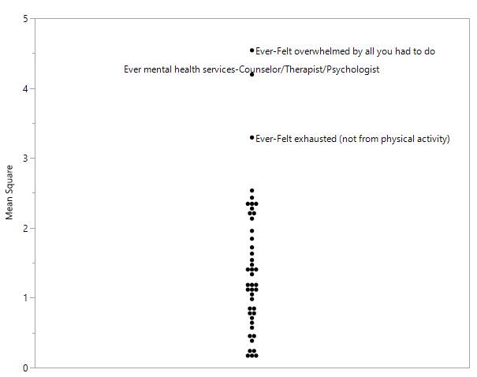
Dot plot of item attributes
According to Linacre (2017), if the mean square (a measure of misfit) is larger than 2, then the item might distort the entire measurement system.
Alternate way: the dot plot indicates that only three items significantly deviate from the majority, and thus they were removed from the subsequent analysis.

Slide 12
Severity of mental issues (part of it)
Item | Severity
Last 12 months diagnosed/treated-Schizophrenia | 6.7672
Last 12 months diagnosed/treated-Phobia | 6.0666
Last 12 months diagnosed/treated-Bipolar Disorder | 5.6537
Ever-Attempted suicide | 5.3589
Last 12 months diagnosed/treated-Bulimia | 5.1284
Last 12 months diagnosed/treated-Substance abuse or addiction (alcohol or other drugs) | 5.1284
Last 12 months diagnosed/treated-Other addiction (e.g., gambling, internet, sexual) | 5.1284
Last 12 months diagnosed/treated-Other sleep disorder | 4.9390
Last 12 months diagnosed/treated-Anorexia | 4.5125
Last 12 months diagnosed/treated-Obsessive Compulsive Disorder (OCD) | 4.4004
Last 12 months diagnosed/treated-Other mental health condition | 4.2982

Slide 13
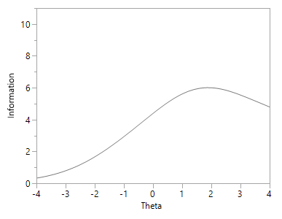
Test information function
The IRT algorithm estimated the item information function (IIF) of each mental condition.
The test information function (TIF), was constructed by summing all IIFs.
This TIF reveals that in this study more precise information can be obtained for students whose theta score (a measure of mental condition) is 2.

Slide 14
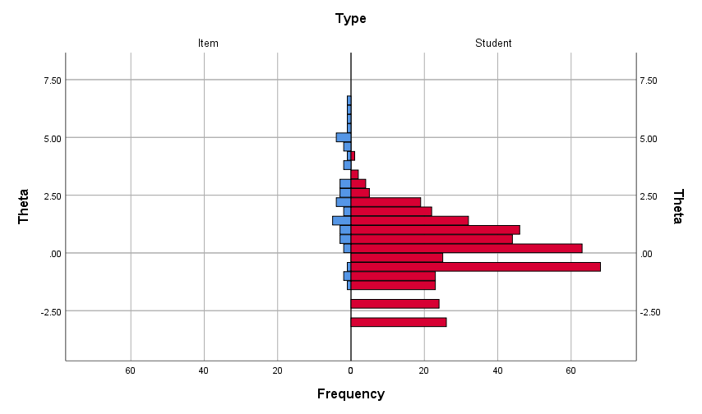
Dual plot
Many severe mental diseases were beyond most students.
Only a few students suffered from severe mental conditions, such as suicide attempts.
The majority centered on zero (average), and some students earned a negative score, meaning that they were relatively healthy.

Slide 15
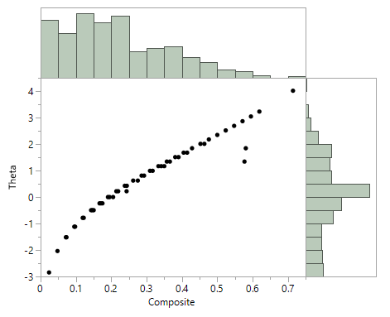
Comparison of theta score and composite score
In traditional composite scores, for some students the severity of mental conditions was either over-estimated or under-estimated.
The distribution of the composite scores conveys a false sense of security because it seems that most students are concentrated toward the lower end. However, this contradicts the national data showing an alarming trend.

Slide 16
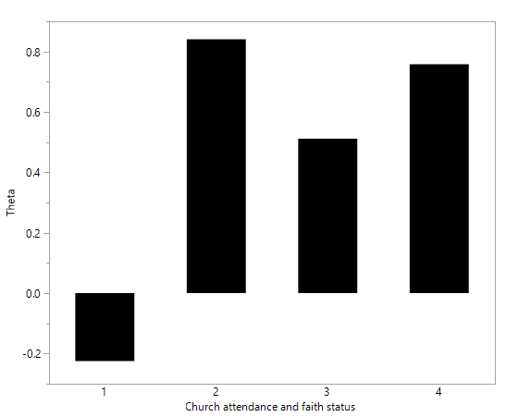
Faith as a protective factor (Overall)
1 = I continue to attend church and have faith in Christ
2 = I still attend church but have serious doubts of my faith in Christ
3 = I have not attended church for over one year but I maintain my faith in Christ
4 = I am not attending church and have abandoned my faith in Christ

Slide 17
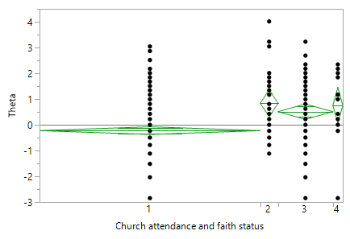
Diamond plot
95% confidence interval: population mean might be as high as the upper bound of the diamond or as low as the lower bound.
Participants who continue to attend church and keep their faith outperformed all other groups.

