Slide 1
Professional path

Slide 2

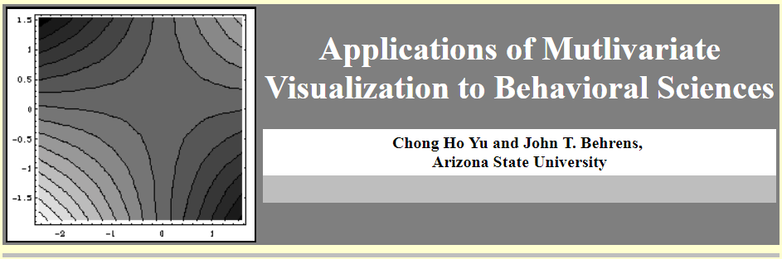
Collaborate with faculty

Slide 3
Graduate study
Master:
  Thesis option: Your paper will be archived in international databases.
  Non-thesis option: Capstone project, your paper will not be archived.
Doctoral:
  Psy. D: Practical, less emphasis on research, for non-research position
  Ph.D.: More emphasis on research

Slide 4
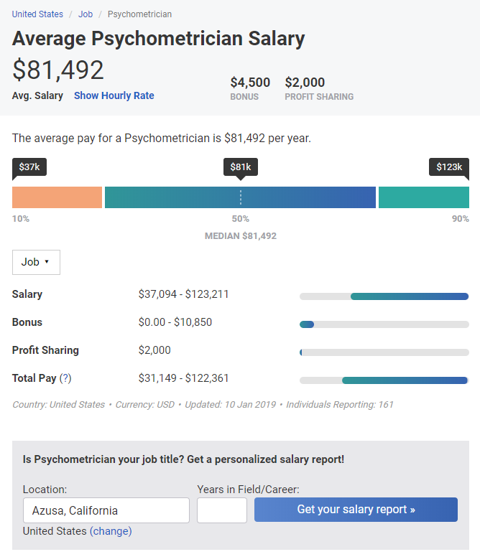

Slide 5
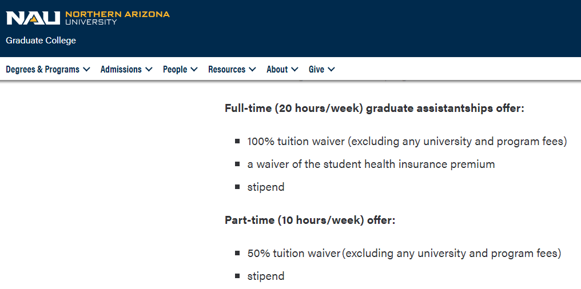
You don’t pay, the school pays you

Slide 6
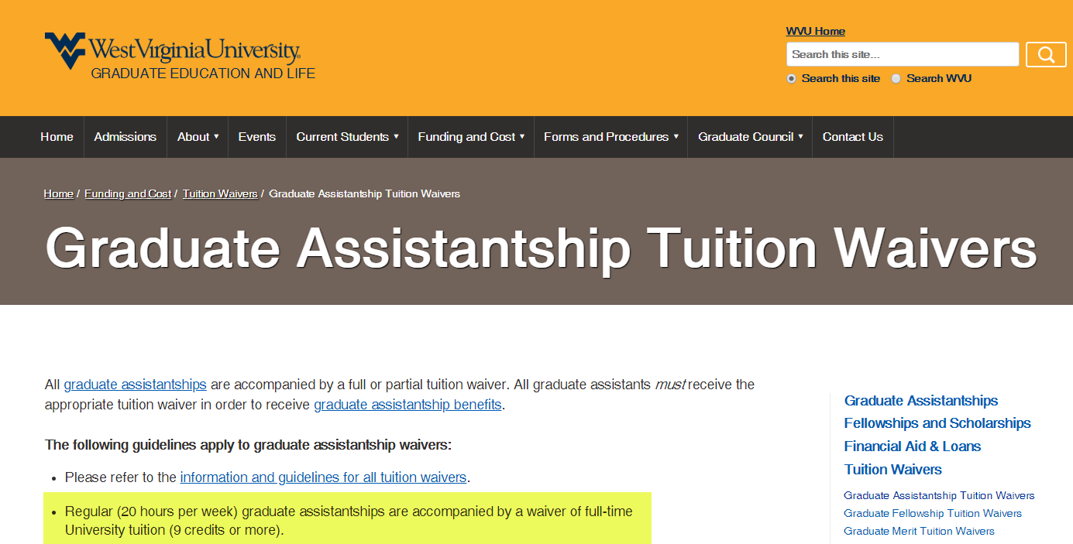
You don’t pay, the school pays you

Slide 7
Graduate assistantship
Teaching assistant (TA): Assist the faculty in teaching e.g. grading, lecturing, preparation (Making PowerPoint slides)
Research assistant (RA): Assist the faculty in research e.g. data collection, literature review, co-present in conferences and co-author in professional journals
Graduate assistant (GA): Could be TA, RA, or admin position

Slide 8
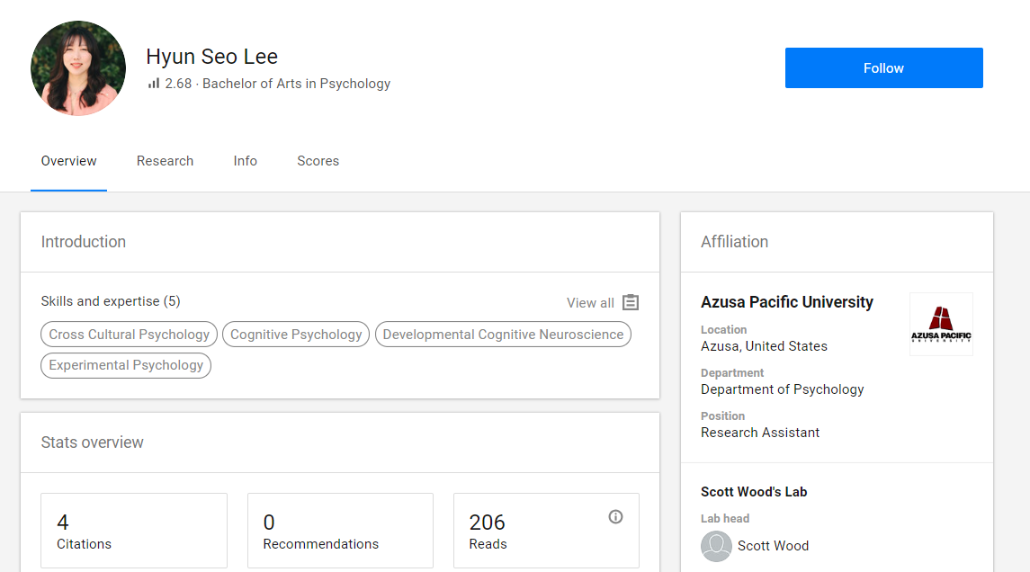
You need a shiny resume
https://www.researchgate.net/profile/Hyun_Seo_Lee

Slide 9
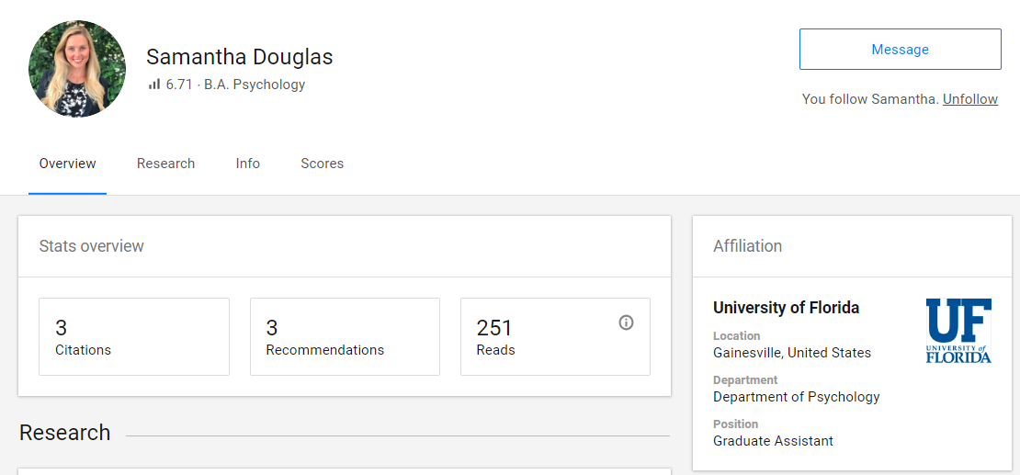
You need a shiny resume
https://www.researchgate.net/profile/Samantha_Douglas

Slide 10
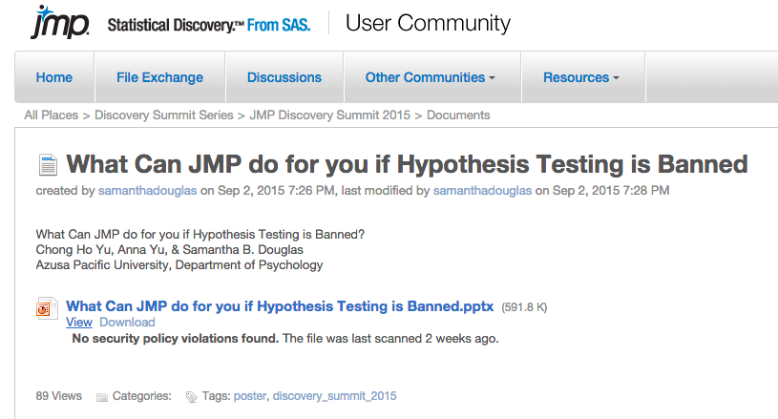

Slide 11
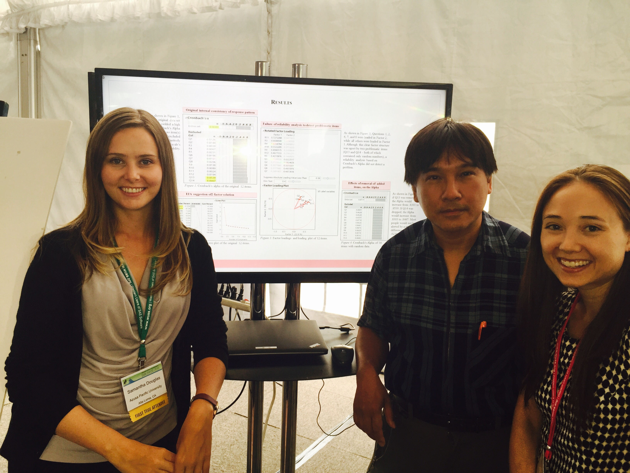

Slide 12
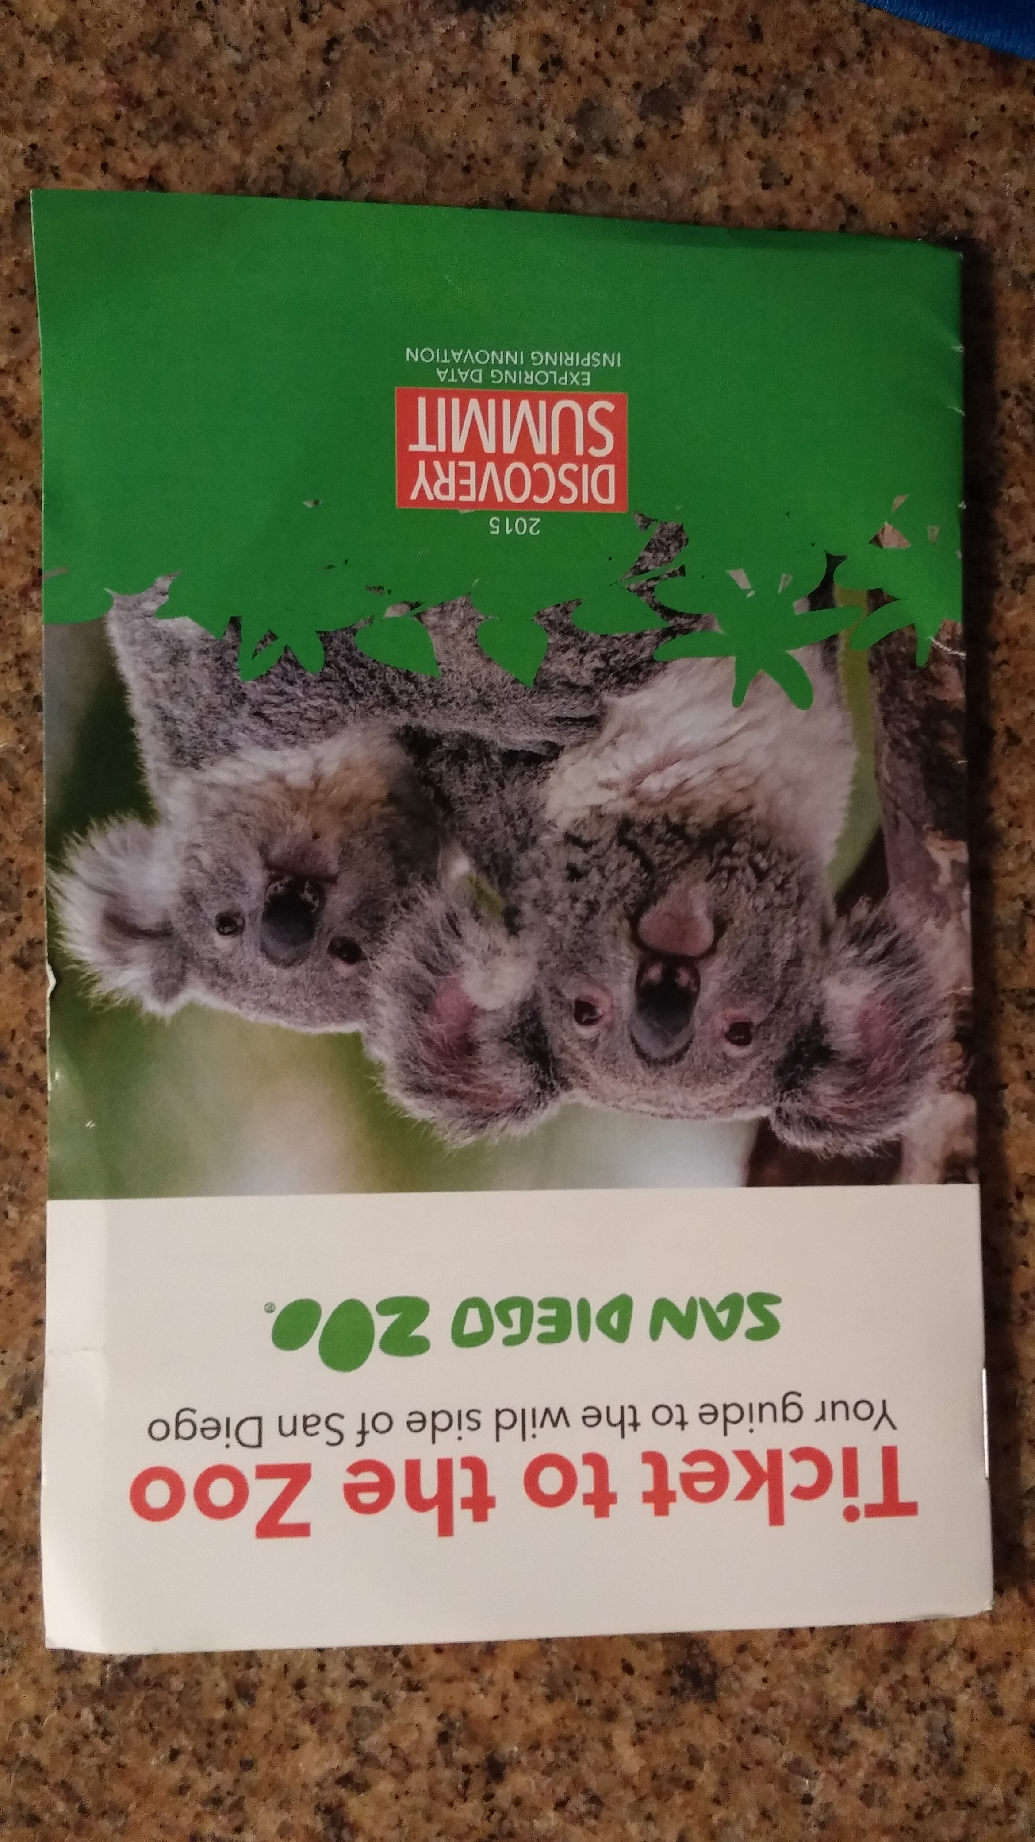
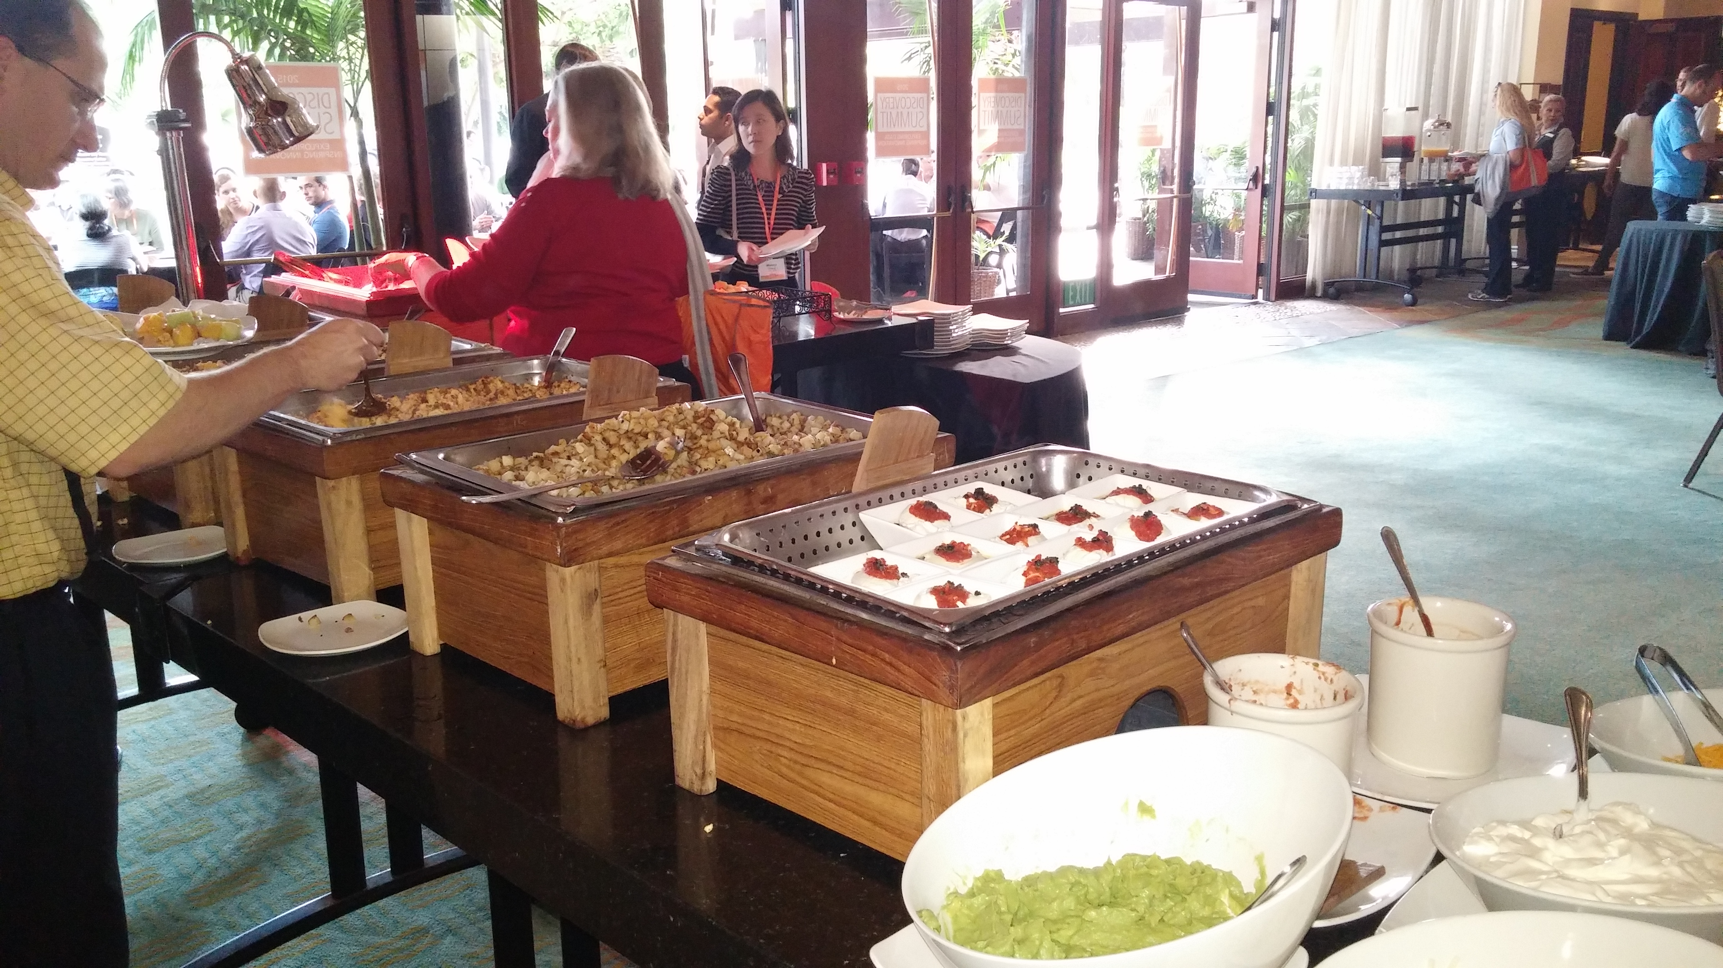
Breakfast, lunch, dinner, snack, entertainment…etc. are all included

Slide 13
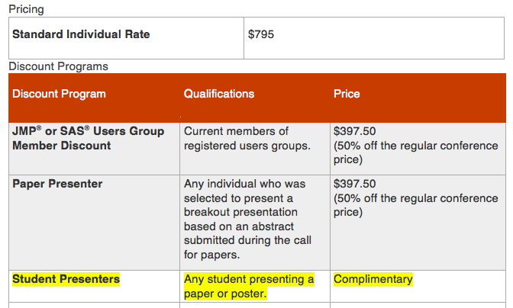

Slide 14
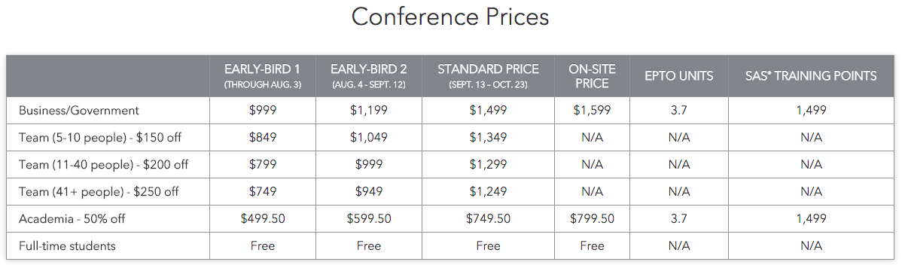
Some conferences are free for students

Slide 15


Slide 16
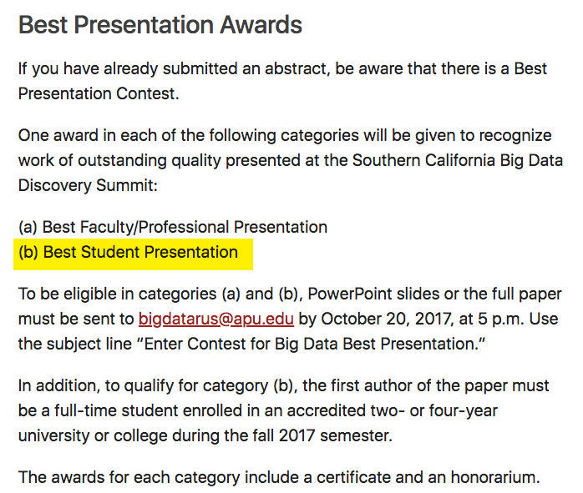

Slide 17
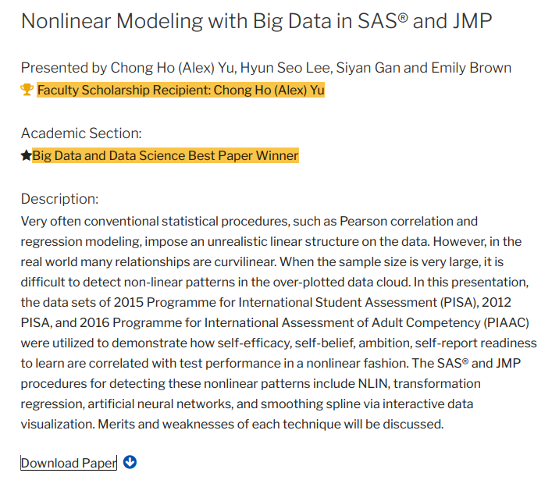
Best paper contest

Slide 18
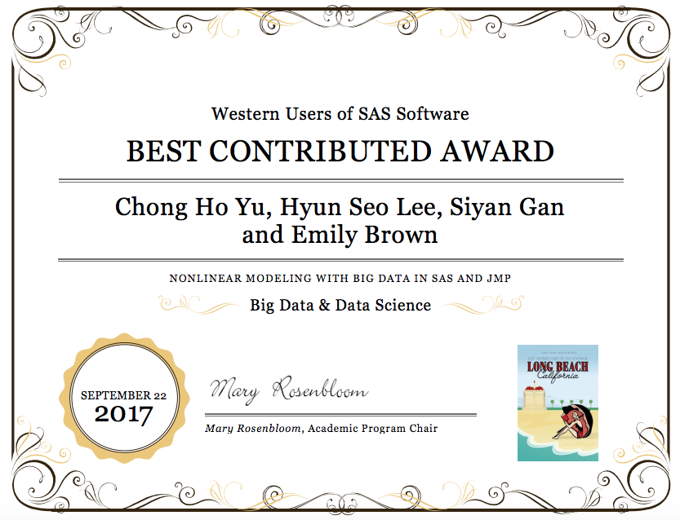

Slide 19
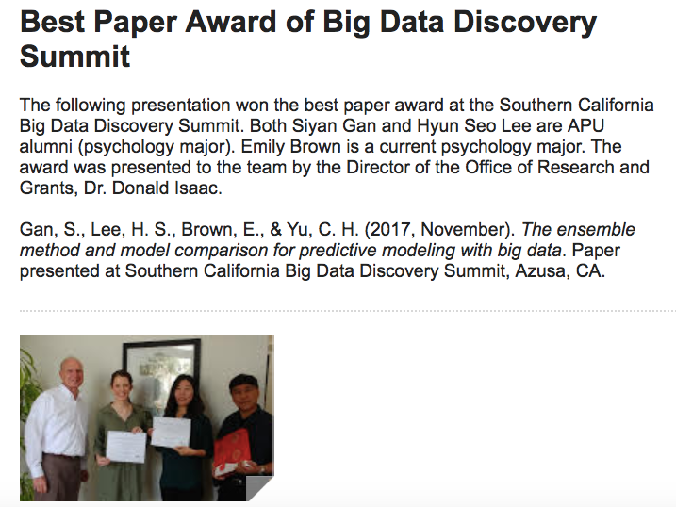

Slide 20
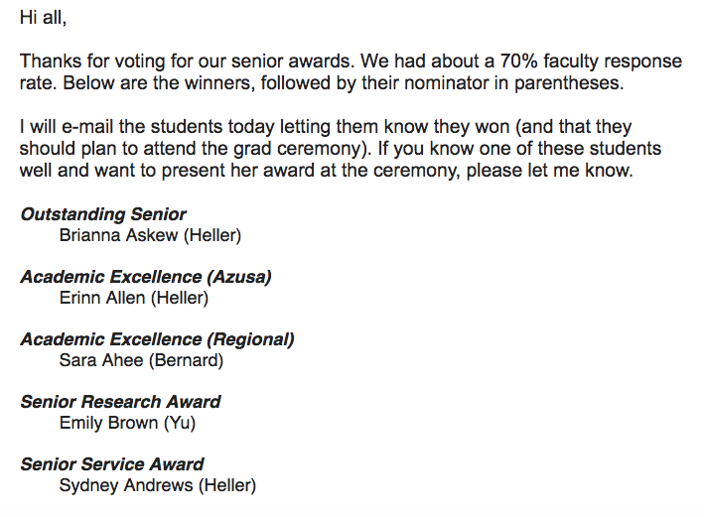
Senior Awards

Slide 21
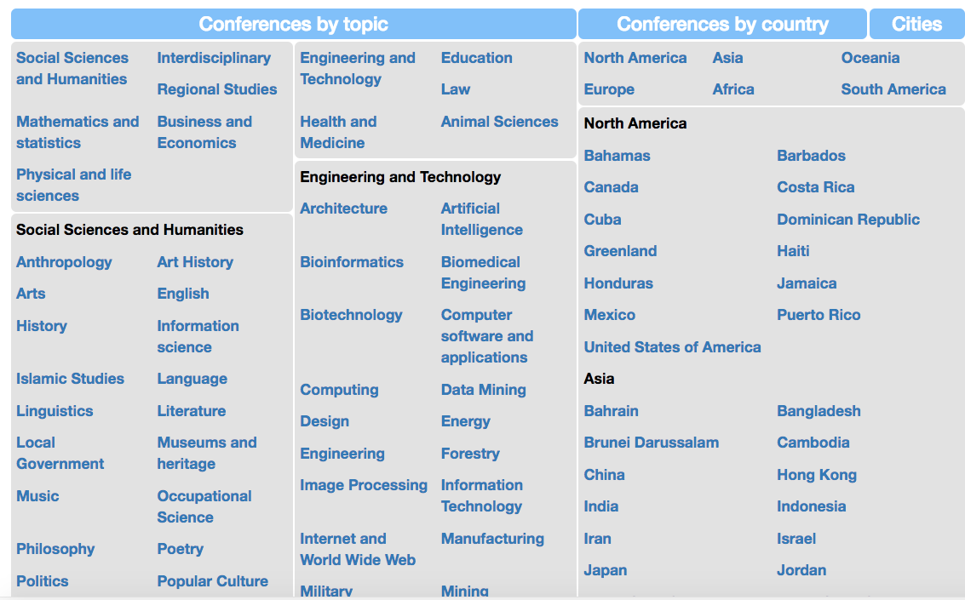
Conference Alerts
https://conferencealerts.com/

Slide 22
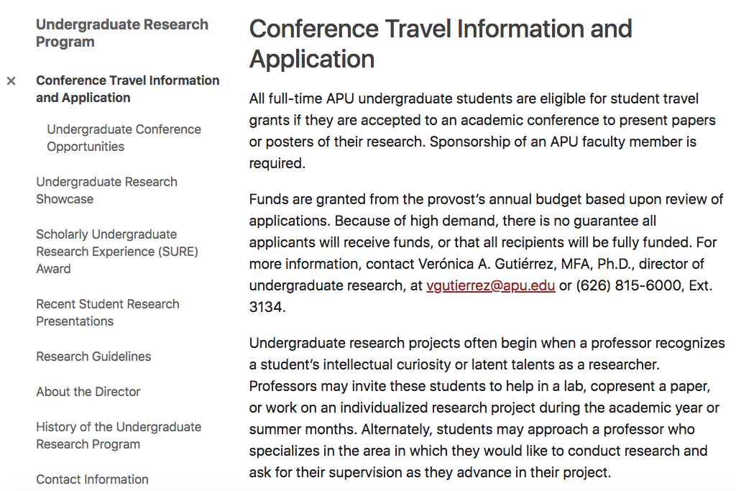
Undergraduate Research Support at APU
https://www.apu.edu/undergraduate-research/

