Slide 1
Unit 3

Slide 2
What is experiment?
Random sampling: a sampling method in which each member of a set has independent chances to be selected (the notion of “equal chance” is a theoretical ideal mentioned by many textbooks, but there are always some hidden bias or disposition in the real world).
Randomization: assign subjects into different groups without any systematic pattern (e.g. draw a ticket).
Experimenter manipulation: directly alter variables to test cause-and-effect relationships e.g. alter the amount of drug given to the patients. The researcher manuipulates the factor that she cares about.
Experimenter control: involves removing all other extraneous variables or conditions that might have an impact on the dependent variables. The researcher removes the effect that she doesn't care.

Slide 3
Common misconception
Random sampling is a sampling process in which every member of the set has an equal probability of being selected.
It is true in an ideal world or a closed system.
But is it true in the empirical (real) world?

Slide 4
Equal? Independent?
Phenomena appear to occur according to equal chances, but indeed in those incidents there are many hidden biases and thus observers assume that chance alone would decide.
Random sampling is a sampling process that each member within a set has independent chances to be drawn. In other words, the probability of one being sampled is not related to that of others.

Slide 5
I want a prize!

Slide 6

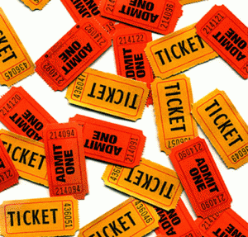
Examples of bias tendency
Throwing a prize to a crowd
Putting dots on a piece of paper
Drawing a winner in a raffle
Not everyone has an equal chance!

Slide 7
Is it truly random (equal chance)?
I am a quality control (QC) engineer at Intel. I want to randomly select some microchips for inspection. The objects cannot say “no” to me.
When you deal with human subjects, this is another story. Suppose I obtain a list of all students, and then I randomly select some names from the list.

Slide 8
Is it truly random (equal chance)?
Next, I sent email invitations to the “random” sample, asking them to participate in a study. Some of them would say “yes” to me but some say “no.”
This “yes/no” answer may not be random in the conventional sense (equal chance). If I offer extra credit points or a $100 gift card as incentives, students who need the extra credit or extra cash tend to sign up.

Slide 9
Changing population
Assume that your population consists of all 1,000 adult males in a hypothetical country called USX.
I want to select 1 participants.
Based on the notion that randomness = equal chance, the probability of every one to be sampled is 1/1000, right?
But the population parameter is not invariant? Every second some minors turn into adults and every second some seniors die. The probability keeps changing: 1/1011, 1/999, 1/1003, 1/1002…etc.

Slide 10
What if the population is fixed?
Assume that we have a fixed population: no baby is born and no one dies. The population size is forever 1,000.
I want to select 5 participants.
When I select the first subject, the probability is 5/1000.
When the second subject is selected, the probability is 4/999.
Next, the p is 3/998.
How could it be equal chance?

Slide 11
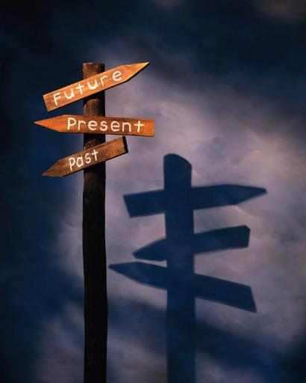
Future samples?
McGrew (2003): A statistical inference based upon random sampling, by definition implies that each member of the population has an equal chance of being selected. But one cannot draw samples from the future. Hence, future members of a population have no chance to be included in one’s evidence; the probability that a person not yet born can be included is absolutely zero. The sample is not a truly random.
This problem can be resolved if random sampling is associated with independent chances instead of equal chances.

Slide 12
Common misconception:
Mix up random sampling and randomization
Morse (2007): “What is wrong with randomization? Processes of saturation are essential in qualitative inquiry: saturation ensures replication and validation of data; and it ensures that our data are valid and reliable. If we select a sample randomly, the factors that we are interested in for our study would be normally distributed in our data, and be represented by some sort of a curve, normal or skewed. Regardless of the type of curve, we would have lots of data about common events, and inadequate data about less common events. Given that a qualitative data set requires a more rectangular distribution to achieve saturation, with randomization we would have too much data around the mean (and be swamped with the excess), and not enough data to saturate on categories in the tails of the distribution” (p.234).

Slide 13
Common misconception: Mix up

Slide 14

Control and manipulation
Shopping for a TV set
Poor picture quality! Poor TV set?
In an experiment, if I put all TVs under study in the same location, then location as a source of "noise" is under my control. If I alternating the location for each TV, then location becomes a variable under my manipulation.

Slide 15

Control and manipulation
A Chinese friend maintained that some Chinese herbs could heal certain diseases. She even conducted an experiment to prove it.
When her husband suffered a long-term illness, he took Chinese herbs for one week and his health condition improved substantively. The next week he stopped taking Chinese herbs and the condition reversed.
I asked her how many types of Chinese herbs her husband took, she answered, "Ten.”
What is the problem? How can you fix it?

Slide 16
Common misconception: Mix up randomized experiment and controlled experiment
Today "randomized experiment" and "controlled experiment" are often used synonymously.
One of the reasons is that usually an experiment consist of a controlled group and treatment group, and group membership is randomly assigned into one of the groups.
If there are influences resulted from uncontrolled variables, by randomization the influences would be randomly distributed across the control and treatment groups even though no control of those variables are made.
”Randomized controlled experiment” is legitimate as long as both control and randomization are implemented in the experiment.

Slide 17
Quasi-experiment
A quasi-experiment is a research design that does not meet all the requirements necessary for controlling the influence of extraneous variables.
Usually what is missing is random assignment. For example, when a researcher studies gender difference in computer use, obviously he cannot randomly assign gender (I am happy as a man. I don't want to be re-assigned).

Slide 18
Quasi-experiment
In 2013, a groundbreaking study was published in the New England Journal of Medicine, revealing that people adopt a Mediterranean diet could lower the chance of heart attack, stroke, or death from cardiovascular disease by 30%, comparing with those people on a low-fat diet.
In 2018 the article was retracted because it was discovered that 14% (75,000) of the participants had not been randomly assigned. Specifically, many married couples were put into the same group and in one extreme case the entire village was assigned to a single group (Wolfson, 2018).

Slide 19

Non-experiment
E.g. Survey research
Common in sociology, political sciences and communications, in which many variables are not controllable. For example, if you intend to study how wars affect people's perception to the quality of policy making, you cannot create a war or manipulate other world affairs, unless you are the villain in the movie "Tomorrow never dies."
Because of this limitation, researchers send surveys to participants who are exposed to the real conditions.
You can use random sampling in survey but this alone cannot make your study a quasi-experiment.
You don’t have to do your own survey!

Slide 20
Secondary analysis: Archival research
Archival research is popular in economics and educational research, especially when the research project involves trends or longitudinal data.
For example, if the researcher wants to find out the correlation between productivity and school performance, he can contact the General Accounting Office (GAO) and the Department of Education (DOE) for obtaining the related data in the last twenty years.

Slide 21
Secondary analysis: Archival research
Center for Collegiate Mental Health (CCMH): http://ccmh.psu.edu/
European Values Survey (EVS): http://www.europeanvaluesstudy.eu/
Gallup Global Wellbeing (GGW): http://www.gallup.com/poll/126965/gallup-global-wellbeing.aspx
Happy Planet Index (HPI): http://www.happyplanetindex.org/
National Opinion Survey Center (NORC): https://gssdataexplorer.norc.org/
Programme for International Student Assessment (PISA): https://www.oecd.org/pisa/pisaproducts/

Slide 22
Secondary analysis: Archival research
Programme for the International Assessment of Adult Competencies (PIAAC): http://www.oecd.org/site/piaac/publicdataandanalysis.htm
Trends for International Math and Science Study (TIMSS): http://timssandpirls.bc.edu/
United Nations Human Development Programme (UNDP): http://hdr.undp.org/en/data
World Values Survey (WVS): http://www.worldvaluessurvey.org/wvs.jsp
US Government's open data: http://data.gov

Slide 23
Secondary analysis: Benefits
It saves time, efforts, and money, because the data are online available.
It provides a basis for comparing the results of secondary data analysis and your primary data analysis (e.g. national sample vs. local sample).
The sample size is much bigger than what you can collect by yourself.
Many social science studies are conducted with samples that are disproportionally drawn from Western, educated, industrialized, rich, and democratic populations (WEIRD; Henrich, Heine, & Norenzayan, 2010). Nationwide and international data sets alleviate the problem of WEIRD.

Slide 24
Secondary analysis: Limitations
You might be interested in analyzing disposable income, but the variable is gross income. In other words, your research question is confined by what you have at hand (Management Study Guide, 2016).
Very often there are discrepancies between different sources of archival data, and thus researcher should exercise caution in drawing firm conclusions derived from a single data source.

Slide 25
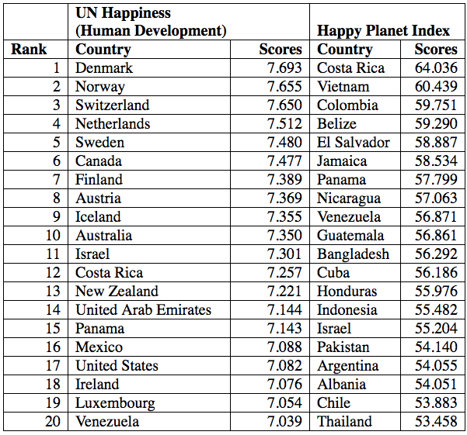
Secondary analysis: Limitations
A big difference?
Why?

Slide 26
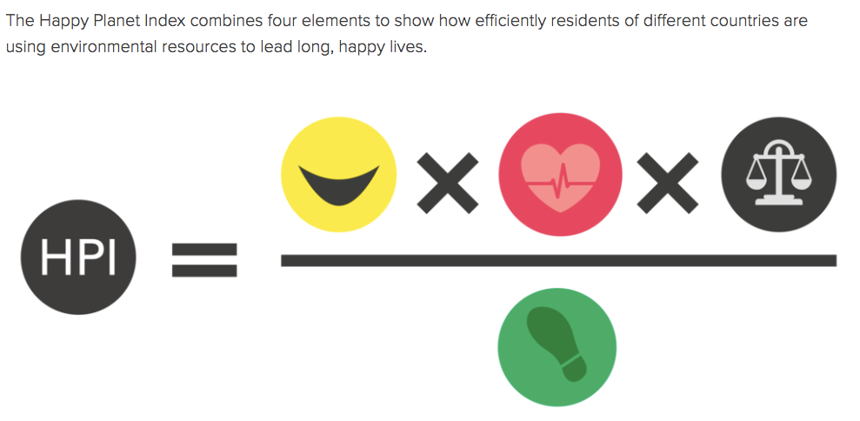
Secondary analysis: Limitations
http://happyplanetindex.org/about/

Slide 27
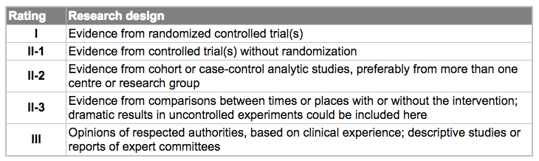
Is RCE the best?
Canadian Task Force for Preventive Health Care

Slide 28
Is experiment the best?
Example: Study of smoking and lung cancer
Between 1922 and 1947 the prevalent rate of deaths attributed to lung cancer surged 15 times across England and Wales.
In 1947 Austin Bradford and Richard Doll were hired by the British Medical Research Council to investigate the possible cause of this pandemic.
It is unethical to conduct a randomized experiment, such as randomly assigning 3,000 healthy people to the smoking group and 3,000 to the control group.

Slide 29
Is experiment the best?
Hill and Doll conducted surveys in the hospitals
In 1950 they published their report, suggesting that there was a causal link between smoking and lung cancer.
In 1957 Fisher, who was the inventor of randomized experiment and a smoker, sent a letter to the journal to repudiate their conclusion.
His reasoning is simple: there is no randomized experiment. Fisher was consistent by doing what he said. He kept smoking until his death!

Slide 30
Is experiment the best?
The dictator game is used very often for studying morality and cooperative behaviors.
In the experiment the participant is told to decide how much of a $10 pie he would like to give to an anonymous person who also signs up for the same experimental session. The game is so named because the decision made by the giver is final.
Many participants were willing to share the wealth.

Slide 31

Is experiment the best?
In a study carried out by Winking & Nizer (2013) at a bus stop in Las Vegas, the researcher told some strangers that he was in a hurry to the airport and therefore he wanted to give away his $20 in casino chips.
The researcher explicitly suggested to the receivers to share some money to another stranger at the bus stop, who was actually a member of the research team.
How many people share the wealth?
How people behave in the lab may not be the same as how they behave in the real world.

Slide 32
Is experiment the best?
"Pepsi Challenge" is based on the unrealistic "sip test" method. Most tasters would favor the sweeter of two beverages when they make a single sip only, but the result is reversed when the entire can or bottle is consumed
I am skeptical of this type of taste tests, including wine tests, coffee tests, water tests...etc. Our limited sensation may not be able to distinguish one from another while the difference is very subtle.
In an experiment the researcher tinted the white wine and asked the wine experts to rate the "red wine." Surprisingly, the experts did not recognize that it is not a glass of red wine!
https://www.youtube.com/watch?v=IphDJH654TA
https://www.youtube.com/watch?v=ZacNCUyalUg

Slide 33
Is experiment the best? Sample size issue
In educational research, What Works Clearinghouse (WCC) still adopts the conventional ranking of study type: Experiment is the best.
Slavin (2008) is critical of this criterion by pointing out that in small, brief, and artificial studies random assignment does not necessarily guarantee validity; over-emphasizing randomized studies without taking sample size and other design elements into account might introduce bias that "can lead to illogical conclusions" (p.11).
Today big data analytics might tell us more about human behaviors!

Slide 34
Can non-experiments give a causal conclusion?
To answer the question of whether helmets reduce the risk of death in motorcycle crashes, virtually identical units were compared: Cases in which two people rode the same motorcycle, a driver and a passenger, one helmeted and the other was not.
Researchers concluded a 40% reduction of risk resulted from wearing a helmet (Rosenbaum, 2005).

Slide 35
Can non-experiments give a causal conclusion?
During the Cold War era, almost the whole world was divided into two camps.
North Korea and South Korea, Mainland China and the Republic of China (Taiwan), East Germany and West Germany, as well as North Vietnam and South Vietnam.
This division is not a result of randomization. Nevertheless, the data about the two camps could still inform us about certain causes and effects.

Slide 36
Can non-experiments give a causal conclusion?
In terms of cultural heritage, language, and racial attributes, the two countries in each pair share a high degree of resemblances.
The major difference is found in the political and economic system only.
Owing to self-isolation and the containment policy performed by the West, the Communist blocs could "experiment" with central planning, class struggle, and so on without much outside influence.
After half a century people were disenchanted by the broken economy and the lack of human rights in those Communist countries.
We call it natural experiment: Large scale and last a long period of time.

Slide 37
Summary
A full experiment ientails random sampling, randomization, manipulation, and control.
A quasi-experiment misses one or two of the above.
A non-experiment has none or almost none of the above. You might use random sampling but it cannot make your study a quasi-experiment.
Experimentation may not be the best. Archival research, natural experiments, or others could also yielded valid causal conclusions.

