Slide 1
Unit 4
Variance control

Slide 2
Signal and noise
The purpose of research is to maximize variance explained and minimize error variance.
Using radio frequency as a metaphor to data, researchers want to filter noise in order to get a clear signal.

Slide 3

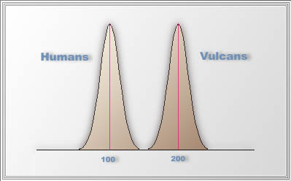
Compare Vulcans against humans
Suppose in the 24thcentury we want to find out whether Vulcans or humans are smarter.
The mean IQ of Vulcans is 200
The mean IQ of humans is 100,
There is very little variability within each group
The mean difference between two groups sends a very clear signal that even the least intelligent Vulcan has higher IQ than the smartest human.

Slide 4
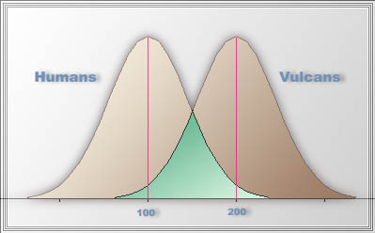
Compare Vulcans against humans
But what if there exist a huge within group variability in both distributions.
Some Vulcans are more intelligent than humans and vice versa.
Within group variability (difference) is noise that distorts the signal. The means must be compared by considering between-group and within-group variability.

Slide 5
Maximize between-group variance (difference)
To maximize between-group variance, researchers should make experimental conditions as different as possible.
For example, if you design a research study to compare Web-based instruction and conventional instruction, the features of the two treatments must be pulled apart as much as possible. The Web version must carry properties that cannot be found in the conventional version.
Researchers expect to detect between-group variability if it is present.

Slide 6
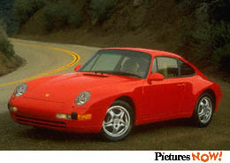
Misconception
Engineer A wants to test the engine performance of Porsche 911. He compares it against a Honda Civic. He concluded: "This is a breakthrough in engineering science. Repeated experiments confirm that a Porsche 911 can outrun a Honda Civic.” Is it insightful?
Engineer B wants to test the engine performance of Porsche 911. He compares it against a Ferrari.

Slide 7
Misconception
By common sense, most people will laugh at the first engineering test and approve the second one. But, look at the next pair:
Researcher A spent 100 hours to develop a Web-based course as the treatment. He simply printed out a hard copy of those WebPages in half an hour for the control group.
Researcher B spent 100 hours to develop a Web-based course as the treatment. He also invested a lot of efforts to develop a multi-media version for the control group to make them comparable.

Slide 8
misconception
Once a series of studies were conducted to evaluate Daisy Quest, a computerized program used to teach phonemic awareness in Grades K through I.
The results were said to be positive, but in the studies (e.g., Barker & Torgesen, 1995), the control groups were not taught phonemic awareness at all.
It is not only invalid in terms of research design, it is also unethical! Why?

Slide 9
Equipoise
The ethics of clinical research requires equipoise, which is a state of genuine uncertainty on the part of the clinical researcher regarding the treatment effectiveness of each side in a trial.
It is unethical for a medical researcher to assign patients into the control group when he/she has known that the treatment is much more effective than the control.
Educational researchers should never conduct a study in which the control/comparison group is absolutely inferior to the treatment. You should not set people up to fail!

Slide 10
exclude the extraneous variable
There are many ways to control noise (unwanted or extraneous variance).
If you worry that variability of GPA among subjects may affect the study, you can select subjects whose GPA is between 3.0 to 4.0.
You ensure that students who participate in the study are well-prepared.
Please be cautious that this approach may hinder the researcher from making a broader generalization (e.g. less-prepared students).

Slide 11
include the extraneous variable as a factor or a covariate
Example: Pre-existing difference (variation). Some students are better-prepared but some are less.
Analysis of Covariance (ANCOVA) can be employed to adjust the pre-existing differences introduced by the extraneous variable, such as GPA, SAT, or a pretest of the subject matter.

Slide 12
Matching subjects
Case-control study
In a study (Tse, Zhu, Yu, Wong, & Tsang, 2015) that aims to identify factors of illegal drug use at schools, it is difficult to recruit students who admit using illegal drug.
A viable approach is to carpeting all the students in a school using anonymous surveys. It turns out that 50 out of 1,000 students report drug use.

Slide 13
Matching subjects
If these 50 cases are compared against 950 controls (no drug use), needless to say the variances of the two groups are extremely asymmetrical.
To make a valid comparison, 50 non-drug users are selected from the sample by matching the demographic and psychological characteristics of the 50 cases.

Slide 14
Improve the reliability of measure
Assume that you cannot remember the test questions or I use equivalent alternate test forms. If I give you the test today, you score is 90. Next day you take the test again, your score is 60. A day later your score is 100. There is a high variability of your scores. What is happening?
If the whole class takes the test, the within-group variability will be very high.
High variability → inconsistency → low reliability → more noise
Improve the test! If the instrument has a high reliability coefficient, there will be less measurement error and thus error variance is reduced.

Slide 15
Summary
To design a study is to control the variance
Between-group variance = signal
All others = noise
Maximize the between-group variance does not mean using an inferior or do-nothing control group.
There are different ways to reduce noise, such as excluding the noise, including the noise as a covariate, matching subjects, and improving test reliability.

