Slide 1
Threats against validity
Chong ho (Alex) Yu

Slide 2
Validity
Internal validity refers specifically to whether an experimental treatment/condition makes a difference to the outcome or not, and whether there is sufficient evidence to substantiate the claim.
External validity refers to the generalizability of the treatment/condition outcomes across various settings.

Slide 3
Common misconception
Validity in the context of research design is NOT the same as validity in the context of measurement. In measurement there are:
  Content validity
  Criterion validity
  Construct validity
These will NOT be covered in this class.

Slide 4
Efficacy and effectiveness
In medical studies, usually efficacy studies in experimental settings are conducted to address the issue of internal validity
Effectiveness studies in naturalistic settings (the "real" world) are employed to examine the external validity of the claim.

Slide 5
Internal vs. external
The US Food and Drug administration (FDA) is responsible for approving drugs before they are released to the market. Rigorous experiments and hard data are required to gain the FDA's approval.
Several drugs that had been approved by FDA before were re-called from the market later (e.g. the anti-diabetic drug Avandia and pain-reliever Vioxx).

Slide 6
Internal vs. external
This discrepancy between the results yielded from lab tests and the real world led to an investigation by the Institute of Medicine (IOM).
To close the gap between internal and external validity, the IOM committee recommended that the FDA should take proactive steps to monitor the safety of the approved drugs throughout their time on the market.

Slide 7
Ecological validity
Unrealistic: Clean data in an artificial setting
Educational researchers realize that it is impossible for teacher to blocking all interferences by closing the door. Contrary to the experimental ideal that a good study is a "noiseless" one, a study is regarded as ecologically valid if it captures teachers' everyday experience as they are bombarded with numerous things

Slide 8
Factors jeopardize internal validity
History: the specific events which occur between the first and second measurement. The 2008 economic recession is a good example. Due to the budget crisis many schools cut back resources. A treatment implemented around that period of time may be affected by a lack of supporting infrastructure.
Maturation: the processes within subjects which act as a function of the passage of time. i.e. if the project lasts a long period of time, most participants may improve their performance regardless of treatment.

Slide 9
Factors jeopardize internal validity
Testing: the effects of taking a test on the outcomes of taking a second test. In other words, the pretest becomes a form of "treatment."
Instrumentation: the changes in the instrument, observers, or scorers which may produce changes in outcomes.

Slide 10
Factors jeopardize internal validity
Statistical regression: also known as regression towards the mean. Galton found that tall parents do not necessary have tall children.
Re-discovered by Daniel Kahneman (2011) in his study about why rebuking pilots cannot explain flight performance.
The threat of regression towards the mean is caused by the selection of subjects on the basis of extreme scores or characteristics.

Slide 11
Factors jeopardize internal validity
Selection of subjects: the biases which may result in selection of comparison groups. Randomization (Random assignment) of group membership is a counter-attack against this threat.
Experimental mortality: the loss of subjects. The hidden variable, intention to treat, might skew the result.

Slide 12
Factors jeopardize internal validity
John Henry effect: John Henry was a worker who outperformed a machine under an experimental setting because he was aware that his performance was compared with that of a machine.
Hawthorne effect: Between 1924 and 32 the Hawthorne Study examined how lighting would influence productivity. Researchers concluded that workers improved their productivity because they were observed rather than better illumination.

Slide 13
Factors jeopardize internal validity
Rosenthal’s effect
  the experimenter or the treatment-giver unconsciously put greater expectations or extra care to the participants.
  Rosenthal and Jacobson (1963) issued a Test of General Ability at an elementary school in California. Later they randomly selected 20% of the students and lied to the teachers that this group had unusual potential for academic growth.

Slide 14

Factors jeopardize internal validity
Eight months later they gave a posttest and found that those so-called gifted students outperformed other students.
Those teachers might have unnoticeably given the supposed gifted children more personal interactions, more feedback, more approval, more positive reinforcement.

Slide 15
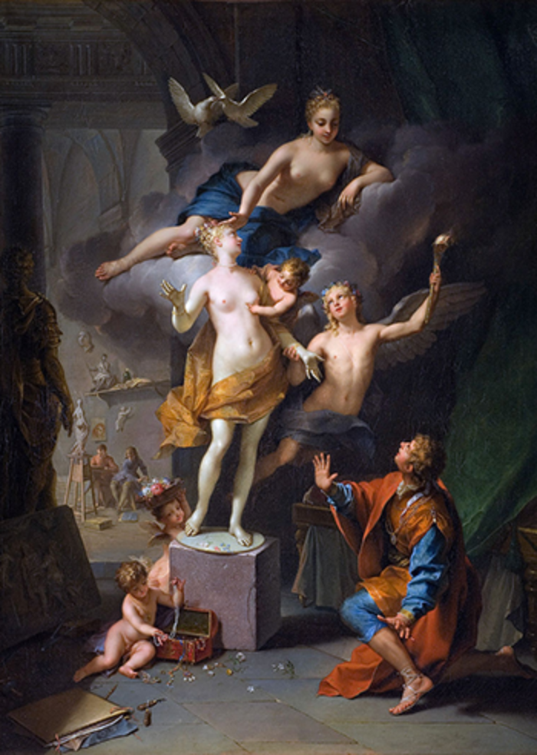
Factors jeopardize internal validity
Also known as the Pygmalion Effect.
Its root can be traced back to a Cyprus mythology.
Pygmalion carved a statue of a woman. He wished for a bride that looked just like his masterpiece.
One day after he kissed the statue it came to life. They fell in love and got married.
A great expectation can lead to a good result.
https://www.youtube.com/watch?v=hTghEXKNj7g

Slide 16
Factors jeopardize external validity
Reactive effects of experimental arrangements: it is difficult to generalize to non-experimental settings if the effect was attributable to the experimental arrangement of the research.
Multiple treatment interference: as multiple treatments are given to the same subjects, it is difficult to control for the effects of prior treatments.

