Slide 1
Psyc 362
Quantitative Research Design 1
Chong Ho (Alex) Yu, Ph.D., D. Phil

Slide 2
Between-subject design
Chong Ho Yu, Ph.D., Phil D.

Slide 3
Between-Subject
By the end of the lesson you will understand the meaning of the following concepts:
  Between-subject
  Grouping factor and level
  Parametric assumptions
  Between-group variance

Slide 4
Between-subject
Analysis of variance: a statistical procedure to compare the mean difference
  Null hypothesis: all population means are not significantly different from each other
  Alternate: Some population means are not equal

Slide 5
What do we care?
In descriptive statistics we talk about the sample means.
In inferential statistics we don’t care about the sample.
We want to use the sample statistics to estimate what would happen in the bigger population or a wider setting.

Slide 6
One-way ANOVA
There must be three or more groups. If there are two groups only, you can use a 2-independent-sample t-test.
The independent variable is called the grouping factor. The group is called the level. In this example, there is one factor and three levels (Group 1-3).
.

Slide 7
Factor and level
I want to study whether there is a gender difference in spending for online shopping. How many factor(s) in this study? How many levels?
I want to study whether day-shift or night-shift workers are more efficient in terms of output. How many factor(s)? How many levels?

Slide 8
Factor and level
I have three different modules for my research class:
  1. Online
  2. Face-to-face
  3. Hybrid.
How many factor(s)? How many levels?

Slide 9
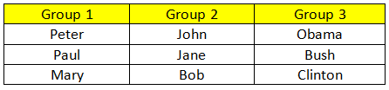
What is between-subject?
Between-subject: The subjects in each level (group) are not the same people (independent).

Slide 10
Why isn’t it called Analysis of means?
If we want to compare the means, why is it called Analysis of Variance, not Analysis of Mean?

Slide 11

I have a side job…
Doing crash test in AAA
  1 Toyota Highlander
  1 Ford Explorer
  1 GMC Yukon
Conclusion: Highlander is safer than Explorer and Yukon.
Assume the test is done properly, would you accept my conclusion?

Slide 12
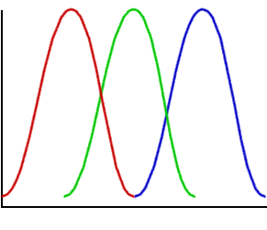
Why isn’t it called Analysis of means?
In the unreal world, the people in the same group have the same response to the treatment:
  All people in Group 1 got 10.
  All people in Group 2 got 11.
  All people in Group 3 got 12.
But we are Not Highlanders or Explorers
But in the real world, usually there is variability in each group (dispersion). We must take the variance into account while comparing the means.

Slide 13
Parametric assumptions
Independence: The responses to the treatment by the subjects in different groups are independent from each other.
Equal variances: the variances of data in different groups are not significantly different from each other.
Normality: The sample data have a normal distribution, but it is not because the population is normal.

Slide 14
Beyond ANOVA
The preceding example includes only one test after the treatment. You may want to include a pretest as the baseline.
In this case the pretest is a covariate for adjusting the posttest score by the preexisting difference.
The procedure to be used is called Analysis of Covariance (ANCOVA).

Slide 15
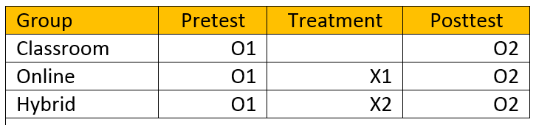
ANCOVA
The design is called Pretest and posttest control group design.
The control group did not do nothing. The students still learn in a conventional classroom.

Slide 16
Within-subject design
Chong Ho Yu, Ph.D.

Slide 17
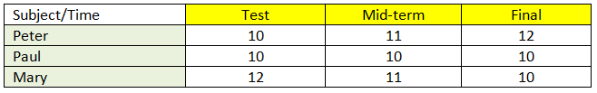
What is within-subject?
Within-subject: The subjects in each level are the same people (correlated). They are measured at different points of time.
Also known as repeated measure design or longitudinal design.

Slide 18
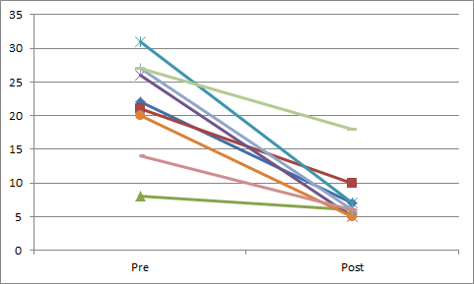
Common problem: Too few measures
Look at the trend using two measures only: pretest posttest.
You can always draw a straight-line by connecting two dots, but that doesn’t mean that there is a linear trend.

Slide 19
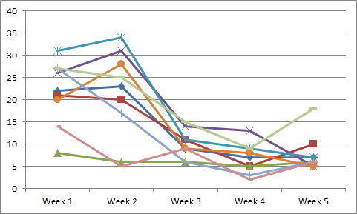
Growth model
Also known as the growth model because you want to examine the trend.
The term “growth” is misleading because things can get worse.

Slide 20
Why within-subject design?
Access to participants is difficult, e.g. you tried your best to recruit subjects but only 10 people signed up. If you use a between-subject design, you have 5 per group!
It is unethical to randomly assign subjects into different conditions.
It may be misleading to draw the conclusion from cross-sectional data (one-time point only)

Slide 21
I come here to bring division!
In experiments we want to have comparable groups; we want to reduce bias.
We will divide the class into two groups
But the two groups must be equivalent or symmetrical
i.e. the same numbers of two genders; the same numbers of different races; the same numbers of different SES, religion…etc.
Can you do that?

Slide 22
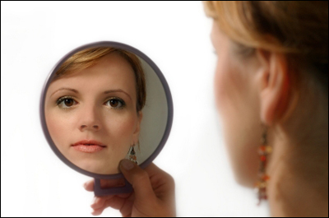
Who is the “control”?
When you have no control group…
You are your own control. The person that is most similar to you is: YOU!

Slide 23
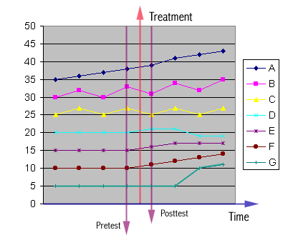
One-shot or pre-posttest only
A: This indicates that the change is a result of natural growth.
B: This behavioral pattern is a cycle with a natural growth tendency. By chances the pretest may be given at the top of the cycle and the posttest may be given at the bottom of the cycle, or vice versa.
Market trend

Slide 24
One-shot or pre-posttest only
C: This pattern resembles B except that there is no growth.
D: This shows a short-term gain. It is not uncommon that a new treatment induces short-term improvement, but this effect does not last. After the excitement is cooled down, the performance may be worse than before.
Example

Slide 25
One-shot or pre-posttest only
E: Short-term gain. Even though the momentum doesn't continue, the performance doesn't’fall back.
F: Long-term gain. Not only the learner learned the knowledge, but also learned how to learn (became a life-long learner).

Slide 26
One-shot or pre-posttest only
G: It seems that there is no effect. However, the effect is latent and thus it takes time for the treatment to show its effect. Although the learner did not learn much information from the treatment, he might be motivated to further utilize the medium in other situations, or he might acquire a new tool and use it to solve other problems.

Slide 27
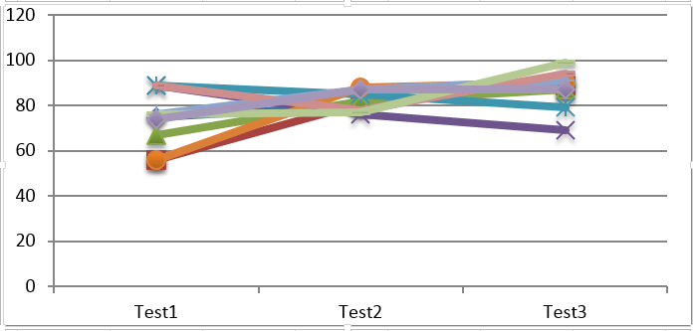
Another example
When you look at the mean of each test, you may miss some interesting information.
A lot of score variability in Test 1. After the treatment, there is a short term equalizing effect. Test 2 variance is smaller.
But at the end the scores spread out again.

Slide 28
Factors which jeopardize internal validity of within-subject design
Maturation: the processes within subjects which act as a function of the passage of time. i.e. if the project lasts a long period of time, most subjects may improve their performance regardless of treatment.
Testing (Practice effect): the effects of taking a test on the outcomes of taking a second test.
Instrumentation: the changes in the instrument, observers, or scorers which may produce changes in outcomes.

Slide 29
Factors which jeopardize internal validity of within-subject design
Statistical regression: It is also known as regression to the mean. This threat is caused by the selection of subjects on the basis of extreme scores or characteristics.
Ceiling effect: Some subjects are very good and there is no room for improvement.
Floor effect: Some subjects are very poor and the treatment could not help them at all.

Slide 30

Order effects
Fatigue effect: score decreases due to boredom, saturation, or exhaustion
Carry-over effect: The effect of one treatment interfere with the next one.
Contrast effect: score change as the previous and current items are vastly difference. E.g. after eating a dish cooked by me, you would give a high rating to MacDonald or Burger King.

Slide 31

My cooking!

Slide 32

Other effects
Assimilation effect: score change due to the previous and current items are correlated positively. E.g. after trying a Macbook Pro, you would give a very high rating to Mac Air.

Slide 33
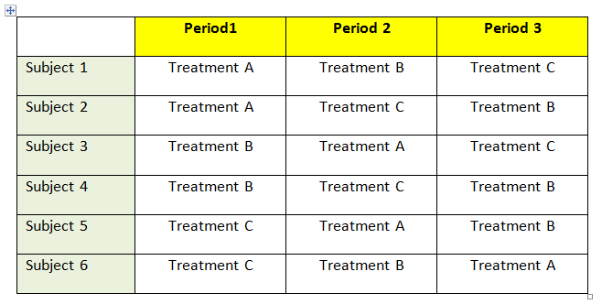
Counterbalancing
To compensate for the order effect, the sequence of the treatment is alternated in an attempt to evenly distribute measurement error. It is called counterbalancing or the cross-over design.

Slide 34
Question
In between-subject design you need two independent groups.
In within-subject design you have the same people.
Can you use the same persons to do a between-subject design?

Slide 35
