Slide 1
Mixed-method design
Chong Ho Yu

Slide 2
Paradigm war
In the past qualitative and quantitative researchers could not get along.
Qualitative researchers criticized quantitative research:
  Based on narrow-minded philosophy: positivism (If it cannot be verified, it is meaningful)
  Reductionism: reduce vibrant and rich human phenomena to objects (numbers)

Slide 3
Verification
A statement is meaningless if verification is not possible or the criteria for verification are not clear e.g.
  God is love.
  Incest is wrong.

Slide 4
Paradigm war is unnecessary!
Positivism is outdated.
Example: Positivism accepts only testable, empirical knowledge (knowledge with reference to concrete data in this world).
Statistics is mathematical. And mathematics is NOT empirical.
Try to prove 2 + 2 = 4

Slide 5
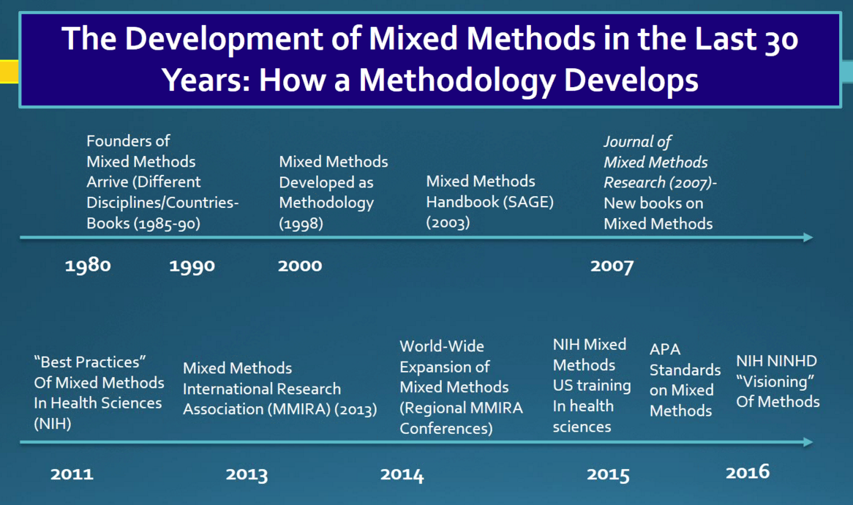
Source: Advancing Methodologies: A Conversation with John Creswell

Slide 6

Source: Advancing Methodologies: A Conversation with John Creswell

Slide 7
But there was a battle…
2004 National Research Council (NRC) released a report to suggest directions of research methodology:
  Research should inform policy and practice
  Research should be scientifically based
  Research should be supported by evidence

Slide 8
But paradigm war continues…
Some critics said that
the NRC committee does not include under-represented groups in the decision process.
The NRC committee has a narrow view of science
Qualitative methods are not highly regarded.
It is a continuation of No Child Left behind Act; the government wants to take more control of the citizens by setting the agenda.

Slide 9
In-class activity
According to the 2004 NRC report, it is advisable that research should inform policy and decision-making; research should be scientific; and research should be data-driven (empirical). Some researchers reject these criteria.
The President appointed you to be the head of National Research Council. To resolve the dispute in the 2004 NRC report, you will revise the research guidelines. What would you change to make it better? (Hints: Consider mixed-method).
Post the answer on Sakai.

Slide 10
Mixed-method
Why either-or? Why not both?
Cronbach, the famous statistician who introduced “Cronbach coefficient Alpha” and “construct validity.”
When he studied causal inference, he looked into the more qualitative methods of the ethnographer, historian, and journalist.

Slide 11
Mixed-method Taxonomy (Creswell and Plano Clark’s)
The third methodological movement
Triangulation design (concurrent)
  quantitative and qualitative methods are concurrently employed
  to bring together different but complementary perspectives by placing emphasis on convergence, data transformation, validation, or multi-level models.

Slide 12
Mixed-method Taxonomy (Creswell and Plano Clark’s)
Embedded design (Concurrent)
  one data set provides a supportive role in a study based primarily on the other data type.
  Example: In a survey most questions are force-option items, but there are some open-ended questions (e.g. Other, please specify _____; Is there anything you want to add?)
  Quant → primary; Qual. → supportive

Slide 13
Mixed-method Taxonomy (Creswell and Plano Clark’s)
Explanatory design (sequential):
  Utilizing the insight gained from qualitative data to explain significant (or non-significant) results, outliers, or surprising findings yielded from quantitative data.
  Example: Why some students can outperform others? Why the treatment is ineffective?

Slide 14
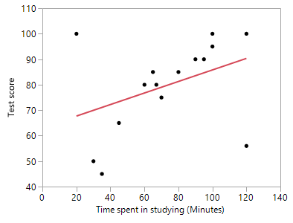
Mixed-method Taxonomy (Creswell and Plano Clark’s)
Explanatory design (sequential):
  What should we do with outliers?
  Quant research: remove them! They mess up everything (p = 0.1486, Not significant!)

Slide 15
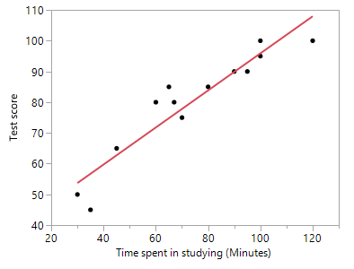
Mixed-method Taxonomy (Creswell and Plano Clark’s)
Explanatory design (sequential):
  Without outliers p < .0001
  In a sequential explanatory design they could be your focal interests.
  You can interview them to find out why someone spent a long time in studying but the score is very low, whereas someone spent a short time but the score is very high.

Slide 16
Mixed-method Taxonomy (Creswell and Plano Clark’s)
Exploratory design:
  A sequential approach. Unlike its explanatory counterpart, the order of employing qualitative and quantitative procedures is reversed
  When the problem is ill-defined and the variables are unknown, employ qualitative methods to understand the problem rather than imposing a theory on the phenomenon.

Slide 17
Mixed-method Taxonomy (Creswell and Plano Clark’s)
Exploratory design:
  This design is particularly useful when the researcher needs to develop an instrument to collect data, but is not sure about what constructs should be measured and what questions should be asked (grounded theory)

Slide 18
Benefits
Enhance validity or credibility: Results from different sources can be converged. The conclusion can be confirmed by triangulation.
Holistic picture: Even if the results cannot converge, it shows diverse aspects of the phenomenon.
Enhance understanding: A person is more than a number (e.g. IQ, GPA); provides rich description of the context

Slide 19
Benefits
Provide causal inferences: Statistical figures can tell you what and how much (e.g. Is there a difference? How effective is the treatment?), but contextual stories can provide exploration of causal mechanisms.
Reach out vulnerable or marginalized groups: Sometime general survey questions may not be able to capture accurate data from vulnerable or marginalized groups. Mixed-method research can develop culturally appropriate instruments.

