Slide 1
Introduction to Cognitive Psychology
Cognition means knowing
Cognizant
Cognizance
Cognize
Cognizable
Incognito
“… it is apparent that cognition is involved in everything a human being might possibly do; that every psychological phenomenon is a cognitive phenomenon.”
- Ulric Neisser

Slide 2
Some Questions to Consider
What is cognitive psychology?
How is cognitive psychology relevant to everyday experience?
Are there practical applications of cognitive psychology?
How is it possible to study the inner workings of the mind when we can’t really see the mind directly?

Slide 3
Physics: Neutrino

Slide 4
Physics: Atom
Indirect measurement and inference

Slide 5
Physics: Black hole?
No, this is not a back hole. This is the light bent around the event horizon.

Slide 6
The Complexity of Cognition
Cognitive Psychology
  The branch of psychology concerned with the scientific study of the mind.
  The study of the mental process of acquiring knowledge and understanding through thought, experience.
  Cognition refers to the mental processes, such as perception, attention, and memory, that are what the mind does.
  If we know how it works, we can know what can go wrong.

Slide 7

The Complexity of Cognition
Cognition involves
  Perception
  Attention
  Remembering
  Distinguishing items in a category
  Visualizing
  Understanding and production of language
  Problem solving
  Reasoning and decision-making
    And all the errors about these processes.
    All include “hidden” processes of which we may not be aware
    Sometime even if we are aware of the error, we don’t want to admit it.

Slide 8


Look alike?
My experience: Many people confuse me with other Asians.
https://www.youtube.com/watch?v=OdxMkQhq58g
https://www.youtube.com/watch?v=9xT8Ucdgb0Q
How could it happen? Do you have similar experience?

Slide 9
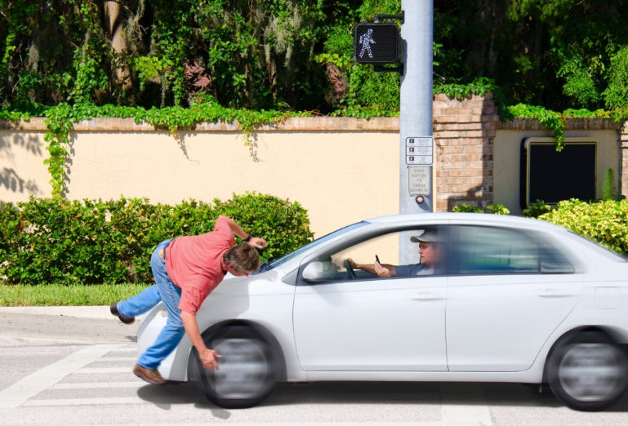
How can we be so blind?
https://www.youtube.com/watch?v=EMCn7mrDd0k
How could the driver fail to see the pedestrian in crosswalk
https://www.youtube.com/watch?v=TSsuwZvom3g
Inattentional blindness
https://www.youtube.com/watch?v=v3iPrBrGSJM
Sleight of hand → sleight of mind
Do you have similar experience?

Slide 10


The First Cognitive Psychologists
Donders (1868)
  Measuring how long it takes a person to make a decision?
  Reaction-time (RT) experiment
    Measures interval between stimulus presentation and person’s response to stimulus
I will be an outlier in his reaction time experiment!
Never recruit subjects from Marvel or DC!

Slide 11
The First Cognitive Psychologists
Donders (1868)
  Simple RT task: participant pushes a button quickly after a light appears
    http://www.humanbenchmark.com/tests/reactiontime
  In-class activity (Ungraded)
  Who are faster? Males or females?
  Every one tries it 5 times and then write down the RT score.
  I will enter your scores in a statistics software app (JMP) by gender.

Slide 12
The First Cognitive Psychologists
Donders (1868)
  Choice RT task: participant pushes one button if light is on right side, another if light is on left side
    http://epsych.msstate.edu/deliberate/SimpleRT/index.html?4.html
  Implication: RT means the difference between life and death for some professions. What professions?

Slide 13



Split-second decision!
Can you share an example of a time when you had to make a split second decision?

Slide 14
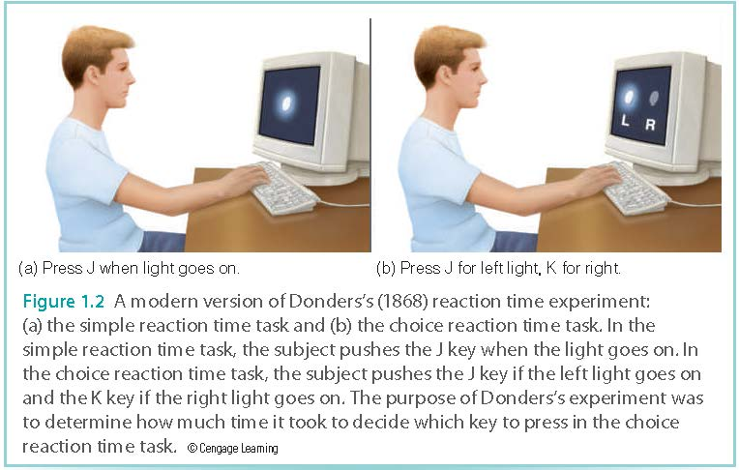
The First Cognitive Psychologists
Notes:
● FIGURE 1.2 A modern version of Donders’ (1868) reaction time experiment: (a) the
simple reaction time task; and (b) the choice reaction time task. In the simple reaction time
task, the participant pushes the J key when the light goes on. In the choice reaction time
task, the participant pushes the J key if the left light goes on and the K key if the right light
goes on. The purpose of Donders’ experiment was to determine

Slide 15
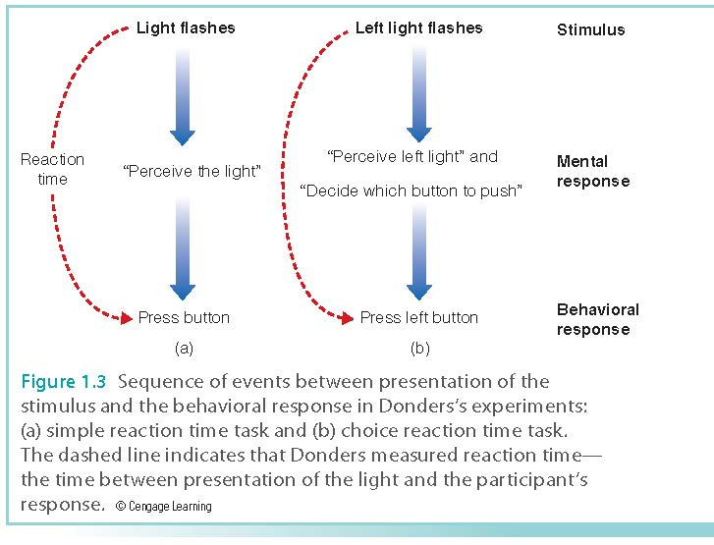
The First Cognitive Psychologists

Slide 16
The First Cognitive Psychologists
Donders (1868)
  Choice RT – Simple RT = Time to make a decision
    Choice RT = 1/10th sec longer than Simple RT
    1/10th sec to make decision (100ms)
  Mental responses cannot be measured directly but can be inferred from the participant’s behavior

Slide 17
The First Cognitive Psychologists
Wundt (1897)
  First psychology laboratory at the University of Leipzig, Germany
  Approach
  Structuralism: experience is determined by combining elements of experience called sensations
  Method
  Analytic introspection: participants trained to describe experiences and thought processes in response to stimuli
  What is the problem?

Slide 18
The Rise of Behaviorism
John Watson noted two problems with Introspection:
  Extremely variable results from person to person
  Results difficult to verify
    Invisible inner mental processes

Slide 19
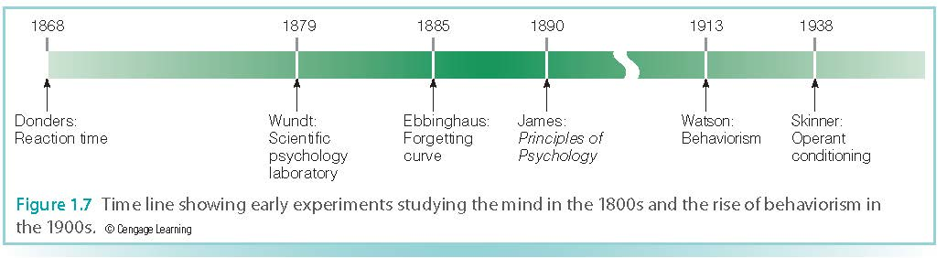
The Rise of Behaviorism

Slide 20
Studying the Mind
To understand complex cognitive behaviors:
  Measure observable behavior
  Make inferences about underlying cognitive activity
  Consider what this behavior says about how the mind works

Slide 21


The Cognitive Revolution
1950s-1970s: Shift from behaviorist’s stimulus-response relationships to an approach that attempts to explain behavior in terms of the mind
Information-processing approach
  A way to study the mind created from insights associated with the digital computer

Slide 22

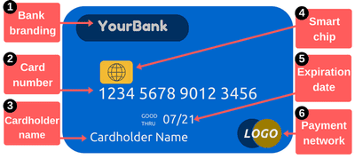
The Cognitive Revolution
Early computers (1950s)
  Processed information in stages
    How much information can the mind absorb? (magic number 7 + -)
    Attend to just some of the incoming information?
    RAM: Short-term memory
    Hard drive: Long-term memory

Slide 23
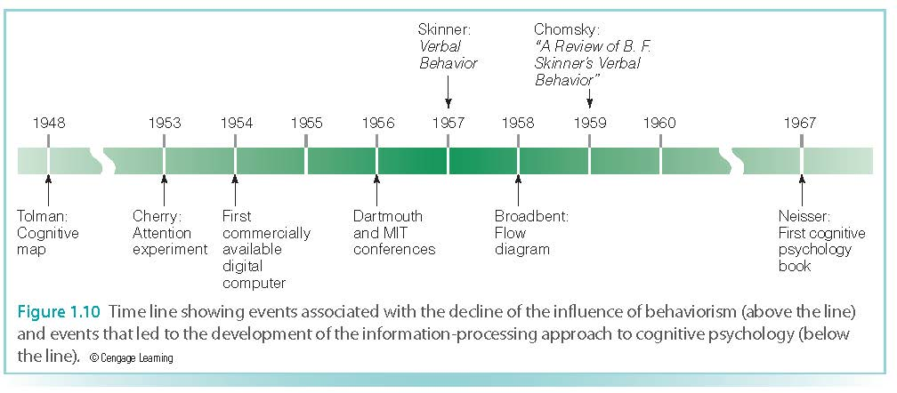
The Cognitive Revolution

Slide 24
Modern Research in Cognitive Psychology
How research progresses from question to question
  Start with what is known
  Ask questions
  Design experiments
  Obtain and interpret results
  Use results as the bases for new research questions and experiments

