Slide 1

Secularization and wellbeing
Chong Ho Yu

Slide 2
What is wellbeing?
Objective: Social-wellbeing
  Health indices (life expectancy rate, infant mortality rate)
  Crime rate
  Education indices
  Income
Subjective-wellbeing
  Satisfaction/happiness
  Self-esteem
  Stress management

Slide 3
What is secularization?
Traditional: Separation of Church and State (US is a secular country!)
Moderate and non-confrontational: Ignore or downplay religion. Many Europeans go to church three times in their whole lifetime (infant baptism, wedding, and funeral)
Aggressive: Purge religion from society (e.g. Phil Zuckerman, New Atheist Movement)

Slide 4

What is religiosity?
Religiosity:
  Affiliation with a particular religious institution.
Spirituality:
  Individualistic, is not affiliated with any institution.
  The divine power may be impersonal, a cosmic force
The second one is hard to measure. Our focus will be on the first one.

Slide 5
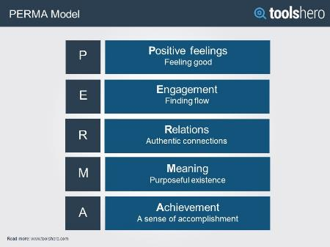
Imago dei and Seligman's PERMA
Imago dei
  Substantive: We have inalienable dignity.
  Functional: We have missions and vocations
  Relational: We are beings-in-relation (social beings)
Can we see the connection?

Slide 6
Subject wellbeing looks good!
Lynch (2012): n =100
  There was a positive correlation between secularization and perceived stress level.
  Less religious → lower psychological health.
Hayward (2016)
  Religious people had higher mean levels of life satisfaction than agnostics.
Galen (2015)
  Religious groups are social supporting systems

Slide 7
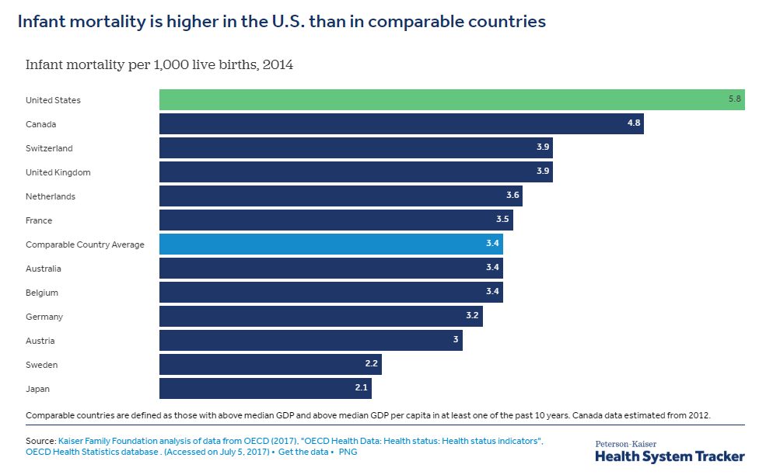
Secularization and wellbeing
How about objective wellbeing?
Chong Ho Yu

Slide 8
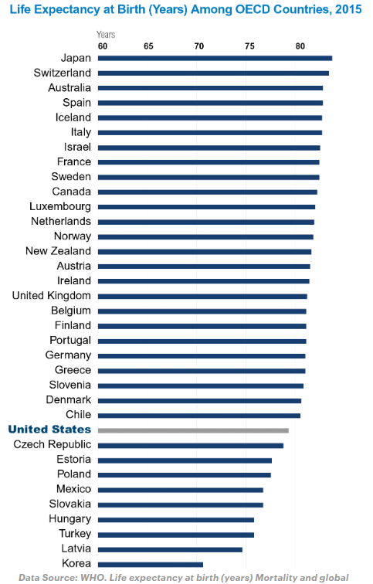

Meet the stress
https://www.cnn.com/videos/tv/2019/03/17/exp-gps-0317-sanjay-gupta-one-nation-under-stress.cnn

Slide 9
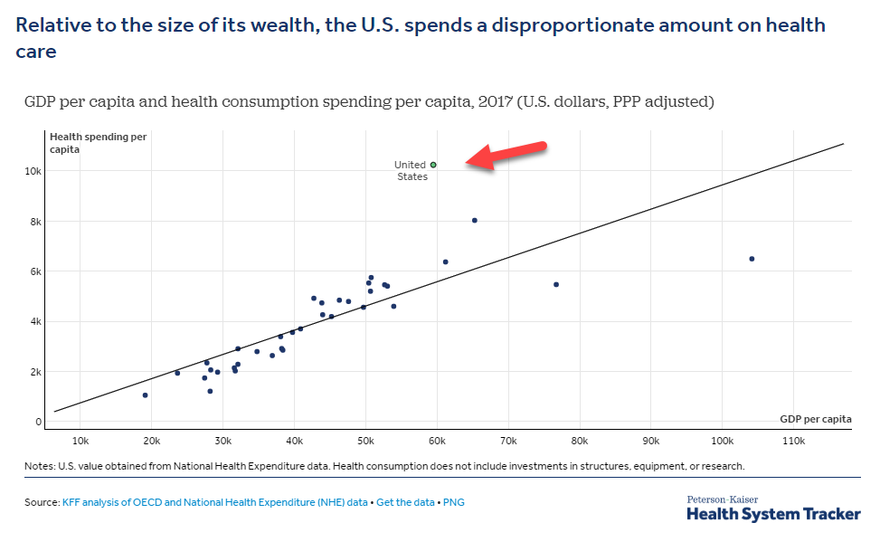

Slide 10
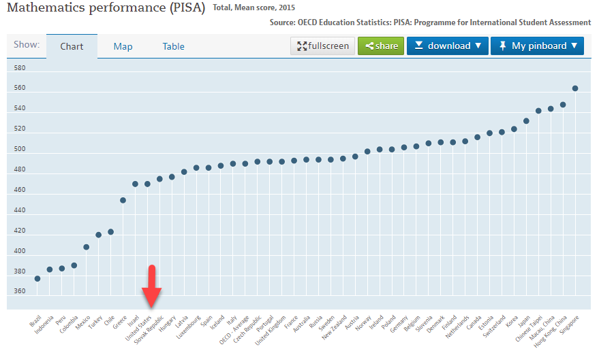
https://data.oecd.org/pisa/mathematics-performance-pisa.htm#indicator-chart

Slide 11
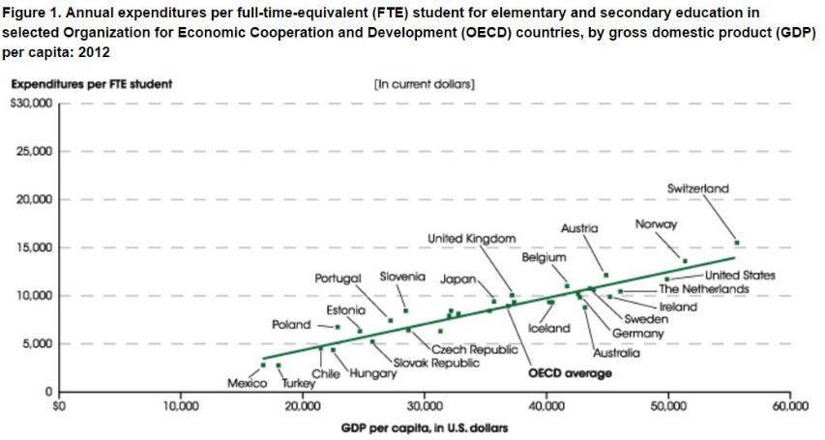
Spending in Education

Slide 12
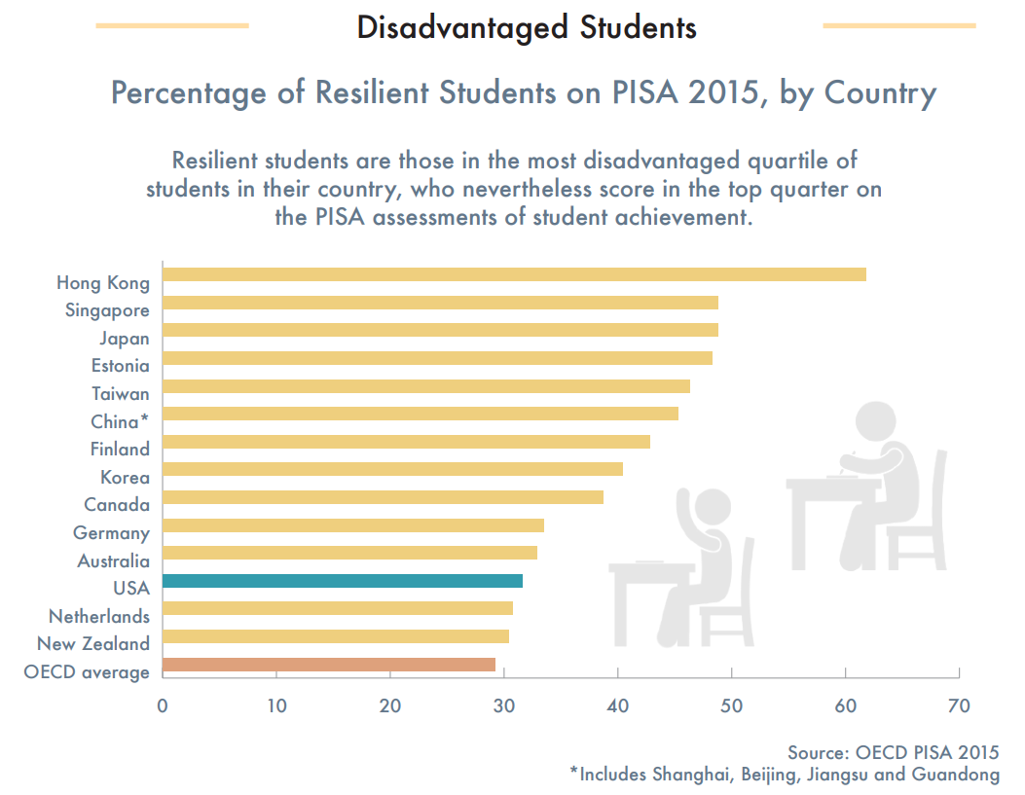

Slide 13

Secularization-wellbeing thesis
Gregory Paul: “unlike science, which goes where the evidence and analysis indicate and is anti-mythical in nature, religion is inherently dogmatic and opinion based, with myths being integral to the system.”
“All comprehensive cross comparisons have found that higher levels of religiosity are strongly correlated with inferior socioeconomics” (Paul, 2014).

Slide 14

Is Religious America the worst?

Slide 15
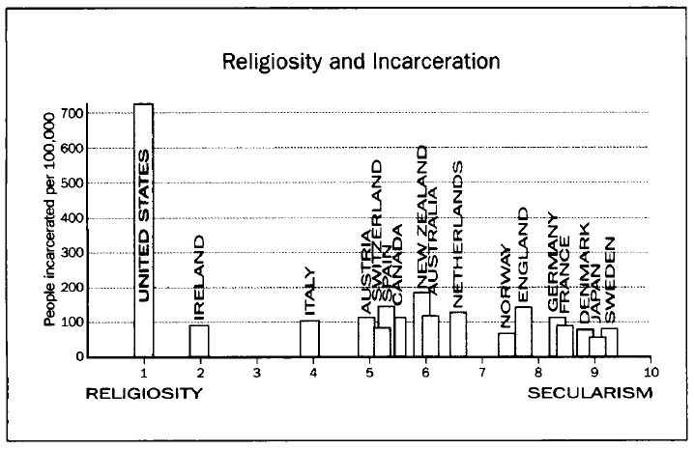
Evidence?

Slide 16
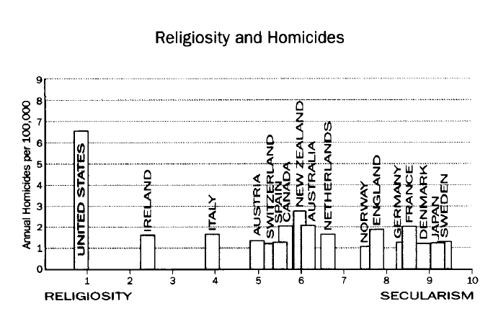
Evidence?

Slide 17
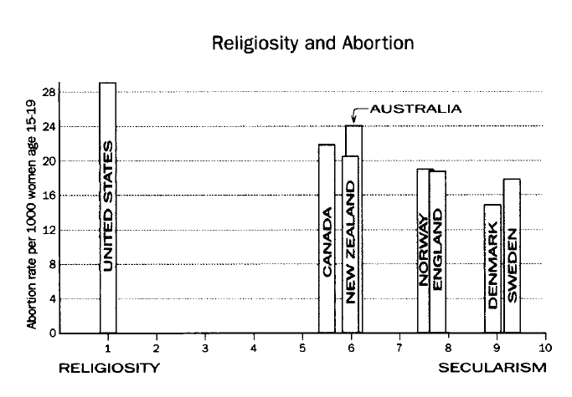
Evidence?

Slide 18
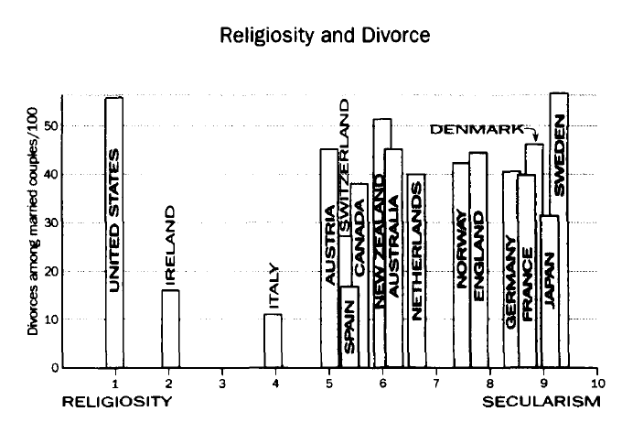
Evidence?

Slide 19

Divorce rate
The divorce rate of the US is 53%.
According to the 2010 and 2011 United Nations Statistics and other sources, several other Western developed nations, such as Belgium, Portugal, France have worse divorce rates than the US.
Hungary, Czech Republic, Lithuania, and Estonia are former Communist nations. According to 2007-2008 Gallup Poll these countries are very secular. But their divorce rate is higher than religious US.

Slide 20
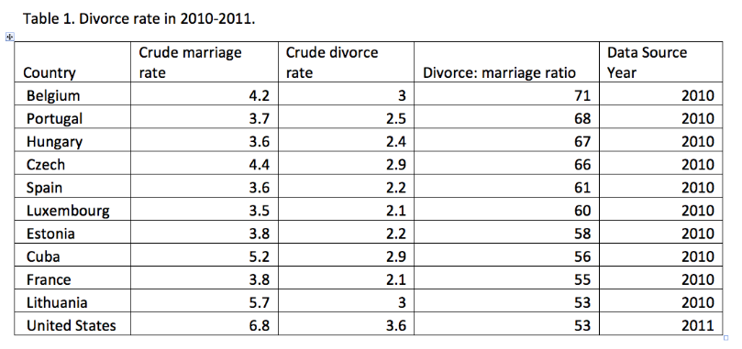
Divorce
According to 2012 United Nations Statistics, in terms of crude divorce rate, the top ten countries are Belarus, Latvia, Lithuania, Moldova, Denmark, Sweden, Czech Republic, Belgium, Liechtenstein, and Finland. The US is not among the top 30.

Slide 21
Divorce
Paul wrote: "divorce is also high in America, and not among ungodly progressives, but among patriarchal evangelicals."
No data are cited to support this. But there is evidence to support the otherwise.

Slide 22
Divorce
Wilcox and Williamson (2007): Protestants that attend church regularly are 35% less likely to divorce compared to secular couples. But irregularly attending conservative Protestants are 20% more likely to divorce.
Wright and Stetzer (2010): Christians have a divorce rate of about 42%. But church service attendance is a crucial predictor of divorce. 60% of evangelicals who never attend church had been divorced or separated, compared to 38% of weekly attendees.

Slide 23

Paradoxical
While it is true to some certain extent, the wellbeing indices selected are limited.
If the US is the worst in terms of wellbeing, why do so many people, including people from nations that have higher wellbeing indices, want to immigrate into the US?
By 2012, immigrants made up 13 percent of the US population.
From 2000 to 2012, there was a 31.2 percent increase in the foreign-born population in the US.

Slide 24

What do the statistics say?
2012 figures: US teenage (aged 15-19) pregnancy rate is 39 out of 1000.
In the secular UK, 29 out of 1,000, the highest in West Europe.
Secularization of UK: 1.15% of Britons attend church Regularly.
Britons use more contraception than other European nations.
Notes:
You can find two countries that will be representative of Paul’s claim, but this is not representative for all religion vs secularization. Find another country that shows the opposite
DEE: You can pick any two countries that will be representative of Paul’s claim, but this is not representative for all religion vs secularization. To accurately compare religion and secularization, we must evaluate more countries than just America and the UK.

Slide 25

How about Asia?
Singapore: Pregnancy rate is 6 out of 1000
Japan: Pregnancy rate is 5 out of 1000
Pippa Norris and Ronald Inglehart: the Japanese have a high degree of religiosity.
World Value survey: 41.3% Singaporeans regard religion as very important.
Notes:
DEE

Slide 26
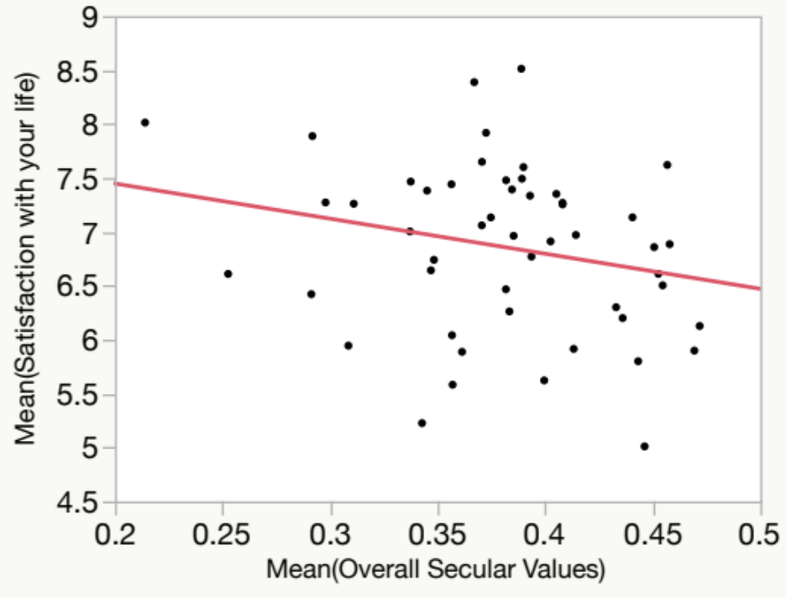
Worldwide statistical evidence
Data from World Values Survey (2010-2014)
Lower overall secular values → Happier!

Slide 27
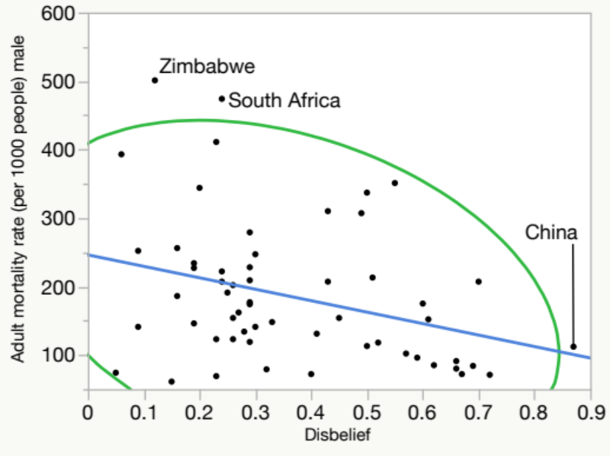
Worldwide statistical evidence
Secularization → better wellbeing?
True to some extent
China is the most disbelieving nation in the world, yet its adult mortality rate is among the low.est

Slide 28
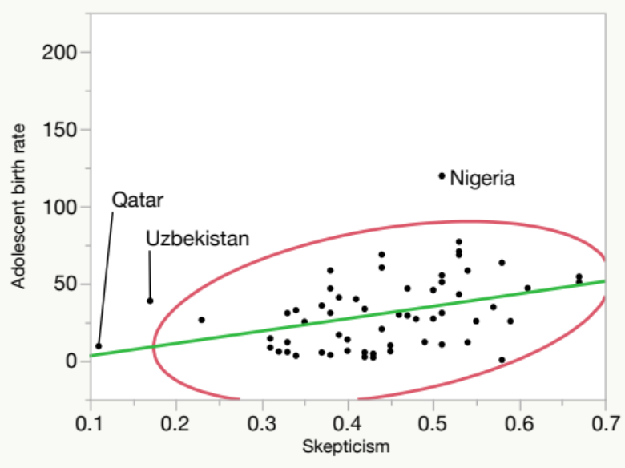
Worldwide statistical evidence
Teenage birth rate: A proxy measure of respect for females, sex education, lifestyles…etc.
Skepticism: A proxy measure of secularization. More skeptical → less religious
More secularization → Higher teenage birth rate?

Slide 29
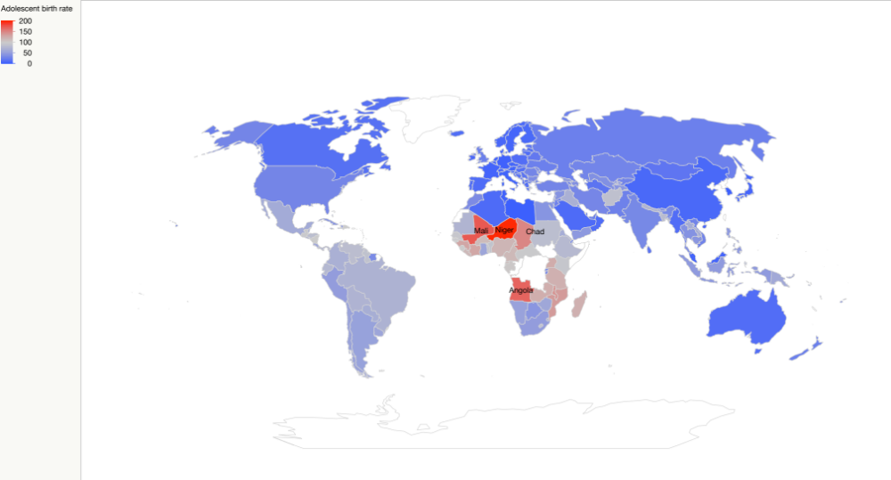
Worldwide statistical evidence
Teenage pregnancy rate (Red =higher; Blue = Lower)

Slide 30
Discussion
There seems to be some contradiction between OWB and SWB studies.
The conclusion depends on:
  How to define secularization, religiosity, happiness and wellbeing
  Which data did you use?
  What measurement and statistical procedures did you use?
Any thought?

