Slide 1
One- to two-dimensional visualization
Chong Ho Alex Yu

Slide 2
What is dimension?
A graphical representation of a variable by a vector or a line (usually, but not always).
One variable → One dimension
Two variables → Two dimensions
When there are too many, the problem is called the curse of dimensionality.
This unit focuses on 1 dimension or 2 dimensions only.

Slide 3
Examples of 1-dimensional graph
Pie chart, bar chart, and histogram
Very easy to make. You can use Excel instead of JMP, SAS, or Tableau.
Caution: Research shows that Pie chart and its variant, donut chart, could be confusing and misleading.

Slide 4
Examples of 1-dimensional graph
Pie charts use angle and curvature to display data, producing most errors in perception (Evergreen , 2017).
Academic journal articles seldom use pie charts.

Slide 5
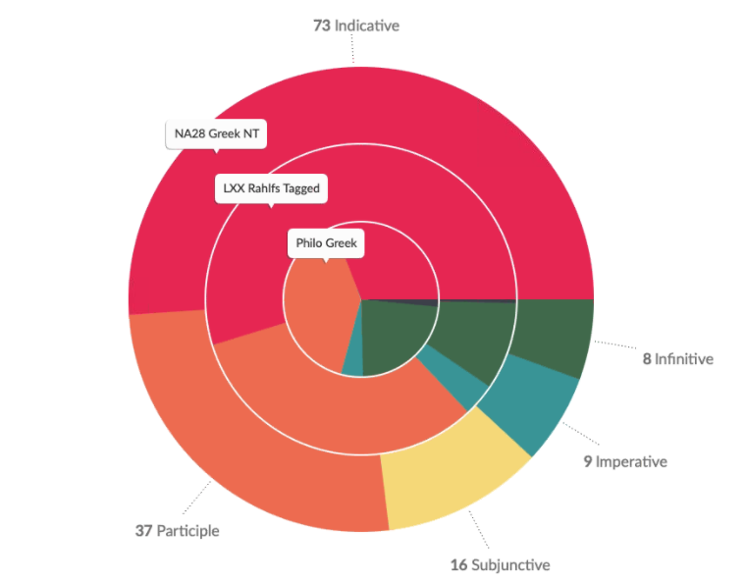
Stacking pie charts
When 1-dimensional pie chart is expanded to multi-dimensional, it could be worse.
Very difficult to make comparison between or link across different dimensions.
Can you really tell which green area is bigger?
Notes:
Source: Accordance Bible Software

Slide 6
bar chart vs. Pie chart
Barchart is much clearer.
If you sort the data by frequency, it is even better (especially when there are many bars)

Slide 7
Side by side barchart or stacked barchart
Another variable: Campus location
They could be very confusing!

Slide 8
Slopegraph or parallel coordinate
Slopegraph or parallel coordinate is easier to compare across two campuses.
In business, psychology, and math, East campus enrollment outnumbers West campus enrollment.
In theology and sociology, it is opposite.
In philosophy, East campus enrollment and West campus enrollment are similar.

Slide 9
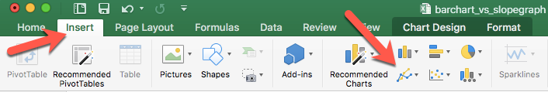
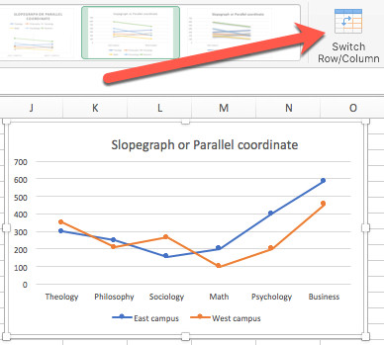
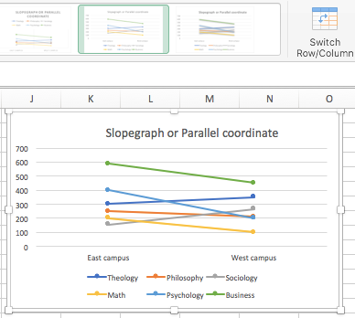

Slide 10
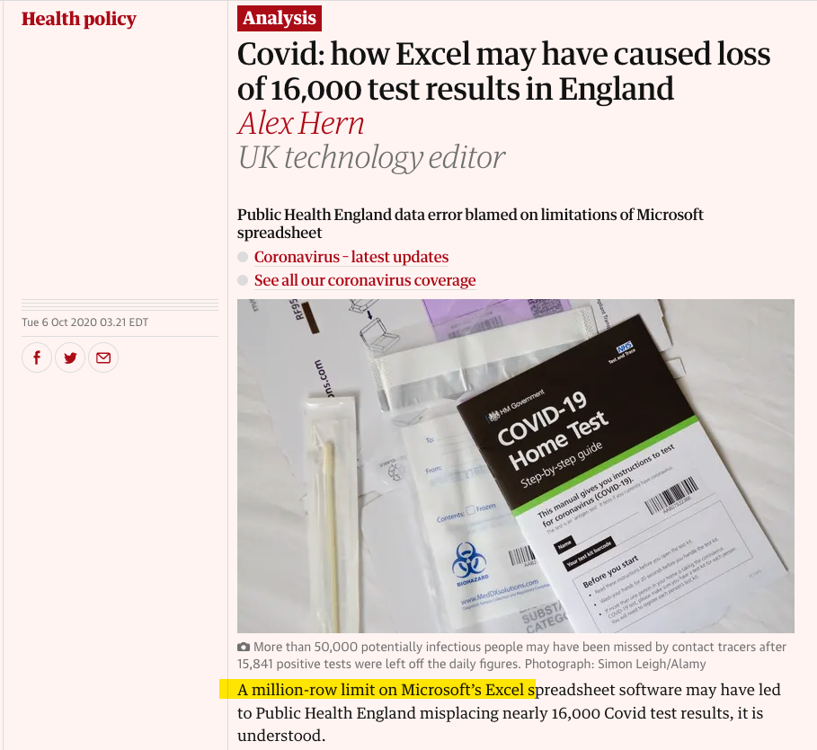
Caution
Excel is suitable to relatively small data set.
When you have big data (e.g., n < 1 million), stay away from Excel.

Slide 11
Summarize the data in JMP for Excel
Excel plots the summary data i.e. the frequency count by department and by campus is already done.
What should I do when I have individual-level data, not summary data?
For example, I want to create a slopegraph. I want to compare the numbers of male and female students by their home state based on the data set visualization_data.jmp.

Slide 12
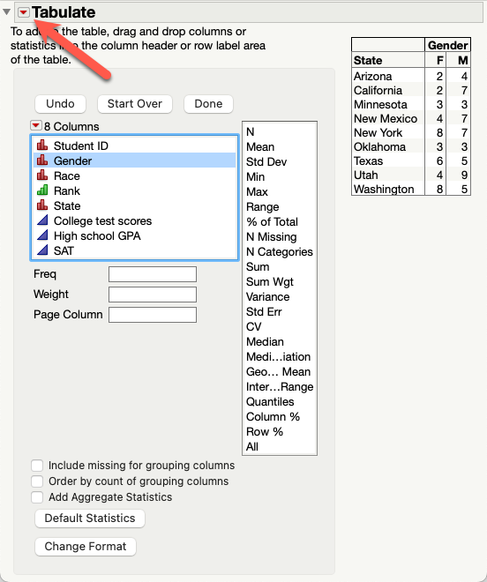
Summarize the data in JMP for Excel
Analyze → Tabulate
Drag state into the Y axis.
Drag gender into the x axis.
Red triangle → Make Into Data Table

Slide 13
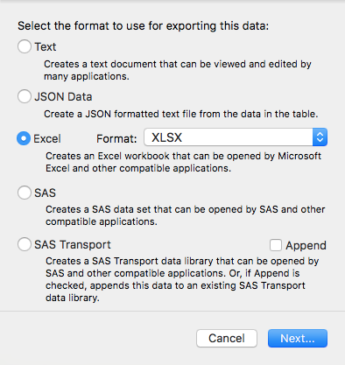
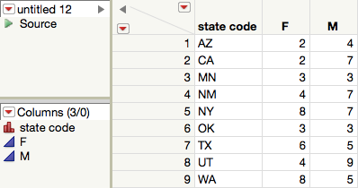
Summarize the data in JMP for Excel
In Windows: File → Save as → Choose the xls or xlsx format.
In Mac: File → Export → Choose Excel

Slide 14
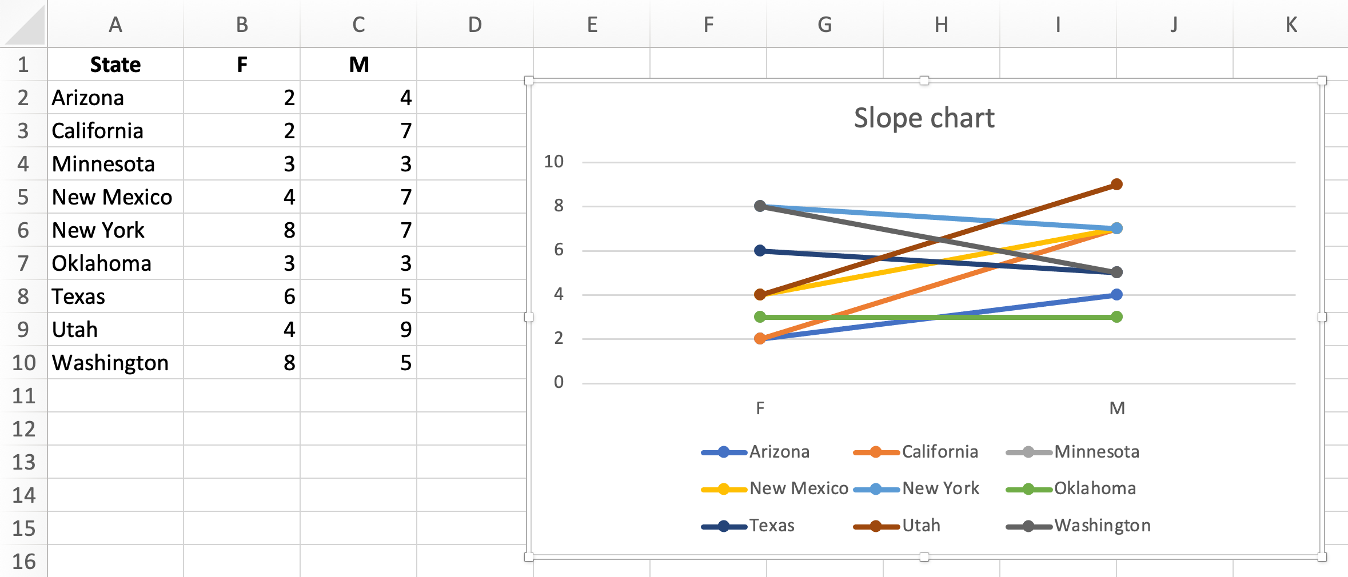

Slide 15
Ungraded Exercise
Use visualization_data.jmp
I want to compare the numbers of male and female students by academic rank (1 = freshman, 2 = sophomore, 3 = junior, 4 = senior).
Use Tabulate to create a summary table.
Export the summary table to Excel
Create a slopegraph.

Slide 16
Bar chart with coloring and centering
At first glance usage of bar chart is straight–forward because there is not any issue about bandwidth in using discrete data (e.g. department: psychology, philosophy, sociology…etc.).
But when the variable contains 50–100 categories, the bar chart becomes too cluttered to be interpreted.
When the data are centered and standardized at the mean of zero and different bars representing different items are colored by their distance from the center, the graph becomes more interpretable (It is discussed in 521, too).

Slide 17
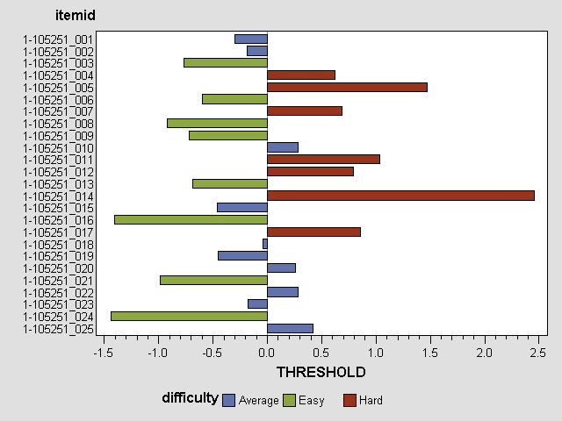
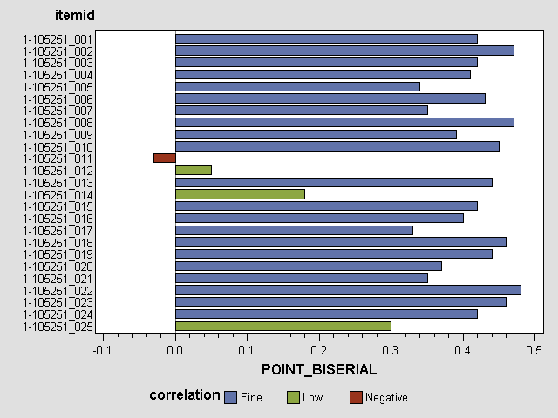
Bar chart with coloring and centering
SAS example: Showing psychometric results of item response theory

Slide 18
Histogram: Bandwidth issue
Barchart is for discrete data whereas historgram is for continuous data.
The preset binwidth (bandwidth) may mislead you.
You can go back and forth to look at the histogram with different binwidths (noise – smooth).
Smoothing algorithms: The process can be thought of as constructing numerous histograms of differing interval widths and averaging the heights of the different bars: a sort of average all possible histograms.

Slide 19
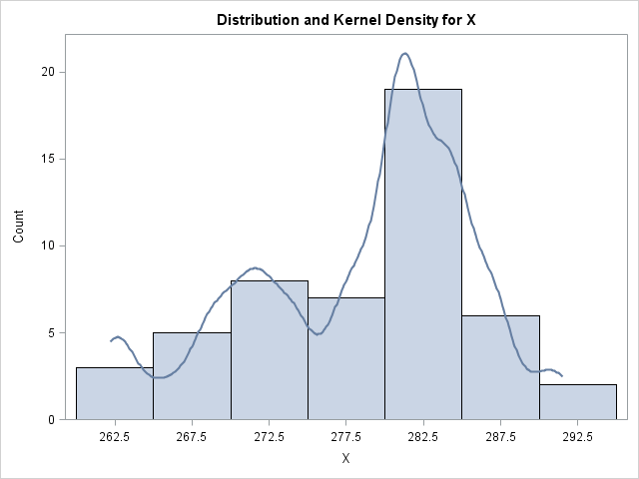
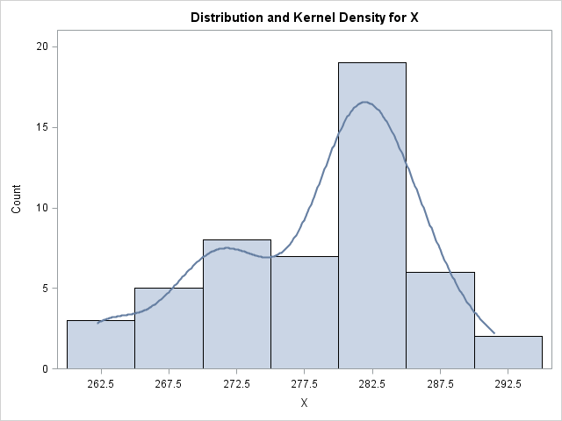
Histogram: Smoothing
Example in SAS (Optional)

Slide 20
Density smoothing in SAS (Optional)
SAS is the focus in 521. It is optional in 551.
When you do visualization in SAS, always turn on the Output Delivery System (ODS graphics on;)
All SAS procedures start with the syntax PROC
The kernel density smoothing procedure is PROC KDE;
You can run the file kde.sas to see how it works.

Slide 21
Mixed variables
Discrete or categorical data alone do not suffer from the bandwidth problem (e.g. the frequency of males and female students)
However, in a bivariate data set when one variable is categorical and the other is continuous, the noisy one “contaminates” the discrete one (e.g. SAT by gender).

Slide 22
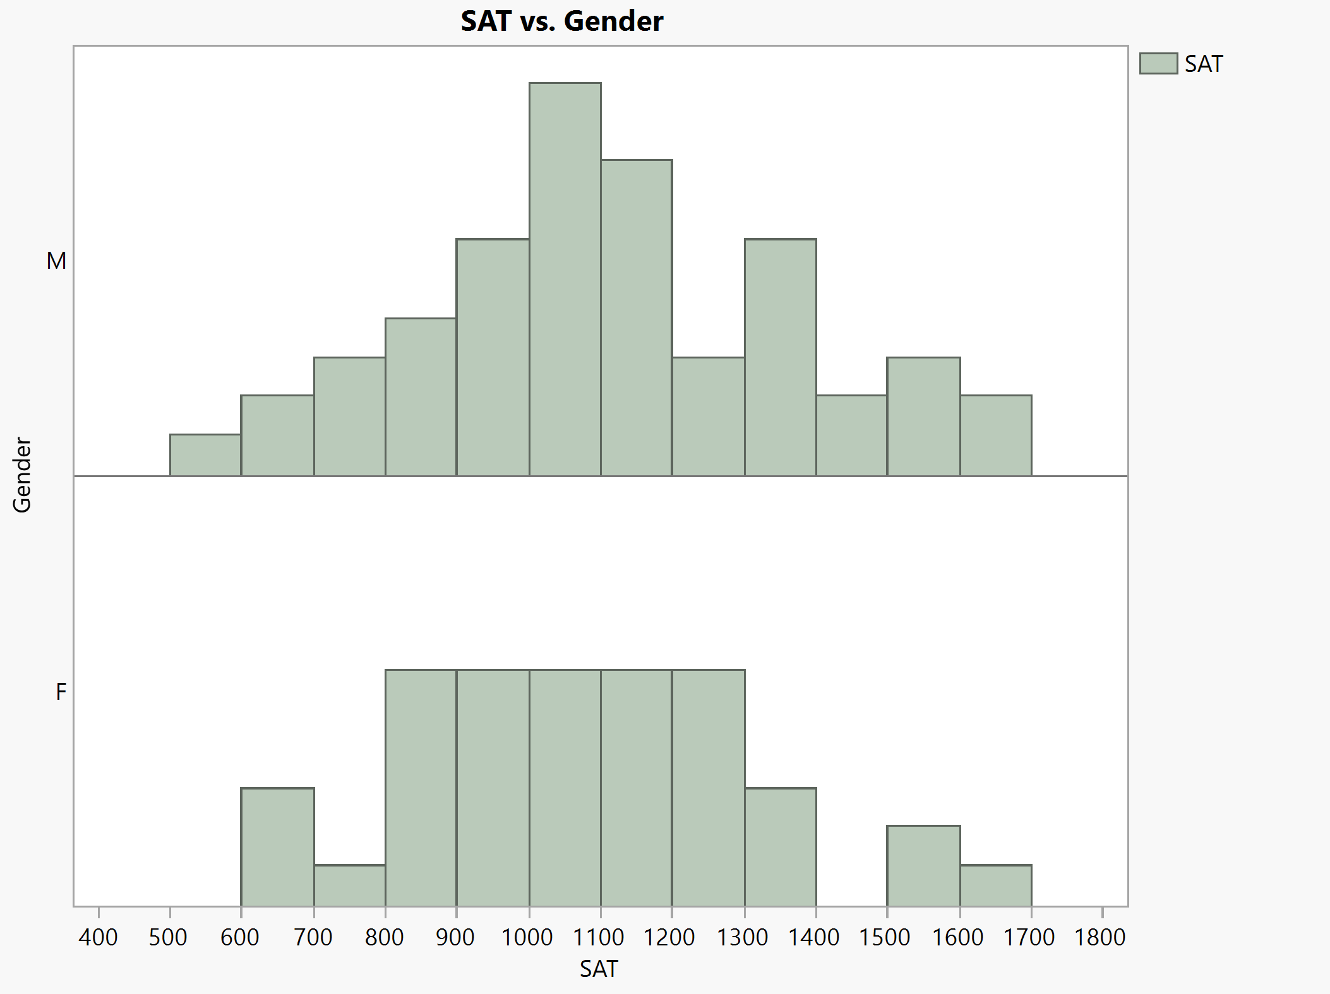
Two Histograms
You may use continuous data as the primary variable and a grouping factor as the secondary variable.
To exam SAT (continuous) by gender (categorical).
Use visualization_data.jmp
In JMP Graph Builder drag SAT into the X-axis.
Drag gender into the Y-axis.

Slide 23
Two Histograms
JMP shows that male SAT is a fairly normal distribution but female SAT is not.
But it would be easier to compare their performance at different score level if the two histograms are back to back.

Slide 24
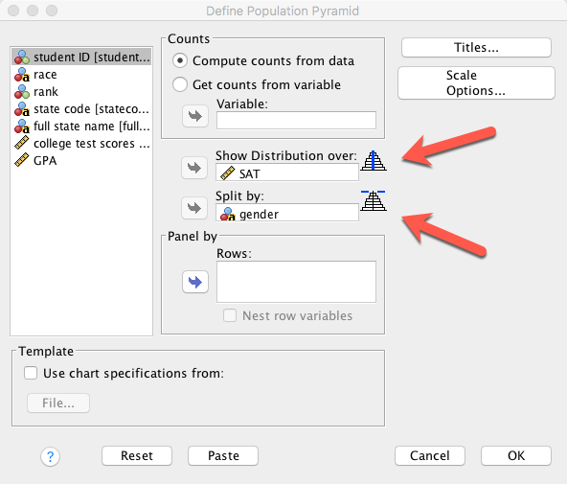
Pyramid graph (back to back histogram)
SPSS is not the focus of 551. This exercise is optional.
Two ways
Graph → legacy dialog → Population pyramid

Slide 25
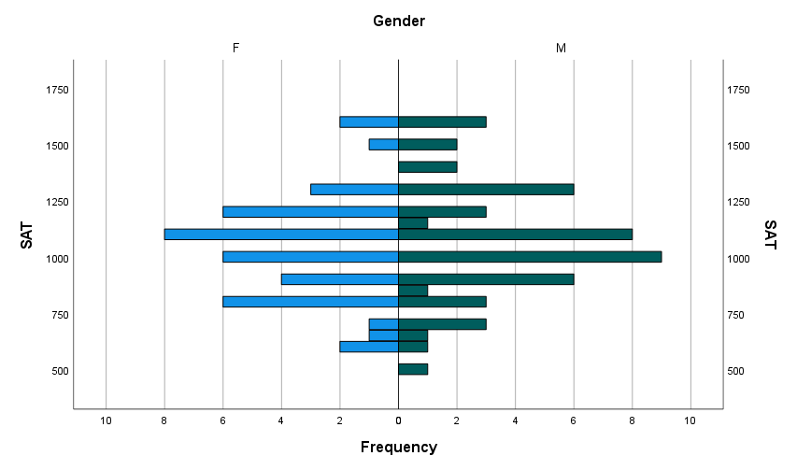
Pyramid graph (back to back histogram)
More males achieved the highest scores than females (At the top the red bars are longer than the blue bars).
But males also obtained the lowest scores.
Shortcoming: The graph is not dynamic. No further manipulation.

Slide 26
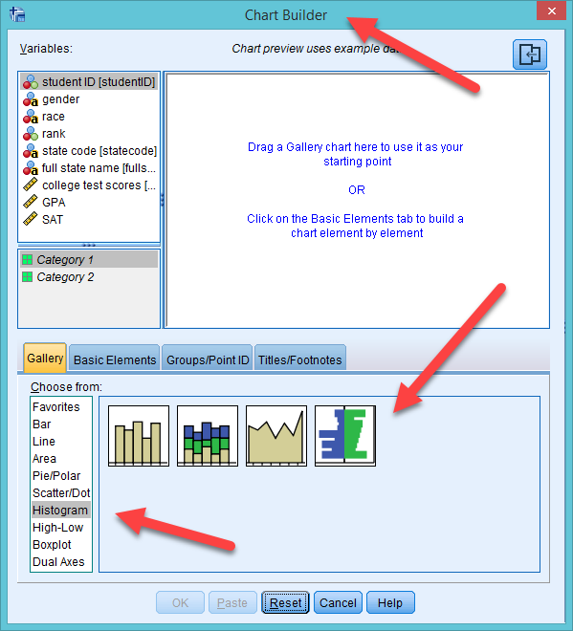
Pyramid graph (back to back histogram)
From Graphs choose Chart Builder
Choose Histogram
Drag the rightmost icon to the canvas.

Slide 27
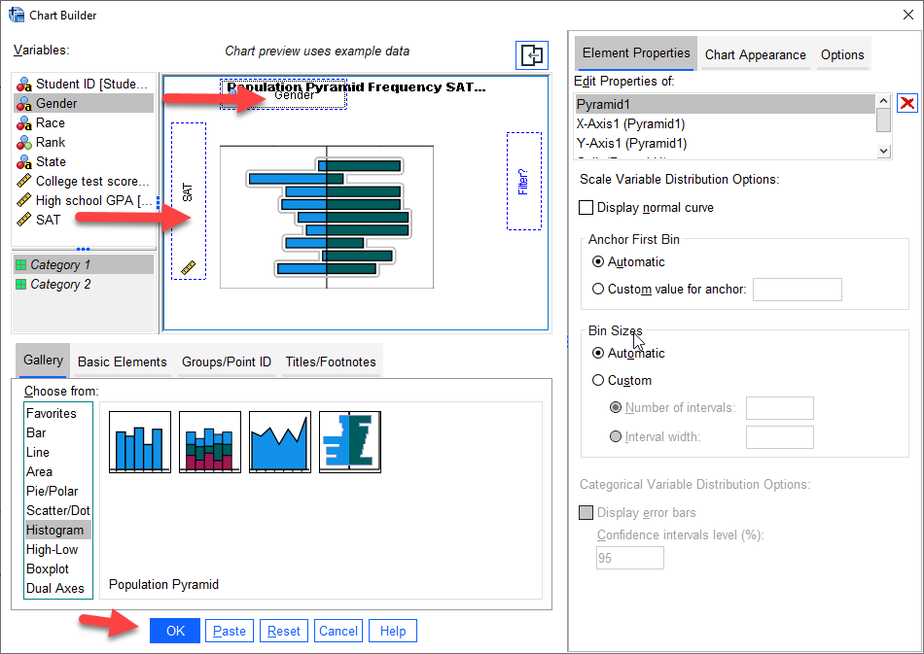
Pyramid graph (back to back histogram)
Drag SAT into Y-axis
Drag gender into X-axis
Press OK

Slide 28
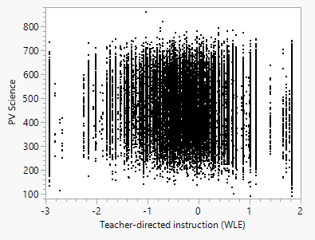
Binning can be helpful!
Noise reduction
Use PISA2018_WLE.jmp
WLE: Weighted Likelihood Estimates
PV: Plausible values (test score)
Too many data! It obscures us from seeing the relationship between science test performance and teacher-directed instruction.

Slide 29
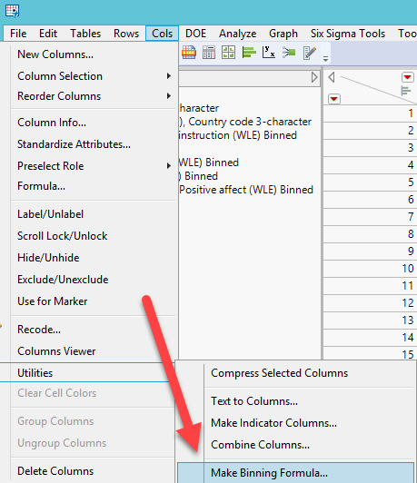
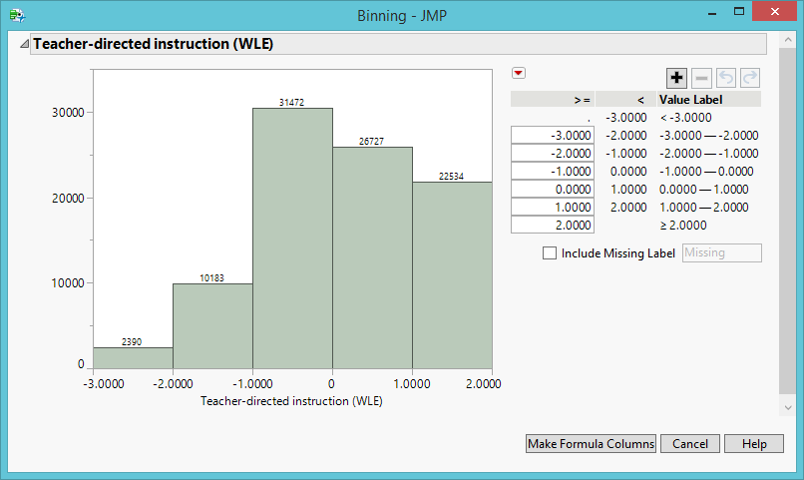
Select the variable and classify the data into different bins

Slide 30
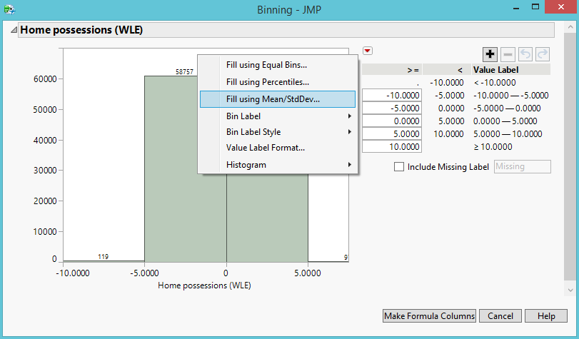
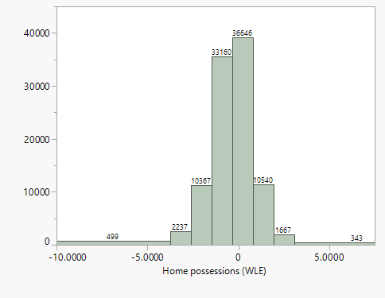
Select the variable and classify the data into different bins

Slide 31
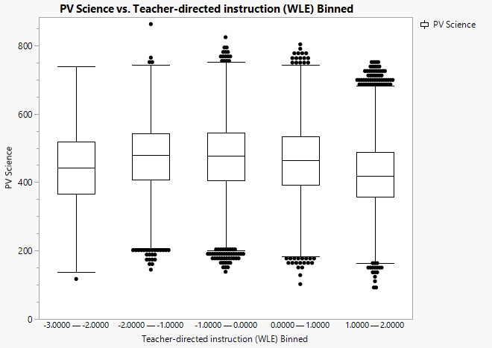
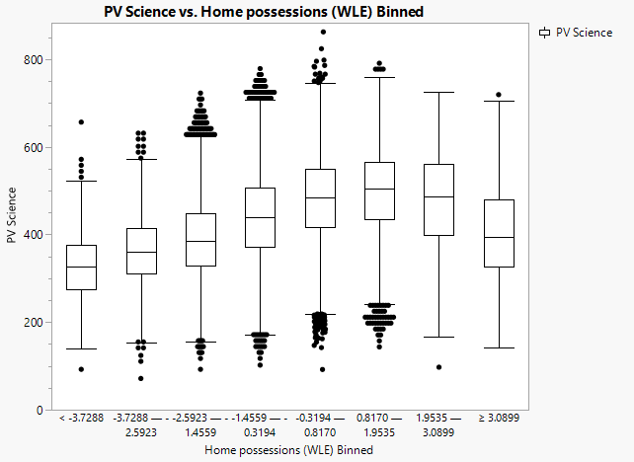
Non-linear pattern emerges!

Slide 32
Ungraded assignment
Use PISA2018_WLE.jmp
Bin all other WLE variables
Use either PV science or PV math as the dependent variable
Use a few binned variables and examine how they are related to science or math test performance.

Slide 33
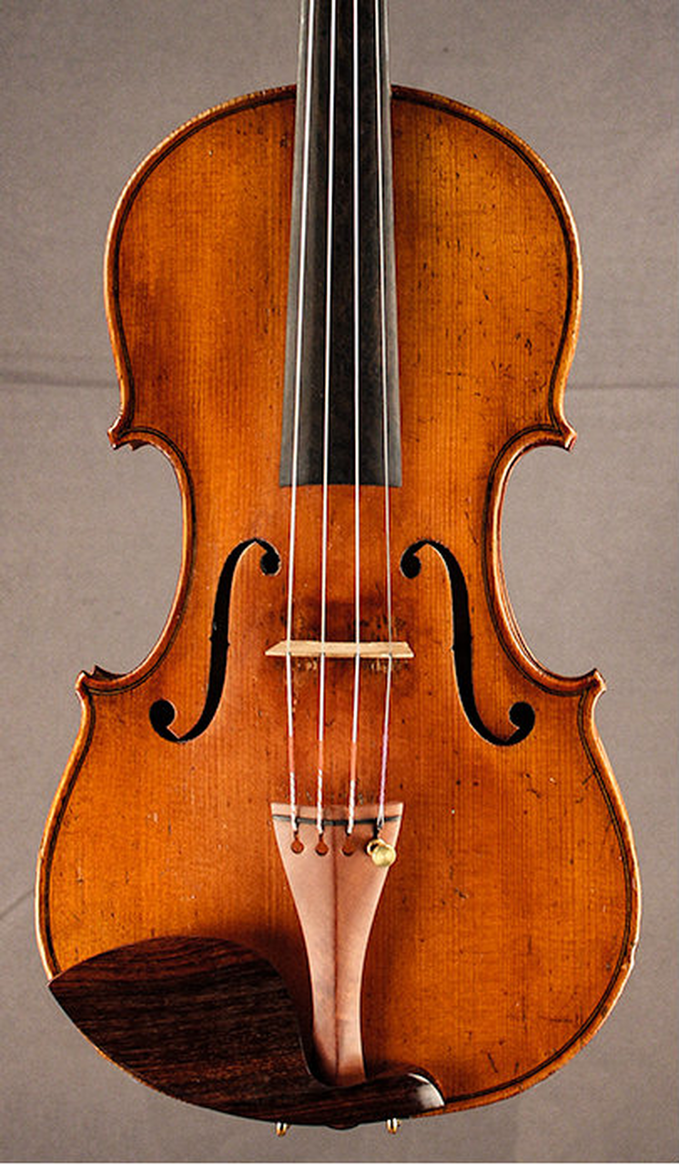
Violin plot
Another way to deal with one continuous variable and one categorical variable.
In JPM, open Hybrid fuel economy.jmp from Sample Data Library.
Open Graph → Graph Builder
Drag Engine into X
Drag City MPG into Y

Slide 34
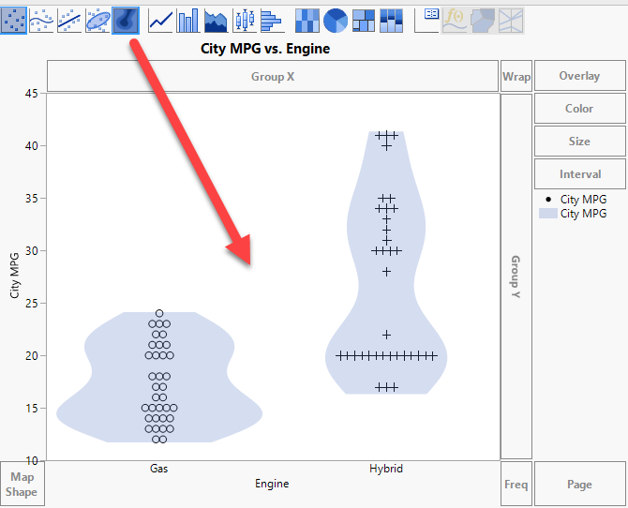
Violin plot
Drag the contour icon into the canvas.
The violin plot is a one-dimensional contour plot.
It shows the density outline of the observations (how many observations at each level).

Slide 35
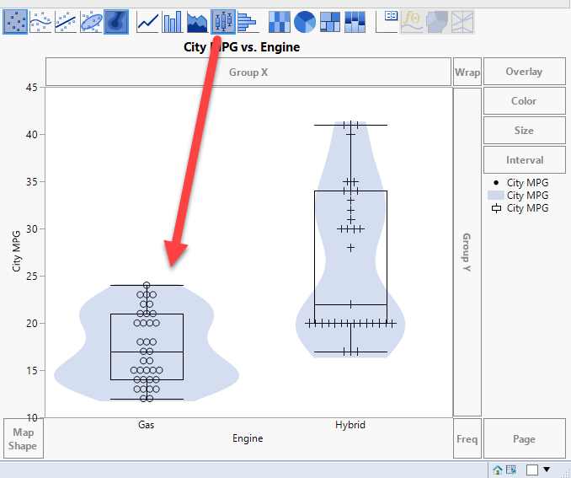
Violin plot
Drag the boxplot into the canvas.
There are three displays in one: raw data, violin plot showing the distribution, and the boxplot showing the 5-point summary.

Slide 36
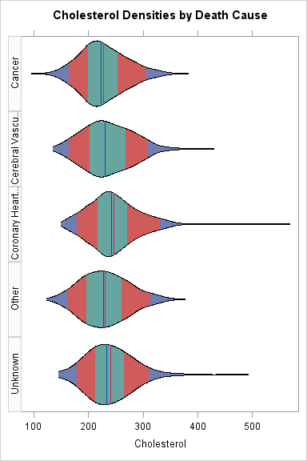
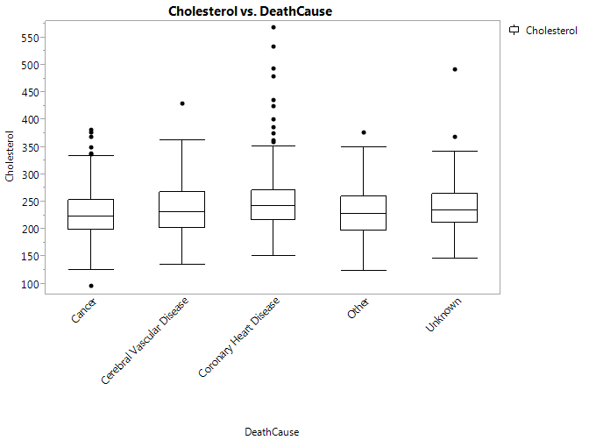
Violin plot in SAS
Use the heart data set in the HELP library.
In SAS the 5-point summary is embedded in the violin plot (by color)
It displays full distribution information, like the density curves, and quantile information (the five–point summary), like the boxplot.
Example: violin.sas (optional)

Slide 37
Violin plot
Unlike the boxplot, it does not explicitly indicate outliers.
Because the violin plot models after the boxplot, the density curve is doubled in order to make it as symmetrical as the boxplot.

Slide 38
Violin plot
This graphical configuration is counter–intuitive because most users do not understand the reason of creating a symmetrical violin plot and what additional information we can obtain from the mirror.

Slide 39
Graphs in SAS programming environment
Graphics in the traditional SAS programming environment are NOT dynamic.
But newer SAS products (e.g. SAS Viya, SAS Visual Analytics) offer dynamic graphics.

Slide 40
Combine violin plot and boxplot (again)
Because both the violin plot and the boxplot have merits and shortcomings, you are encouraged to both.
Use visualization_data.jmp
Graph → Graph builder
Drag state code into X.
Drag college test scores into Y.
Click on the boxplot icon.
Drag the contour icon into the canvas.

Slide 41
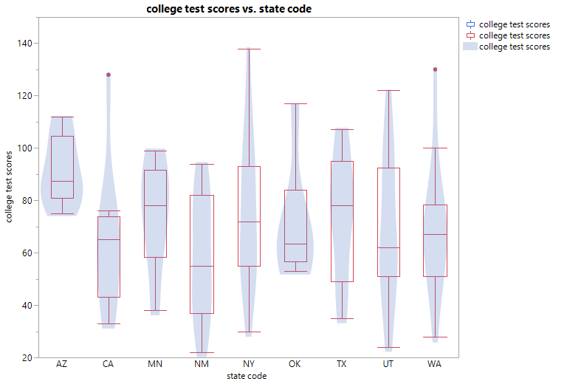
Combine violin plot and boxplot
Now you can see both distribution and quantile information.
And you can spot outliers, too (There is one in “CA” and one in “WA”).

Slide 42
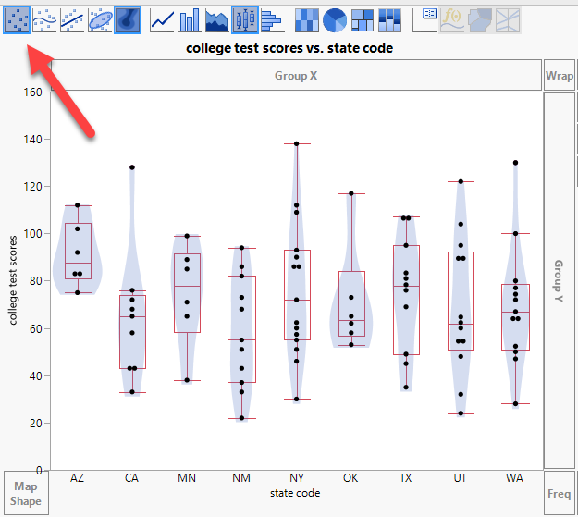
Combine violin plot, boxplot, & raw data
Hold down the shift-key and press the scatterplot icon at the left.
Now you can see the violin plot, the boxplot, and the raw data.

Slide 43
Assignment 4.1
Use visualization_data.jmp
I want to examine GPA by gender.
Use Graph Builder to superimpose a boxplot on a violin plot, and also show the raw data.
Compare the GPA distribution of male and female students.
Compare the GPA quantile information of male and female students.
Save the output into a Word file or RTF file and then upload it Canvas.

Slide 44
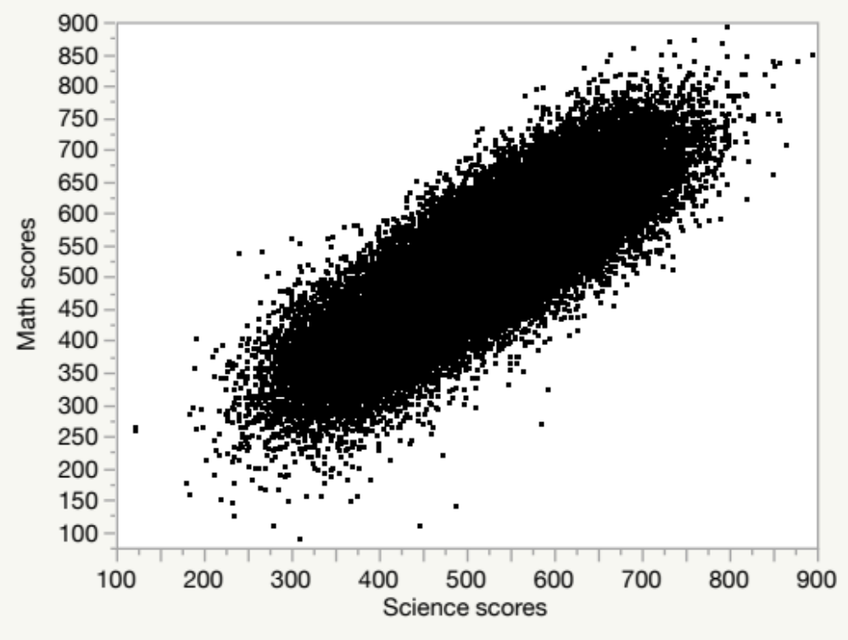
Overplotting
Use PISA2015.jmp in Unit 2
n = 54,978
Analyze → Fit Y by X
A big cloud: Overplotting

Slide 45
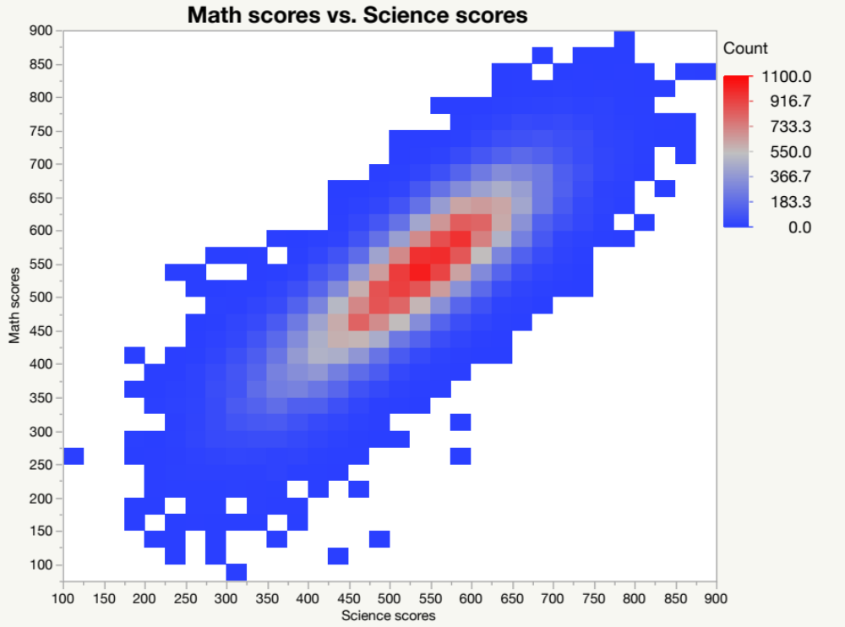
Overplotting
One way to “see through” the cloud is using the heat map (see Unit 3).
Limitation:
  Density is shown by colors only.
  It hides the raw data.

Slide 46
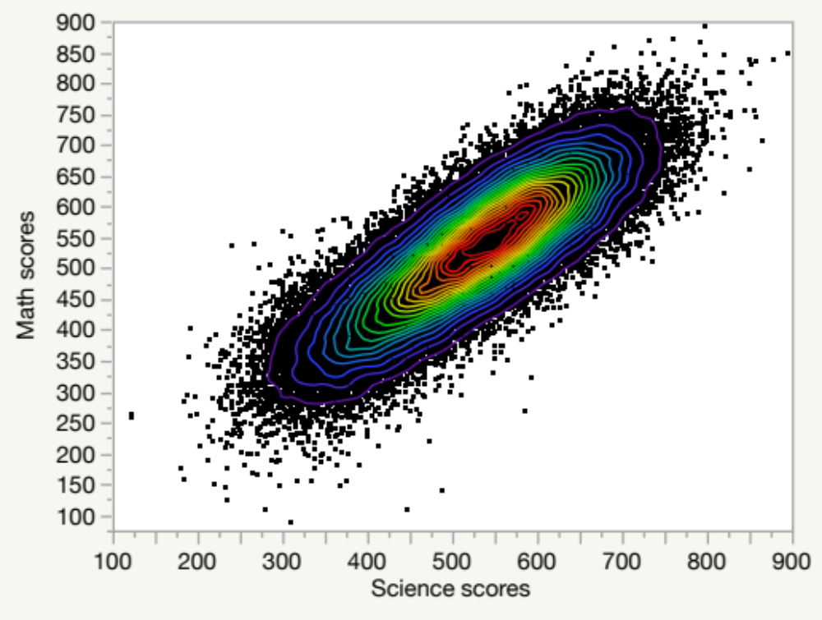
Nonparametric Bivariate Density
From the red triangle choose Nonpar density.
The density of data points is represented by both colors and contour lines.
Its interpretation is straight–forward and no mental translation is required.

Slide 47
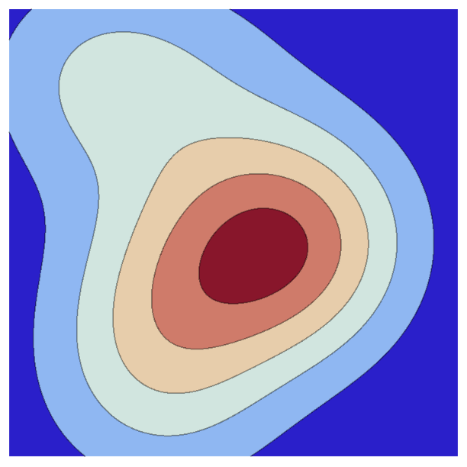
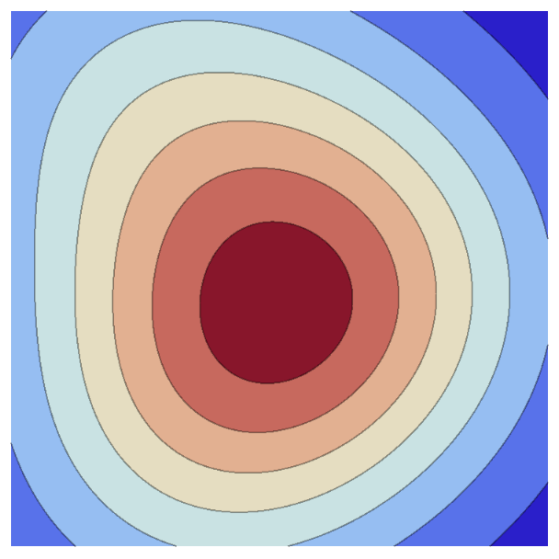
Contour plot
How about using the contour lines without showing the raw data?
It could be confusing and misleading.
The appearance of a one-dimensional histogram is tied to its binwidth or bandwidth.
By the same token, the bandheight of the isolines determines how a contour plot appears.
The two contour plots are based on the same data and they use different bandheights!

Slide 48
Assignment 4.2
Use PISA2015.JMP from Unit 2
Analyze → Fit Y by X
Put Enjoyment to science into Y
Put Interest in broad science topics into X
Create a nonparametric density graph.
Can you see any pattern?

