Slide 1
Multi-dimensional data visualization
Chong Ho (Alex) Yu

Slide 2
Expected learning outcome
You will be able to detect the inter-relationships between multiple variables while facing the challenges of:
  Curse of dimensionality (too many variables)
  Over-plotting (too many observations)

Slide 3
Curse of dimensionality
Before you bring the data into any data visualization software, consider reducing the dimensions (variables):
  Variable selection: drop the variables that are less important or unimportant e.g. stepwise regression (traditional, not recommended), generalized regression, and predictor screening (new)
  Dimension reduction: Collapse variables into a few dimensions e.g. principal component analysis, partial least square.
Optional readings:
  http://www.creative-wisdom.com/computer/sas/collinear_stepwise.html
  http://www.creative-wisdom.com/computer/sas/biplot.html

Slide 4
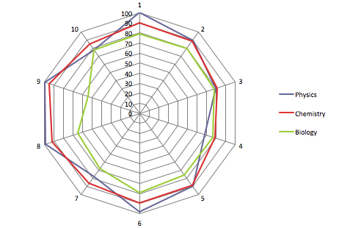
Radar graph
We will start from simple scenarios.
When you have a small data set or summary data (no over-plotting), you can use Excel (e.g. Radar graph).
The biology scores are the lowest and are not correlated to either physics or chemistry scores, but physics and chemistry scores are fairly good predictors of each other.
This visualization approach is applicable to chemistry, toxicology, market research, and health care research.

Slide 5
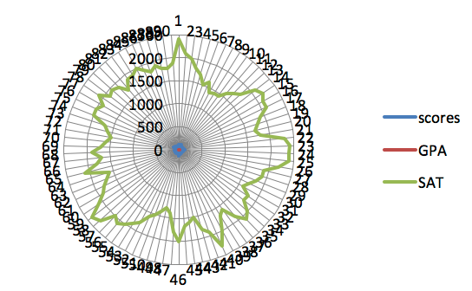
Radar graph: limitation
When there are too many variables, levels, and observations, the data pattern will be concealed.
When the measurement scales are vastly different, it is very difficult, to display a meaningful result using a radar plot.

Slide 6
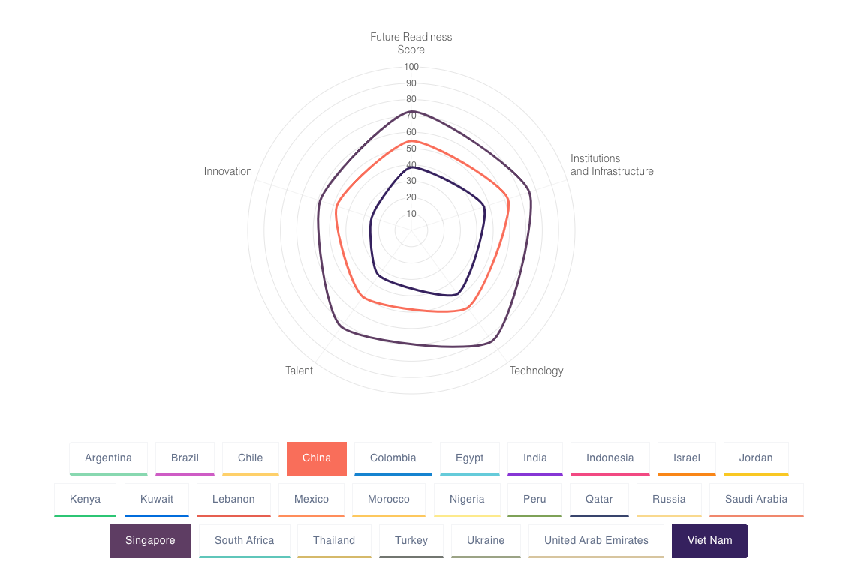
Radar graph
Google uses it for comparing Future Readiness Scores across countries.
When there are many countries (observations), it necessitates a dynamic system.
https://www.portulansinstitutefrei.com/2021/report

Slide 7
Expected learning outcome
You will be able to use coplots (Trellis’s plots) in JMP or Tableau to perform multivariate visualization.
Unlike the radar plot and the needle plot, the coplot can be scaled up .

Slide 8
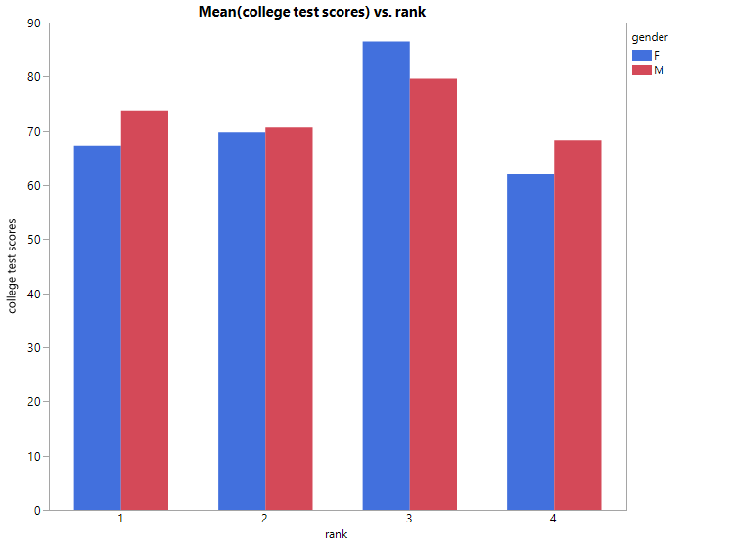
Coplot for multivariate visualization: college test scores X rank * gender
Data set: Visualization_data.jmp
Coplot (Co = Conditional)
Also known as Trellis’s plot
Visualization of three variables (how a relationship is conditioned by the third variable)
Put College test scores on the left Y-axis
Put academic rank on X
Put gender on Overlay at the far right

Slide 9
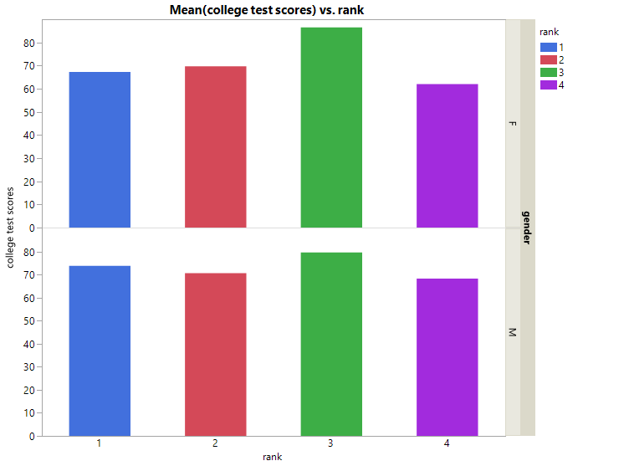
Coplot: college test scores X rank * gender
Put Rank on overlay to assign a unique color to each rank
Put Gender into the right Y-axis
No need to remember the exact procedure; the graph changes by mouse over

Slide 10
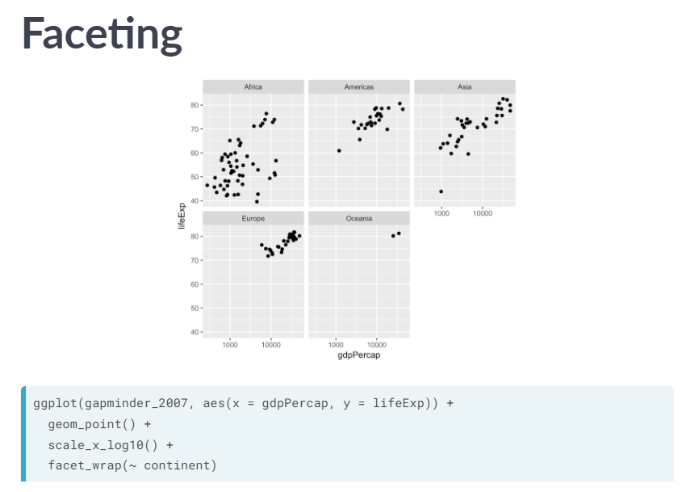
COPLOT
If the coplot has multiple sub-panels, it is known as faceting in R language.
(R will not be covered in this class)
Source: Data Camp

Slide 11
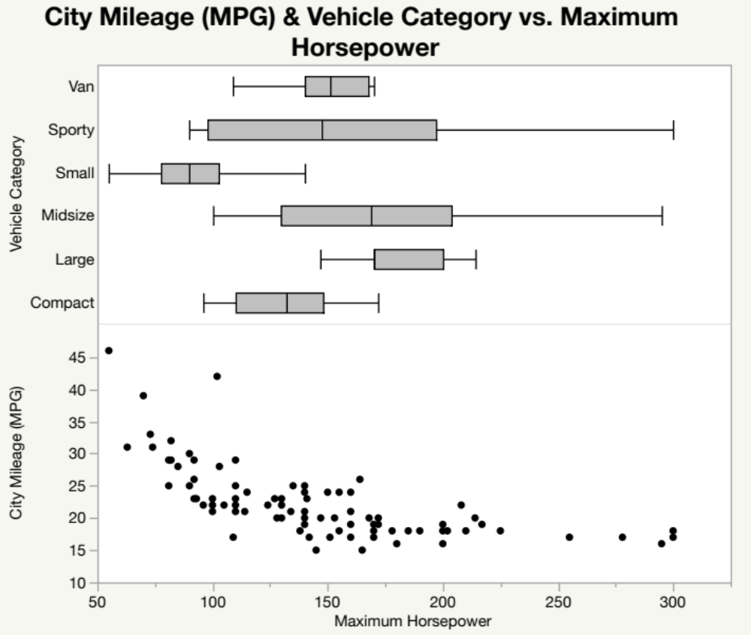
Combining different graphs
Open Cars 1993 from Sample Data Library
Drag City Mileage into Y
Max horsepower into X
Drag Vehicle Category into the upper corner of Y
Drag the box icon into the upper panel Hold down the shift key and click the scatterplot icon to hide the dots.
or do a right-click → Change to boxplot
We will cover more about combining different graphs in the Unit on Dashboard.

Slide 12
Coplot in tableau
Basically, the way of creating a coplot is to dragging and dragging additional conditions into the canvas.
Tableau is very good at it: the interface is similar to Graph Builder in JMP.
Problem: I want to award two scholarships to students from Arizona and California: One is for a male student and the other is for a female student.
I want to take high school GPA, SAT, and college test scores into account.
The last one is more important and so the weight is 150%.

Slide 13
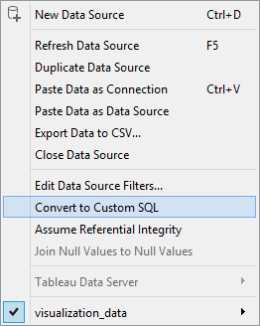
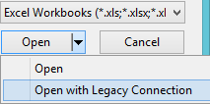
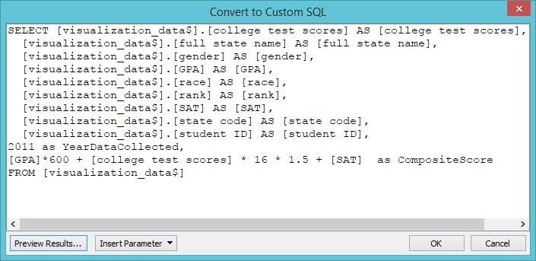
Tableau
Tableau can do more, such as manipulating the data using structural query language (SQL) (Windows only).
SAS have SQL procedures called PROC SQL
http://www.creative-wisdom.com/computer/sas/efficient.html

Slide 14
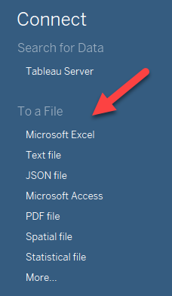
Coplot in tableau
Download free student version of Tableau at: https://www.tableau.com/academic/students
Or a trial version at: https://www.tableau.com/products/desktop/download
Open Tableau
Click on Microsoft Excel
Open visualization_data.xls
Click Sheet 1 at the bottom

Slide 15
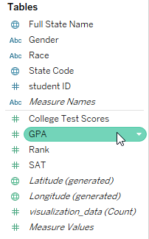
Tableau
Tableau automatically classify the variables into two groups:
  Dimensions: Categorical, grouping variables e.g. Gender, race, state, ID…etc.
  Measures: allows mathematical operations e.g. GPA, SAT, test score.
But you can move them around.
Every variable can be manipulated by using the down arrow or a right-click.

Slide 16
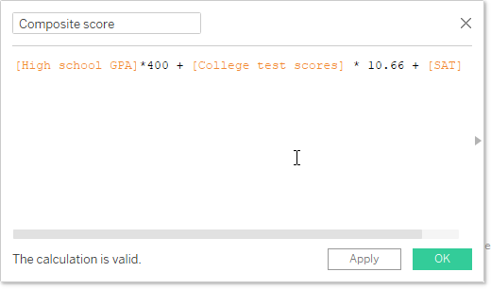
Coplot in tableau
Create a calculation field by right click
The max. of SAT is 1600.
Adjust the 4-point scaled GPA by GPA * 400 (1600/4 = 400)
The max. of test score is 150. Adjust college test score by score * 10.66 (1600/150 = 10.66)

Slide 17
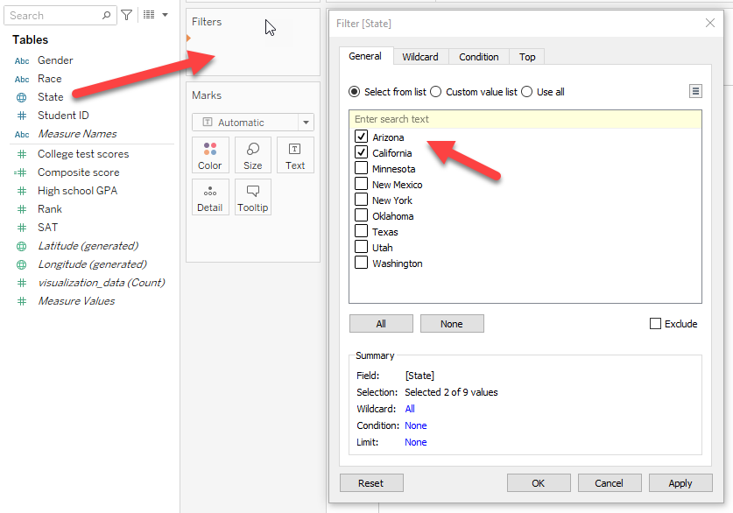
Coplot in tableau
Filter by data by dragging State into Filters
You need to drop it when the orange arrow appears, otherwise nothing will happen.
Select AZ and CA

Slide 18
Coplot in tableau
Put Gender and Student ID into Columns
Put Composite score into Rows
Drag Gender into Color
Click on the top of “Composite score” on the Y-axis to sort the ranking of the students by composite scores
Change the header to “Ranking of students by composite score”

Slide 19
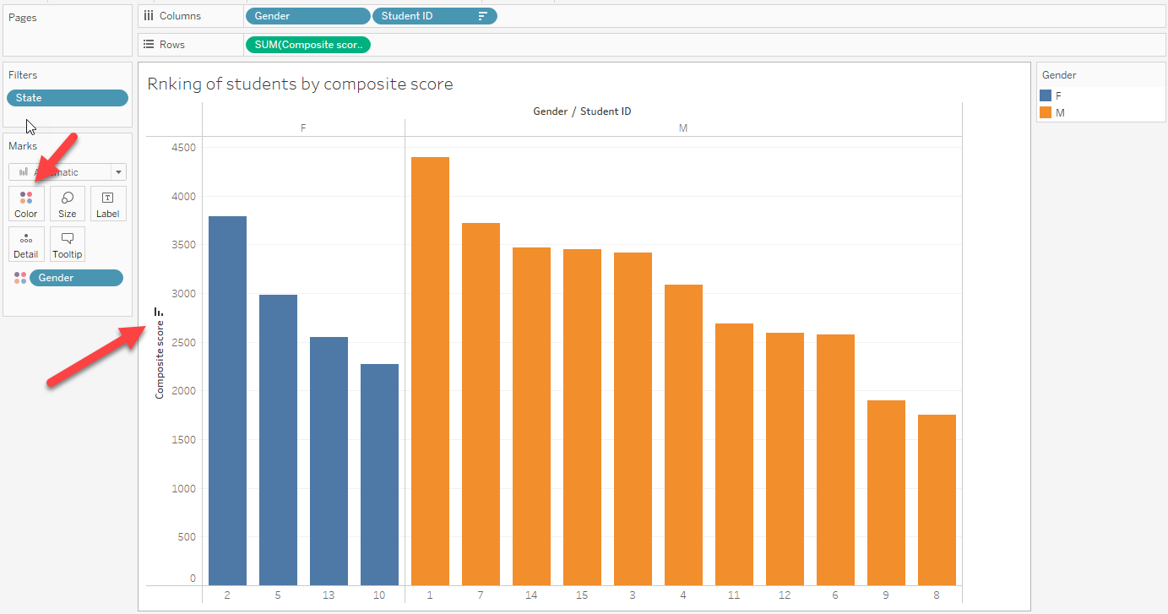

Slide 20
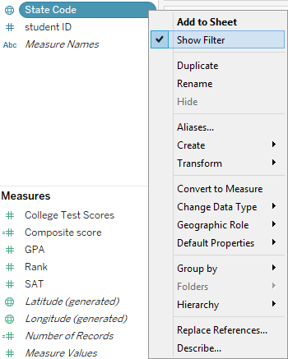
Coplot in tableau
You can drag State into Color to see the home state of each winner
From the green arrow of State Code select Show Filters.
You can select winners from different states by toggling the options in data filter.

Slide 21
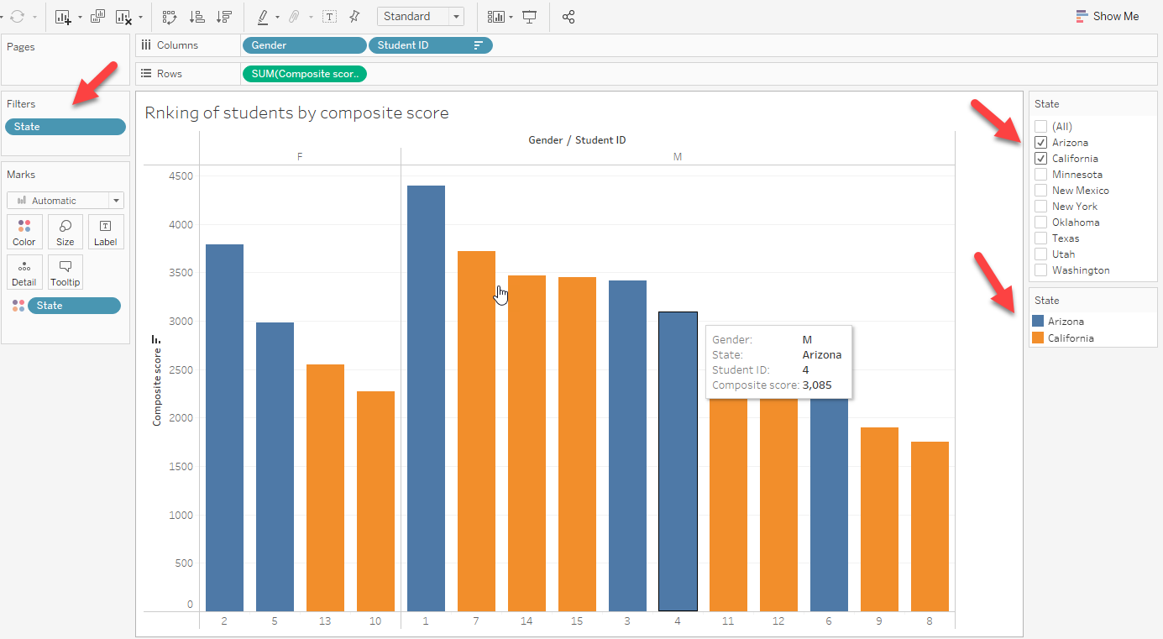

Slide 22
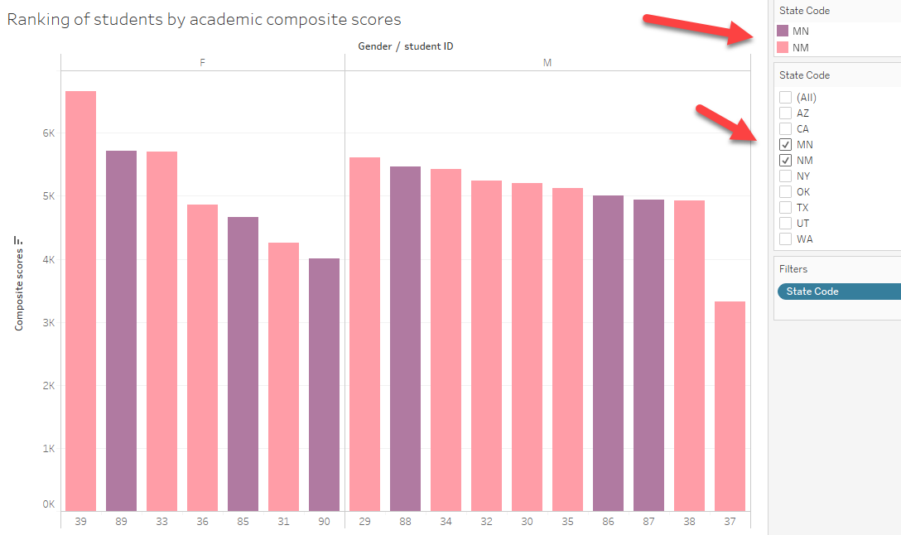

Slide 23
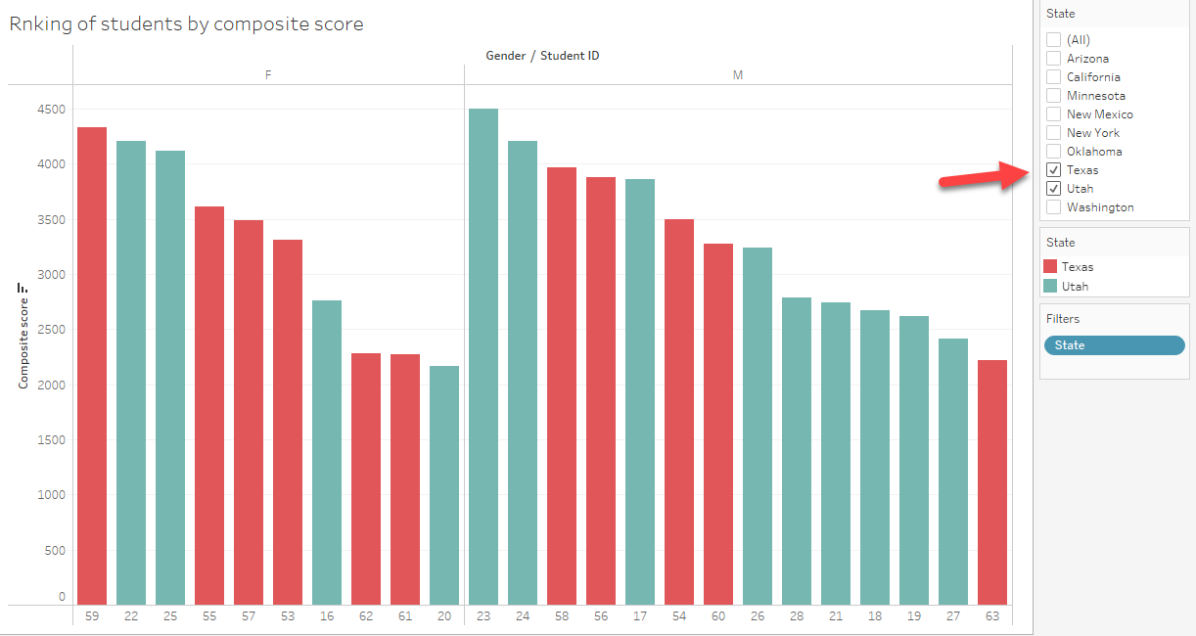

Slide 24
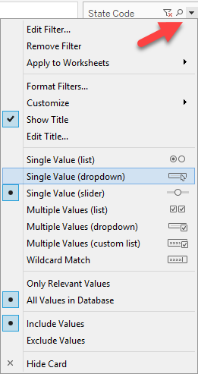
Coplot in Tableau
The default filter is the check box. It is inconvenient to uncheck an option and then check another option.
You can customize the filter list to single value, meaning that when you choose an option, the other one is de-selected. Show the menu from the black down arrow at upper right.
You can also directly type the state code instead of scrolling down the list (It is annoying when I choose a country from a drop list. USA is near the bottom).

Slide 25
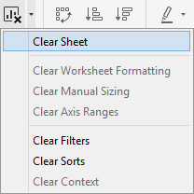
Assignment 5.1
If you have already create a coplot using the previous configuration, please click on the X icon at the top to clear up everything.
This time you want to award the scholarships by state (e.g. one winner from New York, one winner from Arizona…etc.)
This time you want to put more weight into high school GPA (200%), less weight into college test score (150%), and keep the weight of SAT as 100%. Use “calculation field”.
Create a coplot in Tableau and find the winner in each state.

Slide 26
Expected learning outcome
You will be able to use the spin plot to spot multivariate outliers.
You will be able to compare the graphical output with the traditional numeric method (e.g. D2).

Slide 27
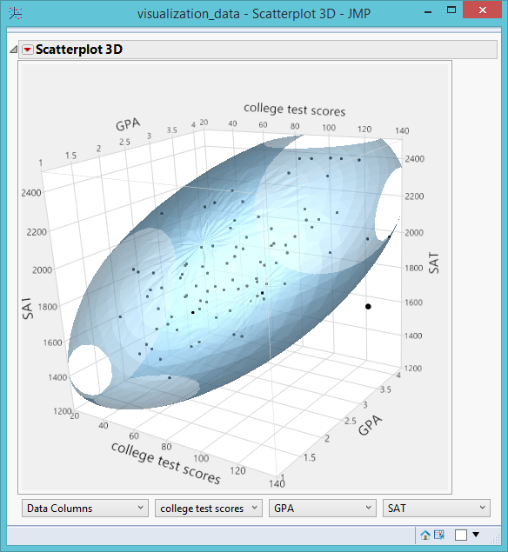
Scatterplot 3D
Also known as 3D spin plot because you can rotate (spin) the plot to inspect the data from different perspectives.
Helpful to spot multivariate outliers
Helpful to detect three-way relationship

Slide 28
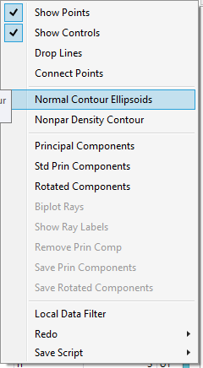
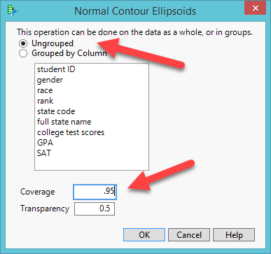
Scatterplot 3D
Data set: Visualization_data.jmp
Variables: college test scores, High School GPA, SAT
Graph → Scatterplot 3D
Inversed red triangle → Normal Contour Ellipsoids
Keep Ungrouped
Change Coverage to .95 (Covered 95% of the data; we have done that before for bivariate data).

Slide 29
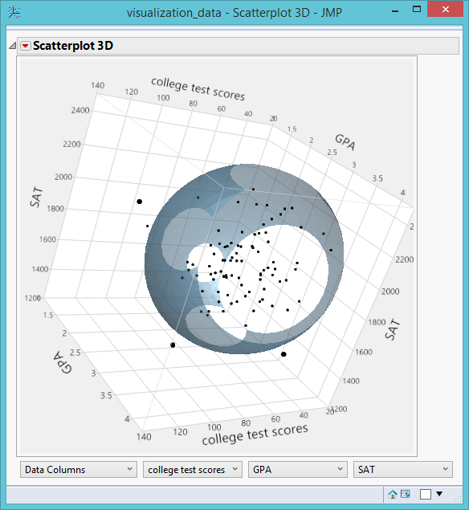
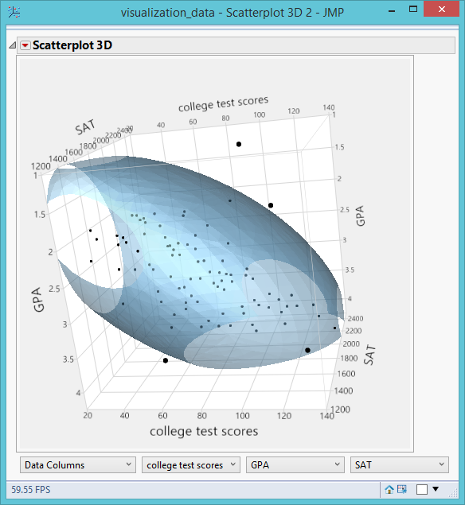
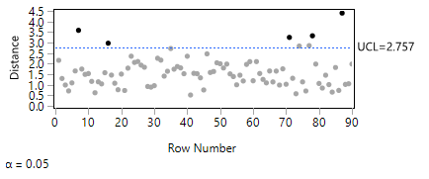
Scatterplot 3D
By rotating the 3D plot, you can identify all multivariate outliers.
Compare the result with Mahalanobis Distances: https://www.statisticshowto.datasciencecentral.com/mahalanobis-distance/
Analyze → Multivariate Methods → Multivariate
Put the three variables into Y
From the red triangle select Outlier Analysis → Mahalanobis Distance
You can explore the data by changing the coverage to .9 or .99

Slide 30
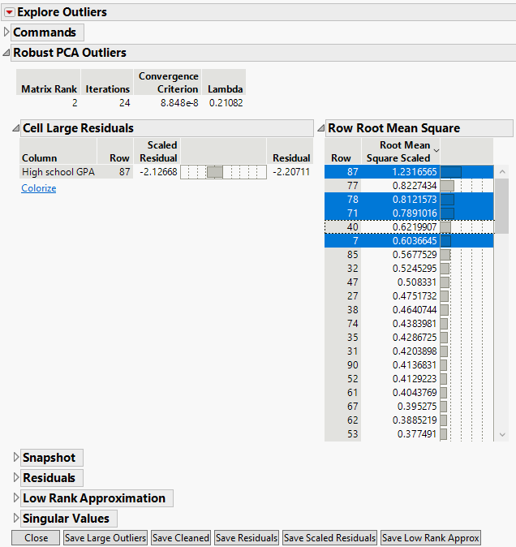
Robust PCA Outliers
Another way: Analyze → Screening → Explore Outliers
Put the variables into Y, Columns
Click on Robust PCA Outliers.
They don’t agree!

Slide 31
Assignment 5.2
Open “US Demographics” from Help → Sample Data Library or from Unit 5 folder
Create a scatterplot 3D with three variables: Obese, Alcohol Consumption, and Physical Activity.
Use .95 for coverage in Normal contour ellipsoids.
Spin the plot to identify outliers, if there is any.
Identify multivariate outliers using Robust PCA and Mahalanobis Distances
Are they the same or different? Which one(s) should you use?

Slide 32
Expected learning outcome
You will be able to use the terney plot to find the grouping pattern (clusters) of the data.

Slide 33
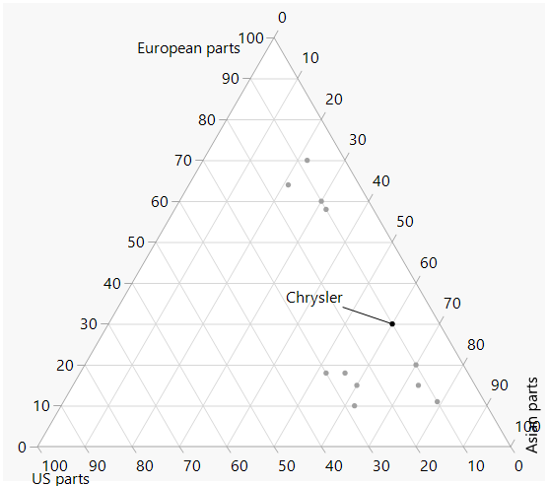
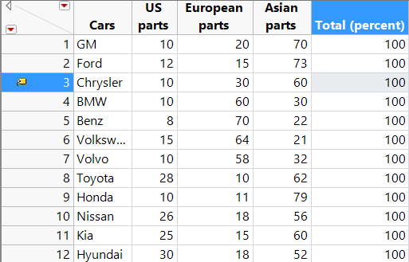
Ternary plot:
Clustering and Profiling
In the era of globalization, how can we define what a USA company is?
One argue that if you buy a Japanese car, you may help reducing the trade deficit because Japanese cars might have many US-made parts.
Data set: cars.jmp in Unit 5 folder

Slide 34
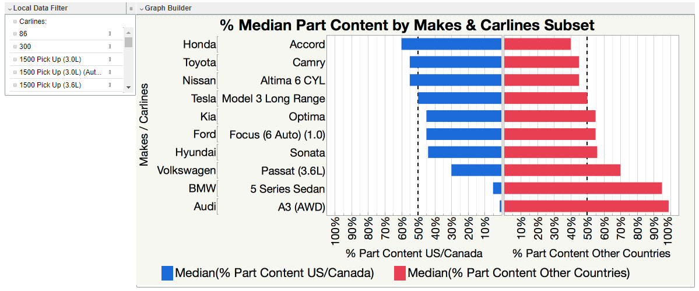
Is buying U.S. cars patriotic?
Source: Scott Wise

Slide 35
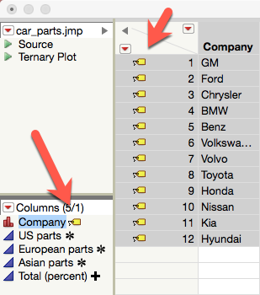
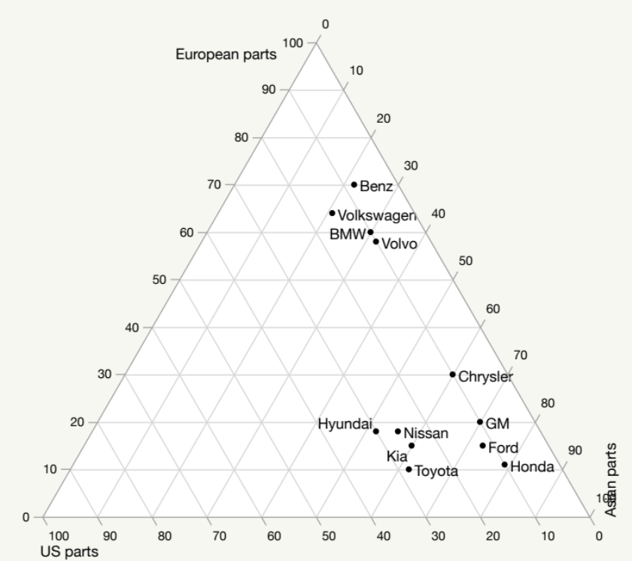
Ternary plot:
Clustering and Profiling
Graph → Ternary plot
Put US, European, and Asian parts into X, Plotting
Use these as coordinates to position each company in terms of the origins of car parts.
Right click → turn on labels to show the name of each automaker.

Slide 36
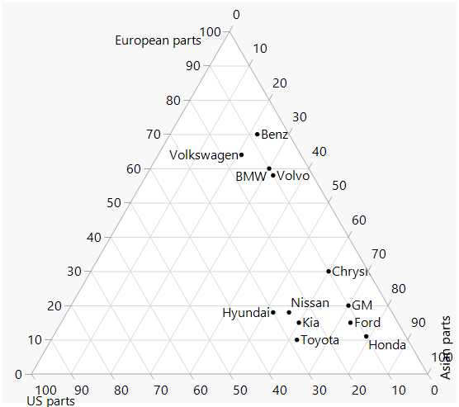
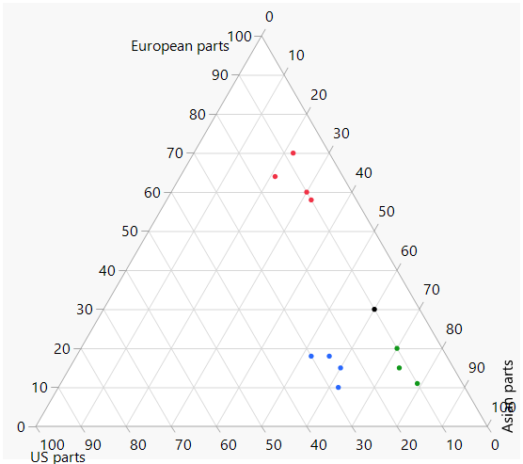
Clustering pattern
There are three clusters, but one company does not belong to any.

Slide 37
Ternary plot:
Clustering and Profiling
The position of each observations is determined by the co-ordinates.
For example, Chrysler has 10% US parts, 30% European parts, and 60% Asian parts. The three implied lines meet at a certain point on the graph.
Limitation:
  Use three variables only
  Must convert the numbers to percentages

Slide 38
Expected learning outcome
You will be able to use different multivariate visualization techniques to go beyond three-dimensional data.

Slide 39
Visualizing multiple dimensions by colors and markers
Data set: visualization_data.jmp
I want to know how academic rank and gender moderate the relationship between high school GPA and university test scores.
Fit Y by X
College test scores → Y
GPA → X

Slide 40
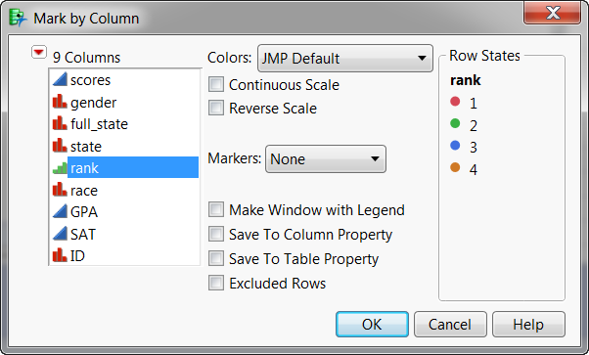
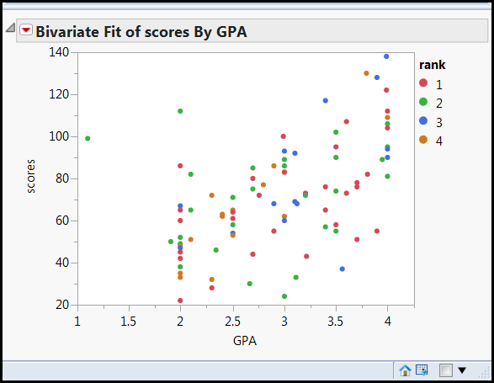
Right click on the scatterplot and choose Row legend.
Select Rank and Keep the default color assignment.
Now you are viewing three dimensions.
Everything is everywhere! Good! No systematic concentration.

Slide 41
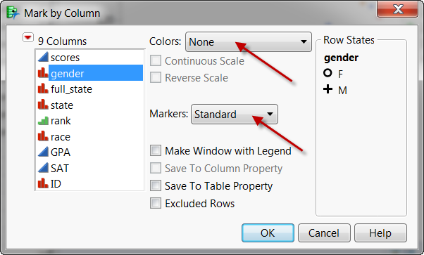
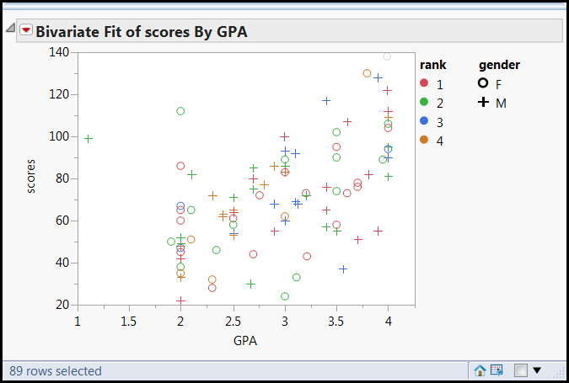
Right click again to choose Row legend.
Do not assign colors to gender.
Use sex symbols for gender marker.
A green O is a female sophomore; a red + is a male freshman.
Four dimensions!
Everything is everywhere! Good!.

Slide 42
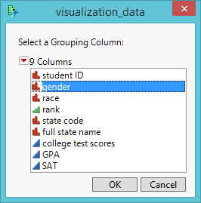
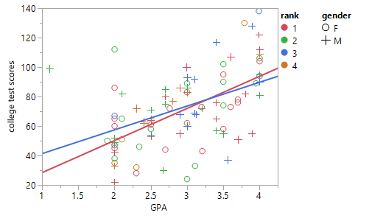
Regression by gender
Inversed red triangle → Group by
Select Gender
Fit line
Different regression slopes for each gender

Slide 43
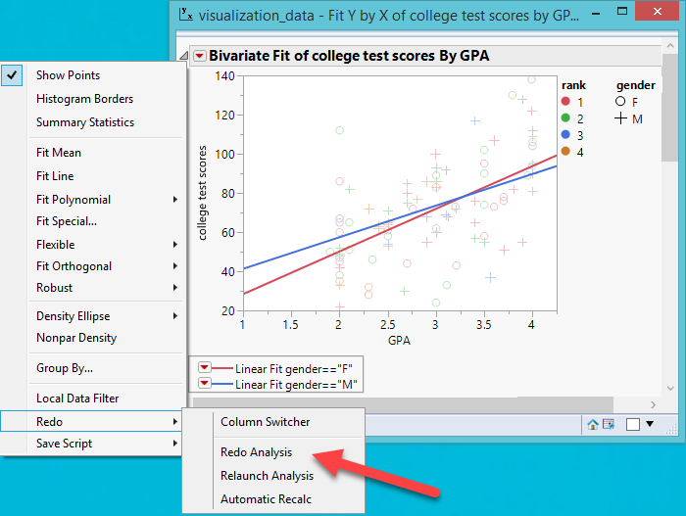
Regression by gender
But there is an outlier!
Select the data point
Right-click and remove it (Row Hide and Exclude)
Inversed triangle → Redo →

Slide 44
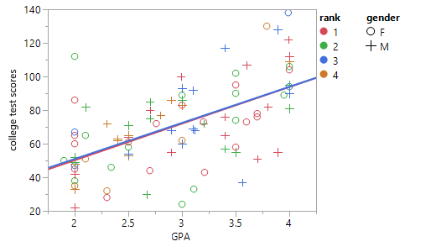
Regression by gender
By removing just one outlier, the regression lines of male and female students are the same!

Slide 45
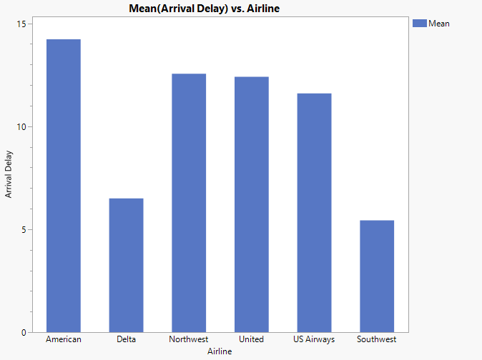
Drill down
Seeing four or more dimensions simultaneously may cause cognitive overload. You can localize the information by seeing one particular subset at one time.
Use drill down to dig into the next level of detail if a particular piece of data is interesting
Open “Airline Delays”
From Graph Builder create a histogram (X = Airline; Y = Arrival delays”
American Airlines has the longest delay. What is going on?

Slide 46
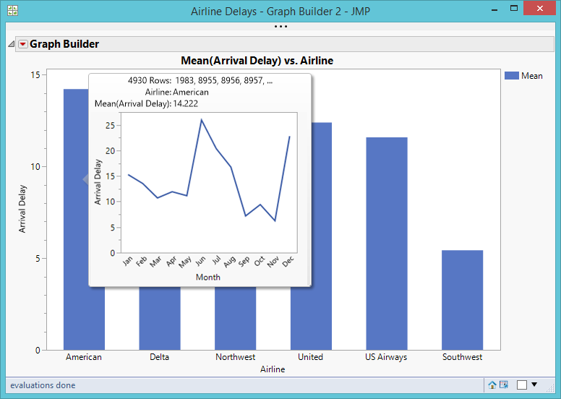
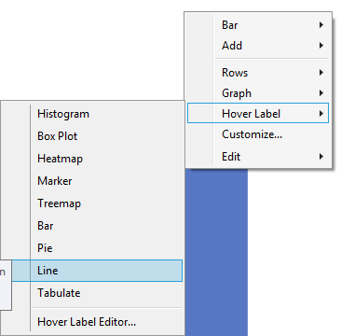
Drill down
Right click on the graph
Choose Hover Label
Choose Line
Mouse over “American” and a line chart pops up

Slide 47
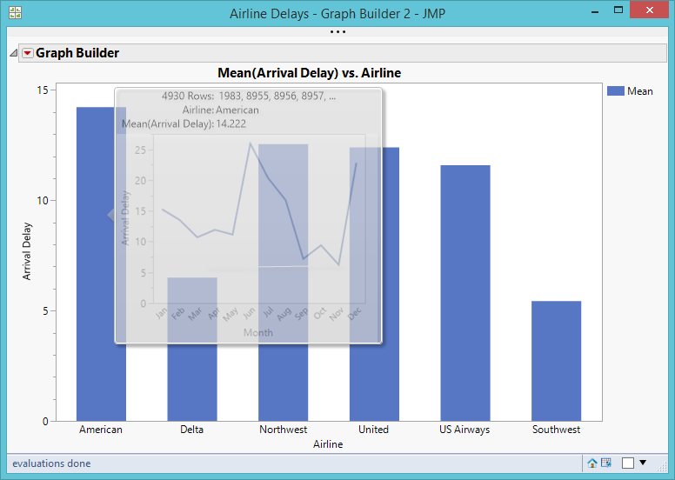
Drill down
If you don’t want the pop-up line chart of delay by month obscuring the bar chart, you can hold down the shift key while hovering over “American.”
You can keep moving the mouse cursor to other airlines.
If you click on the line chart, the graph will expand..

Slide 48
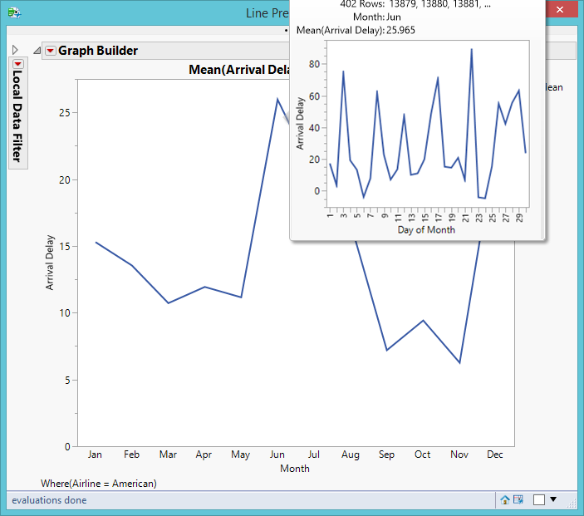
Drill down
It seems that the worst is June.
When you mouse over “June,” another line chart showing Day of Month pops up.
Click on the new line chart and it will expand.
The worst is day is June 22.
Investigate what happened on that day!

Slide 49
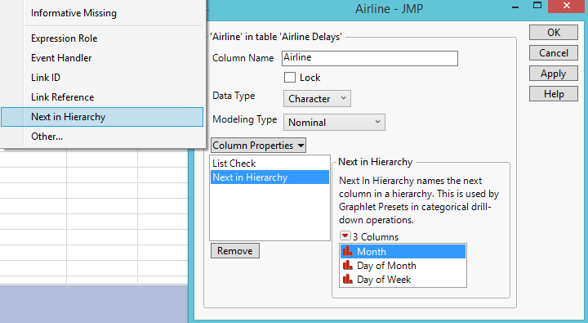
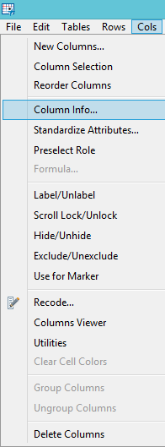
Drill down
How can JMP know the hierarchy?
Select Airline
Choose Column Info from Cols.
Choose Next in Hierarchy from Column Properties.
Arrange the level of variables

Slide 50


Drill down
This example shows a temporal order: Month, Day of Month, Day of Week.
If you have a spatial data set, it could be: Country, State/Province, Region, County, City, Zip code.
Will do this in the Unit “GIS”

Slide 51

Beyond 4-dimension: Linking and brushing
Reuse visualization_data.
You can do limited linking and brushing by pressing the bar icon at the upper left corner of the data table.

Slide 52

Beyond 4-dimension: Linking and brushing
From analyze choose Distributions
Select gender, rank, state, college test score, HS GPA, and SAT.
What are the characteristics of top performers in the college test?
They are from WA, UT, and CA.
Their high school GPA is good but their SAT is not necessarily good.

Slide 53

Linking and brushing
Interestingly, students whose high school GPA is perfect (4.0) are not the top performers in college.

Slide 54

Scatterplot matrix
Use Cars 1993 from the Sample data library or in Unit 5 folder
Analyze → Multivariate methods → Multivariate
Put the five variables into Y columns as shown on the right panel.

Slide 55

Scatterplot matrix
The shows the inter-relationships between five variables.
The upper triangle and the lower triangle (separated by the diagonal line) mirror each other, showing the same information.

Slide 56

Scatterplot matrix
You can add more information into the scatterplot matrix by selecting the options from the red triangle.
  Fit regression line
  Density Ellipses
  Correlation (Pearson’s r)
  Histogram
  Frequency count

Slide 57

Output the image
This step is for Windows user only
Open File → Preferences
Select “Never” in Auto-hide menu and toolbars.
Back to the scatterplot matrix, from File select Export.
Select PDF.

Slide 58

Output the image
Is it easier to do a right-click and copy? Yes, but the image is pixel-based.
The image is vector-based graphic. Even if you enlarge it to 1600%, the image is still sharp. It will be very good for poster presentation.

Slide 59

Edit the image
If you have a full version of Acrobat (not the reader), you can edit the text and the image.
In Acrobat, go to Tools → Content → Edit Object

Slide 60


Scatterplot matrix: make it simple

Slide 61

Scatterplot matrix in graph
The default is lower triangle.
Fewer options.

Slide 62

Multivariate methods
Multivariate methods accept both continuous and categorical variables.
Domestic manufacturers are coded as 1 (yes) or 0 (no).
Never use 1 and 2!!!!!!!

Slide 63

Color map
You can summarize the inter-correlations by color map.
From the first red triangle choose Color maps → Color Maps on Correlations.
You can easily see which pair has a strong correlation and which pair has a weak correlation.

Slide 64

Parallel coordinate
You can also look at the big picture and individual observations in parallel coordinate plot (slope plot).

Slide 65
Assignment 5.3
Use cars 1993 or your own data set
Use at least six variables to create a scatterplot matrix. One of them must be a categorical variable.
Add histogram and regression line into the matrix. Also output the color map and the parallel coordinate.
Output your scatterplot matrix to PDF.
Enlarge it to 800%. Is the image still very sharp?
Write a one-page report to describe the inter-relationships of these six variables.

Slide 66


Prediction Profiler
Data set: Help → Sample data library → US Demographics or in Unit 5 folder
Analyze → Fit model
Y = obese
Xs = Vegetable consumption, smokers, physical activity, Alcohol consumption
Response scores → Factor profiling → Profiler

Slide 67
Prediction Profiler
What would the obesity rate be if vegetable consumption is high, the smoker rate is low, physical activity is medium, and alcohol consumption is low?
Ask “What if….” question?
You can use profiler to go beyond 5 dimensions.

Slide 68
Prediction Profiler
If you want to share the interactive result with people who don’t have JMP, you can export it as interactive HTML. No plug-in is needed.
Mac: Export
Windows: Save as
Example: http://www.creative-wisdom.com/teaching/551/Lecture_PowerPoint/Unit_5_multi-dimensional/profiler.html

Slide 69
Assignment 5.4: Linking and brushing
Use visualization_data.jmp
Show the distributions of gender, rank, state, college test scores, high school GPA and SAT.
For diagnosis purposes: what is the profile of the lowest performers in the college test?
Select male students. What is the profile?

Slide 70
Specific learning outcome
You will understand the concept of interaction (e.g. the relation of Y and Y is inconsistent across different level of another variable).
You will know how to use Excel and other simple tools to detect interactions.

Slide 71

What is interaction?
Dependent variable: Recovery from drug abuse
At the baseline (Time point 1), the intervention (treatment) group scored higher than the control group.
At the discharge (Time point 2), the control group scored much higher than the intervention group.
The difference between the control and intervention groups in terms of recovery is inconsistent across times.
A two-way interaction: treatment type X time

Slide 72


No interaction, main effect only
Both the control and intervention groups grow from lower scores to higher scores from Time Point 1 to Time Point 2.
The growth of control and that of intervention are consistent across time.
The main effect of time is significant (p = 0.0047)
The time X groups 2-way interaction effect is not significant (p = 0.8275).

Slide 73

No interaction, NO main effect
Both the control and intervention groups have almost the same scores at Time Point 1 to Time Point 2.
No main effect of groups
No main effect of time
No interaction effect.
Absolutely nothing!

Slide 74

Detect interactions in Excel
It is easier to visualize interaction effects in Excel.
When there are A, B, and C factors and all factors have two levels, the analyst is interested in whether the A*B effect in C₁ and C₂ are consistent. If they are consistent, s/he could conclude that the three–way interaction is not present.
Two-plot approach or one-plot approach

Slide 75

Two-plot approach (Optional)
A*B cell means are plotted on the condition of C1 and C2 separately.
In this case it shows a two–way interaction of A*B in both conditions.
The fact that the shape of two interactions is similar implies the absence of three–way interaction.

Slide 76

One-plot approach (Optional)
The one–plot approach is quicker than the two–plot method for investigating the three–way interaction.
The C₁ and C₂ means across all the A*B cells are drawn. The cell mean plot blatantly reveals a consistent effect across all A*B cells and thus a three–way interaction effect is absent.

Slide 77

Aiken and west’s plot (Optional)
To detect the two–way interaction in regression, Aiken and West suggested to plot the regression lines of X against Y on the conditions that Z is at the mean, one standard deviation above the mean, and one standard deviation below the mean.

Slide 78
Aiken and west’s plot: Limitations (optional)
The raw data are hidden and thereby the visualizer has no information about the residuals.
This discrete approach fails to depict the continuous nature of the function.

Slide 79
Dancing with multi-way interaction
The objective of showing you these graphics is to let you be aware what options you have if you want to do multi-dimensional data visualization in the future. It is NOT required to learn how to create these graphics now.
Can be done in Mathematica or Maple.

Slide 80


2-way interaction
You can plot 3 dimensions (3 variables) using 3 axes (a, b, c) in a 3D plot.
Detecting and interpreting two-way interactions in regression may be very complicated. Using a mesh surface is much clearer.
Interaction means inconsistency.
If the surface is not curved, it means that the relationship between a and c is consistent across all levels of b (top graph). No interaction!
If the surface is curved, the relationship between a and c varies across different levels of b. There is a 2-way interaction (bottom graph).

Slide 81


Dancing with 3-way interaction
In the three-way interaction, the fourth dimension is the temporal dimension (e.g. when d = 1, d = 2, d =3…etc.)
Interaction: the effect of X on Y is not consistent across all levels of A and B → regression lines vary.
If there is NO interaction, there should be no curving or dancing in the movie. Every frame should look the same.
http://creative-wisdom.com/multimedia/regression.html

Slide 82
Wolfram
There are three ways to create interaction plots in Mathematica:
  WolframAlpha.com (free)
  Wolfram Cloud
  Mathematica Desktop

Slide 83

Wolframalpha.com

Slide 84

Wolframalpha.com
This is a regression equation: y = a + b1x1 + b2x2 + b3x3 + e → 0.32 + x*0.2 + z*0.12 + x*z*0.45 + 0.012
Paste the code into the box: Plot3D[0.32 + x*0.2 + z*0.12 + x*z*0.45 + 0.012, {x, -10, 10}, {z, -10, 10}, PlotPoints -> 50]
Wolfram Alpha can create 3D graphs with different perspectives.
Drawback: Non-dynamic and non-interactive. Each one is a still image and you cannot rotate it.

Slide 85

Wolfram
Go to wolframcloud.com
Open a new notebook
Paste this into the box: Plot3D[0.32 + x*0.2 + z*0.12 + x*z*0.45 + 0.012, {x, -10, 10}, {z, -10, 10}, PlotPoints -> 50]

Slide 86





Wolfram
You can rotate the graph to examine the interaction, add contour lines, or manipulate the graph in different ways.

Slide 87

Mathematica
You can expand 3D to 4D by treating the fourth dimension as the temporal dimension: t

Slide 88
Rules of thumb
2-dimensional (2D): No crossing, no interaction
3D: No curved (twisted) surface, no interaction
3D and beyond: No motion (all frames look alike), no interaction

