Slide 1
Visualization for Time-series data
Chong Ho Alex Yu

Slide 2
Expected learning outcomes
You will understand why it is a good practice to use trend-based data.
You will understand the difference between the tall and wide structures, and also how to convert these formats back and forth.
You will be able to use still and animated graphs (e.g. Bubble plot) to examine trends and patterns across different time points.
You will be able to use graphing methods to examine the overall pattern (e.g. Least square mean plot) and diagnose individuals (e.g. parallel coordinate plot).

Slide 3
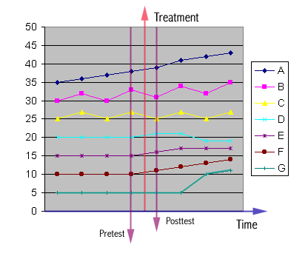
One-shot or pre-posttest only
Why trend-based data?
A: This indicates that the change is a result of natural growth.
B: This behavioral pattern is a cycle with a natural growth tendency. By chances the pretest may be given at the top of the cycle and the posttest may be given at the bottom of the cycle, or vice versa.
Market trend

Slide 4
One-shot or pre-posttest only
C: This pattern resembles B except that there is no growth.
D: This shows a short-term gain. It is not uncommon that a new treatment induces short-term improvement, but this effect does not last. After the excitement is cooled down, the performance may be worse than before.
Example

Slide 5
One-shot or pre-posttest only
E: Short-term gain. Even though the momentum doesn't continue, the performance doesn't’fall back.
F: Long-term gain. Not only the learner learned the knowledge, but also learned how to learn (became a life-long learner).

Slide 6
One-shot or pre-posttest only
G: It seems that there is no effect. However, the effect is latent and thus it takes time for the treatment to show its effect. Although the learner did not learn much information from the treatment, he might be motivated to further utilize the medium in other situations, or he might acquire a new tool and use it to solve other problems.

Slide 7
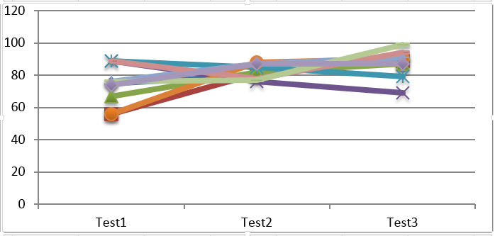
Another example
When you look at the mean of each test, you may miss some interesting information.
A lot of score variability in Test 1. After the treatment, there is a short term equalizing effect. Test 2 variance is smaller.
But at the end the scores spread out again.

Slide 8
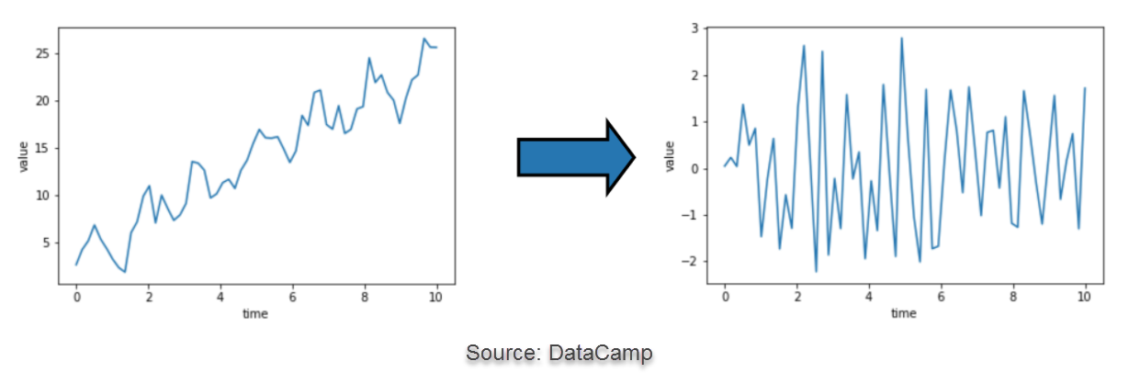
Data structure: Non-stationary or stationary
If we want to focus on the trend, we use the data as is (non-stationary).
If we want to focus on the change between time points, we transform the data to stationary by taking the difference between time points (e.g. t1-t0, t2-t1, t3-t2…etc.).

Slide 9
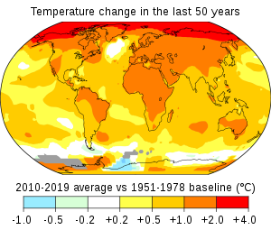
Data structure: Non-stationary or stationary
Why do we transform the data to stationary?
To study climate change we need to find out the global temperature change between time points to determine whether the rate of temperature rising has been accelerating since industrialization.
We will focus on non-stationary data only.

Slide 10
Data structure: Wide or Tall
If you do number-crunching, the time-based data could be wide or tall.
Traditionally, the wide structure is for repeated measures (RM) and latent growth curve model (a special case of SEM).
The tall structure is for time series analysis, forecast modeling, and mixed modeling (also known as hierarchical linear modeling, multi-level modeling). If the distribution is not normal, you need generalized linear mixed modeling.
Differences between RM and mixed modeling:
https://www.theanalysisfactor.com/six-differences-between-repeated-measures-anova-and-linear-mixed-models/
https://www.introspective-mode.org/repeated-measures-anova-versus-linear-mixed-models/
https://link.springer.com/chapter/10.1007/978-981-16-9142-3_5

Slide 11
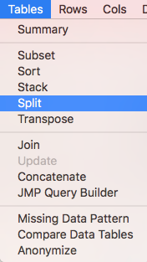
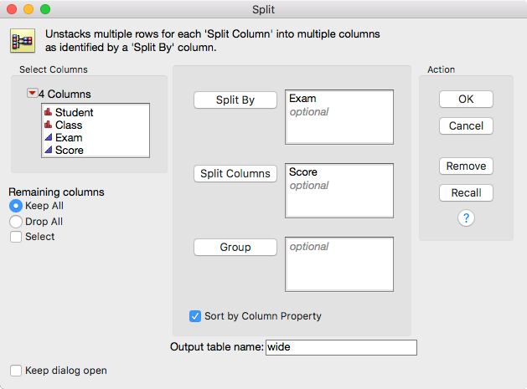
Tall-structure and wide-structure
TS and WS are inter-convertible.
Example: tall_nomiss.jmp
From tall to wide:
Keep all remaining columns

Slide 12
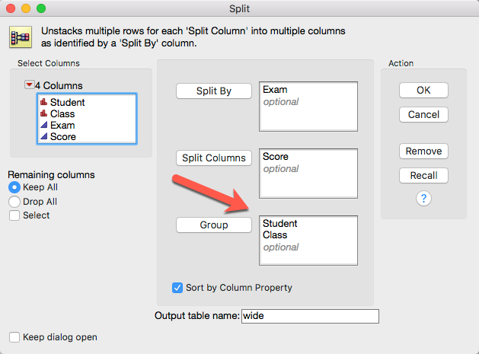
Tall-structure and wide-structure
Alternatively, you can put the variables that you want to keep into Group.

Slide 13
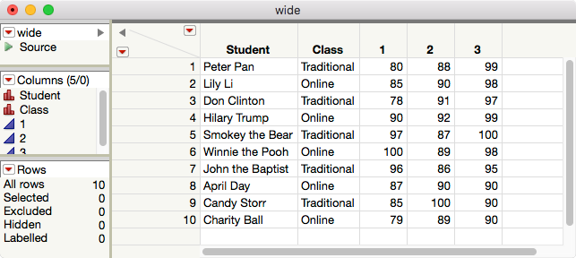
Tall-structure and wide-structure

Slide 14
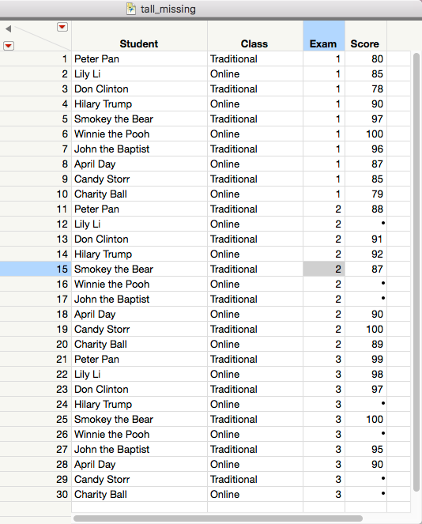
What if there are missing data?
Three students are sick and missed the mid-term.
Four students dropped the class before the final exam.
Missing data are common in longitudinal study (drop-out)

Slide 15
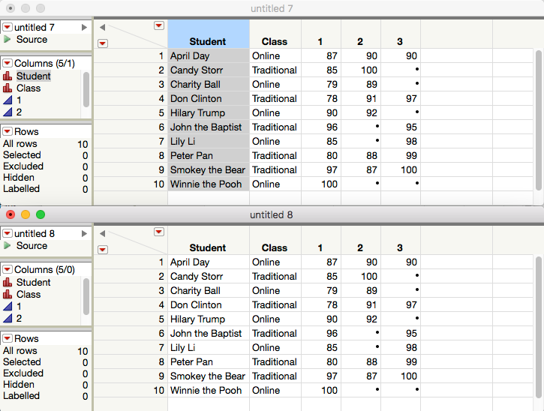
What if there are missing data?
It doesn’t matter. Either one of the splitting methods still works.

Slide 16
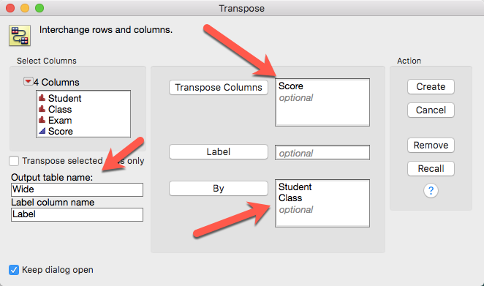
Transpose

Slide 17
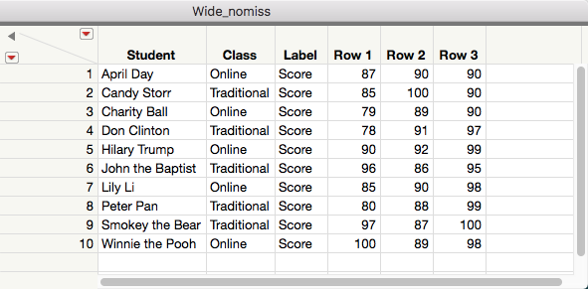
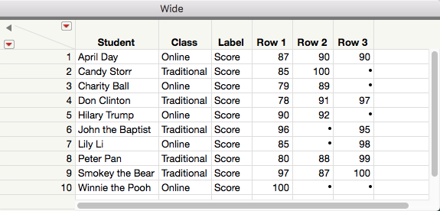
Transpose
It doesn’t matter whether there are missing data or not.
Transpose yields the correct wide structure.

Slide 18
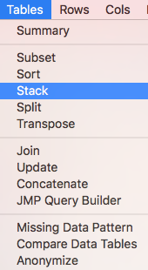
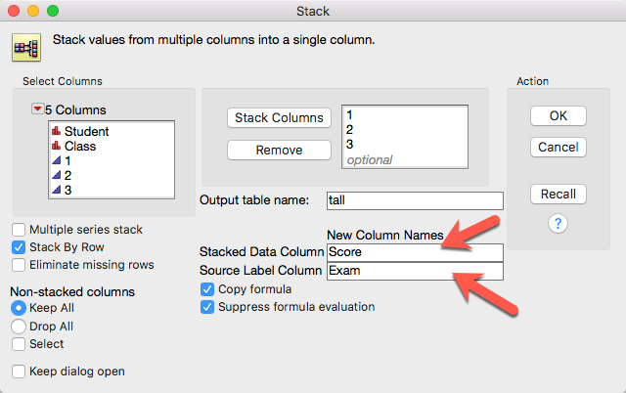
Convert from wide to tall

Slide 19
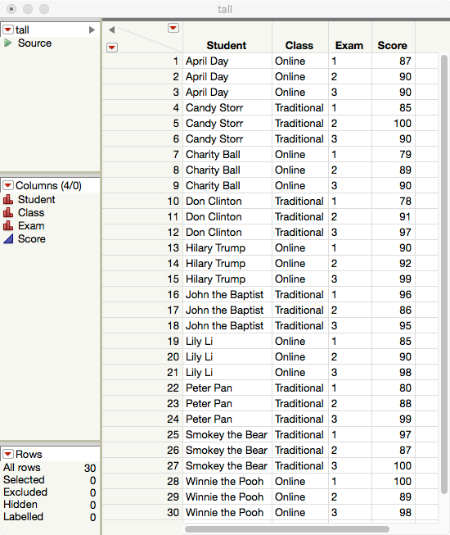
Back to tall

Slide 20
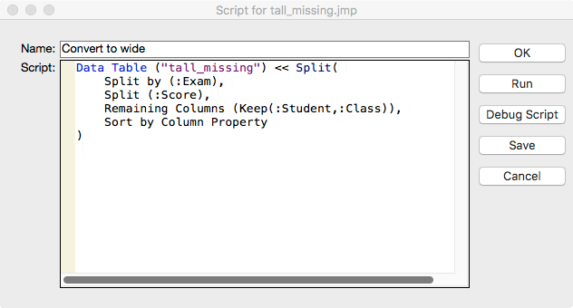
JMP Script
If you use a JMP script, you can simply copy and paste, change the file name and variable name, and then run it for other data sets.

Slide 21
PROC TRANSPOSE in SAS (Optional)
The conversion can be done by SAS programming.
It works no matter there are missing data or no missing.
When the conversion procedure becomes a routine, it is better to do it by programming.
Open the SAS data set “tall_missing” from Unit 6: SAS_JMP_files
If you use traditional SAS programming environment, the default library is TMP1. If you use SAS Studio, it may be different.
Open the SAS program “transpose.sas” You need to right-click to download.

Slide 22
PROC TRANSPOSE in SAS (Optional)
proc sort data=tmp1.tall_missing; by Student; run;
/* No need to sort if the Student ID is in order */
proc transpose data=tmp1.tall_missing out=tmp1.wide(drop= _NAME_) prefix=exam; by Student; id exam; var score;
copy class; run;
proc sort nodupkey data=tmp1.wide; by Student class; run;

Slide 23
PROC TRANSPOSE in SAS (Optional)
Alternatively, you can download “transpose2.sas” and run it.
In this program the data are embedded.
Please use a right-click to download, and then open the program in SAS. If you open the program in a Web browser an then copy-n-paste, the space in the data set may turn into a tab, and the program will not run.

Slide 24
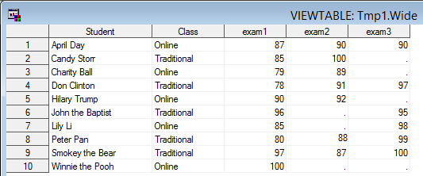
PROC TRANSPOSE in SAS

Slide 25
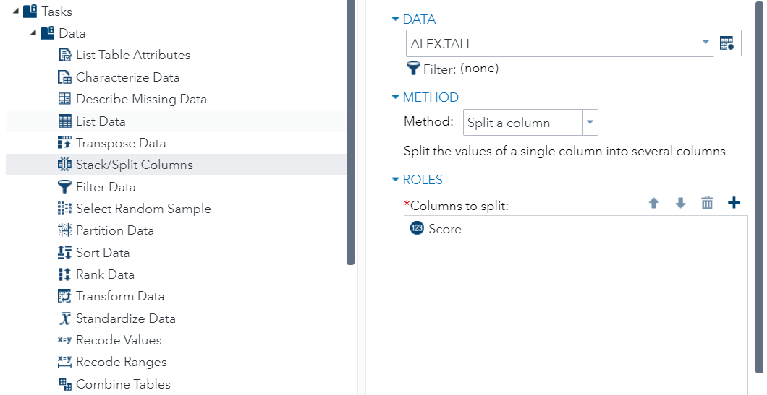
Split Columns in SAS Studio

Slide 26
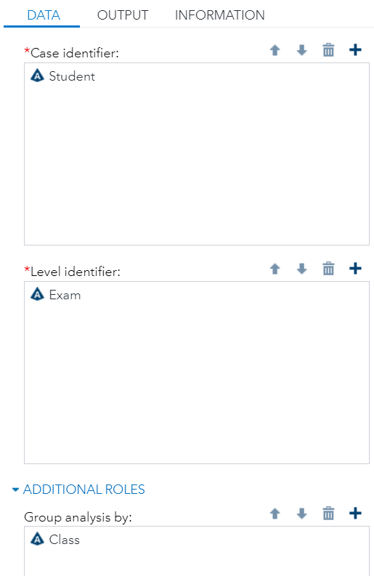
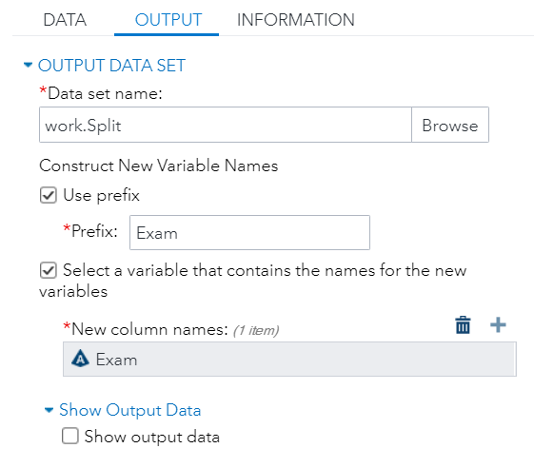
Split Columns in SAS Studio

Slide 27
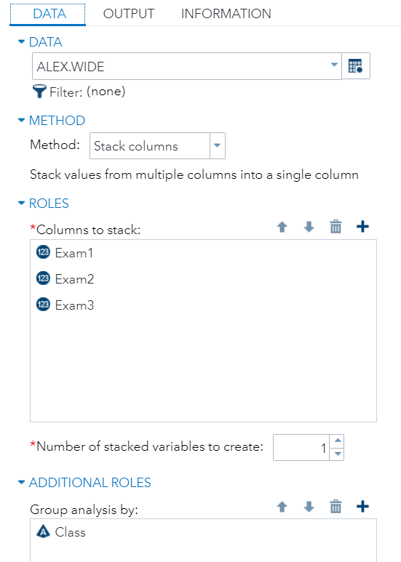
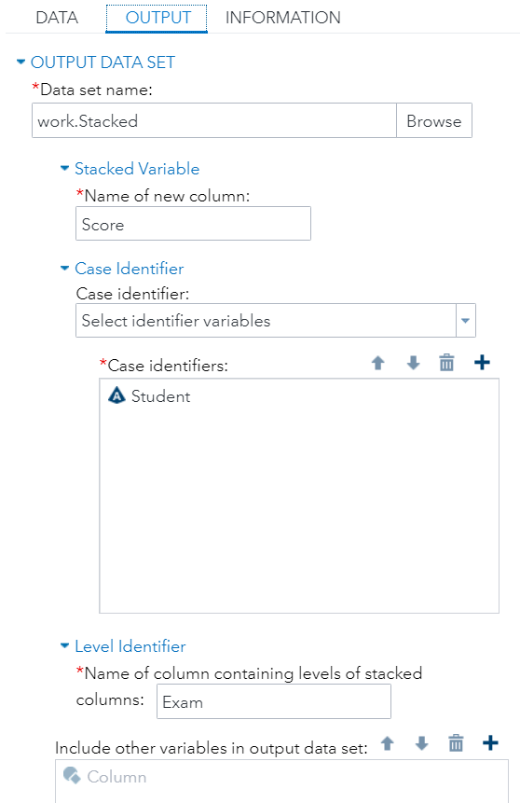
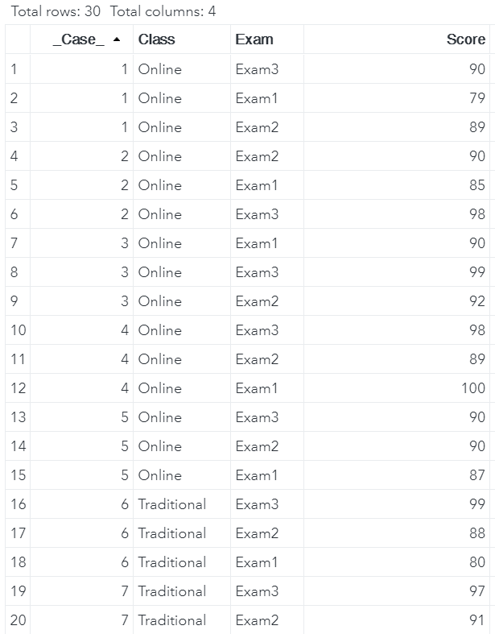
Stack columns in SAS Studio

Slide 28
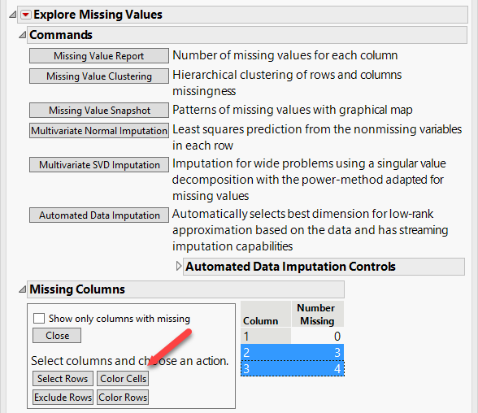
Data imputation
Due to missing data, the sample size is dropped. You can impute the missing data.
Open “wide_missing.jmp”
Choose Analyze → Screening → Explore Missing Values
Put 1-3 into Y
In the pop-up window select 3 and 4
Press Color Cells

Slide 29
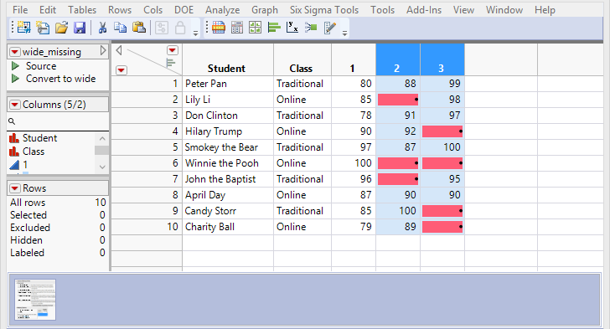
Data imputation
The missing cells are colored.
In a small data set like this one this procedure is not necessary.
If you have big data, it is helpful to detect the missing patterns (Is it missing completely at random?)

Slide 30
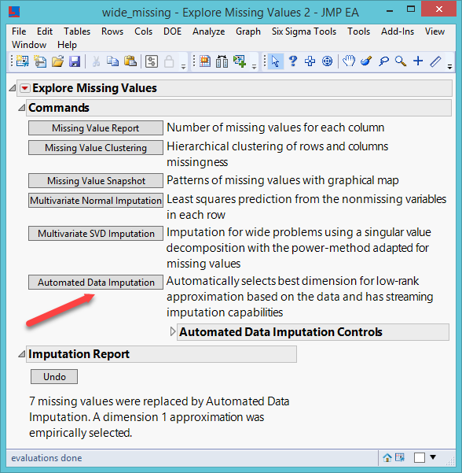
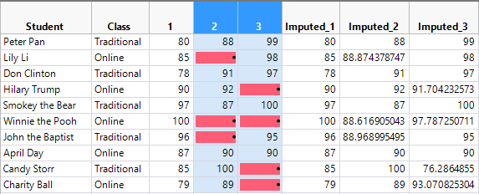
Data imputation
Re-open Explore Missing Values
Press Automated Data Imputation (ADI)
ADI imputes missing values using a low-rank matrix approximation method, also known as matrix completion. This method is good for streaming data (time-based data).

Slide 31
Data imputation
Fully Conditional Specification (FCS) in SAS is one of the best imputation methods for multivariate data set.
https://www.ncbi.nlm.nih.gov/pmc/articles/PMC4945131/
Run the SAS program “imputation.sas”
Alternatively you can run “imputations2.sas” (The data and the program are together)

Slide 32
Data imputation
ods graphics on;
data one; set tmp1.wide;
proc mi seed=1213 nimpute=4 mu0=50 10 180 out=tmp1.wide_impute;
fcs nbiter=10 reg(/details);
var exam1 exam2 exam3;
run;
/* the algorithm went through fur iterations and output four imputed data set. Take the last one only */
data tmp1.wide_impute2; set tmp1.wide_impute;
If _Imputation_ in (1, 2, 3)
then delete;
drop _Imputation_;
run;
ods graphics off;

Slide 33
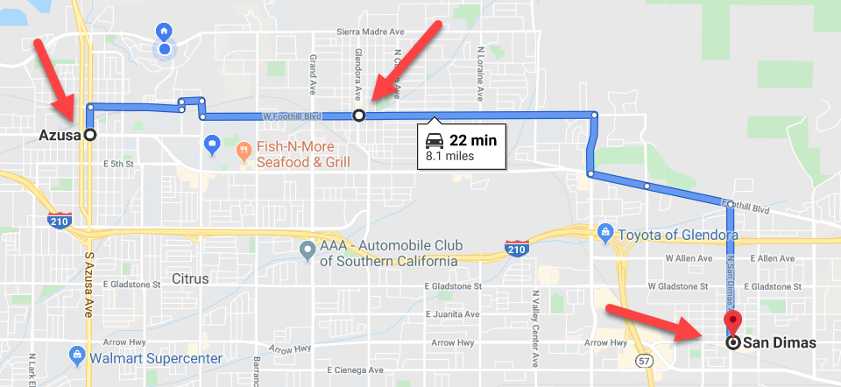
Data imputation
Imputation is not 100% fool-proof.
Metaphor: If I am at Azusa at 1:00, at Glendora at 1:15, you may predict that I will be at San Dimas at 1:30.
You need at least two positions to predict my next position or impute the missing data.
You have only one and only one data point: I am at Azusa at 1:30. I could be at Duarte or Glendora later.
For more info: Sterne, J., et al. (2009). Multiple imputation for missing data in epidemiological and clinical research: potential and pitfalls. Biomedical Journal, 338, Article b2393. doi: 10.1136/bmj.b2393

Slide 34
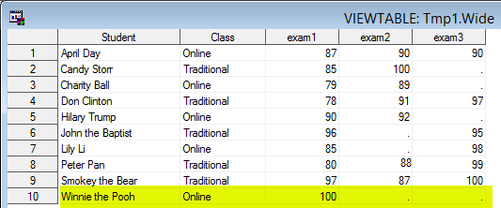
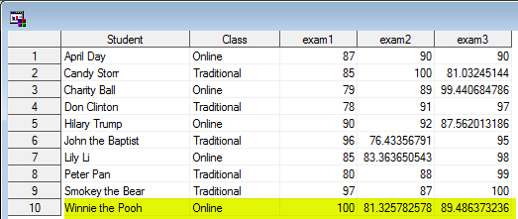
Data imputation
Winnie the Pool has one and only one data point: 100 in Exam 1.
He might keep the consistent performance: 100 in both Exam 2 and Exam 2.
SAS imputation said that his performance drops to 81 in Exam 2 and 89 in Exam 3 based on the overall trend of all other observations.
JMP is better in this case.

Slide 35
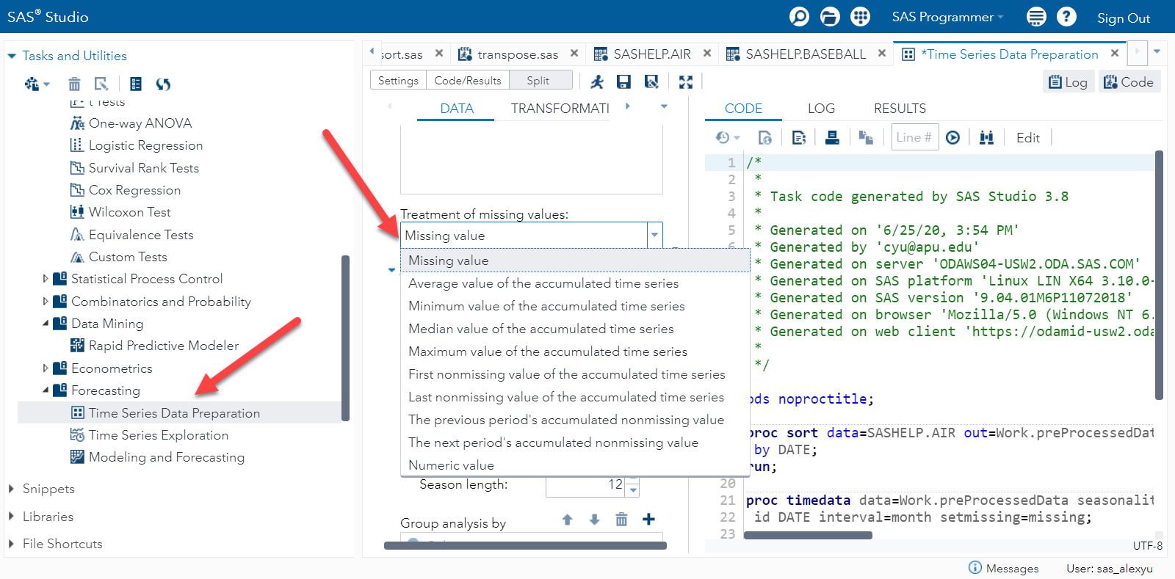
Data imputation: Quick and “dirty”
In SAS Studio you can use the task “Time Series Data Preparation” to impute missing data.
But this method is not recommended because the numbers are “static” and simplistic (e.g. mean, median, first, last, max, min).

Slide 36
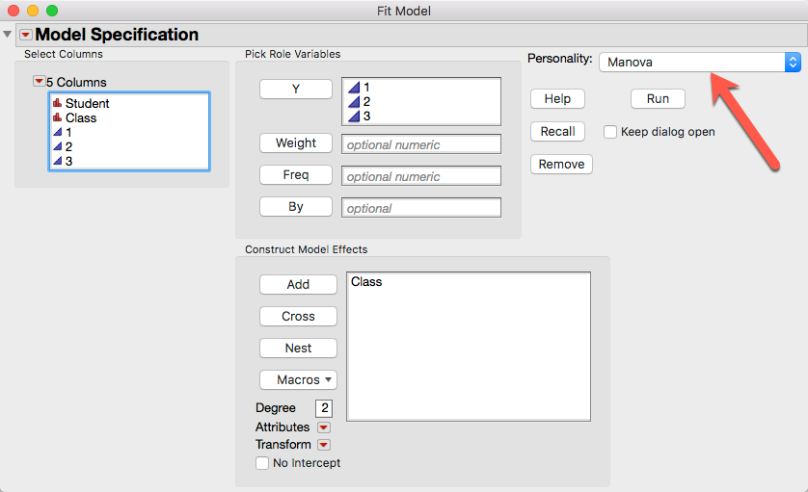
Least square mean plot for wide
Use wide.jmp
Analyze → Fit model
Drag the scores across all time points into Y
Drag class into Add
Change Personality to MANOVA (Multivariate analysis of variance)
Press Run

Slide 37
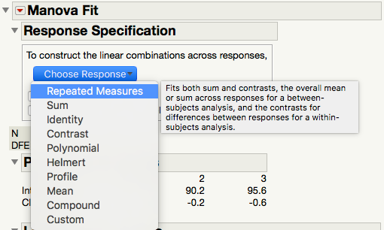
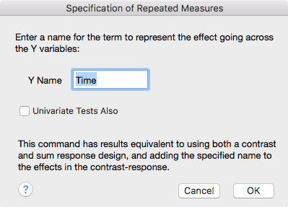
Least square mean plot for wide

Slide 38
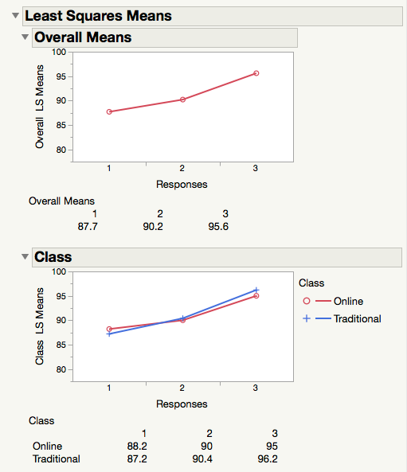
Least square mean plot for wide
Estimated from a linear model
A raw mean is the average of all values without weighting or any adjustment.
Least square means are adjusted for covariates (if there is any) or missing data (if there is any).
A better estimate of the “true” population mean.
In both classes, exam 3 is better than exam 2, and 2 is better than 1.
Students are getting better and better regardless of what class they take.

Slide 39
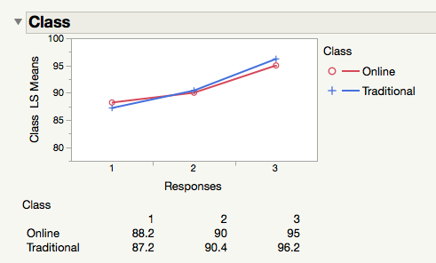
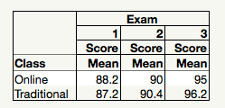
Least square mean plot for wide
Compare the least square means at the bottom of the plot and the raw means output by Tabulate.
They are exactly the same!
I change my ”personality” for this analysis! All for nothing! Why????

Slide 40
Assignment (Challenging!)
Convert tall_missing.jmp to a wide structure using Split.
In the wide structure use MANOVA to create a least square mean plot.
Go back to the tall structure and use Tabulate to create a raw mean table.
Output the raw mean table to Excel and make a raw cell mean plot.
Compare the raw means and the least square means. Are they the same or different?
Use the information from the previous lesson (crossing vs. no crossing). Is there any main effect or interaction effect in the raw mean plot? How about the LS mean plot?

Slide 41
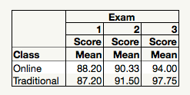
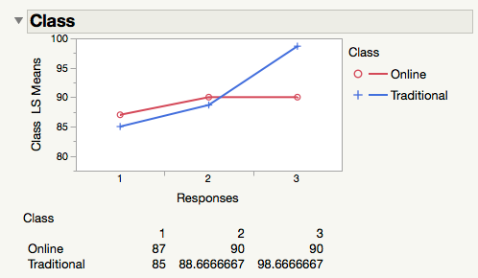
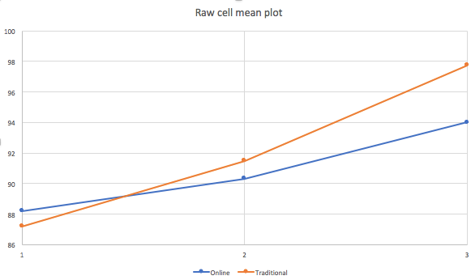
Answer
Using LS means, from Exam 2 to 3 there is no growth in the online class.
Traditional students improved a lot.
In Raw mean plot both improved (raw_cell_meanplot.xlsx)

Slide 42
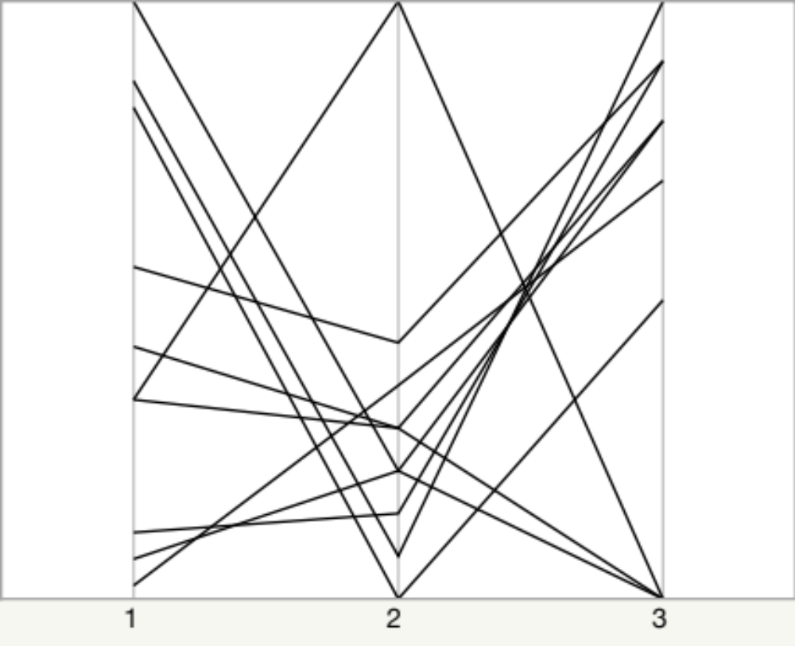
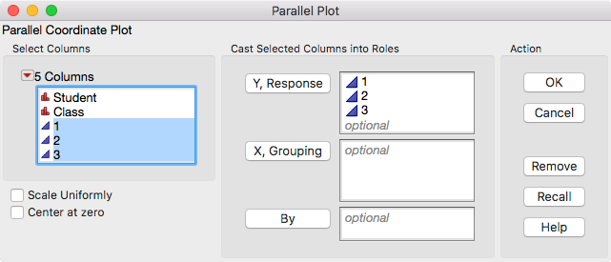
Parallel coordinate for wide
In JMP, go to Graph → Parallel Plot
Parallel coordinate using the wide structure doesn’t look good and useful

Slide 43
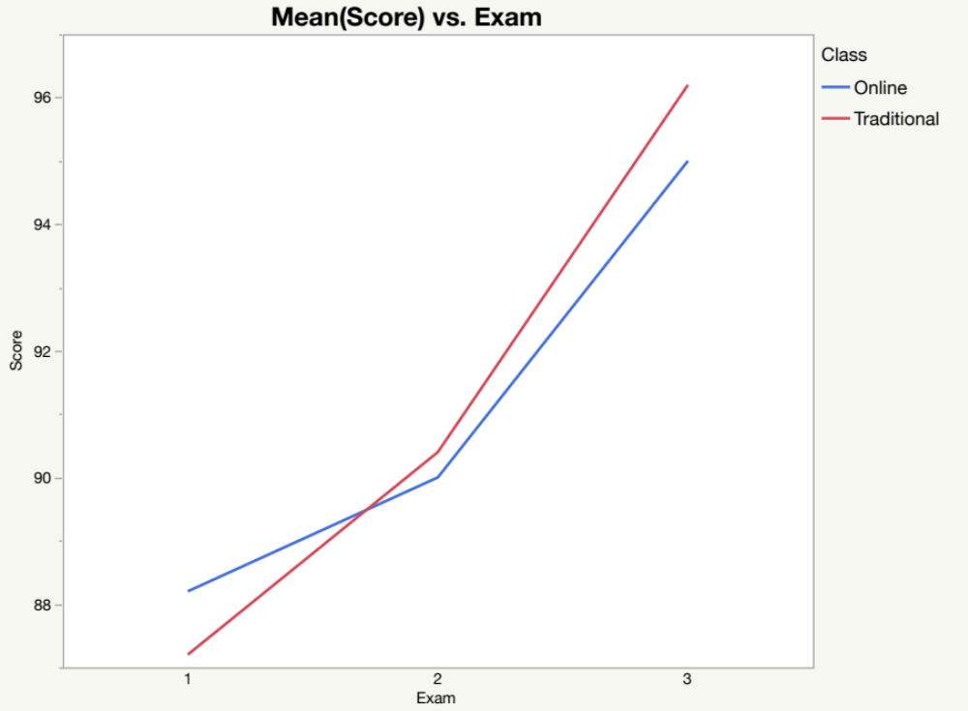
Graph builder for tall
Use tall_nomiss_jmp
Score → Y
Exam → X
Class → overlay
When you look at the summary (the average of each exam), it seems that students are getting better and better over time.

Slide 44
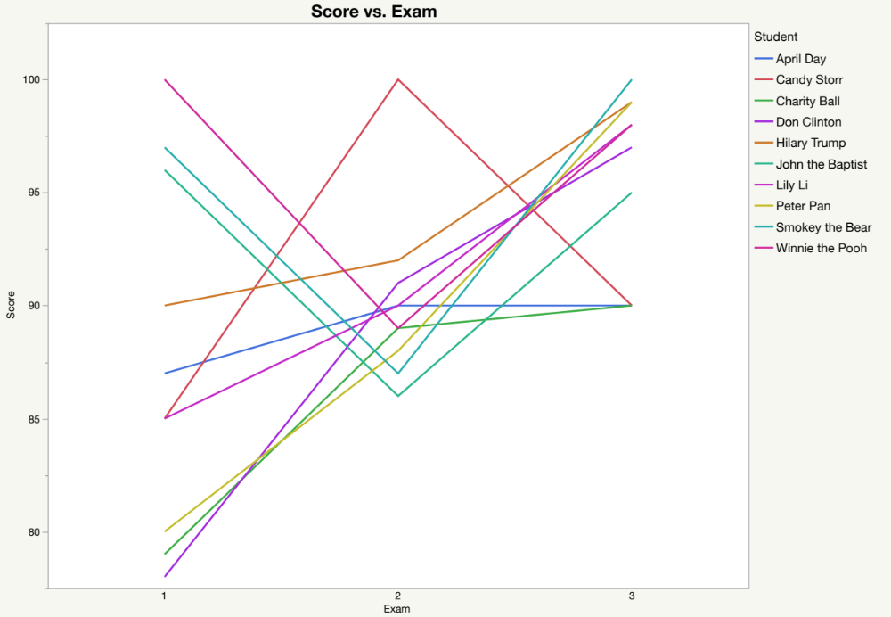
Graph builder for tall
Student → overlay
You can examine individual students for diagnosis.
There are dramatic ups and downs.

Slide 45
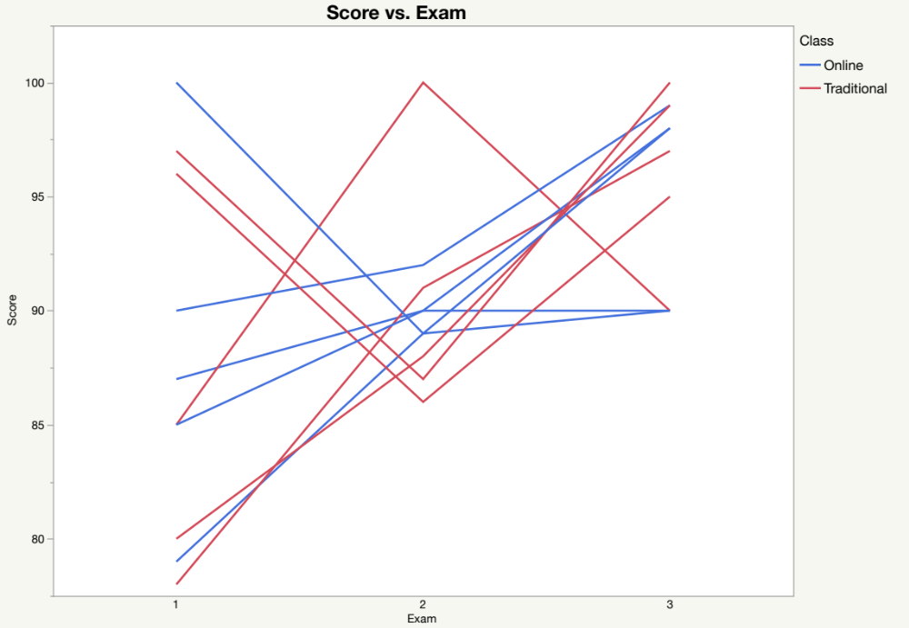
Graph builder for tall
You can examine the overall with the detail of individual.
One online student got worse.
One traditional student got better and then got worse.

Slide 46
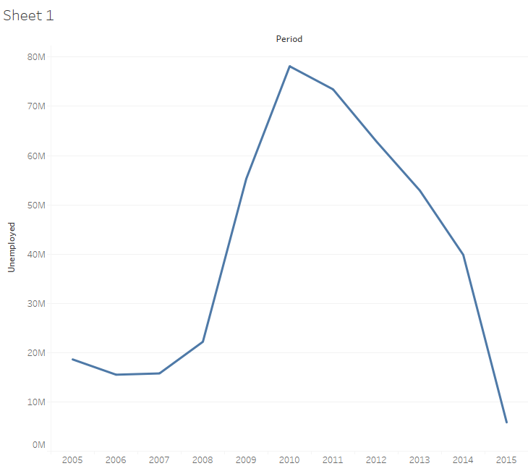
Tableau: Tall structure
Import the excel spreadsheet “unemployment data”
Double-click period
Put Unemployed into Rows

Slide 47
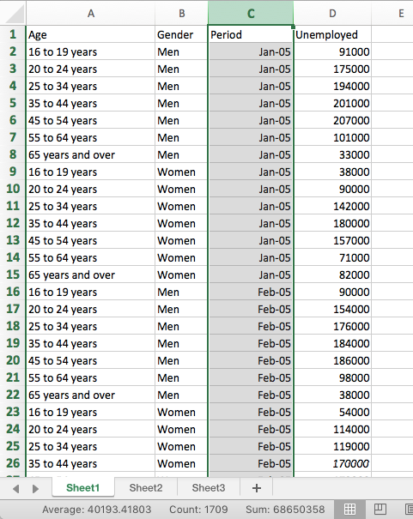
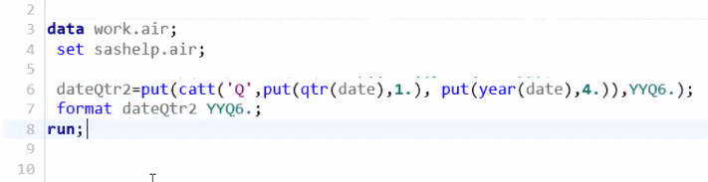
Tableau: Tall structure
It is a good practice to have a hierarchal time variable so that you can drill down (e.g. Year, month…etc.)
In Tableau it is automatic but in SAS you need to write codes to convert the date (see the example below).

Slide 48
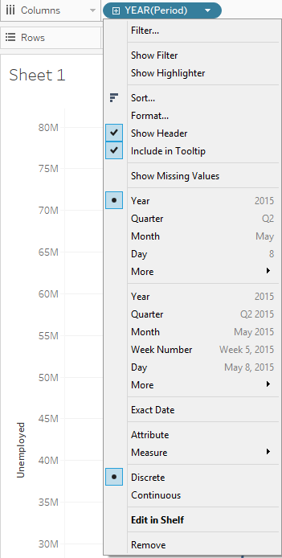

Track the unemployment trend
Drill down into more granularity (month)
The first month is: regardless of year (You will have the average of January of all years)
Choose the second “month” by year (e.g. March, 2010, March 2011, March 2012…etc.)

Slide 49

Track the unemployment trend
Drill down into more granularity (month)

Slide 50

Track the unemployment trend
You can do Quarter, too.

Slide 51

More granularity (Gender)
Change Marks to shape
Drop gender into color

Slide 52

More granularity (Gender & Age)
Drop age into shape, but it is too cluttered.

Slide 53

Too cluttered! Overplotting!
Highlight selected from the drop down menu

Slide 54

Line chart
Drop age into Color
Change Marks from Shape to Line

Slide 55

Line chart
The unemployment rates of very younger and old workers are low.

Slide 56

Line chart
The worst are 25-34 years old and 45-54 years old workers

Slide 57


Area Chart
Choose area chart from Show me (upper right)

Slide 58

Area Chart
Or choose Area from Marks

Slide 59

Area chart
Drop age into label

Slide 60

Add filter
Drop gender into filter
From the arrow of gender choose show filter

Slide 61


Add filter
The default is Check box but I want to toggle between men and women.
From the arrow of gender choose Single value (list)

Slide 62

Forecast the future
If today is 2017 and you would like to predict what may happen in the future, go to Analytics → Forecast.
Tableau compares different models against each other, exploring different parameters and combinations, and selecting the optimal model.

Slide 63

Forecast the future
You can create a coplot to predict the future unemployment rate by dragging gender to the x-axis.

Slide 64


Forecast the future
The blue shade indicates the prediction interval.
You can change it in the forecast options by right-clicking on the graph.

Slide 65


Forecast the future
You can also obtain a table to describe the forecast model.

Slide 66

Forecast the future
You can do the same in SAS Studio and SAS Forecast Studio.

Slide 67


SAS Studio

Slide 68

SAS Forecast Studio
SAS Forecast Studio is a forecasting application that is designed to speed the forecasting process through automation.
Overview

Slide 69
Animated bubble plot in Tableau
Import the Excel data file “CrimeData” into Tableau
Drag Robbery Rate into Columns
Rape Rate into Rows
State into the center of the scatterplot
State into Label
Region into Color
Population into Size
Change Marks from Automatic to Circle
Drag Year into Pages (make sure you see the orange triangle)
Play the button to view the movie

Slide 70

Animated bubble plot in Tableau

Slide 71

Share interactive Tableau output
You can share the interactive Tableau output with people who don’t have Tableau.
Export the file as Packaged Workbook.
The file will look exactly like a regular Tableau file except that it is read only.
The extension is .twx
The viewer needs Tableau Reader to view your packaged workbook. It can be freely downloaded at: https://www.tableau.com/products/reader

Slide 72
Assignment 6.2
Import Unemployment data into Tableau
Create a horizontal bar chart, showing the number of unemployment by age and gender
Create an animated plot by putting Period into Page.
Export the file as Packaged Workbook.

Slide 73

Answer

Slide 74

Animated bubble plot in JMP
Help → Sample data library → CrimeData.jmp (not Crime.jmp) or download from Unit 6 folder.
Graph → Bubble plot
Enter the variables as shown and press OK.
Click the Pay button to show the animation.

Slide 75

Bubble plot

Slide 76

Bubble plot

Slide 77

Share the interactive result
Output it to interactive HTML
Mac: Export
Windows: Save as

Slide 78
Assignment 6.3: Bubble plot in JMP
Do not look at the next slide.
Play the movie of the US Crime data in Tableau or in JMP.
If it is too fast, you can move it frame by frame.
Observe the overall pattern across years.
Pick two states and compare their difference across years.

Slide 79
What the bubble dance (animation) tell me about the overall pattern?
In 1973 a strong association was found between the two crime rates, but in 1993 their connection became weaker.
In both years big cities with a large population size tended to suffer from higher crime rates, with the Northeast region being the worst.
The US crime rate has been steadily declining since the 1990s. In 2010, the crime rates appear to be under control. The robbery rate and the rape rate seemed to be negatively correlated.
In many years Alaska is the worst in sexual assault rate.
Big cities and Northeast are no longer the most dangerous places to live.
Dancing with the data!

Slide 80

Compare CA and NY
In 1973 CA is the worst in sexual assault and NY is the worst in robbery.
NY is an outlier while CA is among the worst.

Slide 81

Compare CA and NY
In 1991 the murder rate caught up with NY.
NY is still an outlier in the murder rate while CA is marginal.

Slide 82

Compare CA and NY
In 2000 both CA and NY became normal.
NY is low in sexual assault (lower than CA).
But NY still has a higher robbery rate than CA.

Slide 83

Compare CA and NY
In 2010 NY is better than CA in both sexual assault and robbery.

Slide 84

Bubble plot in SAS Viya/Visual Analytics
In SAS you can drill down the data.
The following are all data. The bubble size of the Internet/Catalog Customers is the biggest. You can click on it to get more information.

Slide 85

Bubble plot in SAS Viya/Visual Analytics
Among Internet/Catalog Customers, the Female bubble is much bigger than the Male.

Slide 86

Bubble plot in SAS Viya/Visual Analytics
Among female customers, the age groups of 30-44 years and 75 and above tend to spend more.

Slide 87

Bubble plot in SAS Viya/Visual Analytics
You can add animation by year.

Slide 88
World Bank Public Data Explorer
Go to https://www.google.com/publicdata/directory
Click Explore the data
Research question: Can better education lead to better public health outcome? It depends on how we define and measure the two.
You can mouse over the question mark next to the variable to get the description.
Put Education: Government expenditure on Education into X
Put Life Expectancy into Y
Drag the time slider back to 1980
Click the play button

Slide 89

World Bank Public Data Explorer
Did you see a relationship between the two variables?
Are there any outliers? You can mouse over the data points to find out.

Slide 90
Assignment 6.4
Can better education lead to better public health outcome? It depends on how you define and measure the two constructs.
In the Public Data Explorer for World Bank data, use another variable related to education and another variable related to health.
Select two countries for comparison.
Make a screen capture at the beginning and the end of the Bubble plot.
What is the overall relationship between the two variables?
What is the overall trend across 4 decades?
What is the overall trend of the two countries across 4 decades?
Are there outliers?

Slide 91
Gapminder
Gapminder goes one step further beyond UN Public Data Explorer
It can show you the “trail” of the temporal change.
In the Web browser go to https://www.gapminder.org/tools/#$chart-type=bubbles
Question: can gender equality lead to better economic growth?
Put GNP per capita PPP into Y
Put Gender ratio of mean years in school in X
Select South Korea, Japan, and USA

Slide 92

Gapminder

Slide 93
Ungraded assignment
In Gapminder choose any variables for X and Y
Choose any countries
Look at the trails to discover the temporal change.

Slide 94
Specialized time-based model (Optional)
Survival analysis: How long does it take for the patient to die given a period of time?
Churn model: How long does it take for a customer to cancel the service given a period of time.
Censoring: a condition in which the value of a measurement is partially known e.g. if the patient or the customer withdraws from the study before the “event” (death or cancellation), the data are incomplete.

Slide 95

Visualization for survival or churn
Open “VA Lung Cancer.jmp” from JMP Sample Library.
Select Analyze → Reliability and Survival → Life Distribution
Put time into “Time to event” and Censor into “Censor”

Slide 96

Visualization for survival or churn
Nonparametric is “as is”
You can explore different smoothing models.
After 600 days, the chance of death almost remains the same.

Slide 97

Visualization for survival or churn
Re-open the same dialog box.
Choose Compare groups
In addition to entering Time and Censor, put Treatment into Grouping.

Slide 98

Visualization for survival or churn
At the beginning, on 100th day the probability of death for patients using standard treatment is 0.5, but the probability of using the experimental treatment is 0.7.
Later it is reversed.

