Slide 1
Dashboard
Chong Ho (Alex) Yu

Slide 2
Learning outcomes
You will understand the functions of dashboard.
You will be able to create a dashboard in JMP using:
  Combine windows
  Dashboard builder
You will be able to create a dashboard in Tableau by
  Tiled layout
  Floating layout
You will be able to link multiple dashboards in Tableau by inserting a navigation button.

Slide 3
What is dashboard?
A form of multi-panel data visualization tool, which incorporates different chart types into one single interface.
You can check key performance indicators (KPI) and key data points to monitor the health of your organization or the progress of your project.
Like a dashboard in aviation, you can take proactive actions before it is too late.

Slide 4
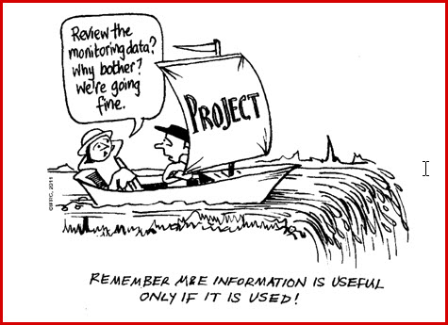
What is KPI?
A measurable value that demonstrates how effectively an organization is achieving key objectives e.g.
  For-profit company: Sales, profit, market share, R & D patents…etc.
  University: Ranking, citation per faculty, research funding, faculty-student ratio…etc.
  Law enforcement: Crime rate, arrest…etc.
  Church?

Slide 5
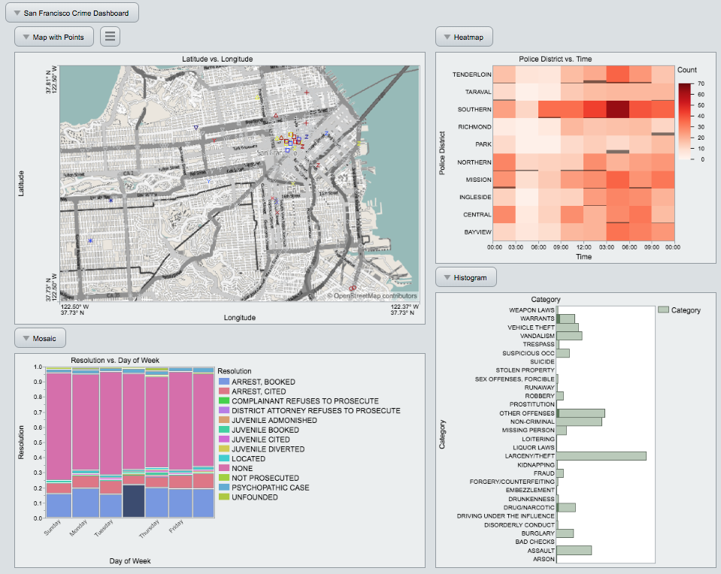
Examples of JMP Dashboard
San Francisco Crime Dashboard
More arrests (booked, released by paying bail) on Wednesday.
Most concentrated on a particular area.
More crimes happen in the afternoon.
Let’s re-create it!

Slide 6
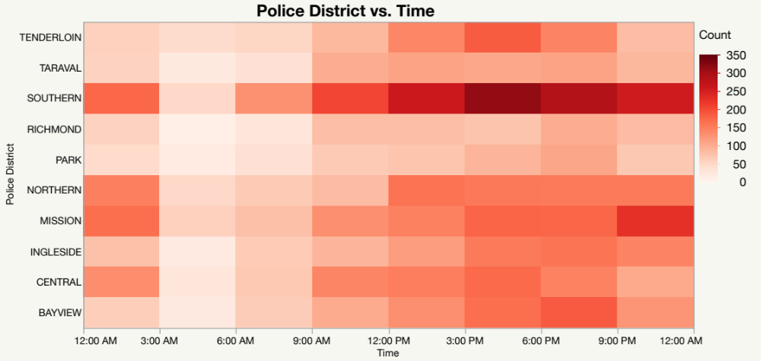
Dashboard in JMP
Open “San Francisco crime” from JMP Sample Library.
You have already learned various graphing techniques in JMP, such as GIS maps, coplot, heatmap, bubble plot. To save time, we will use the scripts in the data set.
Click the green arrow of “Graph Builder District by Time”

Slide 7
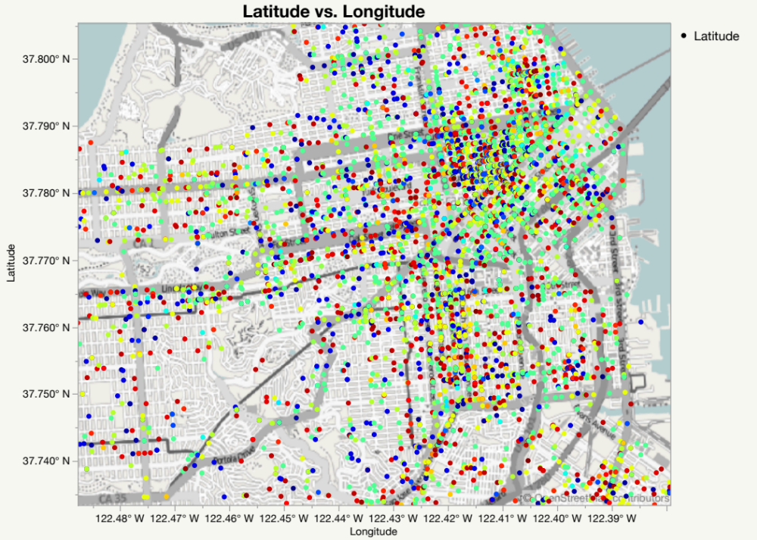
Dashboard in JMP
Run the script “Graph Builder Street Map” by clicking on the green arrow.
It shows different crime types by street coordinates.

Slide 8
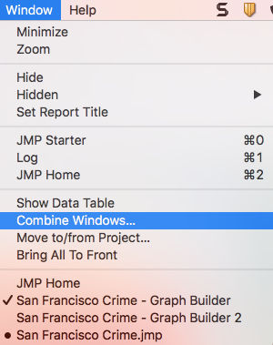
Dashboard in JMP
There are several ways to create a dashboard in JMP.
You can use either Dashboard Builder or Combine Windows.
The former allows you to control the process while the latter is automatic (easier, of course).
When both graphs are open, go to Combine Windows.

Slide 9
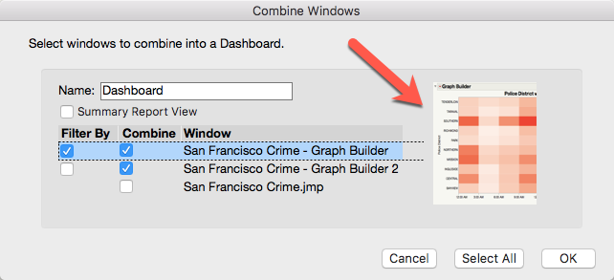
Dashboard in JMP
Check the graphs to be included.
When there are too many opening graphs and you forgot which is the one you want, you can click on the name and a mini-version is displayed.
Select the heat map as a filter.

Slide 10
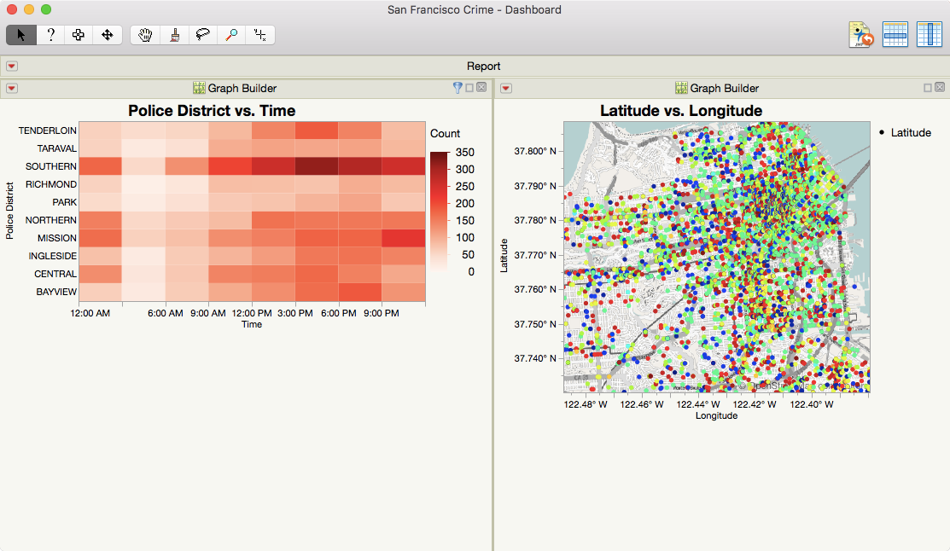
Dashboard in JMP
Result of combined windows

Slide 11
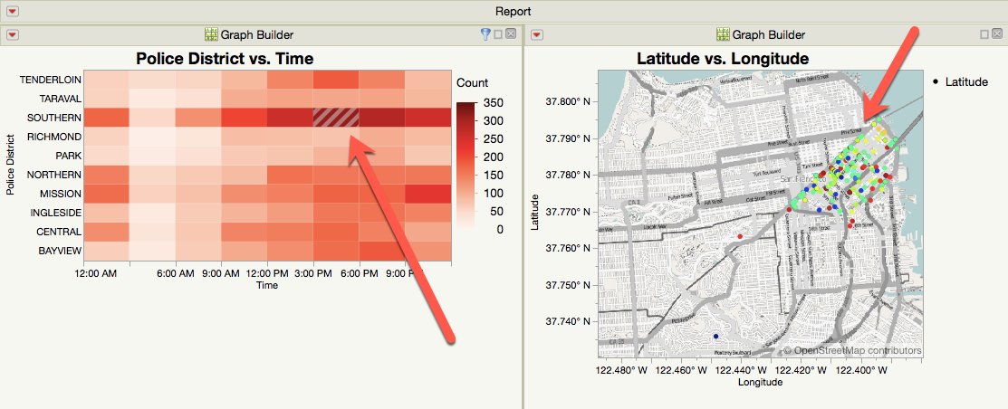
Dashboard in JMP
Between 3 PM and 6 PM at the southern region, it is the most dangerous.

Slide 12
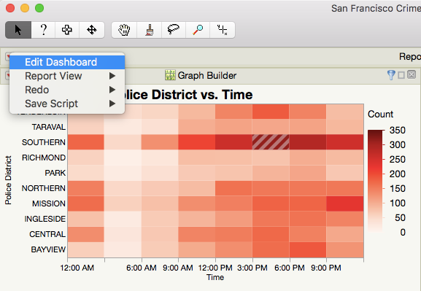
Dashboard in JMP
You can alter the existing dashboard by choosing Edit Dashboard from the top red triangle.

Slide 13
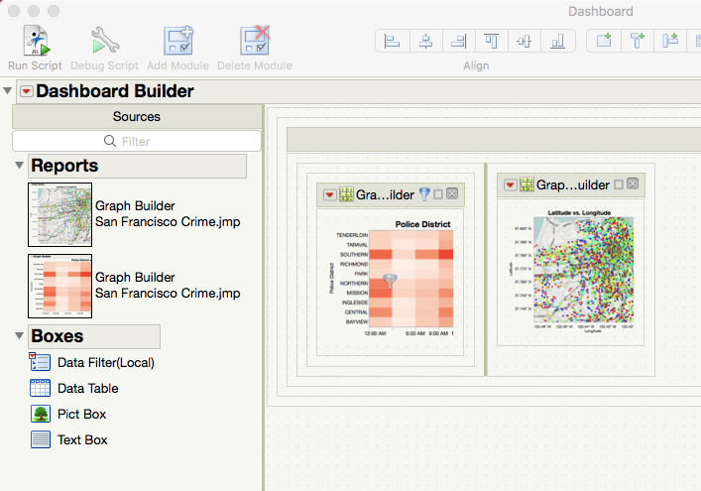
Dashboard in JMP
It opens the Dashboard Builder for you to add or delete objects into the dashboard.

Slide 14
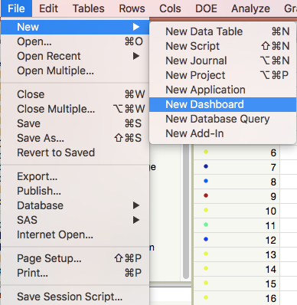
Dashboard in JMP
You can build a dashboard by choosing New dashboard from File.

Slide 15
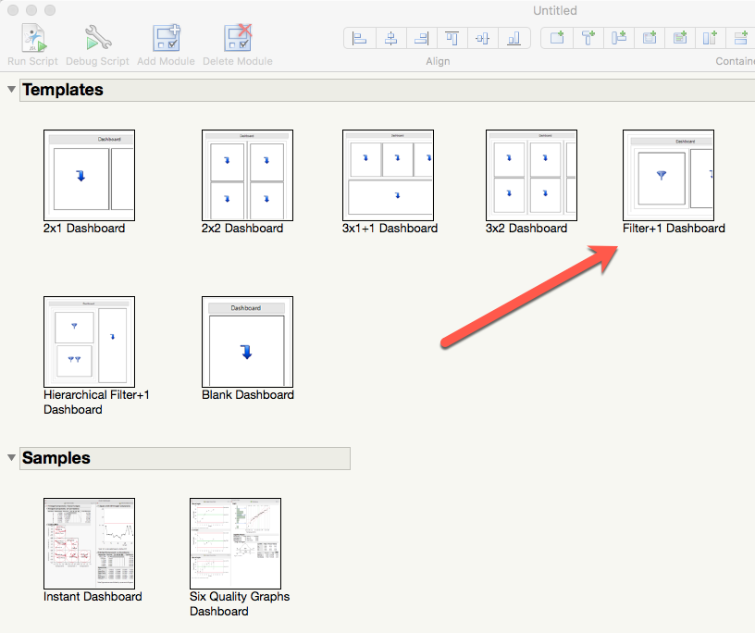
Dashboard in JMP
The one we have just created is a 2-object dashboard with one filter.
Let’s choose a similar type.

Slide 16
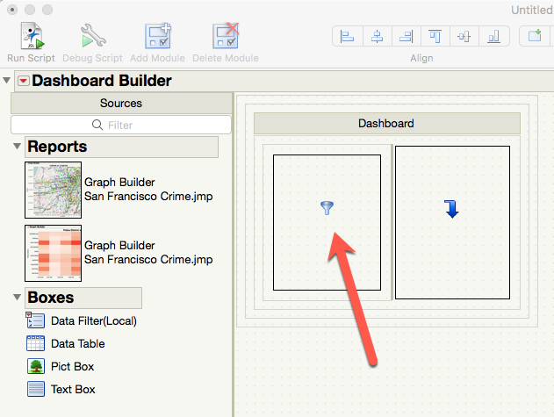
Dashboard in JMP
One of the cells has a filter icon.
Drag the heat map into the filtering area.
Drag the map into another one.

Slide 17
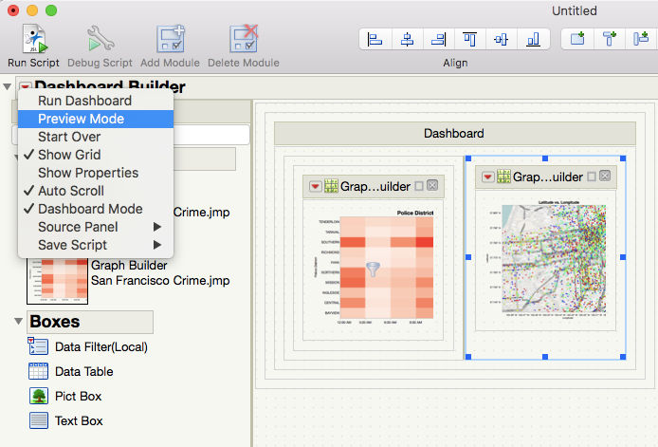
Dashboard in JMP
Before you run it, you can preview the look and feel by choosing Preview Mode from the red triangle.
If you are satisfied, go to Run Dashboard.

Slide 18
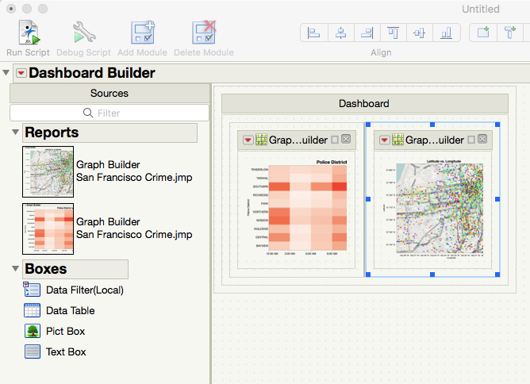
Dashboard in JMP
Go back to New Dashboard
Choose a 2X1 layout.
Drag the graphs into the cells.

Slide 19
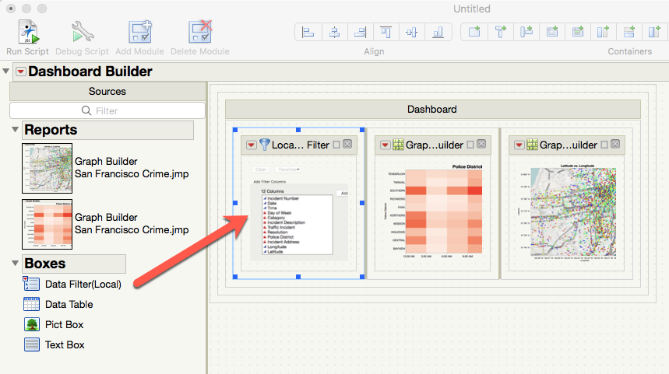
Dashboard in JMP
Drop Data Filter (Local) to the left and the run it.

Slide 20
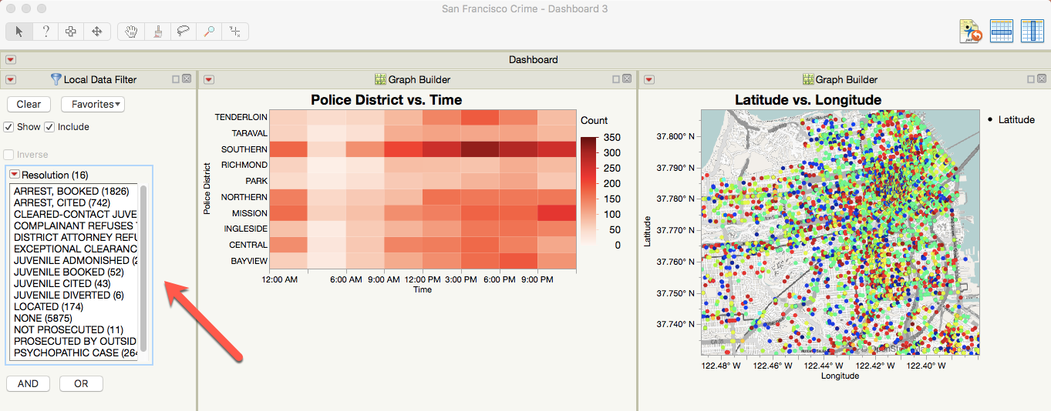
Dashboard in JMP
Now you can choose any data filter you like.

Slide 21
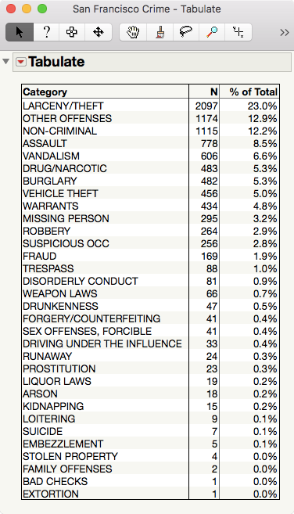
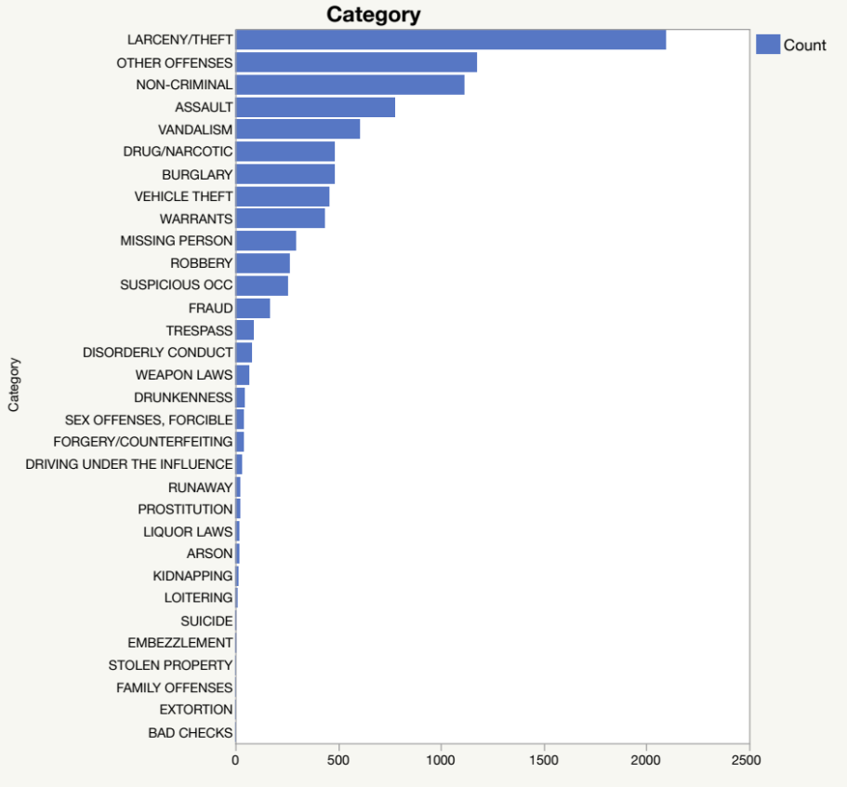
Dashboard in JMP
Add two more graphs by running the scripts “Graph Builder Summary Bar Chart” and “Tabulate Category, Summary, and Percentage”.

Slide 22
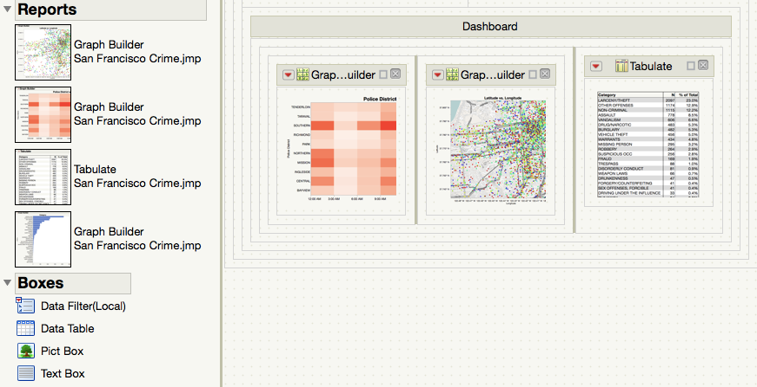
Dashboard in JMP
Now there are four graphs.
After dragging three graphs into the dashboard, it may not be a good idea to add more. The space is too crowded.

Slide 23
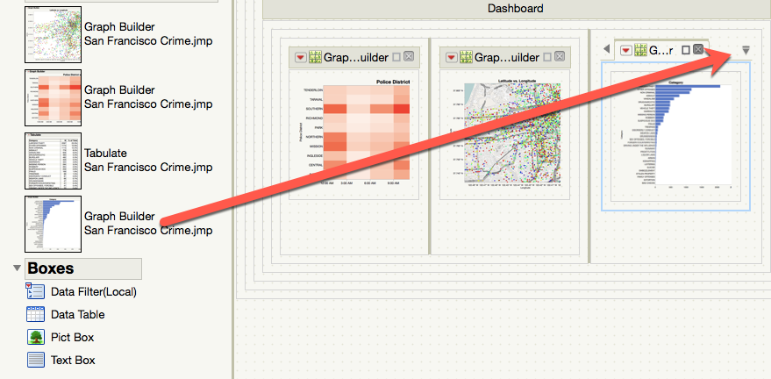
Dashboard in JMP
Rather than creating another panel and making the dashboard so cluttered, you can drag the bar chart to the upper right corner (the cross) of the table to create a tab.
Make sure you see a down arrow. If not, you replaced the table with the bar chart.

Slide 24
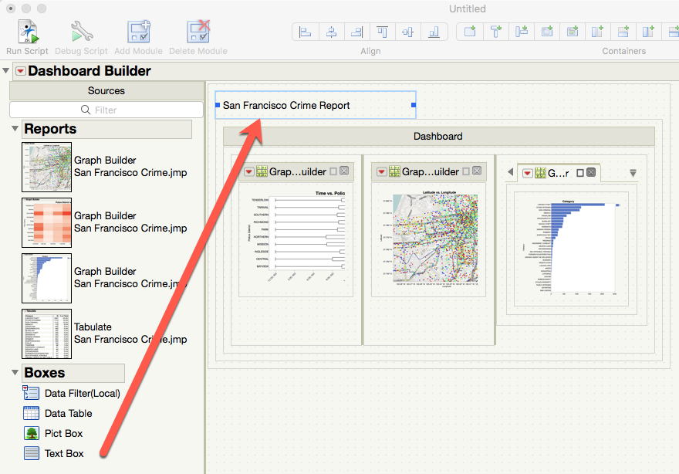
Dashboard in JMP
You can customize the dashboard by adding a Text Box anywhere.
You can also insert an image by dragging the Pict Box into the dashboard.

Slide 25
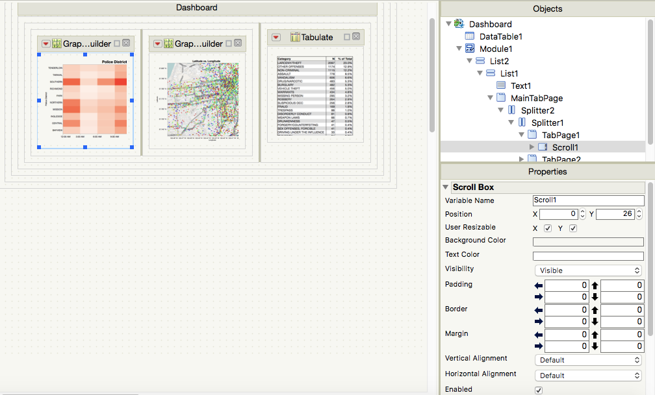
Dashboard in JMP
When you right-click on an object, you can open the editable properties to customize the look and feel.

Slide 26
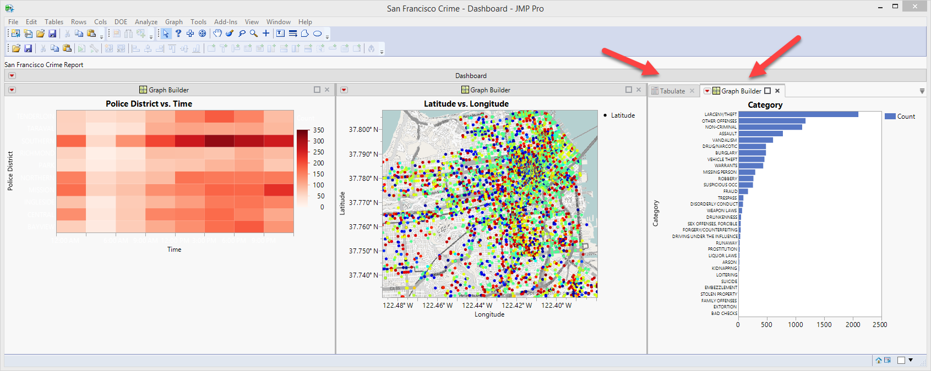
Dashboard in JMP
After running the Dashboard, you can toggle between the two tabs.

Slide 27
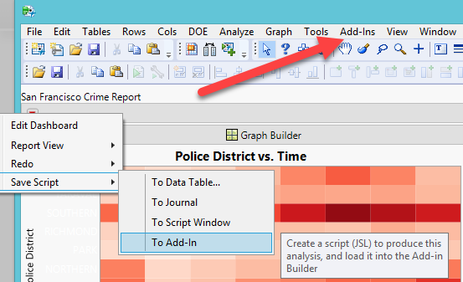
Save the file
When you save the Dashboard Builder, by default it is the application source (*.jmpappsource). This is for you to continue working on building the dashboard.
To share it with your users, you need to save it as an application: jmpapp (Windows only). But you need to send the data table, too.
Another way to share the dashboard is you save the dashboard as an add-in from the red triangle of the dashboard.

Slide 28
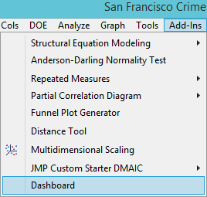
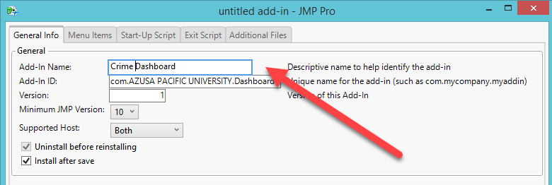
Save the file
You should give it a more descriptive name.
After the user install it, the dashboard becomes an item under the Add-ins menu.

Slide 29
Save the file
Another option is to save the dashboard (not the dashboard builder) as an interactive HTML. You can post the HTML file on the Internet or send it to the users as an attachment via email.
Do NOT send the link! That link points to your local hard drive.
http://www.creative-wisdom.com/teaching/551/Lecture_PowerPoint/Unit_8_dashboard/JMP_files/Dashboard.htm

Slide 30
Assignment 8.1
Use CrimeData.jmp in the sample library
Create a dashboard that is similar to the following:
http://www.creative-wisdom.com/teaching/551/Lecture_PowerPoint/Unit_8_dashboard/JMP_files/Dashboard.htm
Display four graphs in your dashboard by using tabs.
Save the result as an application or an interactive html file.

Slide 31
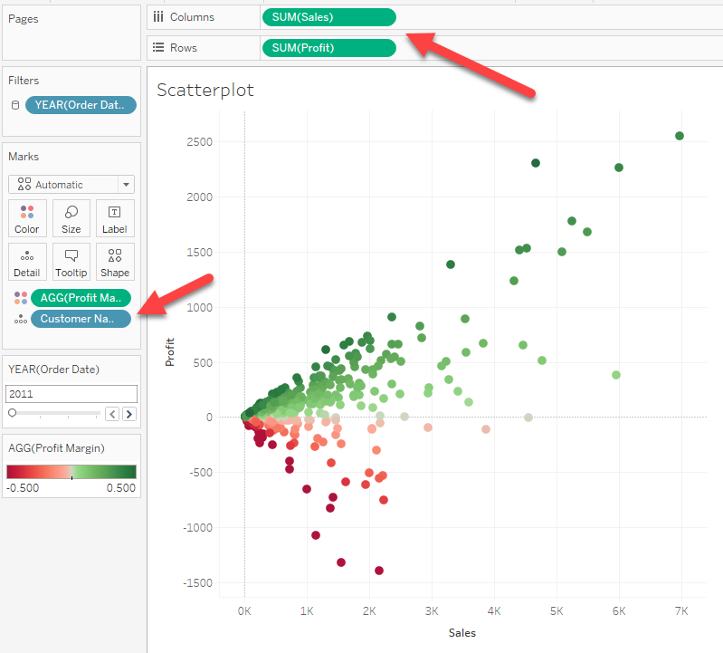
Dashboard in Tableau
Reuse the same data set in Unit 7 GIS (AmazingMartEU2): the join tables of ListOfOrders and OrderBreakDown.
Open the GIS workbook and add a new worksheet.

Slide 32
Scatterplot
Drag Sales to Columns
Drag Profit to Rows
Drag Profit margin to Color
Drag Customer name into the Canvas.
Drag Order date into filter. Select Years
Select All years

Slide 33
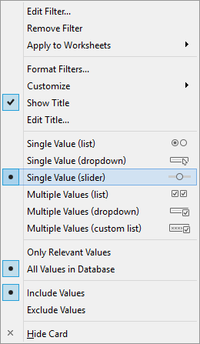
Create filter by year
From the arrow select Show Filters.
From the drop down menu of year choose Single Value (slider).
No need to use multiple check boxes.
In most cases you want to view the data one year at a time.

Slide 34
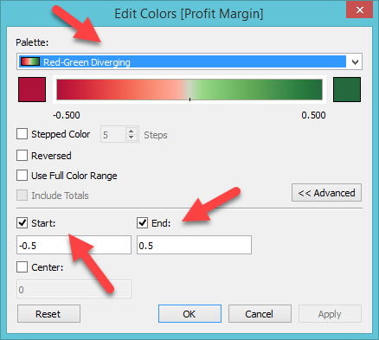
Change color
Red is bad
Green is good
More intuitive.
Click Advanced.
Change start to -0.5 and end to 0.5
Red and green become even. If the two colors are even, then skip this step.

Slide 35
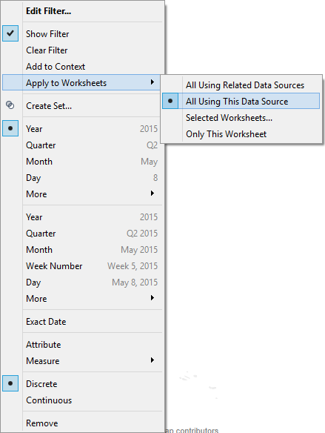
Apply to all worksheets
Go back to the GIS map in Unit 7: Europe
You can create multiple graphs in multiple worksheets.
Right-click on the filter to activate the pull down menu
Select All using this data source
Link all graphs together so that changing one can make corresponding change in all others.

Slide 36
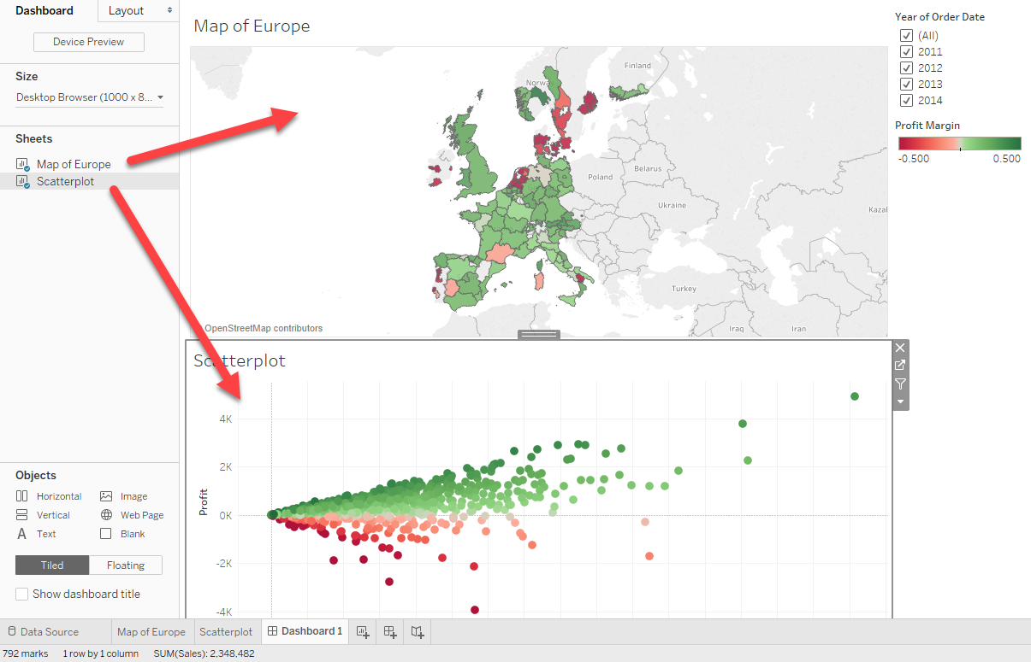
Create Dashboard
Create a new dashboard from the pull down menu Dashboard
Drag and drop the GIS map created in the previous unit and the scatterplot into the canvas

Slide 37
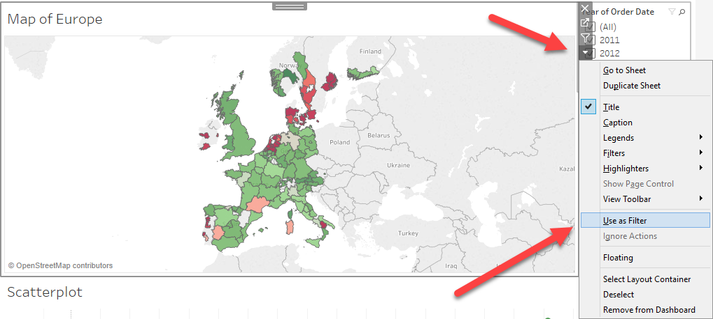
Add action (use as filter)
Click on the map
At the right hand side select Use as Filter from the gray menu.
Now the map, like the slide bar or checkboxes, become a filter.

Slide 38
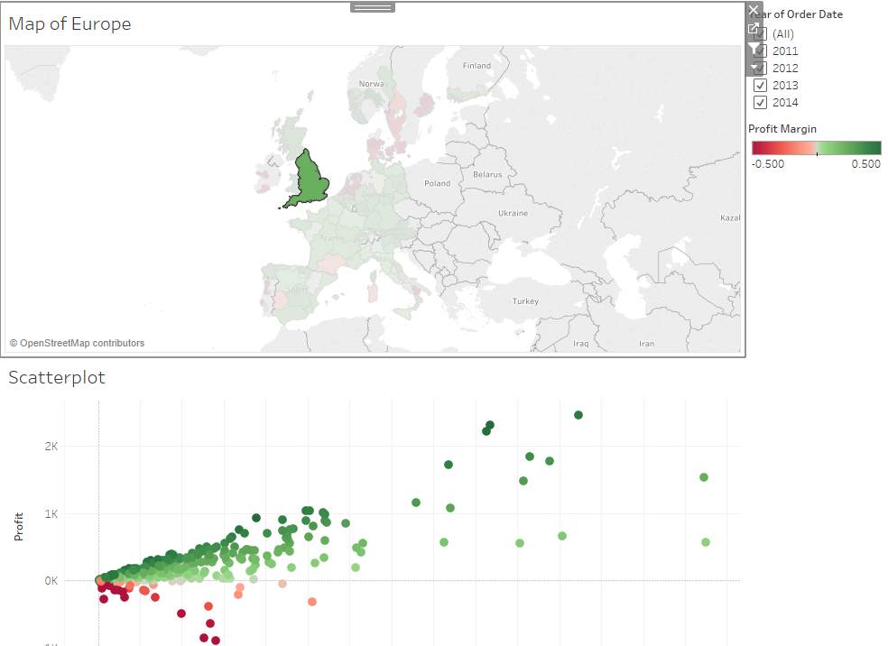
Filter
Click on England on the map
The scatterplot shows England data only.

Slide 39
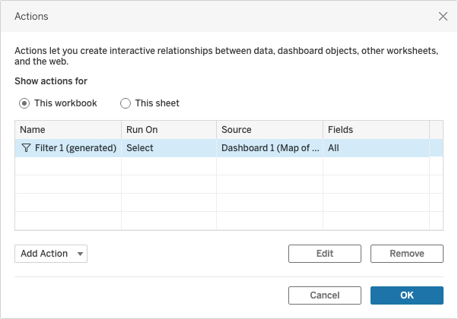
Edit Action
From the drop down menu Dashboard choose Actions

Slide 40
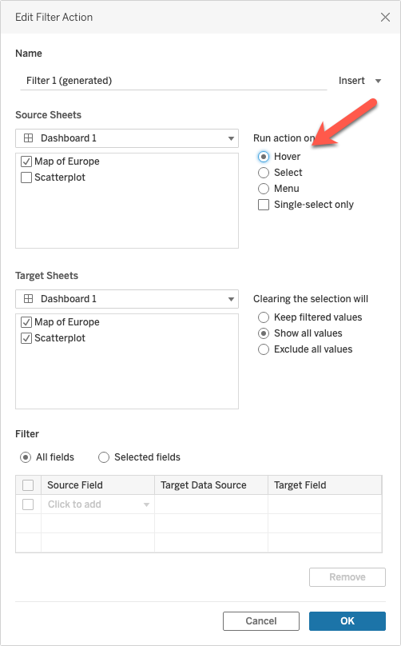
Edit Action
Double-click the filter 1 (generated)
Change “Run action on” to hover
The interaction happens by mouse over. You don’t need to keep clicking.

Slide 41
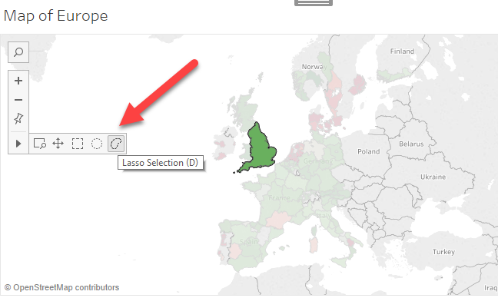
Free form selection
Restore from Hover to Select
The selection menu is hidden. You must click on the map to see it.
Lasso: Allow you to select multiple countries at the same time.

Slide 42
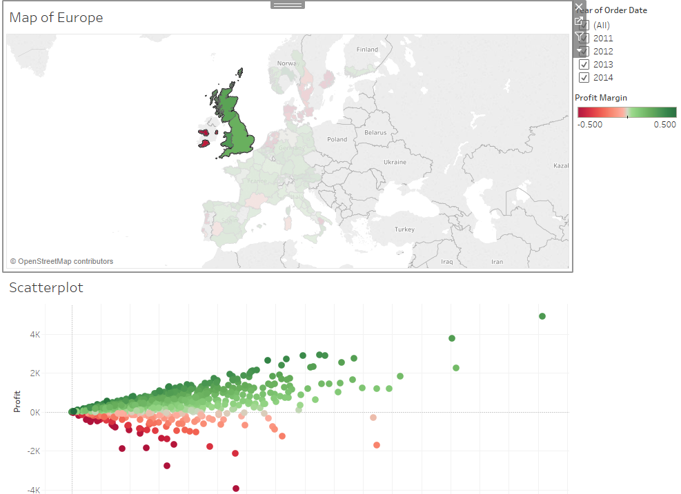
Free form selection
The UK and Ireland

Slide 43
Data Source
Mobile phone data set will be used. The data set is not in the public domain. Please do not share.
Source: Young, B. (2018). Tableau expert: Top visualization techniques in Tableau 10.

Slide 44
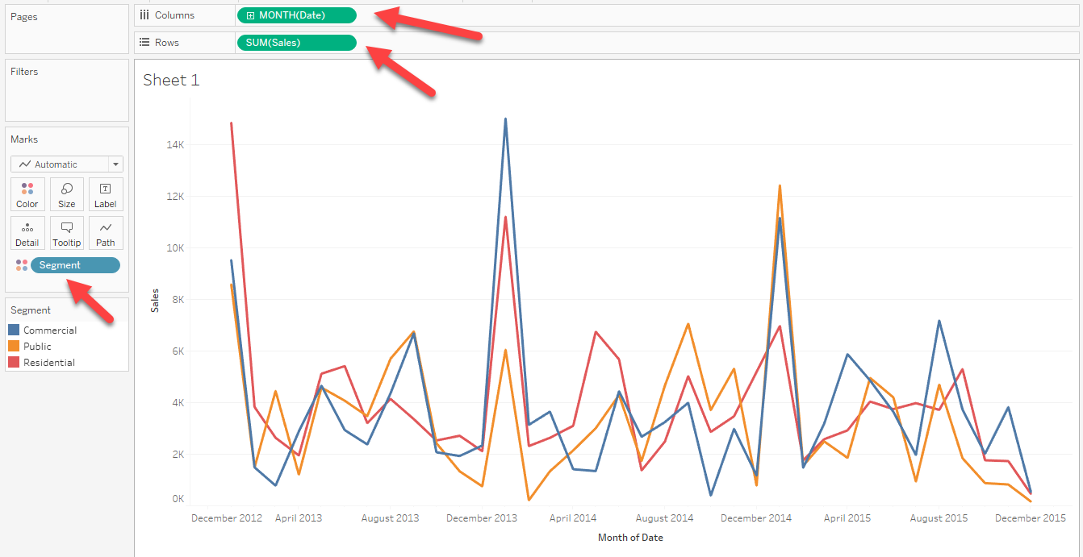
Create a time-series line graph
Use Mobile phone sales data set: Section 2
Put Sales into Row
Put Segment into Color
Put Date into Columns
Change Date from Year to Month (May 2015)
Name it “Sales by segment”

Slide 45
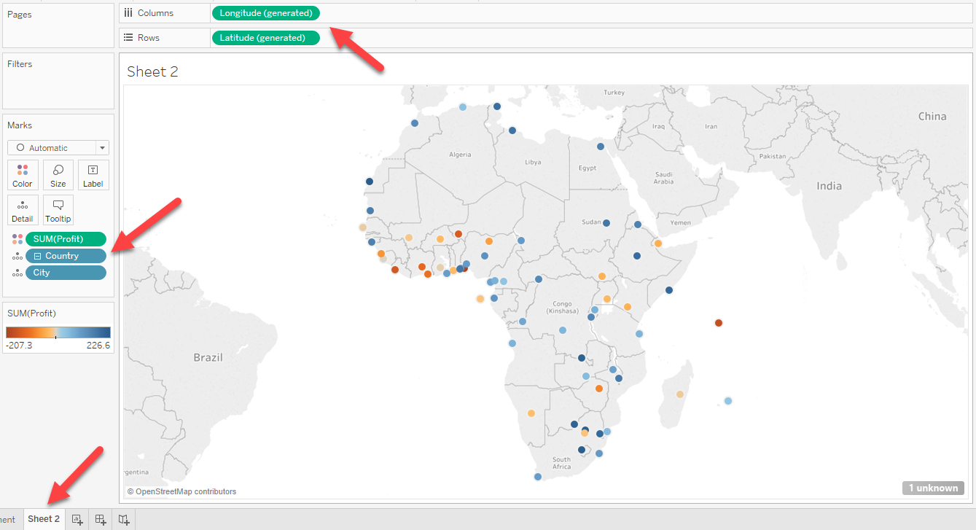
Create a GIS map
Click the icon with a + sign to open a new worksheet
Use Longitude and Latitude to create a map
Put Profit into Color
Put Country and City under Profit
Rename it to Profit by City

Slide 46
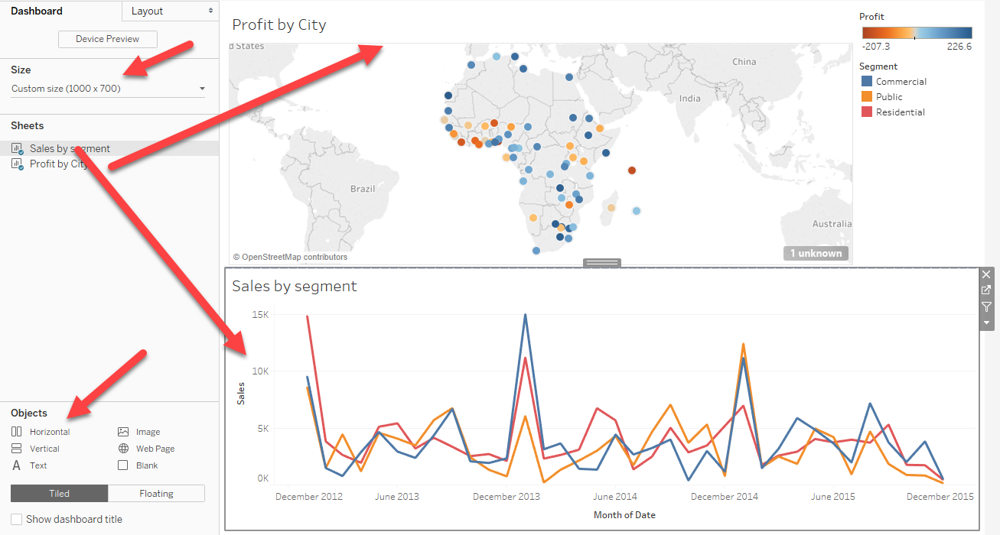
Create a dashboard
Choose New Dashboard from Dashboard
Choose Horizontal
Change the size if the canvas is too big
Drag the two graphs into the canvas

Slide 47
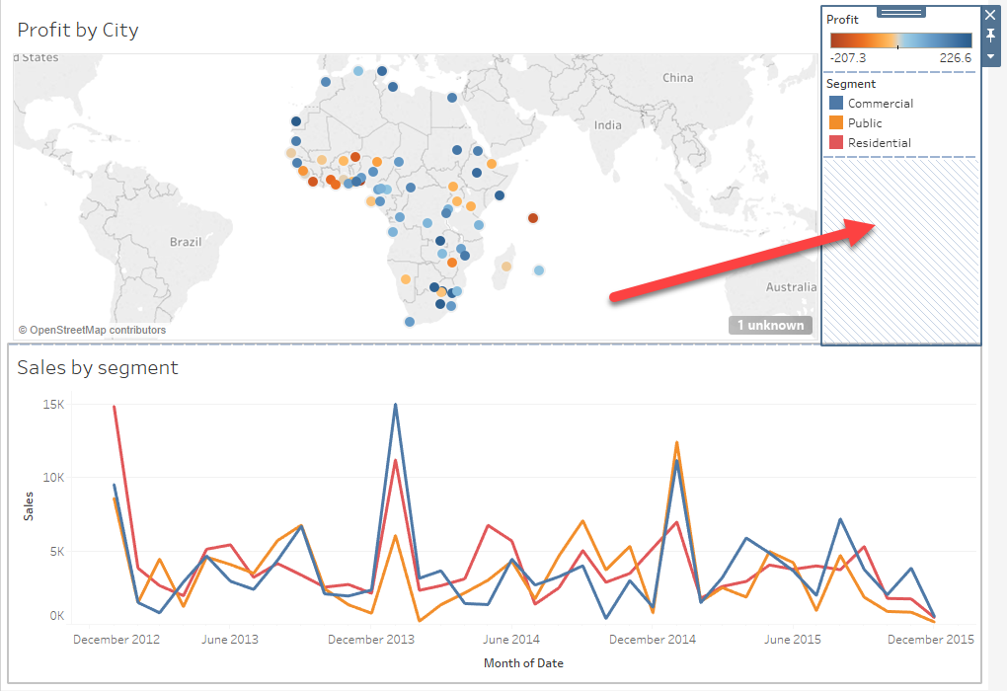
Select a panel to edit
When you click on a panel, that object becomes active.
When the vertical panel is active, you can edit the object and add more things into it.

Slide 48
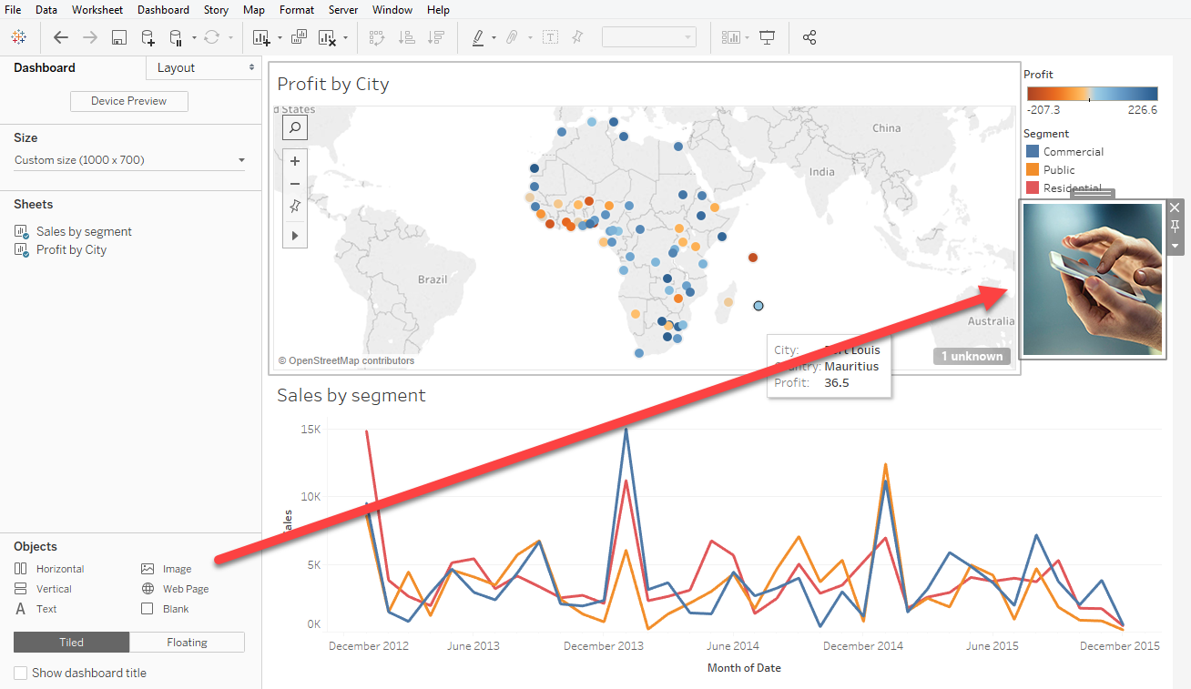
Add image or logo
You can drag image into the active panel and then import a picture into the spot.
The image file for this example is called “phone.jpg”, which can be downloaded from Unit 8 folder: Tableau_files.

Slide 49
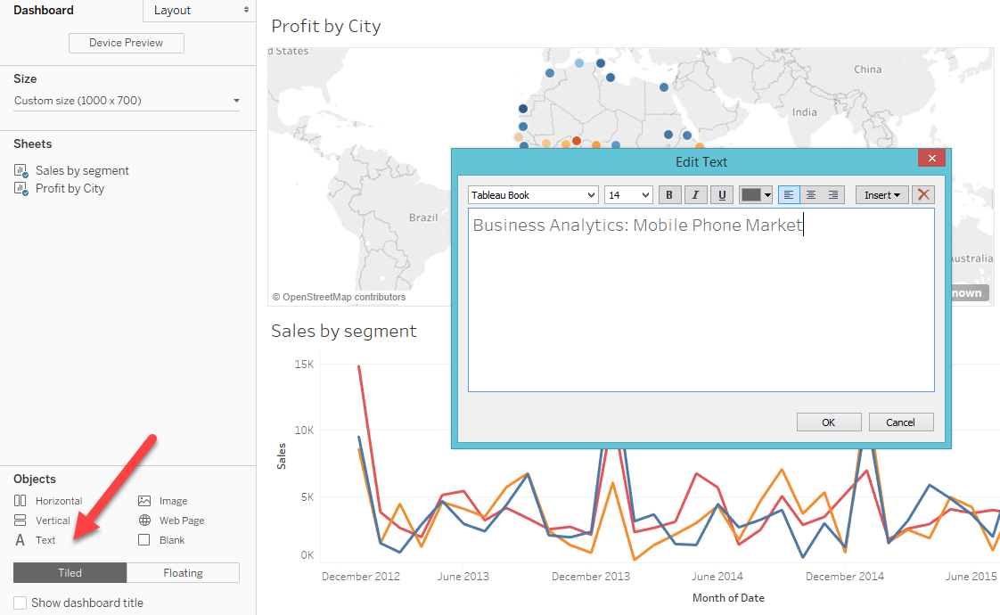
Add text
You can also add text into the active panel by dragging the text object into the panel.
In the pop-up dialog type the text, choose the font size, style, and color that you like.

Slide 50
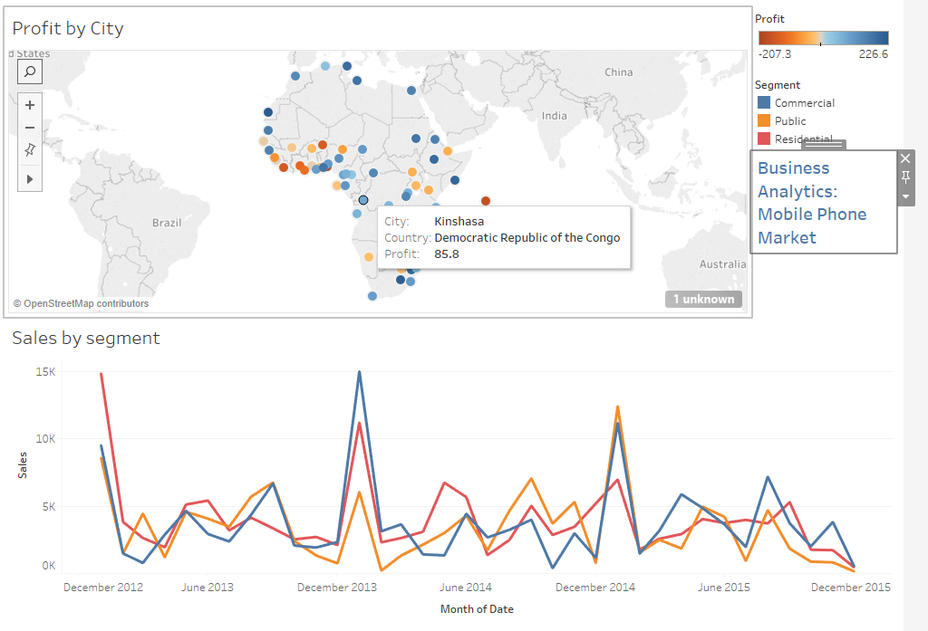
Report with a title

Slide 51
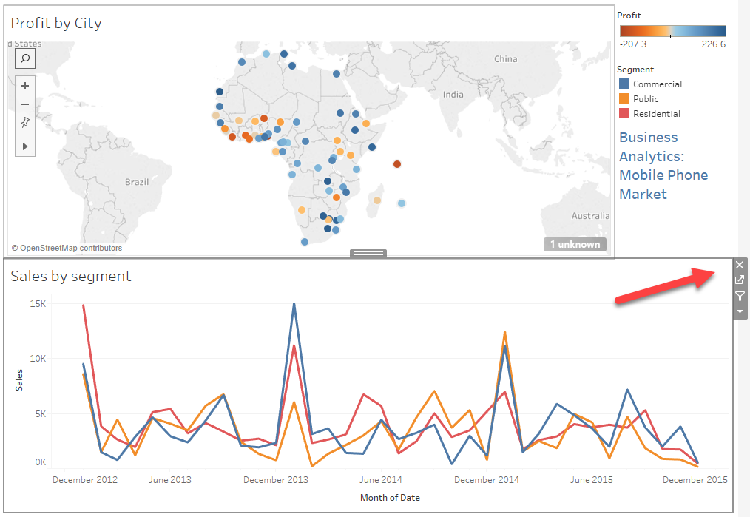
Take out a panel
You want to add a webpage at the bottom so that the reader can verify the data or look for additional info.
You can show three panels but it is too cluttered.
Click on the bottom panel to make it active.
Click on the X sign on the right to remove the object.

Slide 52
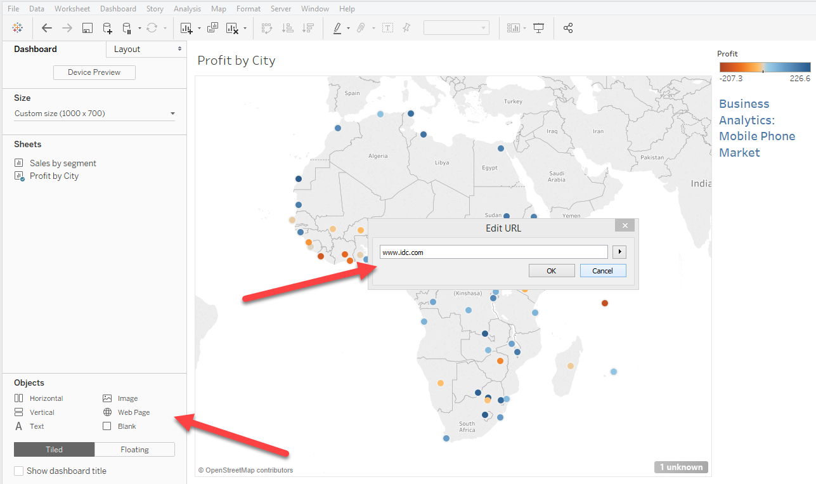
Add a webpage
After the bottom panel is removed, drag Web Page into the bottom of the canvas.
In the pop-up dialog box, enter www.idc.com

Slide 53
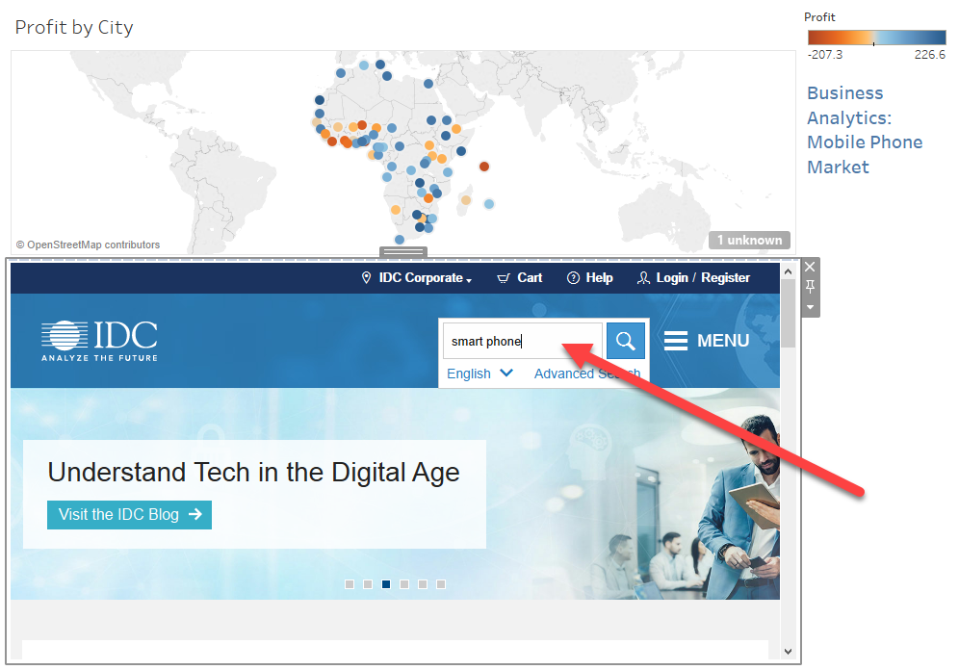
Report with a website
Now the user can access the Internet from the report.
Enter “smart phone” into the search box and you see a list of market research about smart phones.

Slide 54
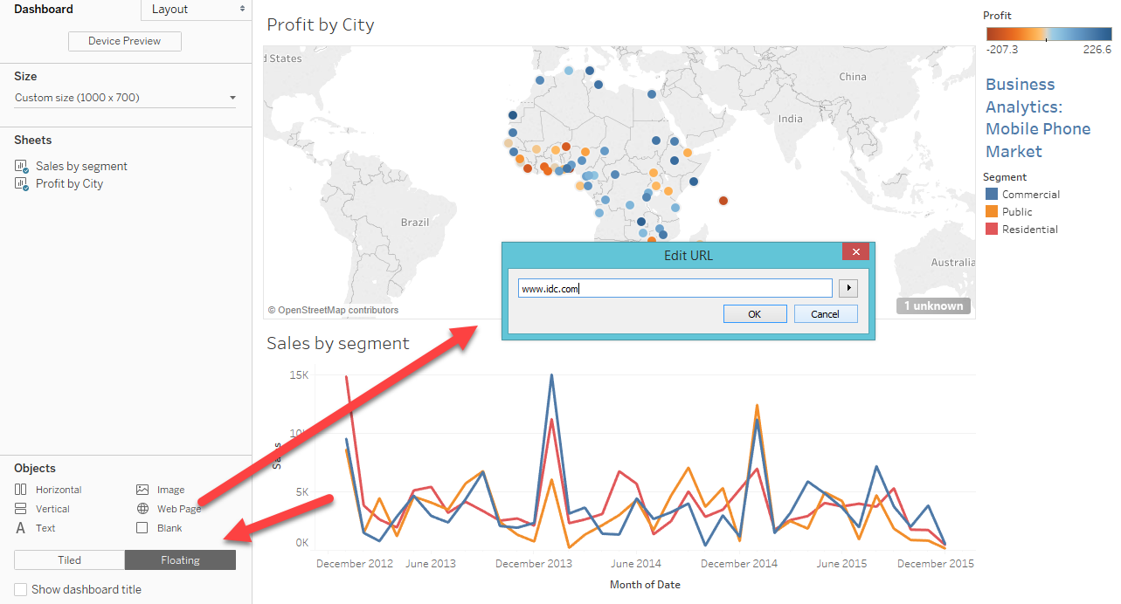
Floating objects
If you want to put three or more objects in the dashboard, it is better to use a floating object (JMP uses tabs)
Remove the website and put back the graph of Sales by segment.
Change the object type from Tiled to floating.
Drag Web page into the canvas and enter www.idc.com

Slide 55
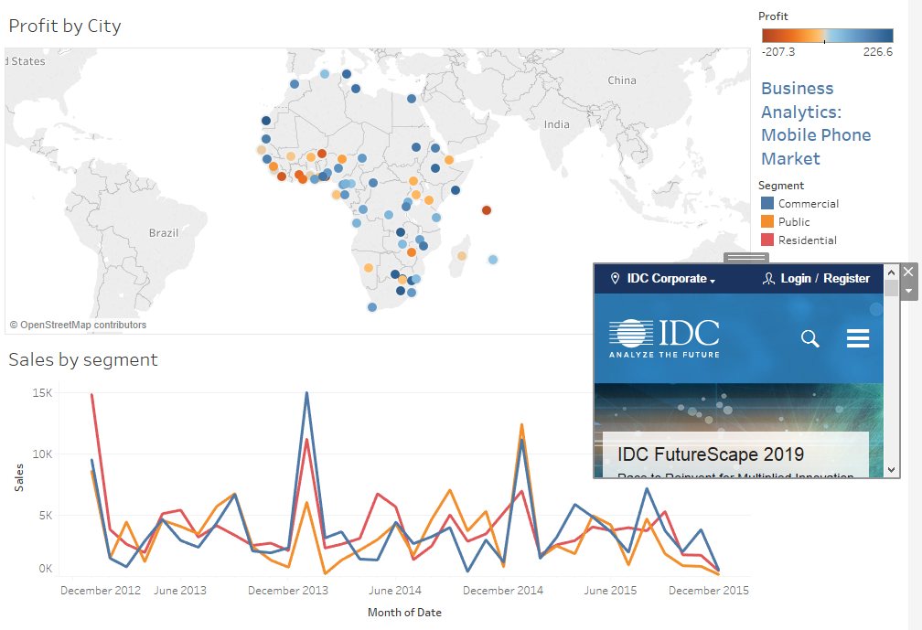
Floating objects
The floating object can be resized and moved around.
It will not obscure other objects.

Slide 56

Customize the dashboard size
If your client has a large monitor, then you can put three to five panels into the dashboard in the tiled layout, rather than using the floating layout.
You can customize the dashboard size by using the device preview.

Slide 57
Optional: Create a navigational button
The following slides show you how to create another dashboard and also a button for the user to navigate between different dashboards.
This process is complicated and confusing and therefore I will not do the demo in class.
You are welcome to follow the instruction in the following pages to learn how it works. It is completely optional.
It is much easier to add navigational buttons into webpages: Example

Slide 58

Create a Sales by country map
Open a new sheet,
Drag Latitude into Rows
Longitude into Columns
Sales into Color
Country into Details

Slide 59

Create a profit by region bar chart
Open another sheet
Drag Date into Columns
Profit into Rows
Region into Color
Change Marks from Automatic to Bar

Slide 60

Create Dashboard 2
Create another Dashboard.
Drag Sales by Country and Profit by Region into the new Dashboard.

Slide 61


Navigation between different dashboards
Open a new sheet ad name it “Navigation”.
Change Marks to Shape
Edit Shape by clicking it open.
Choose More shapes
Choose Arrows from Select Shape Palette
Choose Green arrow.

Slide 62

Calculation field
Do a right-click to create a new calculation field.
Name it “Navigation”
Type “Continue to Dashboard 2”
The Navigation prompt is under Dimensions now.

Slide 63

Create the forward button
Drag Navigation from Dimensions to the canvas.
You can resize the text and the arrow to make it look better.

Slide 64


Create the forward button
You can also right-click the text and choose Format
Choose a bigger font size and make it bold.
Optional: You can right-click on the title to hide the text.

Slide 65

Create the forward button
Go back to Dashboard 1
Choose Floating layout
Drag Navigation to the canvas.
Resize and move it.

Slide 66


Create the forward button
The button cannot do anything unless an action is assigned.
Choose Action from Dashboard.
Choose Filter from Add Action

Slide 67

Create the forward button
Name the action “Continue to Dashboard 2”.
The action should be triggered when the navigation button is pressed, so uncheck the two graphs.
Choose “select” from Run Action on.
If you choose “hoover,” it jumps to the next page when the mouse is on top of the button even though there is no mouse-click.

Slide 68
Create the forward button
If you choose Menu, you need to take two steps to go to the next page. After a click, you will see a pull-down menu. You have to click again to go forward,
When the button is pressed, it should jump to Dashboard 2, and so the Target sheet should be Dashboard 2.

Slide 69
Optional Assignment
Create a button on Dashboard 2. When the user clicks on the button, it can go back to Dashboard 1.
The button can be a tiled or floating object.

