Slide 1


Data visualization: Dancing with the data
Chong Ho (Alex) Yu

Slide 2
Agenda
What is data visualization?
Why data visualization? Why not numbers only?
Brief history of data visualization
Visualization techniques of GIS and from lower to higher (multiple) dimensions
Future trend: multi-panel visualization to go beyond 5 dimensions

Slide 3
What is data visualization?
The process of exploring and displaying data in a manner that builds a visual analogy in the service of researcher insight and learning.
A common ground shared by EDA and data mining: The data visualizer should explore the data in as many ways as possible until a plausible story of the data emerges.
For the purpose of exploration the tool should be interactive and dynamic.

Slide 4
Static vs. dynamic
Static
  What you see is what you get. The graph is frozen.
  After the graph is made, you cannot manipulate the graph (changing the background color or the line width is not considered “data manipulation” because it cannot reveal any insight about the data)
Dynamic
  The data table and different graphic panels are linked. Changing one would change all others.
  You can manipulate the graph to explore the data through different perspectives.

Slide 5
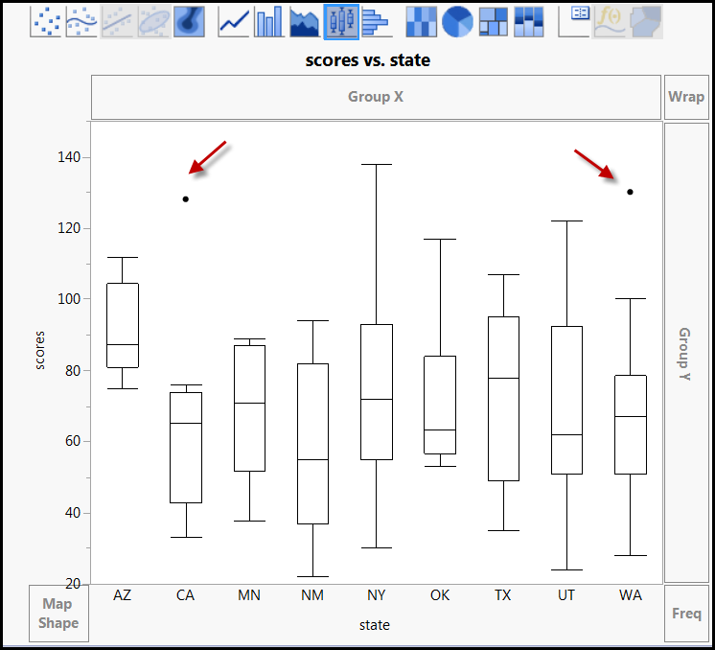
Dyanmic: Boxplot of scores by state
Data set: Visualization_data.jmp in Unit 2
Drag college test scores into the left y-axis
State into axis
Use histogram first
Change the display to boxplot
Outliers are exposed and cannot be excluded right away.

Slide 6
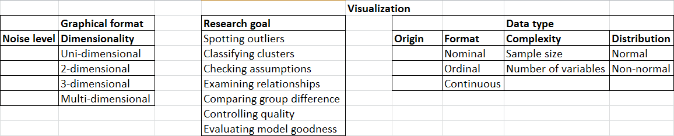
What is data visualization?
DV entails finding a balance between the detail of the raw data and the parsimony of statistical summary (noise vs. smooth).
Graphical format, research goal, and data type should be in alignment.
There are numerous combinations. No cook-book! Experience! Experience! Experience!

Slide 7
Why not numbers only? Opposition
Fisher (1932) said:
  Diagrams prove nothing, but bring outstanding features readily to the eye; they are therefore no substitute for such critical tests as may be applied to the data.
Today many researchers insist that reporting the numbers is sufficient.
How can we spot outliers, check assumptions (e.g. linearity, normality), identify patterns (e.g. clusters), evaluate model adequacy (e.g. residuals) without looking at the data?

Slide 8

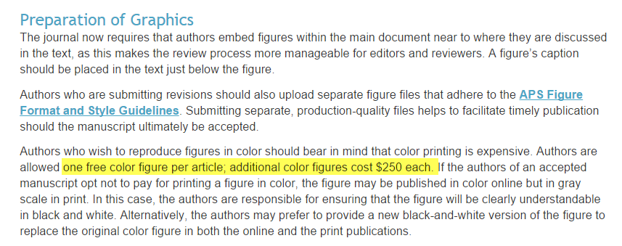
Why not numbers only? Opposition
“Many journal articles do not display graphics.”
Because it is expensive! It’ll cost you an arm and a leg!

Slide 9
Why data visualization?
See beyond the horizon!
The trend is digital and online publishing.
Multimedia and interactive modules cannot be displayed in traditional print journals?
Yu, C. H., & Stockford, S. (2003). Evaluating spatial- and temporal-oriented multi-dimensional visualization techniques for research and instruction. Practical Assessment, Research & Evaluation, 8(17). Retrieved from http://pareonline.net/getvn.asp?v=8&n=17

Slide 10
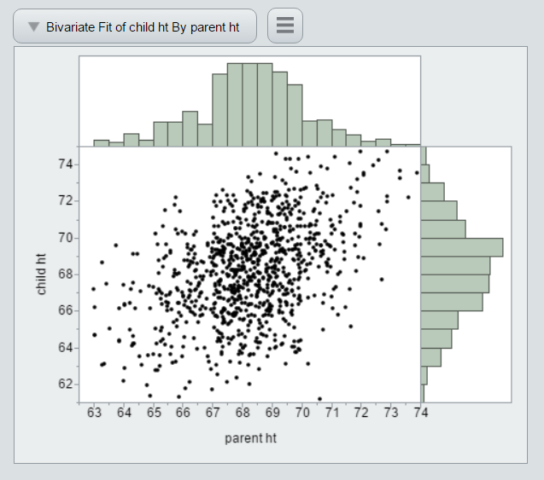
Why data visualization?
See beyond the horizon!
Help → Sample data library → Galton data: Discover regression to the mean
Fit Y by X
Inversed red triangle → Histogram borders
You can output the graph to HTML (Save as) and display the result interactively.
No plug-in for the Web browser
Can you do the following in a hard copy?
http://www.creative-wisdom.com/teaching/WBI/galton.htm

Slide 11
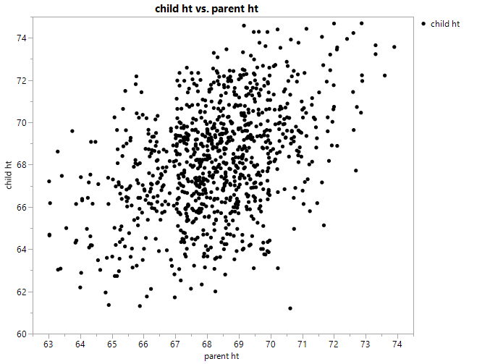
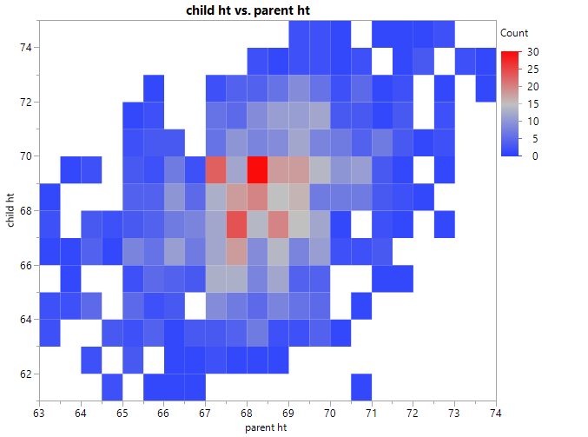
Why data visualization? See beyond the horizon!
Galton data
If using a traditional B & W scatterplot, it is hard to tell the data density, especially big data (over-plotting)
Heatmap can. Today online journals accept color graphs.

Slide 12
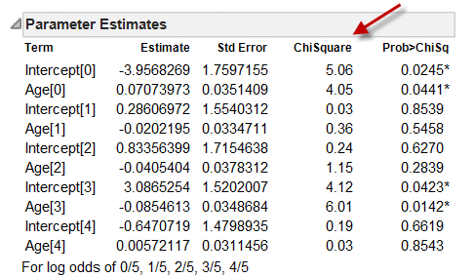
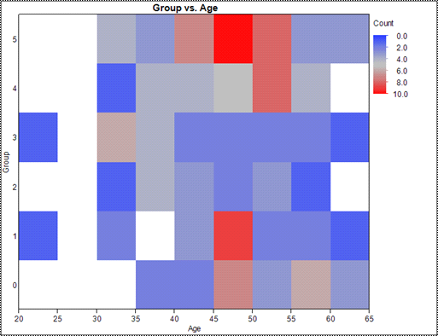
Why data visualization? See beyond the horizon!
Easier to interpret e.g. logistic regression
Aged between 45 and 50 → in group 1 and 5
http://www.creative-wisdom.com/computer/sas/jmp_heatmap.pdf

Slide 13
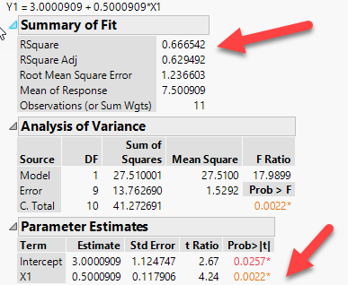
Why data visualization?
Numbers may fool you!
Open Anscombe data (1973) from the sample data library
Click on the green arrow of “The Quartet”
What do you see?
All of the them have the same result: R2 = .666; p = .0022

Slide 14
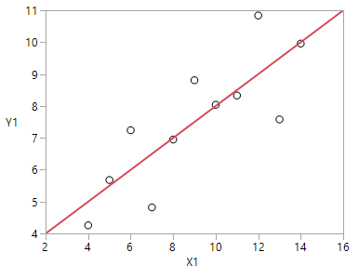
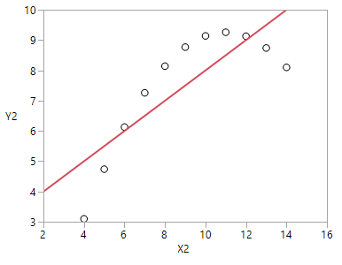
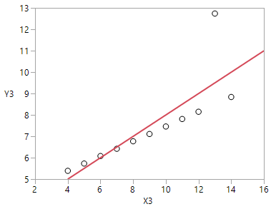
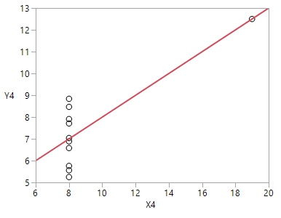
Numbers can fool you!
Same numeric results, but all four are different!

Slide 15
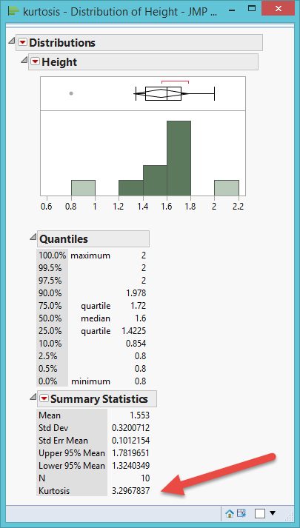
Why data visualization?
Numbers may fool you!
Another one: Kurtosis is the relative ratio of the mass of the distribution located in the center vs. in the tails. Kurtosis = 3 → Normal curve.
In this example, Kurtosis = 3.2, fairly normal, right?
No, there is a lot of central mass, but the histogram shows that the distribution is skewed and there are two outliers.

Slide 16
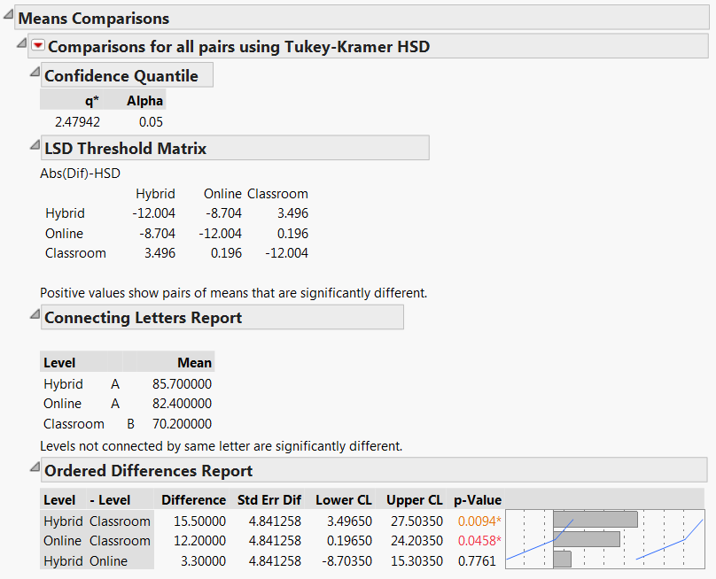
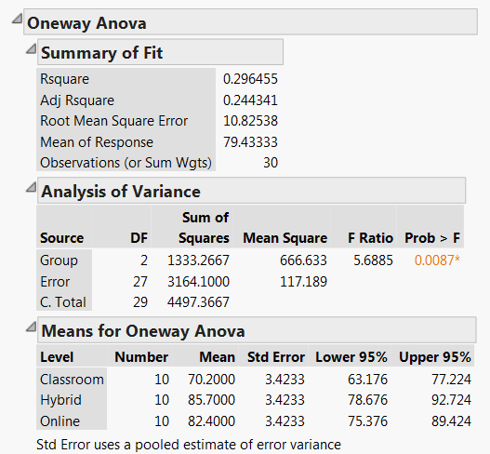
Why data visualization? It benefits even traditional statistics
Traditionally, ANOVA and multiple comparison show numeric output only.

Slide 17
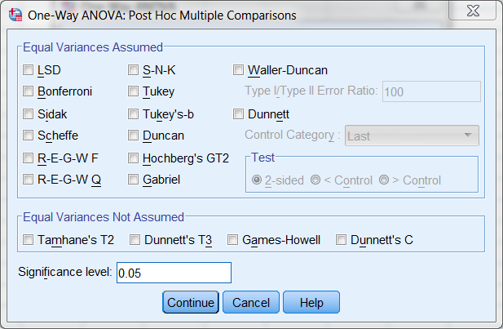
Why data visualization? It benefits even traditional statistics
It is confusing to both the analyst and the reader.
SPSS Post hoc multiple comparisons.
In SPSS you have 18 options. When I was a graduate student, I took a course on it.

Slide 18
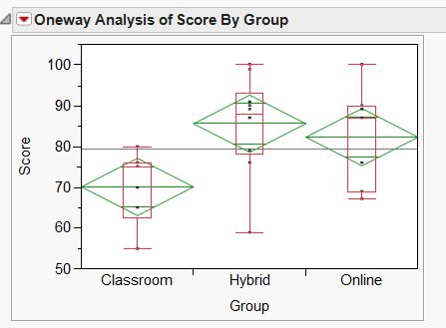
Diamond plot
Data set: One-way.jmp
There are three teaching modes: Traditional classroom, online, and hybrid.
Which one is more effective in terms of test performance?
Analyze → Fit Y by X
Inversed red triangle → Quantile (no outliers)
Inversed red triangle → Means/ANOVA

Slide 19
Diamond plot
Grand sample mean: horizontal black line
Group means: horizontal line inside each diamond.
Confidence intervals: The top of the diamond is the upper bound (the best case scenario) while the bottom is the lower bound (the worst).
Quantile: boxplot

Slide 20
Diamond plot
The hybrid group outperforms the classroom group in the population because the best case scenario of classroom cannot match the worse case scenario of hybrid.
Hybrid and Online overlap and thus they might not be different from each other in the population.
Online and classroom only overlap a bit. It is likely that Online still outperforms Classroom.
Making easier and clearer judgment by visual inspection of the data.

Slide 21
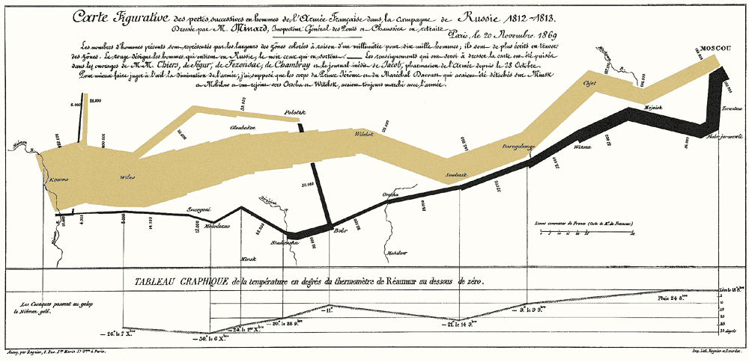
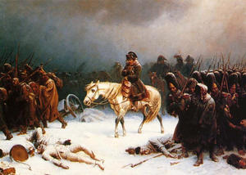
Brief history
Charles Joseph Minard's Visualization Of Napoleon's 1812 March to Moscow (1869)

Slide 22
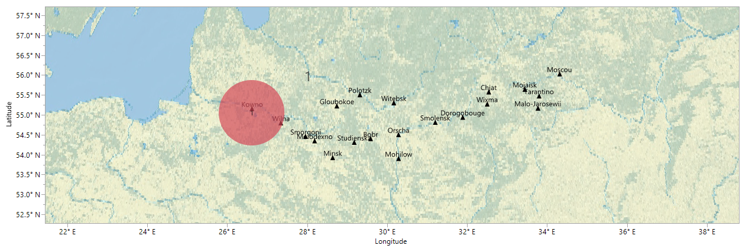
A modern version
JMP Sample data: Napoleon’s March
The circle depicts the size of the French army
This is the beginning (attack)

Slide 23
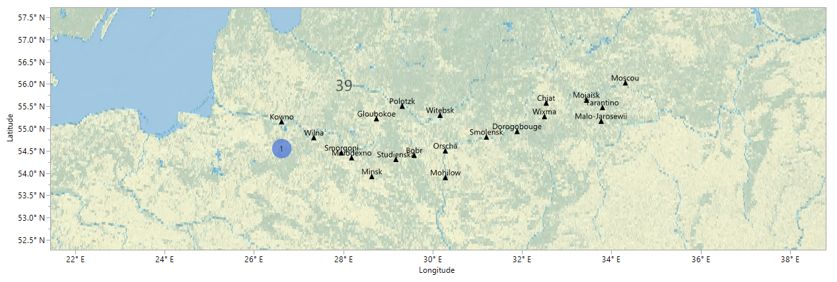
A modern version
Blue circle : Retreat
This is the end!

Slide 24
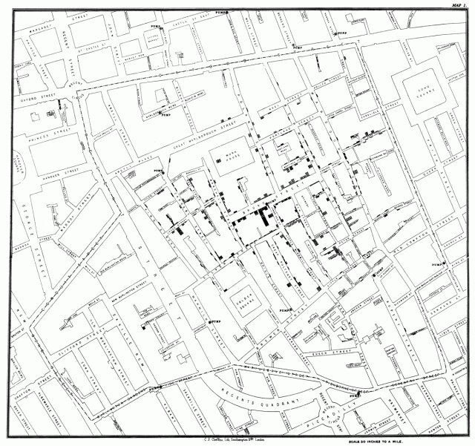
1854 London Cholera Outbreak
In 1854 a severe outbreak of cholera occurred in the Soho district of London, England, killing 616 people
John Snow used a quasi-GIS method to trace the source to contaminated water, not air.

Slide 25
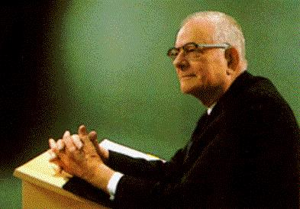
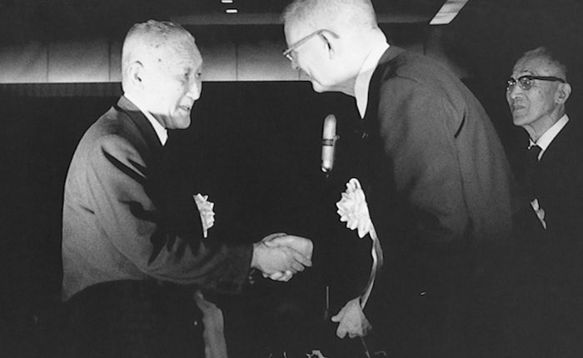
Deming’s total quality management
1950s: Edwards Deming
TQM also uses graphical aids heavily for statistical quality control (SQC).
The goal of research on quality is to identify the pattern of changes and reduce this variation.
Deming considered hypothesis testing is one of the evils taught in statistics courses.
Toyota listened to him.

Slide 26
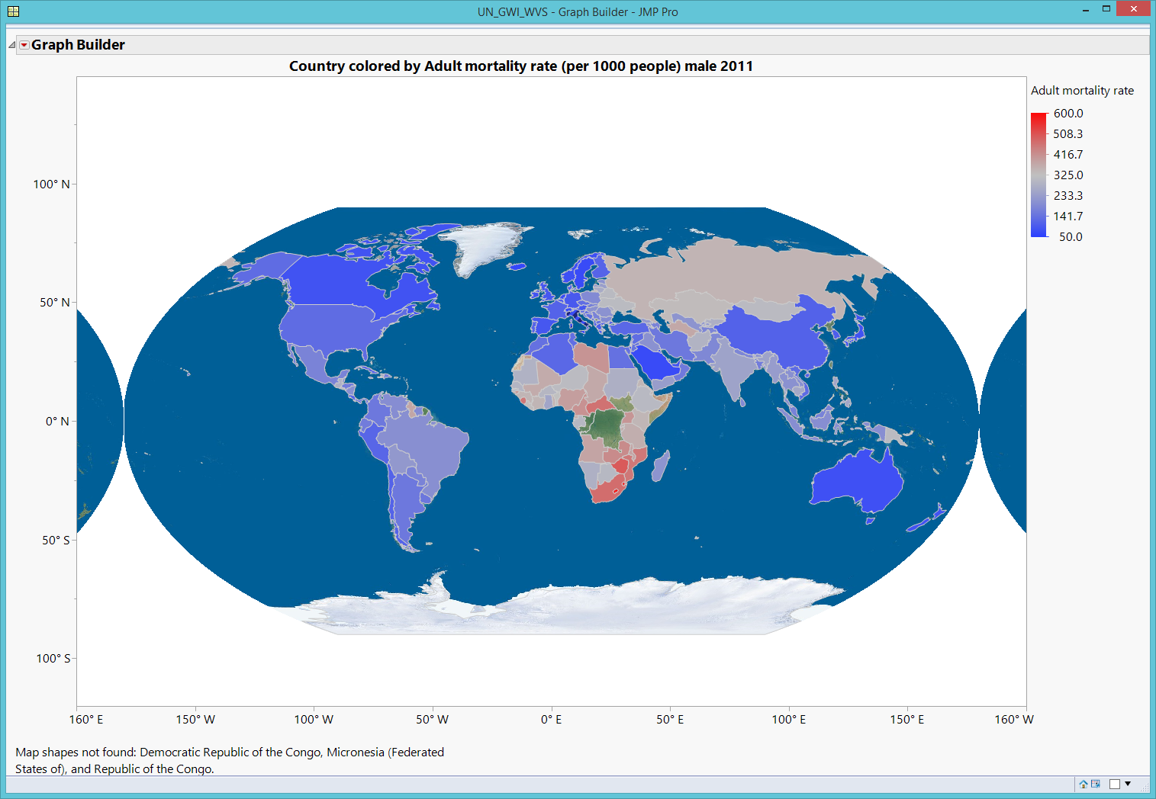
GIS Map: World_data
Today we have much more powerful tools than Charles Minard and John Snow.
Drag country into the Map shape.
Drag Adult mortality rate per 1,000 people (Male) 2011
Right-click to open Graph → Background Map
Choose Simple map for Images and World for Boundaries.

Slide 27
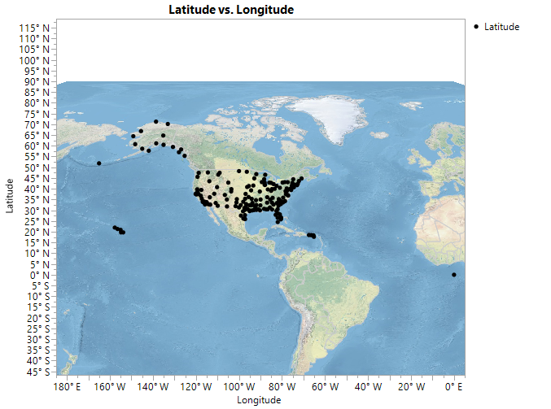
GIS map
Qualtrics (Online survey engine) records the longitude and latitude of the response. You can check the origins of your data.
Use JMP Sample Data: Air Traffic
Put Latitude into Y and Longitude into X
Right click to Graph → Background Map
Use Detailed Earth

Slide 28
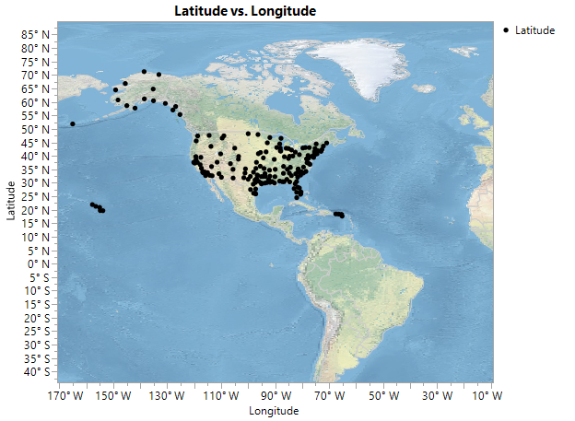
GIS map
But there are no data near the North Pole.
Move the cursor to the y axis.
The pointer turns into a hand.
Move the map upward.

Slide 29
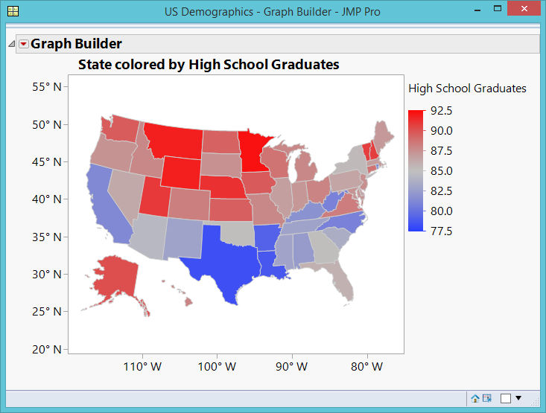
GIS Map
Sample data library: US demographics
Drag state code into Map shape (lower left)
Drag high school graduates into the map.
The Yankees (Northern states) are doing better.
But usually people perceive “red” as “risk”.

Slide 30
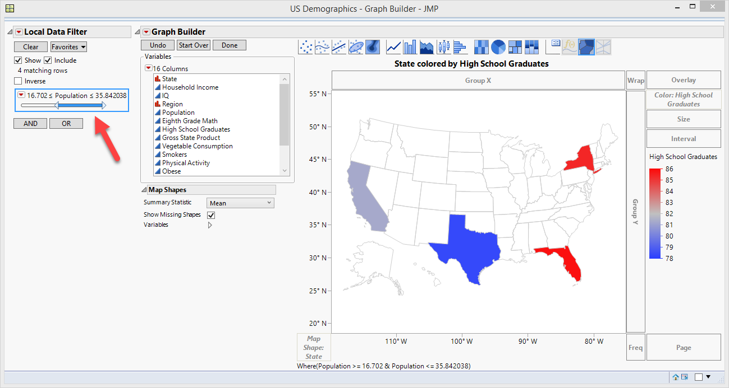
GIS Map: local filter
Wonder whether there is a relationship between population and high school graduate rate.
Add local data filter → Population
It doesn’t seem that more populated states have more high school graduates: Size doesn’t matter!

Slide 31
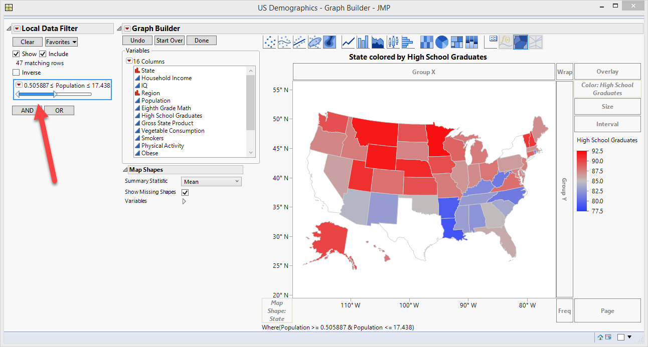
Local filter
Less populated states do not necessarily have fewer high school graduates.
I don’t like the color scheme. Red signifies “risk” or “crisis” but higher graduation rate is a good thing.

Slide 32
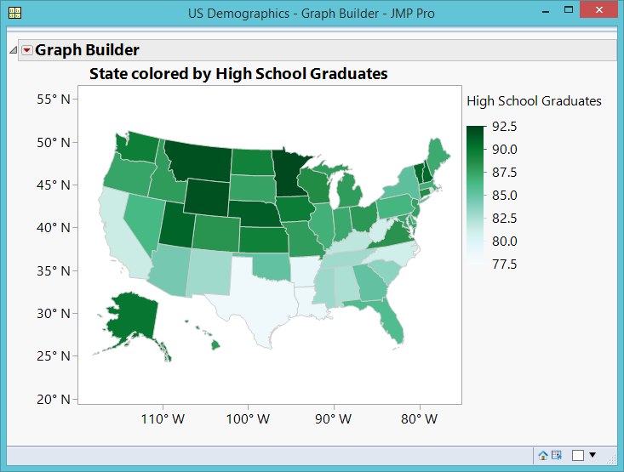
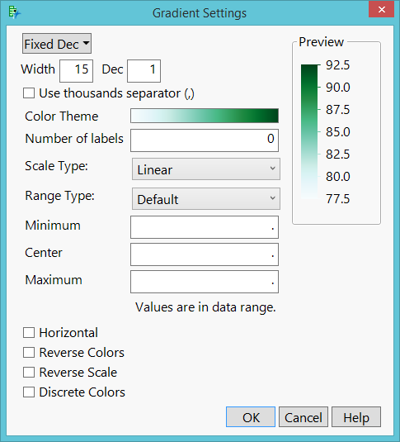
Customized GIS Map
Double-click the legend to change the color scheme.
Green means “good”

Slide 33
Assignment 2.1
Open the data set visualization_data.jmp in Unit 2.
Use Graph builder to make a US map. Show college test scores on the map.
Select “Show missing shapes”
Which states have best and worst average scores?
Add local data filter. Use Rank (1 = Freshman; 4 = Senior).
Answer the same question by Rank.
Change the default color scheme to another color one.
Save the script to the data table

Slide 34
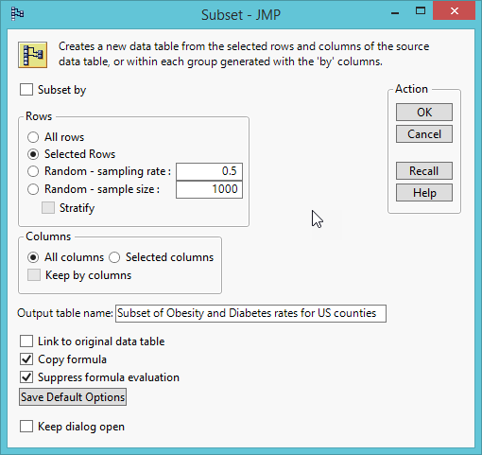
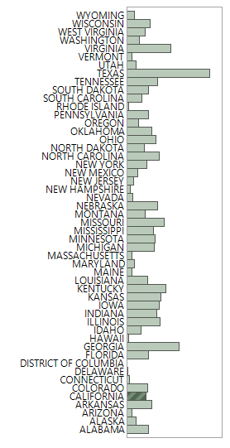
GIS Map: County
Obesity and diabetes rates for US counties: https://wiki.harvard.edu/confluence/display/hsphpophealth/Visualizing+obesity+module
I want to look at California only. There are two ways to select a subset:
  Select CA, inverse selection, Hide and exclude others
  Create a subset from Tables

Slide 35
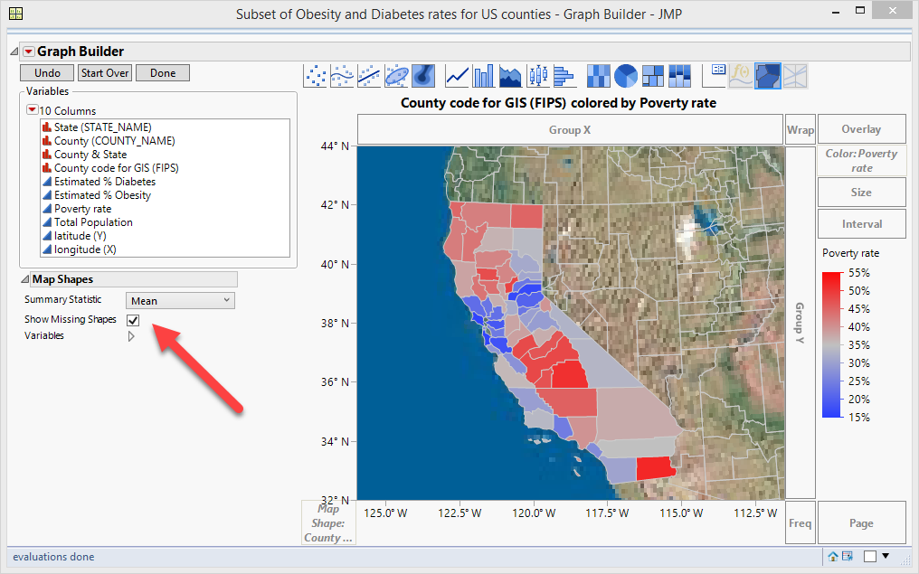
GIS Map: County
Drag Country Code for GIS (FIPS) into Map Shape.
Check Showing missing shapes
Right click to Graph → Background Map
Use Simple Earth or Detailed Earth
Use US County

Slide 36
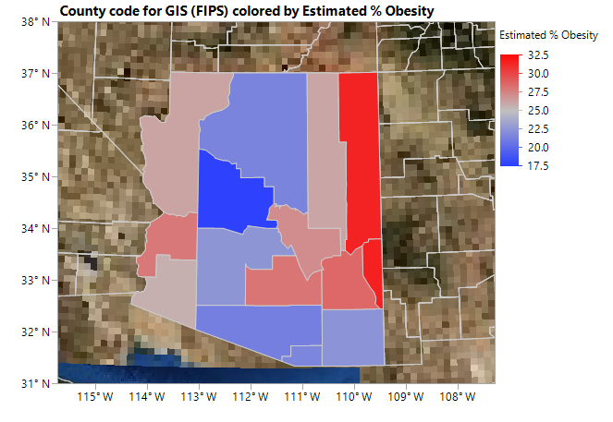
Assignment 2.2
Download and open the dataset “Obesity and diabetes rates for US counties”
Choose Arizona data only to create a subset
Drag County code for GIS (FIPS) into the canvas
Drag estimated %Obesity into the canvas
Check “Show Missing Shapes”
Add background map
Which county has the highest obesity rate?
Which one has the lowest?

Slide 37
GIS Map: Zip (Windows only)
Download the zip plugin: https://community.jmp.com/t5/JMP-Sample-Data/US-ZIP-Code-Maps/ta-p/22545
Unzip it and copy the two files into C:\Program Files\SAS\JMPEA\14\Maps
Data set: abuse.jmp (not in the public domain and thus cannot share it on my website)
I want to know the geographical pattern of substance use.

Slide 38
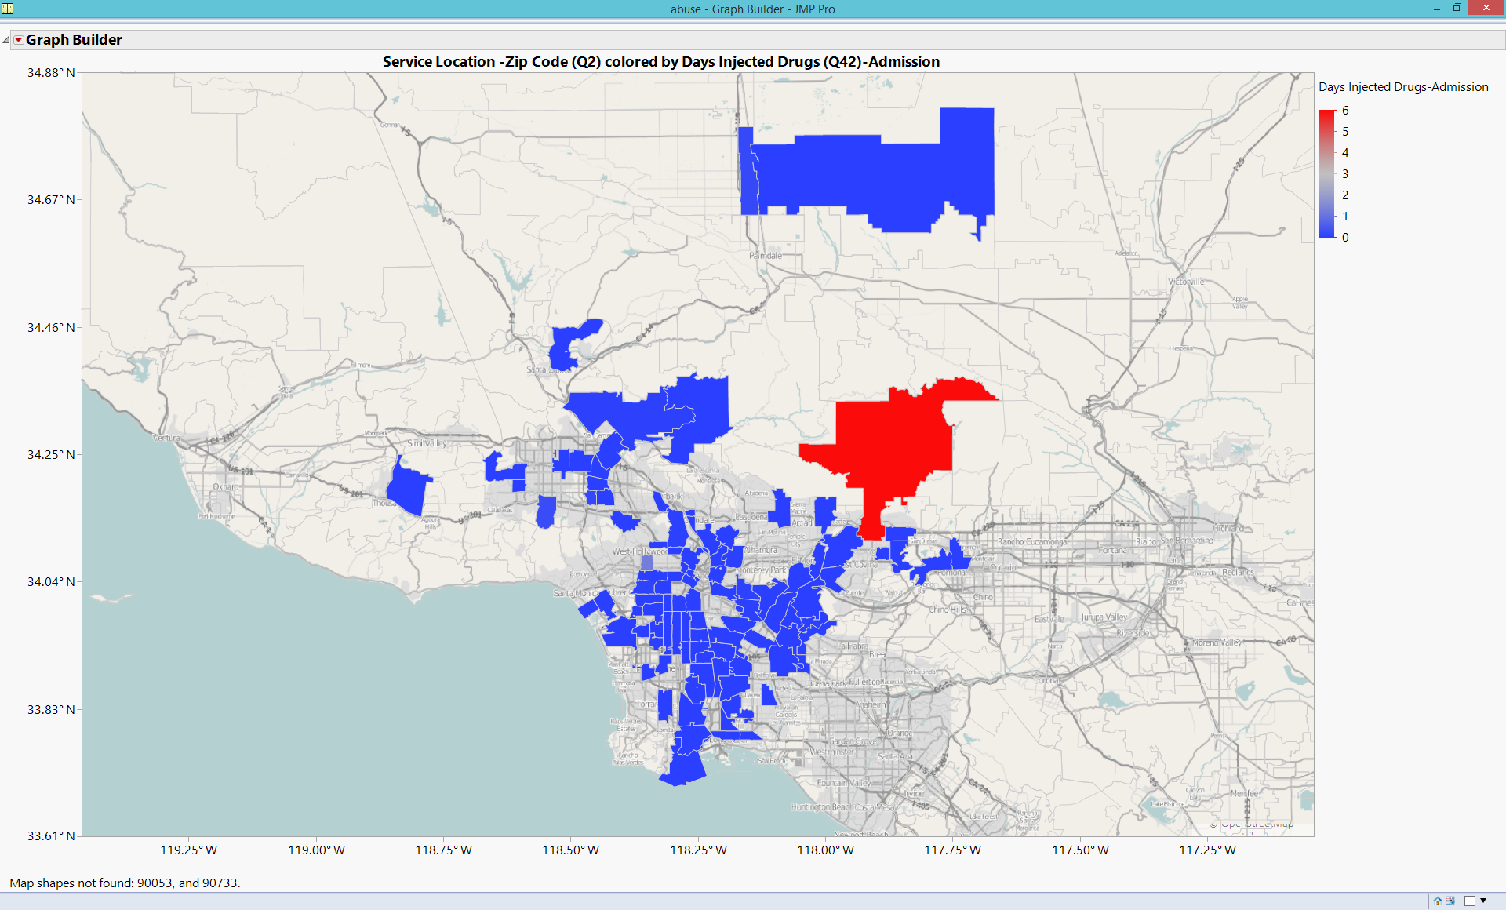
GIS Map: Zip
Use Street Map Service for Images and US Counties for Boundaries

Slide 39
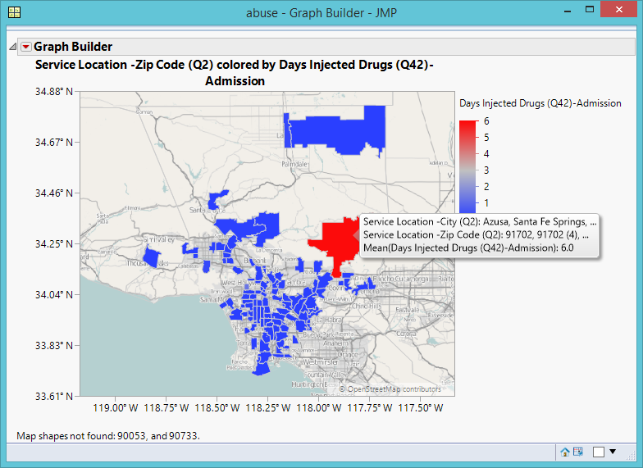
GIS Map: Zip
Keep the default color scheme because the color red signifies risk.
Wonder where the red area (highest) is.
Mouse over to show the detail.

Slide 40
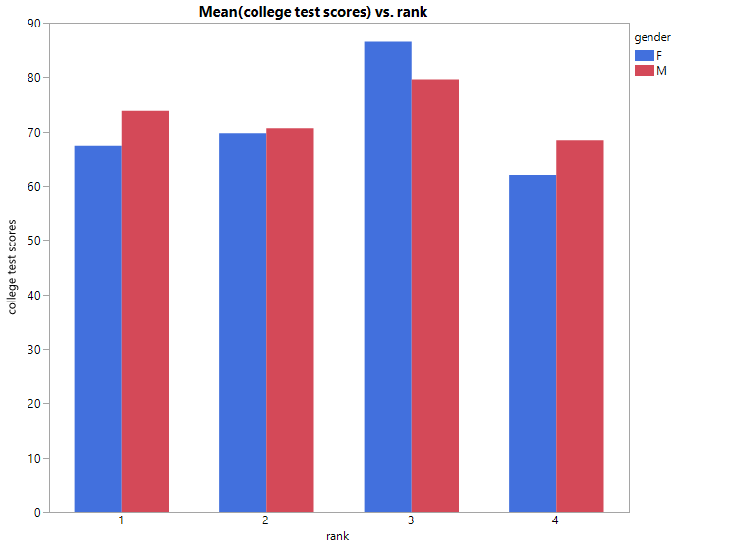
Coplot for multivariate visualization: college test scores X rank * gender
Data set: Visualization_data.jmp
Co = Conditional
Visualization of three variables (how a relationship is conditioned by the third variable)
Put College test scores on the left Y-axis
Put academic rank on X
Put gender on Overlay at the far right

Slide 41
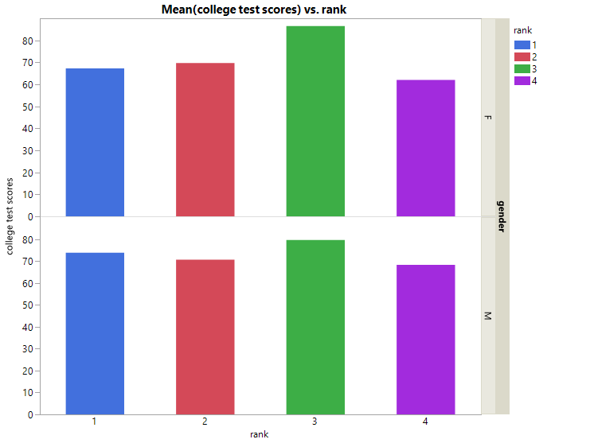
Coplot: college test scores X rank * gender
Put Rank on overlay to assign a unique color to each rank
Put Gender into the right Y-axis
No need to remember the exact procedure; the graph changes by mouse over

Slide 42
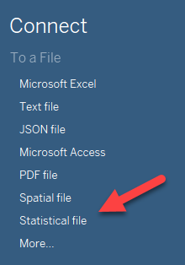
Coplot in tableau
Download free student version of Tableau at: https://www.tableau.com/academic/students
Or a trail version at: https://www.tableau.com/products/desktop/download
Open Tableau
Open Statistical file
Open visualization_data.sas (not JMP)
Click Sheet 1 at the bottom

Slide 43
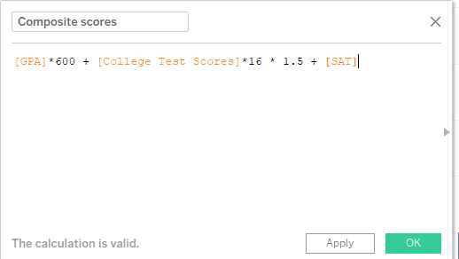
Coplot in tableau
I want to award two scholarships to students from Arizona and California: One is for a male student and the other is for a female student.
I want to take high school GPA, SAT, and college test scores into account.
The last one is more important and so the weight is 150%.

Slide 44
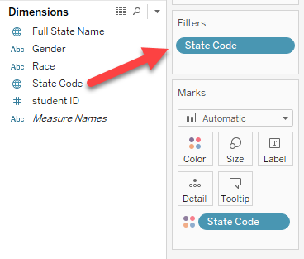
Coplot in tableau
Create a calculation field
The max. of SAT is 2400
Adjust the 4-point scaled GPA by GPA * 600 (2400/4 = 600)
The max. of test score is 150. Adjust college test score by score * 16 (2400/150 = 16)
Filter by data by dragging State code into Filters
Select AZ and CA

Slide 45
Coplot in tableau
Put Gender and Student ID into Columns
Put Composite scores into Rows
Drag Gender into Color
Click on “Composite score” on the Y-axis to sort the ranking of the students by composite scores
Change the header to “Ranking of students by academic composite scores”
You can drag State code into Color to see the home state of each winner
You can select winners from different states by toggling the options in data filter.

Slide 46
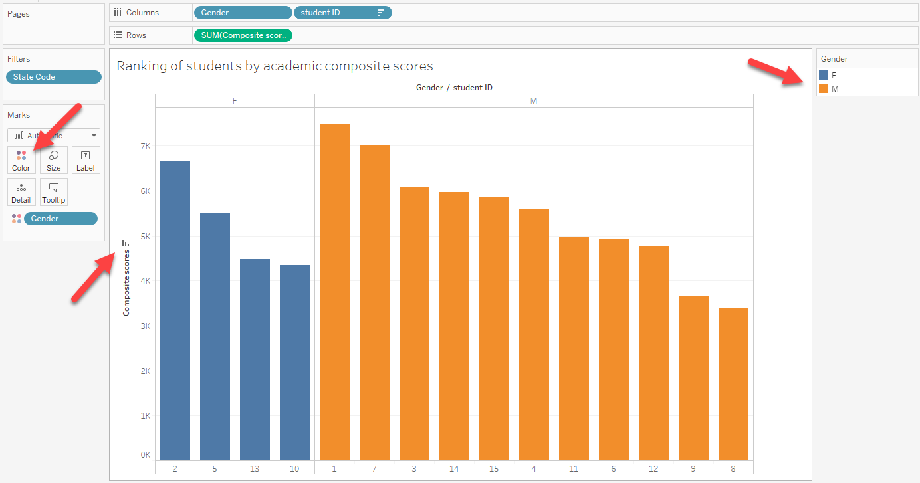

Slide 47
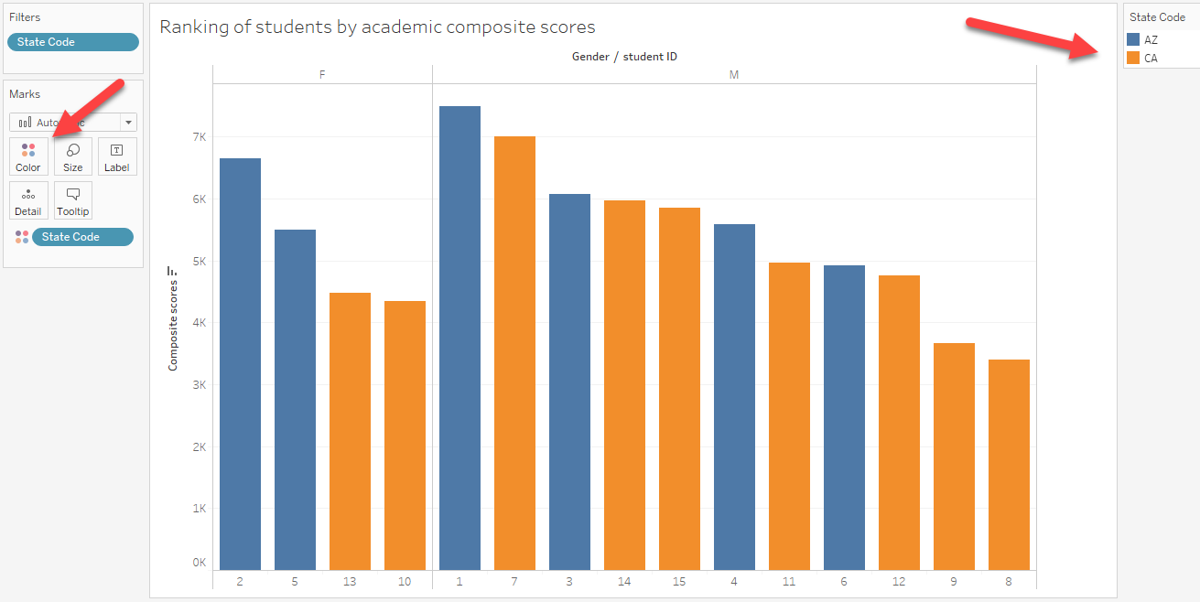

Slide 48
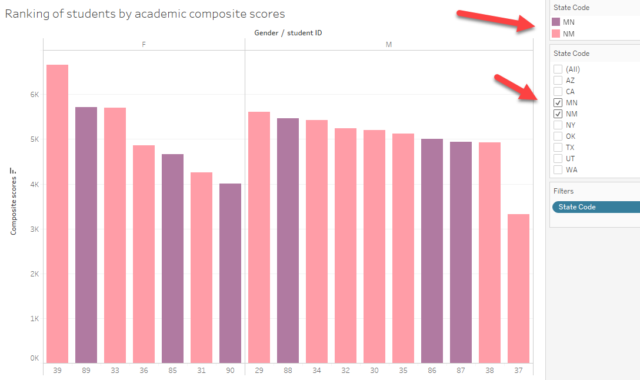

Slide 49
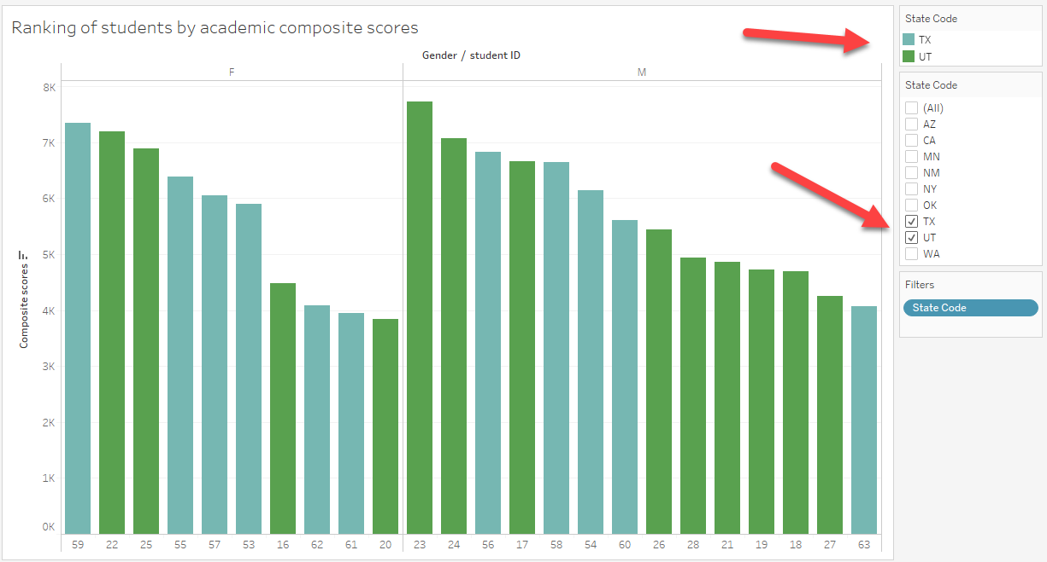

Slide 50
Assignment 2.3 (Optional)
If you have already create a coplot using the previous configuration, please click on the X icon at the top to clear up everything.
This time you want to award the scholarships by state (e.g. one winner from New York, one winner from Arizona…etc.)
This time you want to put more weight into high school GPA (200%), less weight into college test score (150%), and keep the weight of high school GPA as 100%.
Create a coplot in Tableau and find the winner in each state.

Slide 51
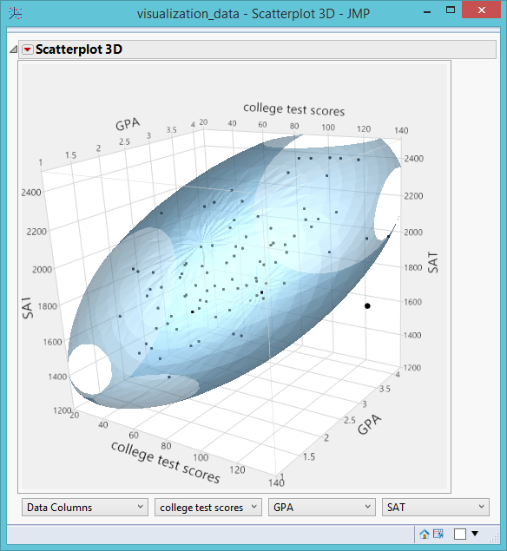
Scatterplot 3D
Also know as 3D spin plot because you can rotate (spin) the plot to inspect the data from different perspectives.
Helpful to spot multivariate outliers
Helpful to detect three-way relationship

Slide 52
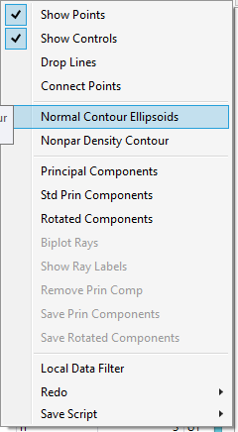

Scatterplot 3D
Data set: Visualization_data.jmp
Graph → Scatterplot 3D
Inversed red triangle → Normal Contour Ellipsoids
Keep Ungrouped
Change Coverage to .95 (Covered 95% of the data)

Slide 53



Scatterplot 3D
By rotating the 3D plot, you can identify all multivariate outliers.
Compare the result with Mahalanobis Distances
Analyze → Screening → Explore outliers
Put the three variables into Y
Click Multivariate Robust Outliers
You can explore the data by changing the coverage to .9 or .99

Slide 54
Assignment 2.4
Open “US Demographics” from Help → Sample Data Library
Create a scatterplot 3D with three variables: Obese, Alcohol Consumption, and Physical Activity.
Use .95 for coverage
Spin the plot to identify outliers, if there is any.
Run Screening → Explore outliers → Multivariate Robust Outliers
Compare the visual inspection with Mahalanobis Distances
Are they the same or different?

Slide 55


Ternary plot:
Clustering and Profiling
In the era of globalization, how can we define what a USA company is?
One argue that if you buy a Japanese car, you may help reducing the trade deficit because Japanese cars might have many US-made parts.
Data set: cars.jmp

Slide 56

Ternary plot:
Clustering and Profiling
Graph → Ternary plot
Put US, European, and Asian parts into X, Plotting
Use these as coordinates to position each company in terms of the origins of car parts.
Right click → Row label to show the name o each automaker.

Slide 57


Clustering pattern
There are three clusters, but one company does not belong to any.

Slide 58
Ternary plot:
Clustering and Profiling
The position of each observations is determined by the co-ordinates.
For example, Chrysler has 10% US parts, 30% European parts, and 60% Asian parts. The three implied lines meet at a certain point on the graph.
Limitation:
  Use three variables only
  Must convert the numbers to percentages

Slide 59
Visualizing multiple dimensions by colors and markers
Data set: visualization_data.jmp
I want to know how academic rank and gender moderate the relationship between high school GPA and university test scores.
Fit Y by X
College test scores → Y
GPA → X

Slide 60


Right click on the scatterplot and choose Row legend.
Select Rank and Keep the default color assignment.
Now you are viewing three dimensions.
Everything is everywhere! Good! No systematic concentration.

Slide 61


Right click again to choose Row legend.
Do not assign colors to gender.
Use sex symbols for gender marker.
A green O is a female sophomore; a red + is a male freshman.
Four dimensions!
Everything is everywhere! Good!.

Slide 62


Regression by gender
Inversed red triangle → Group by
Select Rank
Fit line
Different regression slopes for each gender

Slide 63

Regression by gender
But there is an outlier!
Select the data point
Right-click and remove it (Row Hide and Exclude)
Inversed triangle → Redo →

Slide 64

Regression by gender
By removing just one outlier, the regression lines of male and female students are the same!

Slide 65

Beyond 4-dimension: Linking and brushing
What are the characteristics of top performers in the college test?
They are from WA, UT, and CA.
Their high school GPA is good but their SAT is not necessarily good.

Slide 66

Linking and brushing
Interestingly, students whose high school GPA is perfect (4.0) are not the top performers in college.

Slide 67
Assignment 2.5: Linking and brushing
Use visualization_data.jmp
Show the distributions of gender, rank, state code, college test scores, GPA and SAT.
For diagnosis purposes: what is the profile of the lowest performers in the college test?
Select male students. What is the profile?

Slide 68


Prediction Profiler
Data set: Help → Sample data library → US Demographics
Analyze → Fit model
Y = obese
Xs = Vegetable consumption, smokers, physical activity, Alcohol consumption
Response scores → Factor profiling → Profiler

Slide 69
Prediction Profiler
What would the obesity rate be if vegetable consumption is high, the smoker rate is low, physical activity is medium, and alcohol consumption is low?
Ask “What if….” question?
You can use profiler to go beyond 5 dimensions.

Slide 70

Two-way interaction is easy
You can do it in Excel.
We can extend the two-way plot to three-way or four-way in Mathematica or Maple.

Slide 71
Dancing with multi-way interaction
The objective of showing you these graphics is to let you be aware what options you have if you want to do multi-dimensional data visualization in the future. It is NOT required to learn how to create these graphics now.
Can be done in Mathematica or Maple.
A regression equation is a function. Y is a function of Xs.
http://www.creative-wisdom.com/multimedia/regression.html

Slide 72


Dancing with three-way interaction
Detecting and interpreting three-way interactions in regression may be very complicated. Using a mesh surface is much clearer.
Interaction: the effect of X on Y is not consistent across all levels of A and B → regression lines vary.
If there is NO interaction, there should be no curving or dancing in the movie. Every frame should look the same.

Slide 73
Dancing with three-way interaction
Download a trial version of Mathematica: https://www.wolfram.com/mathematica/trial/
Open “plot3d.nb” to see a two-way interaction
Open “animation.nb” to see a three-way interaction
In the four-way interaction, the fourth dimension is the temporal dimension.
It is very difficult, if not impossible, to illustrate these results in print (hard copy).

Slide 74

WolframAlpha
If you do not have Mathematica or Maple, you can use WolframAlpha. It is free!
Open https://www.wolframalpha.com/
Paste this into the box: Plot3D[0.32 + x*0.2 + z*0.12 + x*z*0.45 + 0.012, {x, -10, 10}, {z, -10, 10}, PlotPoints -> 50]
But you see static graphics, not animation

Slide 75

How about five dimensions? Bubble plot
Help → Sample data library → CrimeData.jmp (not Crime.jmp)
Graph → Bubble plot
Enter the variables as shown and press OK.
Click the Pay button to show the animation.

Slide 76

How about five dimensions? Bubble plot

Slide 77

How about five dimensions? Bubble plot

Slide 78
What the bubble dance (animation) tell me?
In 1973 a strong association was found between the two crime rates, but in 1993 their connection became weaker.
In both years big cities with a large population size tended to suffer from higher crime rates, with the Northeast region being the worst.
The US crime rate has been steadily declining since the 1990s. In 2010, the crime rates appear to be under control. The robbery rate and the rape rate seemed to be negatively correlated.
Big cities and Northeast are no longer the most dangerous places to live.
Dancing with the data!

Slide 79
UN Public Data Explorer
http://hdr.undp.org/en/data-explorer
Want to know the relationship between education and health over time, conditioning (moderating) by population size and GNI per capita
X = Education index
Y = Health
Size = Population
Color = GNI per capita
Reference countries: China and US

Slide 80

UN Public Data Explorer

Slide 81

UN Public Data Explorer

Slide 82
What the bubble dance (animation) tell me?
There is a positive relationship between education and health.
Overall most countries in the world have been improving in both since 1980.
Population size doesn’t matter.
Nations with high GNI per capita tends to improve faster.
A few countries have overtaken the US in both.
Dancing with the data!

Slide 83
Assignment 2.6
Some critics charged that multi-national corporations are harming developing counties through investment because they extract natural too many resources from those countries.
Examine this claim by the UN Public Data Explorer
Put Natural resource depletion into Y
Foreign direct investment into X
Population size into Size
GNI per capita into color
Choose two or three countries as the references
Run the animation from 1980 to 2013
What are your findings?

Slide 84
Future trend:
Multi-panel visualization in SAS Visual Analytics:

Slide 85
Multi-panel visualization in SAS Visual Analytics

Slide 86

Tableau: Multi-panel visualization

Slide 87


