Slide 1

Decision Tree
Chong Ho (Alex) Yu

Slide 2
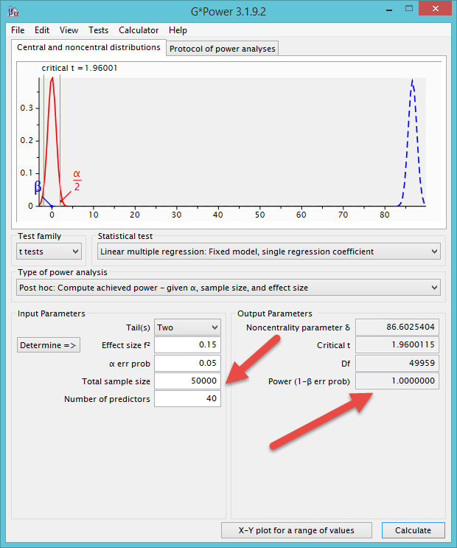
What not regression?
OLS regression is good for small-sample analysis.
If you have an extremely large sample (e.g. Archival data), the power level may aproach 1 (.99999, but it cannot be 1).
What is the problem?

Slide 3
What is decison tree?
Also known as Classification tree and recursive partition tree.
Developed by Breiman et al. (1984).
Aim to find which independent variable(s) can make successively a decisive partition of the data with reference to the dependent variable.

Slide 4

We need a quick decision!
When heart attack patients are admitted to a hospital, physiological measures, including heart rate, blood pressure, and background information of the patient, such as personal medical history and family medical history, are usually obtained.
But can you afford any delay? Do you need to run 20 tests before doing anything?

Slide 5
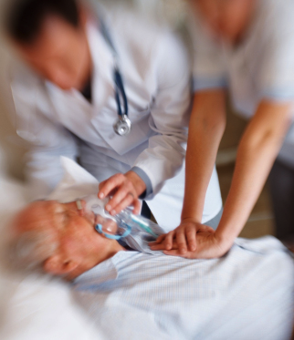
We need a decision tree!
Breiman et al. developed a three-question decision tree.
  What is the patient's minimum systolic blood pressure over the initial 24-hour period?
  What is his/her age?
  Does he/she display sinus tachycardia?

Slide 6
Nested-if logic
If the patient's minimum systolic blood pressure over the initial 24 hour period is greater than 91, then
  if the patient's age is over 62.5 years,
    then if the patient displays sinus tachycardia, then and only then the patient is predicted not to survive for at least 30 days.

Slide 7

Titanic survivors
A night to remember!
After the disaster, people asked: What types of people tend to survive?
Sample data library → Titanic Passengers.jmp

Slide 8
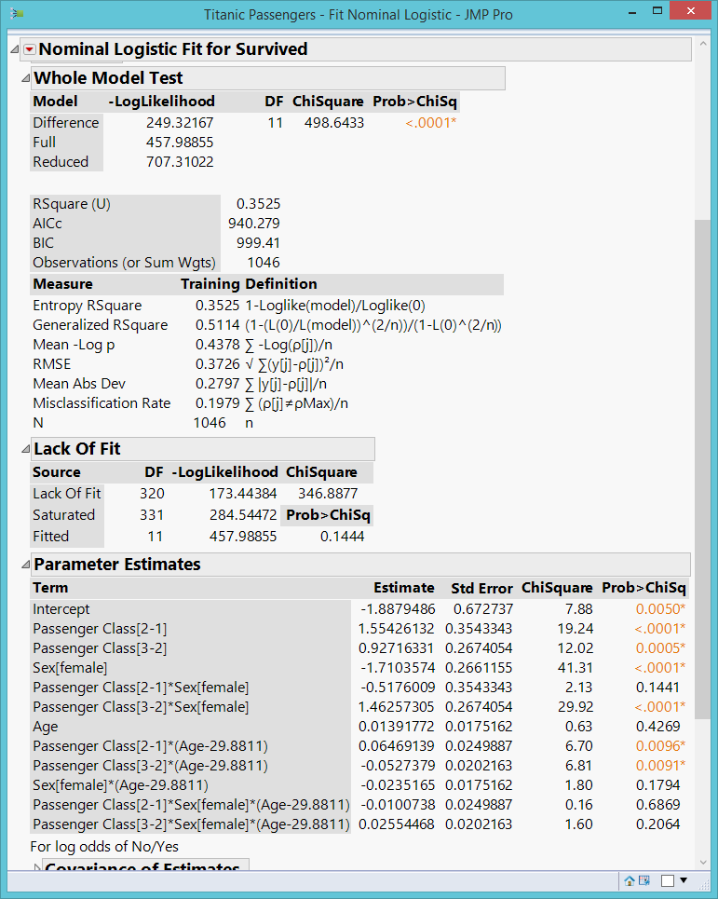
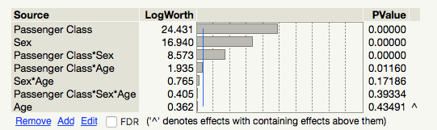
Titanic survivors
Use logistic regression (Fit Model)
Y = Survived
Xs = Sex, Age, Passenger class, interaction, and their interaction (Macros → full factorial)
Results are too complicated!

Slide 9
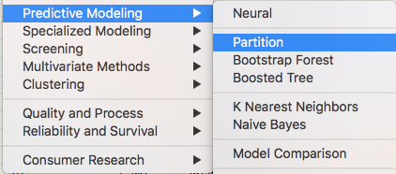
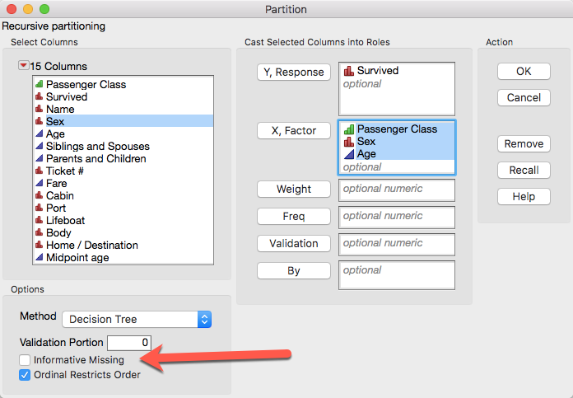
Decision tree
Much easier to run (no assumption) and to interpret.
Don’t include missing or it will create “missing” as a group.

Slide 10
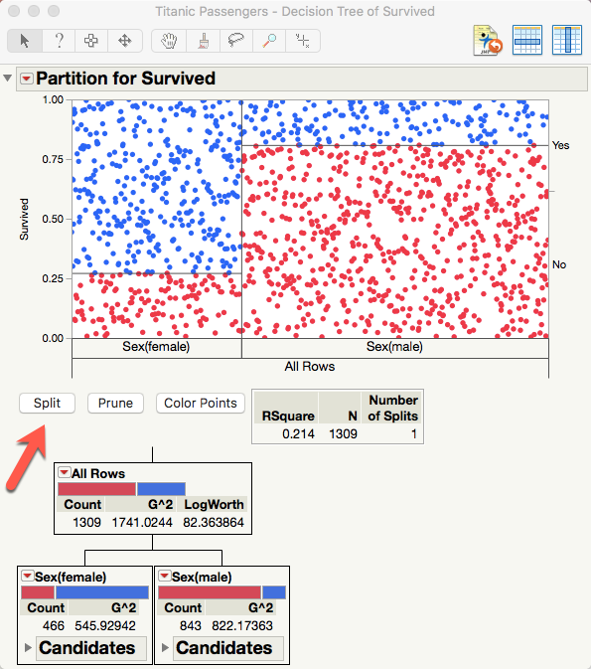
Decision tree
Split (partition) the tree variable by variable.
The first partition shows the most important variable.
Unlike what the logistic regression model suggests, the most crucial factor to survival is sex.

Slide 11
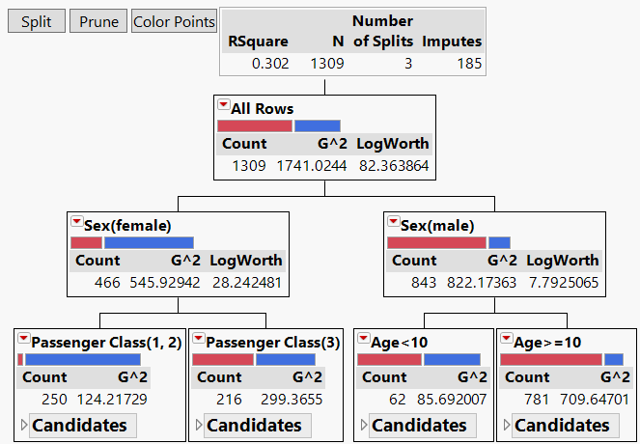
Decision tree model

Slide 12
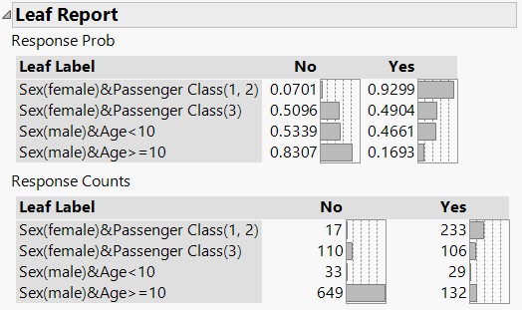
Leaf report:
Nested-if and interaction
If the passenger is a female and she has a first-class ticket, then the probability of survival is .9299 (sex X class interaction).
If the passenger is a male and he is not a young boy ( age > = 10), then his chance of survival is .1693 (sex and age interaction).
This is empirical probability based on the data at hand, not the p value with reference to the sampling distribution.

Slide 13


Leaf report:
Nested-if and interaction
How unfair! Prior research shows that women are more robust against hypothermia!

Slide 14
Splitting Criteria
Criteria based on statistical tests:
  LogWorth and G2: used in JMP
  CHAID criterion: used in SPSS
Criteria based on impurity:
  GINI: The default of Python
  Entropy: The default of SAS’s High Performance Split Procedure (HPSPLIT)

Slide 15
LogWorth and G²
Examines each independent variable to identify which one can decisively split the sample with reference to the dependent variable.
If the input is continuous (e.g. household income), every value of the variable could be a potential split point.
If the input is categorical (e.g. gender), then the average value of the outcome variable is taken for each level of the predictor variable.

Slide 16
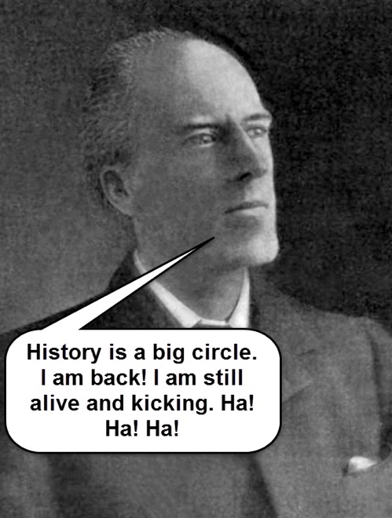
LogWorth and G²
Afterwards, a 2x2 crosstab table is formed (e.g. [‘proficient’ or ‘not proficient’] x [‘male’ or ‘female’]).
Next, Pearson’s Chi-square is used for examining the association between 2 variables.
But the result of Chi-square is dependent on the sample size. When the sample size is extremely large, the p-value is close to 0 and virtually everything appears to be ‘significant.’

Slide 17
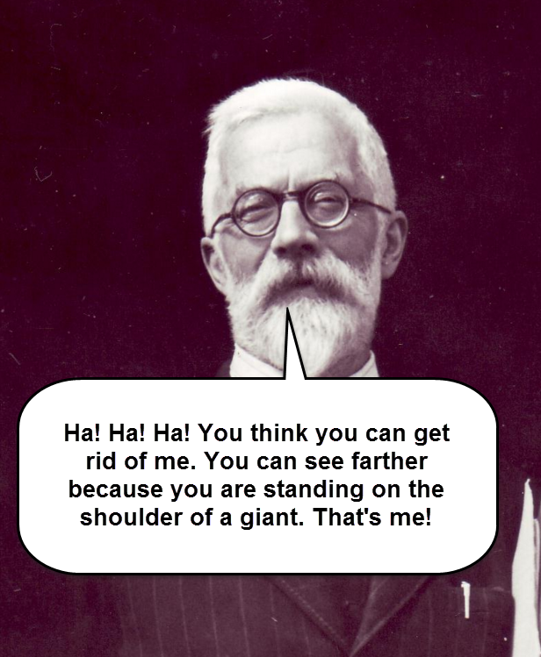
LogWorth and G²
LogWorth was invented by R. A. Fisher!
As a remedy, the quality of the split is reported by LogWorth, which is defined as –log10(p).
Because the LogWorth statistics is the inverse of the p value, a bigger LogWorth is considered better.
If the outcome variable is categorical, G^2 (the likelihood ratio of chi-square) is reported.

Slide 18
GINI
Based on Information Theory
Measure the impurity (heterogeneity) of the partitioned group.
GINI = 1 – (sum of squares of the proportion of each category)
Ideally a partitioned group should be pure (homogeneous)
10 apples (100%) in one Group 1 and 10 oranges (100%) in Group 2
GINI = 1 – (1)² = 0
If the group is absolutely pure, GINI = 0 → smaller is better

Slide 19
GINI
In reality nothing is pure, e.g.
  5 apples (.5 or 50%)
  3 bananas (.3 or 30%)
  2 oranges (.2 or 20%)
GINI = 1 – (.5)2 + (.3)2 + (.2)2 = .62
The algorithm examines all variables to determine which one can partition “purer” group.

Slide 20
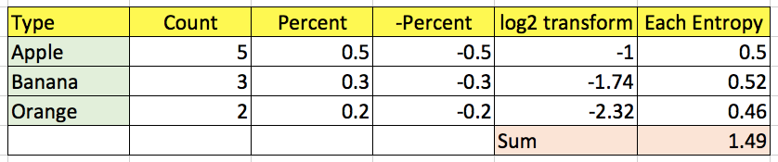
Entropy
Entropy = sum of (-percent of each category * log2 (percent))
Like GINI, smaller is better.

Slide 21
ROC
Receiver Operating Characteristic (ROC) Curve for examining “hit” rate
Originated from Signal Detection Theory
developed by electrical engineers and radar engineers during World War II.
to decide whether a blip on the radar screen signaling a hostile object, a friendly ship, or just noise.
In the 1970s it was adapted into medical tests.

Slide 22
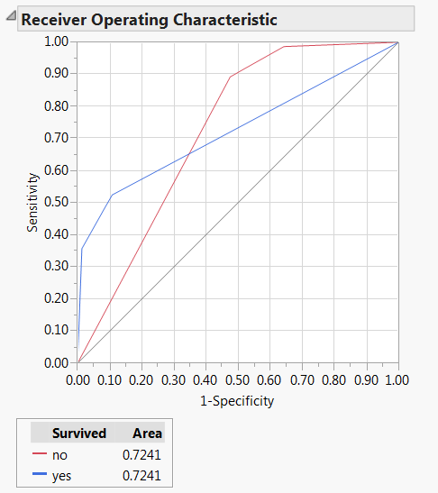
ROC curves and AUC
Inverted red triangle → ROC Curve
Area under curve (AUC)
4 possible outcomes:
  true positive (TP)
  false positive (FP)
  false negative (FN)
  true negative (TN).
Sensitivity = TP/(TP+FN)
1 - Specificity = 1 - [TN/(FP+TN)]
No model = 50% chance

Slide 23
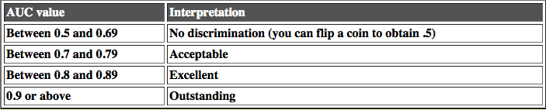
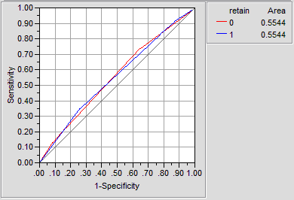
Criterion of judging ROC curves
The left is a coin-flipping model.
This cut-off is a suggestion only. Don't fall into the alpha < 0.05 reasoning.

Slide 24
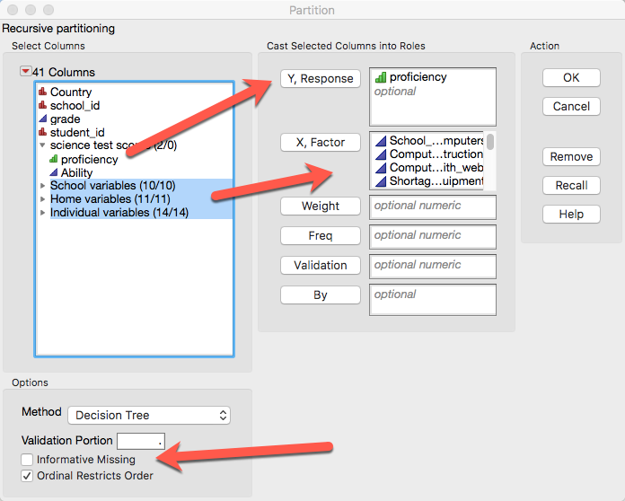
Example: PISA 2006 USA & Canada
Uncheck informative missing and missing data will be imputed.
Something no answer is an answer → missing is treated as a category.

Slide 25
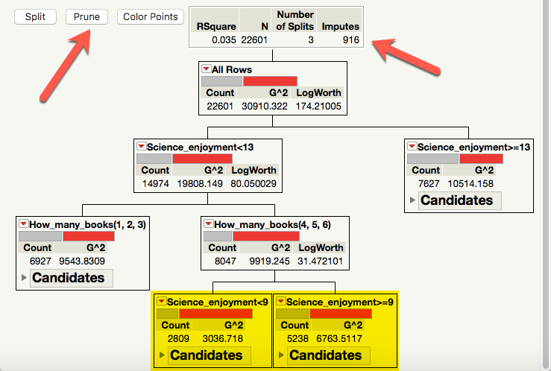
Example: PISA 2006 USA
Missing are automatically imputed.
The same variable (Science enjoyment) recurs.
It is saturated. You cannot add anything to make it better.
Prune it!

Slide 26
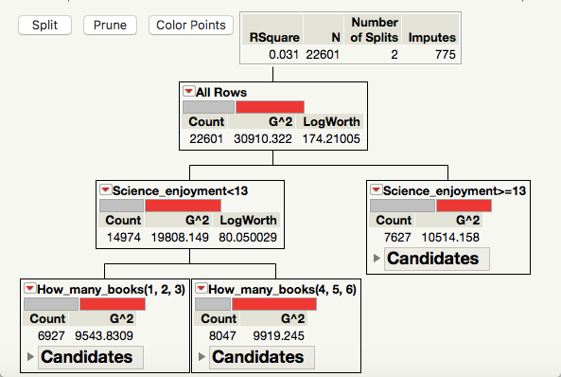
After pruning
A very simple model
Two variables can predict PISA science test performance!

Slide 27
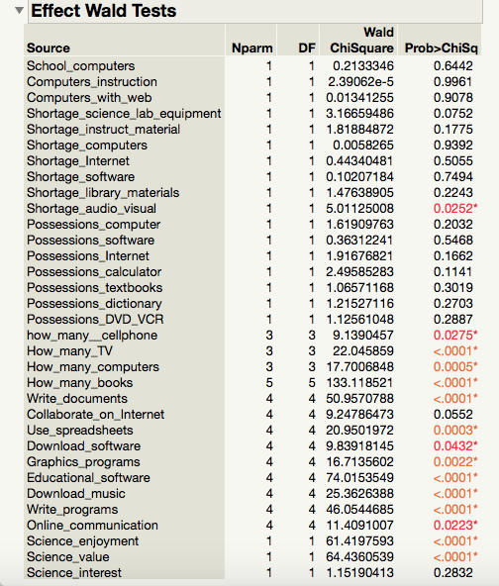
Compare DT with logistic regression
Too complicated!
If almost everything is important, then nothing is important!
No practical implications!
Remember the fifty ways of improving your grade?

Slide 28
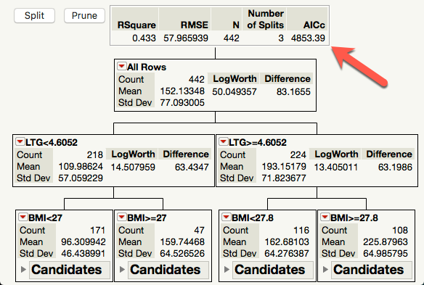
Compare DT & GR
Use Diabetics.jmp
Decision tree
Only two predictors are important for predicting diabetic progression.
AICc = 4853.39

Slide 29
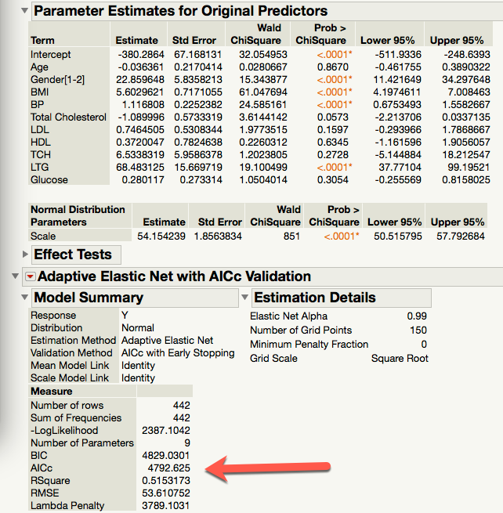
Compare DT & GR
Generalized regression
Elastic net
Four predictors are important for predicting diabetic progression.
AICc = 4792.625, smaller than that of DT
A 4-predictor model is still actionable and practical.
Sometimes DT is better and sometimes GR is better. Explore and compare!

Slide 30
Assignment 5.2
Run the decision tree using proficiency as the DV and all school, home, and individual variables as IVs.
Uncheck informative missing
Put country into by so that you can compare the US and the Canadian models
Prune the model when it is saturated (seeing the same predictor).
What are the differences and similarities between the two models?

Slide 31
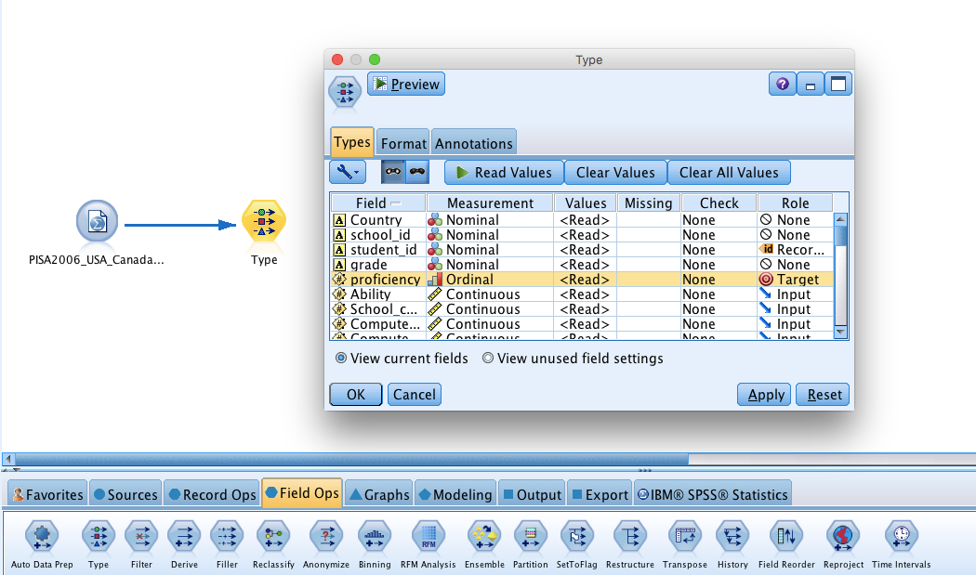
Decision trees in IBM Modeler

Slide 32
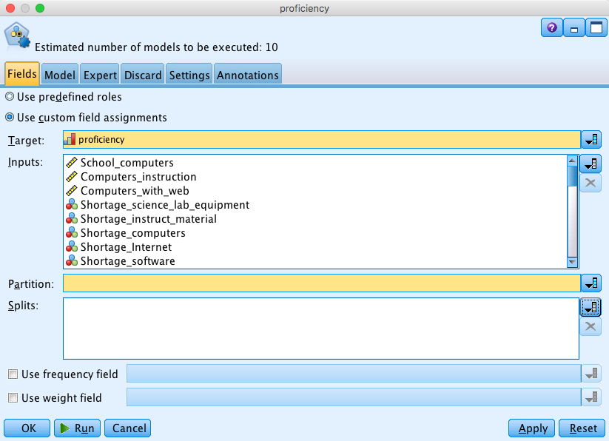
Decision trees in IBM Modeler

Slide 33
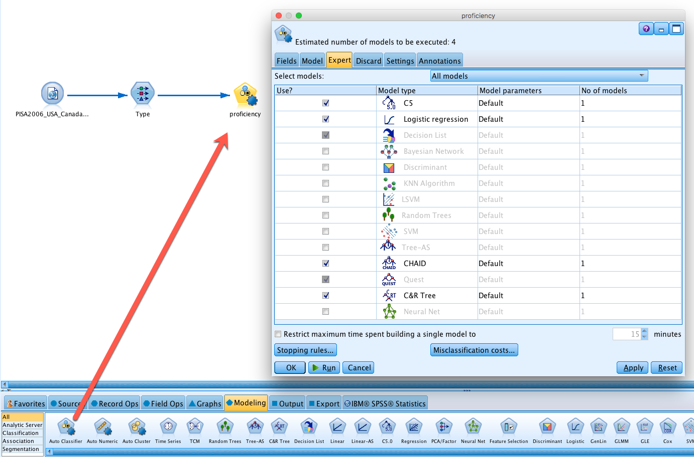
Decision trees in IBM Modeler

Slide 34
Decision trees in IBM Modeler
C5: C4.5 is ranked #1 in the Top 10 Algorithms in Data Mining pre-eminent paper published by Springer in 2008. C5 enhances C4.5.
Chi-square automatic interaction detection (CHAID): Pick the predictor that has the strongest interaction with the DV.
Exhaustive CHAID: modification of CHAID that examines all possible splits for each predictor
Quick, unbiased, efficient statistical tree (QUEST): Fast and avoids bias.
Classification tree and regression (CRT): try to make each subgroup as homogeneous as possible.

Slide 35
Decision trees in IBM Modeler
Shih (2004): when the Pearson chi-square statistic is used as the splitting criterion, in which the splits with the largest value is usually chosen to channel observations into corresponding subnodes, it may result in variable selection bias.
This problem is especially serious when the numbers of the available split points for each variable are different.
On many occasions CRT and JMP’s tree produce virtually the same results.

Slide 36
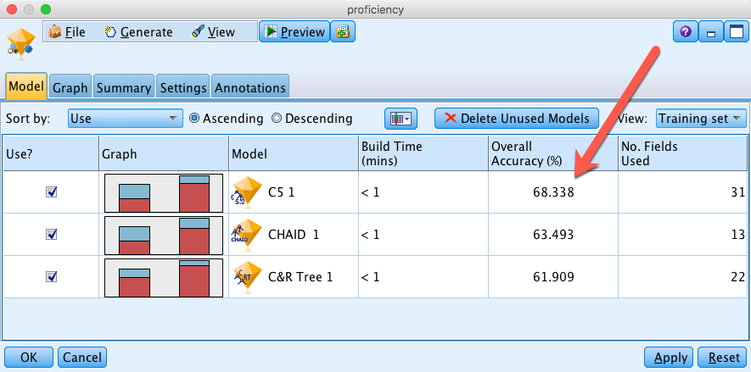
Rank the best three
Logistic regression is not even on the radar screen!

Slide 37
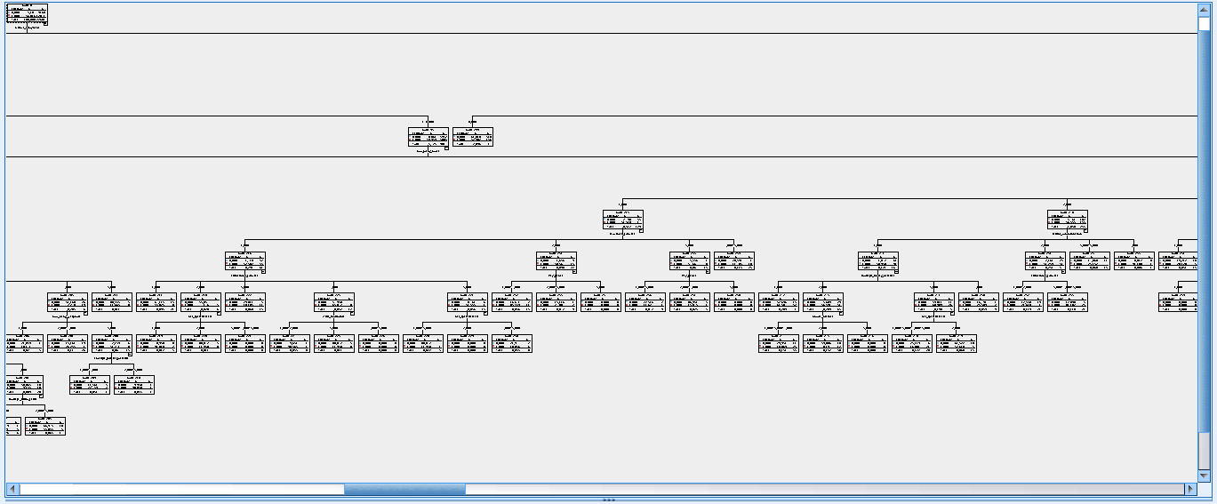
Drawbacks
Double-click on the model to view the details → Viewer
Unlike SAS/JMP, IBM SPSS graphs are static, not dynamic
You cannot prune the trees

Slide 38
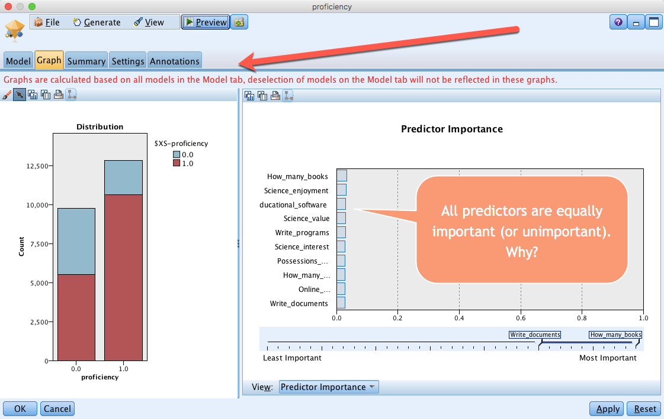
Drawbacks

Slide 39
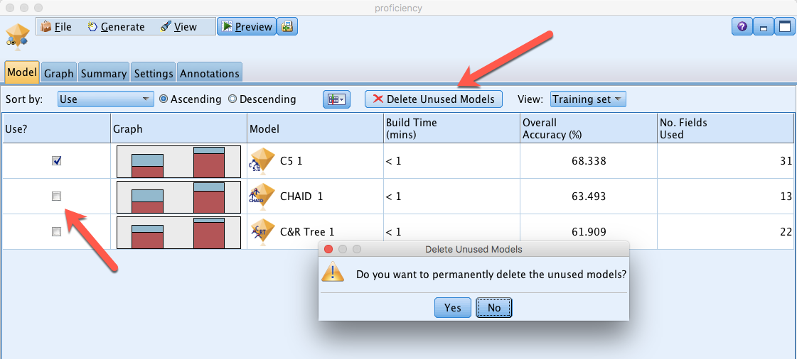
Drawbacks
Even if you deleted unused models, it doesn’t change the disaply.

Slide 40
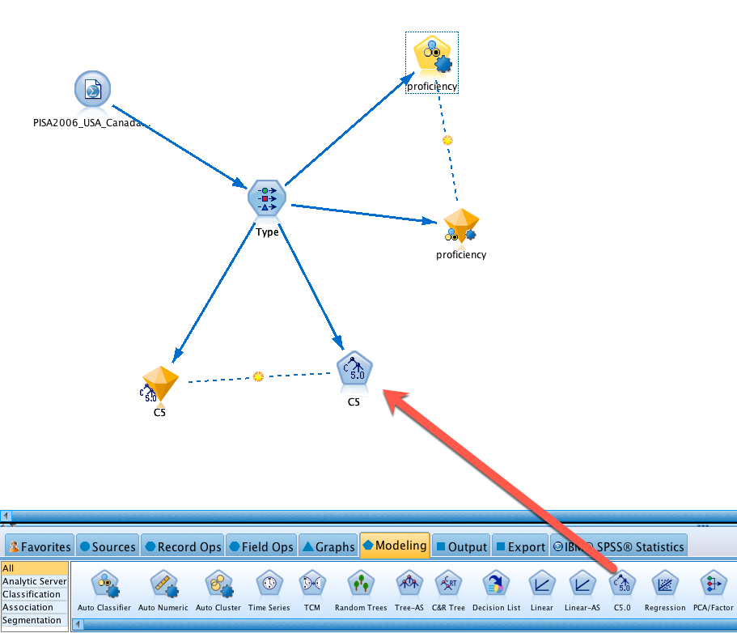
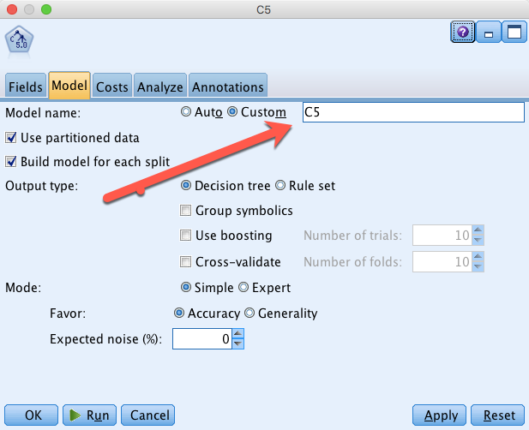
Go after C5
Solution: Run a C5 model
By default it uses the FV as the model name
Rename it to C5

Slide 41
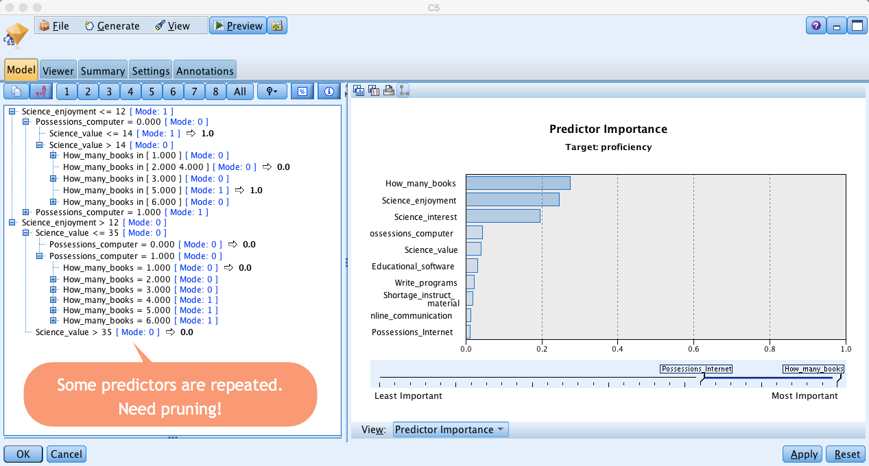
Go after C5

Slide 42
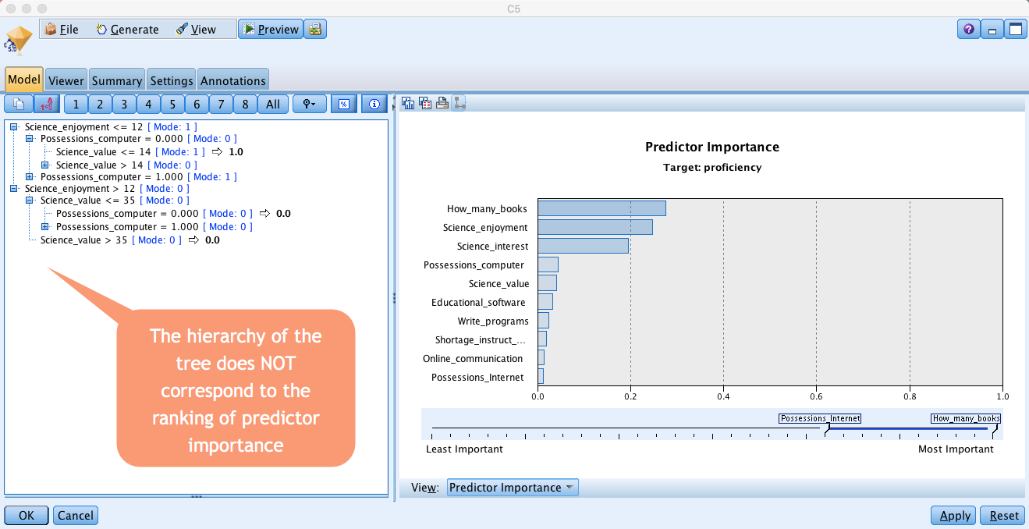
Go after C5

Slide 43
Summary
Both SAS/JMP and IBM/SPSS have pros and cons
Only one type of decision tree can be done in JMP whereas there are different options (e.g. C5, CGAID, CRT, QUEST…etc.) in IBM/SPSS, and SPSS performs automatic comparison in Auto Classify
The graphs of JMP are dynamic and interactive whereas the counterparts of SPSS are static, disallowing manipulation.
The interactive model outline in SPSS shows much less details than the tree in JMP.
The hierarchy of the SPSS tree might not correspond to the rank of predictor importance. It is harder to interpret.

Slide 44
Assignment 5.3
Use PISA2006_USA_Canada.sav to run a CHAID model and a CRT model (You can put both on the same canvas)
Target = proficiency
IVs = all school, home, and individual variables.
Compare the two models. What are the differences and similarities between the two models?

