Slide 1
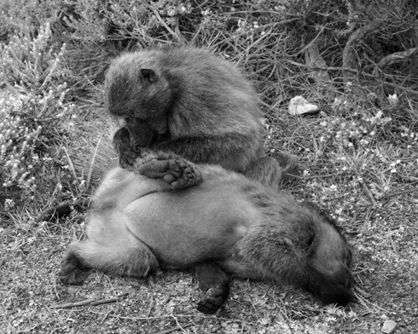
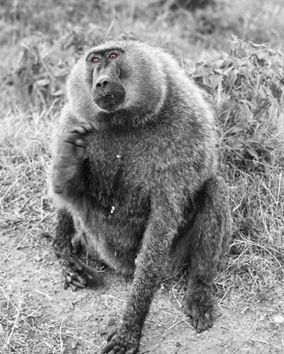
From OLS to
Generalized Regression
Chong Ho Yu
(I am regressing)

Slide 2


OLS regression has a long history
Ordinal least squares (OLS) regression, also known as standard least squares (SLS) regression, was discovered by Legendre (1805) and Gauss (1809) when our great grandparents were born.

Slide 3
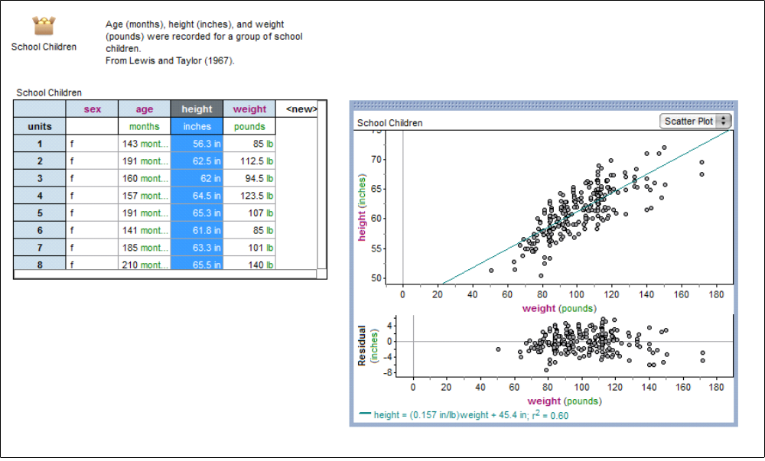
OLS regression
Least square = least square of residuals
Residual = distance between actual and predicted
Best fit

Slide 4

R square
The purpose of simple regression is to find a relationship (but not the one in the picture below).
When there are multiple predictors, the multiple-relationship is denoted by the R-square (variance explained).

Slide 5
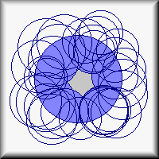
Inflated variance explained
Picture that the overlapping area between Y and Xs is the variance explained (multiple-relationship).
When you put more and more Xs on Y, the circle of Y is almost fully covered. R-square = .89! Wow! Voila! Allelujah!

Slide 6
Useless model
A student asked me how he could improve his grade. I told him that my fifty-variable regression model could predict almost 89% of test performance: study long hours, earn more money, buy a reliable car, watch less TV, browse more often on the Web, exercise more often, attend church more often, pray more often, go to fewer movies, play fewer video games, cut your hair more often, drink more milk and coffee...etc.
This complicated model is useless!

Slide 7
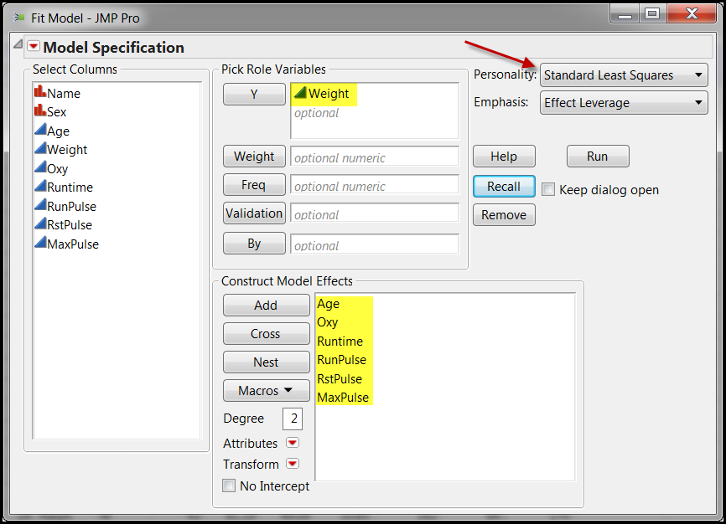
Fitness
In this example I want to use six variables to predict weight. The method is OLS regression.

Slide 8
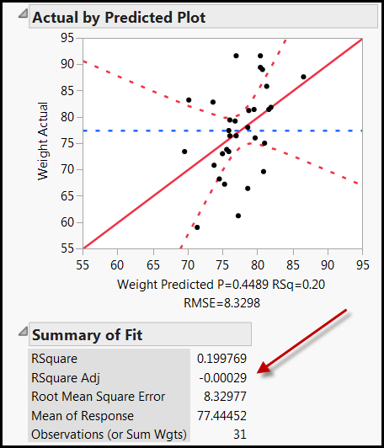
Negative adjusted R-square!
The R-square is .199. Not bad! This model can explain 20% of the weight variance.
But when many predictors are used, the program used adjusted R-square to adjust the inflated R-square.
It is negative! What is that?

Slide 9
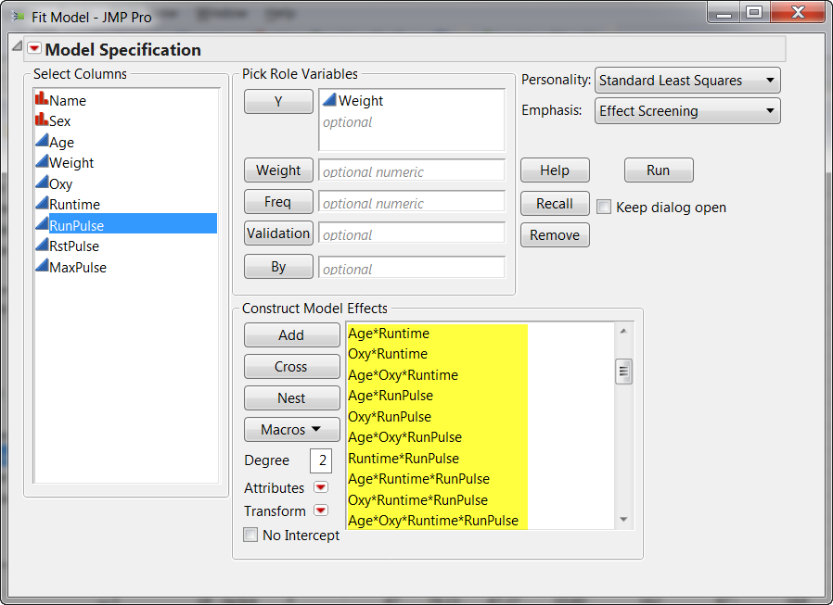
How about all possible interactions?

Slide 10
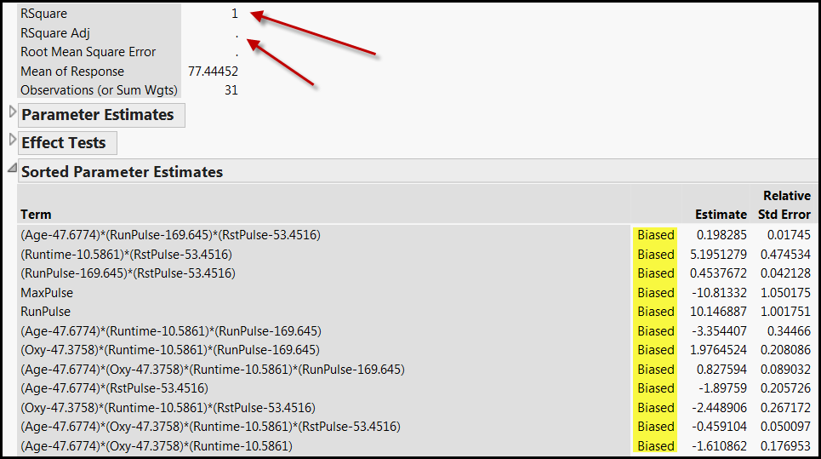
100% R-square but biased?
If I use all possible interactions, the R-square is 100%, but JMP cannot estimate the adjusted R-square, and every parameter estimate is biased. What is happening?

Slide 11
Problems of OLS regression
Too many assumptions about the residuals and the predictors
It tends to overfit to the sample.
The model is unstable when some predictors are strongly correlated (collinearity)
There is no unique solution with a large data set.
It must be a linear model.

Slide 12
Generalized regression
Introduced by Friedman (2008)
Similar to abduction or IBE: don't fix on one single answer, consider a few.
There may be many solutions to solve the problem. Why not explore different paths?
Start with no modeling or zero-coefficient.
Try out a series of models. The solution is elastic (changeable).
Pick the best (by the algorithm, not by you)!

Slide 13

KISS!
Also known as regularized regression (In SPSS).
Also known as Penalized regression: give the model a penalty if it is too complicated or the fitness is inflated → Keep it simple, stupid (KISS)!

Slide 14
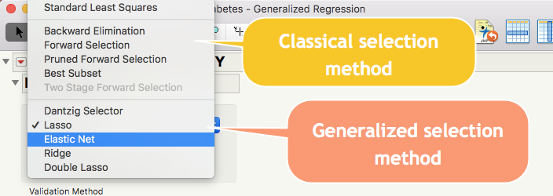
Options of model optimization
Most people ran Standard Least Squares and stopped!

Slide 15
Dantzig selector
Only can work when the specified distribution is normal and no intercept option is NOT selected.
Penalizes the sum of absolute values of the regression coefficients.

Slide 16

Lasso
Will zero out the regression coefficient → select variables by dropping some out.
Not good for wide data structure: If there are too many predictors and too few observations (high p, low n), LASSO will saturate very fast (stop further selection of variables).
When there are too many collinear predictors, LASSO select just one and ignore others.

Slide 17
Double Lasso
Two stages
  Stage 1: A model is fit to generate the terms (the predictors and their slope estimates) for Stage 2.
  Stage 2: Use the terms in Stage 1 and make adjustment.
It is useful for wide data structure: When the sample size is smaller than the number of predictors.
Stage 2 would NOT overly penalize the terms that should be included.

Slide 18
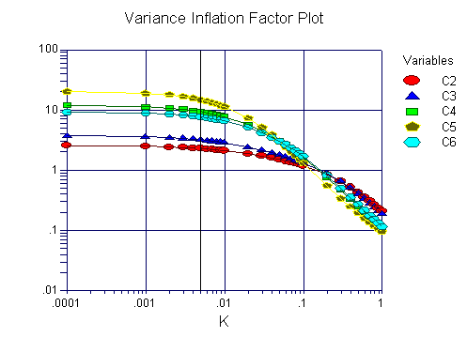
Ridge
Counter-measure against collinearity & variance inflation: Shrinking the regression coefficients towards zero.
But regression coefficients will not be exactly zero. You may end up with all the coefficients or none.
It controls the cancer cell, but won't remove it.

Slide 19

Elastic
Adaptive, versatile
It combines the penalties of the lasso and ridge approaches.
Why not use the best of both only?

Slide 20
Penalize complexity against overfitting
Akaike's information criterion (AIC): used in comparison, no cut-off.
Given all things being equal, the simplest model tends to be the best one
Simplicity is a function of the number of adjustable parameters.
AIC = 2k – 2lnL where k is the number of parameters and L is the likelihood function of the estimated parameters.
AIC does not necessarily change by adding variables. It varies based upon the composition of the predictors and thus it is a better indicator of the model quality.

Slide 21
Penalize complexity against overfitting
AICc (correction) imposes a greater penalty for additional parameters.
AICc = AIC + (2K(K+1)/(n-k-1)) where n = sample size and k = the number of parameters.
Burnham & Anderson (2002) recommend using AICc, especially when the n is small and the k is large.
AICc converges to AIC as the n is getting larger and larger.
AICc should be used regardless of n and k.

Slide 22
Penalize complexity against overfitting
Bayesian information criterion (BIC) imposes heavier penalty.
But AIC and AICc are superior to BIC .
AIC and AICc is based on the principle of information gain.
The Bayesian approach requires a prior input but usually it is debatable.
AIC is asymptotically optimal in model selection in terms of the least squared mean error, but BIC is not asymptotically optimal (Burnham & Anderson, 2004; Yang, 2005)

Slide 23
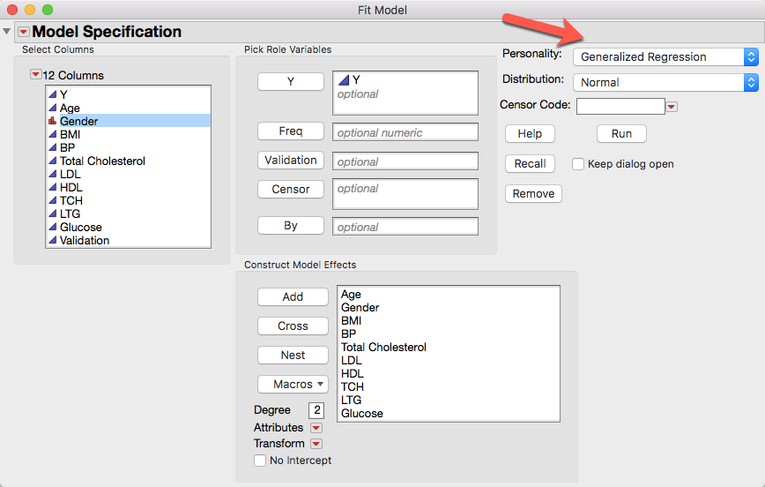
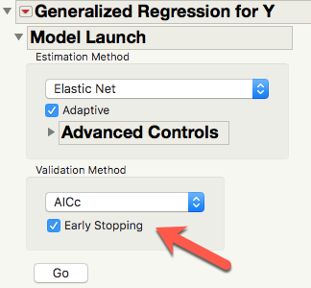
Example 1: Diabetics
Use multiple predictors to predict diabetics progression (Y).

Slide 24
Multi-collinearity!
Total cholesterol
LDL (low-density lipoprotein cholesterol): bad cholesterol
HDL (high-density lipoprotein cholesterol): "good" cholesterol)
TCH (Triglycerides): fats carried in the blood from the food we eat. Excess calories, alcohol, or sugar are converted into TCH and stored in fat cells.

Slide 25
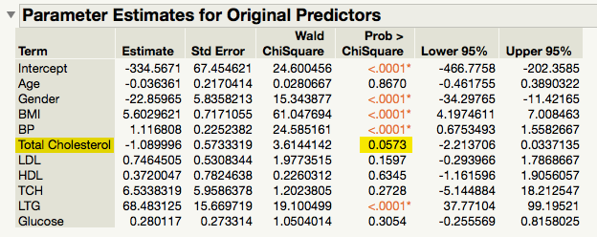
Example
Total Cholesterol, LDL, HDL, TCH are collinear.
OLS regression does NOT consider any one of those as an important predictor (Total Cholesterol, almost! P = .0573).

Slide 26
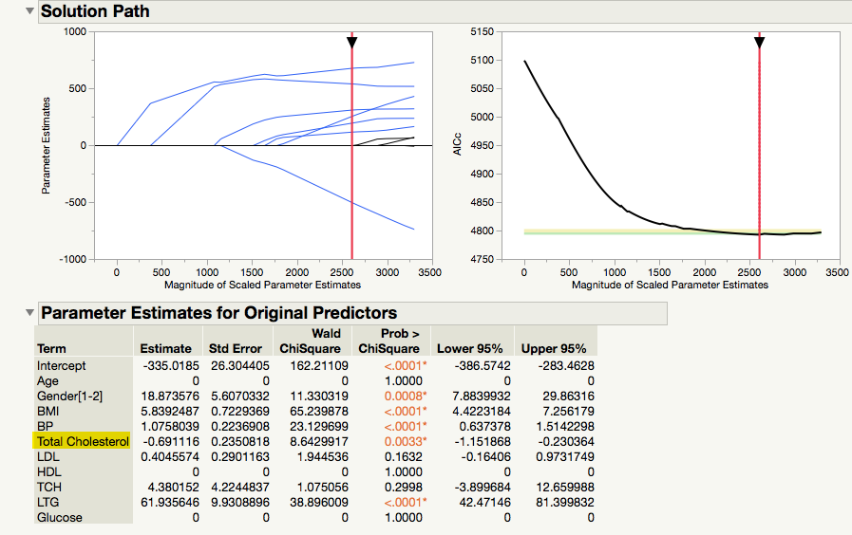
GR output
OLS regression AICc: 4796
GR AICc: 4791
Smaller is better

Slide 27
Why coefficient is 0 and p is 1?
In traditional statistics, the probability is an approximation based on sampling distributions, which is open-ended (the two-tails never touch down the x-axis). In this case the p value at most could only be .9999, but never be 1.
In GR regression coefficients of unimportant variable could be 0.
Y = bx; when b is 0 → Y = x
When the data could be perfectly described by the model, the probability of observing the data could be 1.

Slide 28
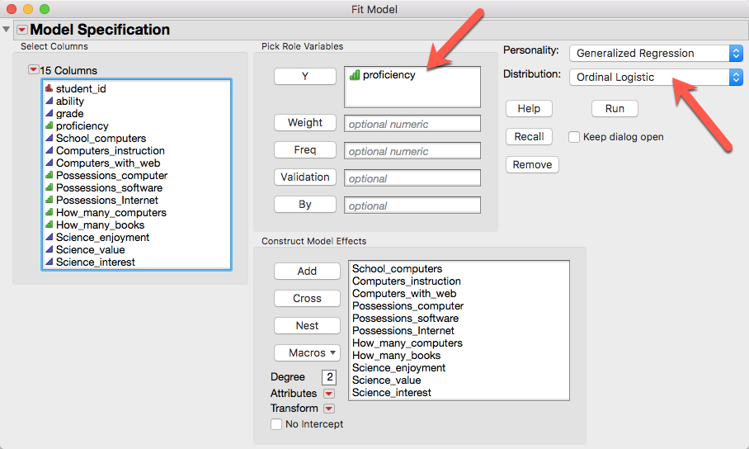
Example 2: GR can be use for categorical DV
Data set: PISA2006_USA in Unit 4

Slide 29
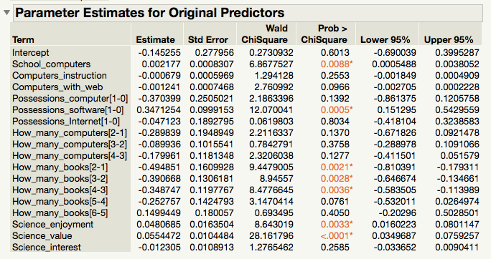
Logistic regression result

Slide 30
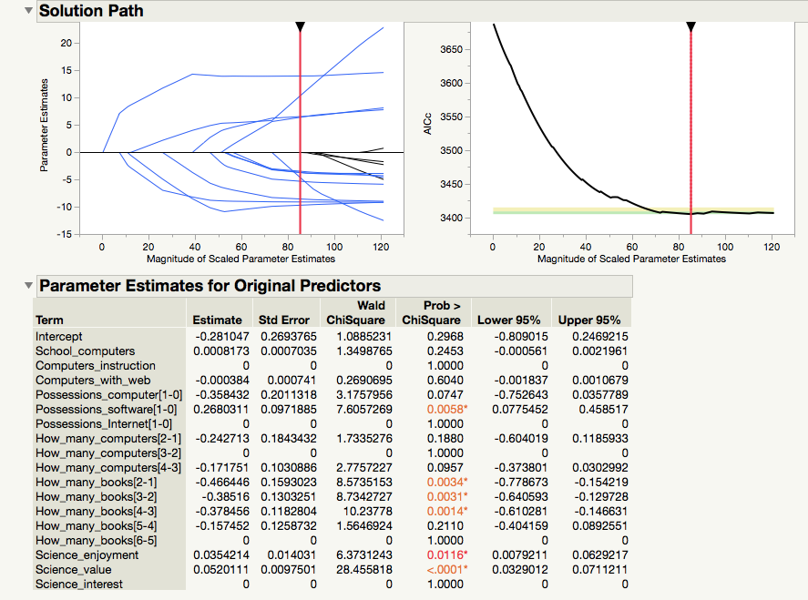
GR result
Model comparison
Logistic regression AICc: 3407
GR AICc: 3404 (result may vary)
Smaller is better

Slide 31
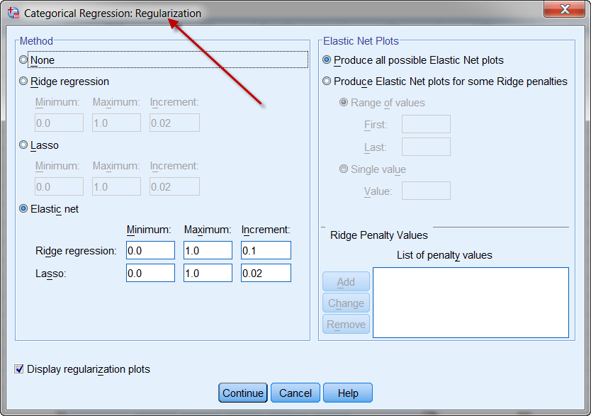
SPSS Statistics
SPSS can also do regularized (generalized) regression.
But fewer options

Slide 32
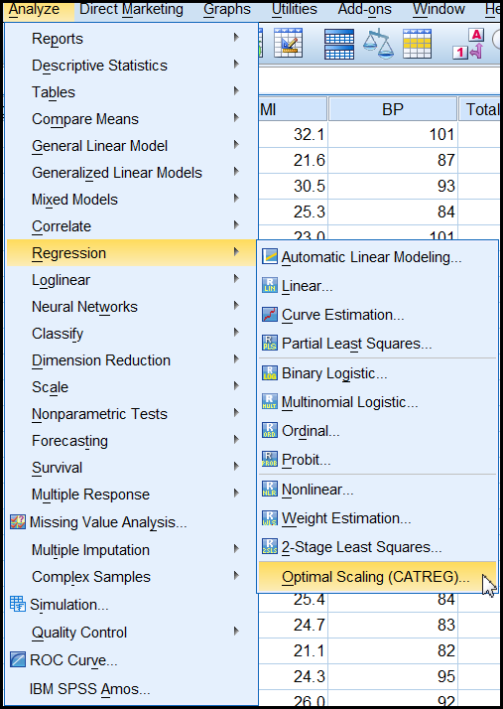
SPSS
You can access this feature from: Analyze → Regression → Optimal scaling (CATREG) → regularized.
Categorized regression: quantify categorical variables.
It is harder to interpret the SPSS output.

Slide 33
Pros and cons
Pros
  It accepts all types of data. GR can replace OLS and logistic
  It can solve the problem of collinearity.
  It can avoid ovefitting.
  It is the best of all possible paths.

Slide 34
Pros and cons
Cons
  It is still a global model (one size fits all). Unlike hierarchical regression, it cannot discover local structures or specific solutions for special population segments.
  It is still a linear model. What if the real relationship is non-linear?

Slide 35
Recommendations
If your colleague or the reviewer wants a conventional solution (wants to see the term “regression”), use generalized regression.
If there are many predictors and some are collinear, use GR.
If the data structure is wide, use double lasso in GR.
If the data structure is tall, use elastic net in GR.
If the relationship is nonlinear, use artificial neural network (covered in Unit 4).

Slide 36
Assignment 5.1
Use PISA2006_USA to run two Generalized regression models: LASSO and Ridge
Y = proficiency
X = all others, excluding ID, ability, and grade
Compare the two models. What are the differences and similarities? (Check AICc)

